Slide 1
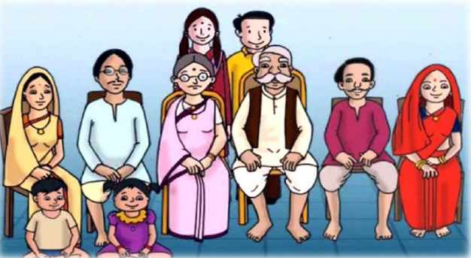
360 degree analysis on HUF
CA. Pankaj Shah
Notes:
Story of father mother shareholder who want control but benefits for children. Options Voting shares and non voting shares, equity and preference shares, Trust (Settle shares for benefit of children) and be Trustees (Classical Private Trust)
What cannot be done through will can be done through Trusts

Slide 2
Report of Law Commission
Law Commission of India has stated that
"today when it has been seventy-two years since independence, it is high time that it is understood that justifying this institution on the ground of deep-rooted sentiments at the cost of the country's revenue may not be judicious".
Suggestion to Govt that HUFs should be abolished as a special taxpaying entity under the IT Act.

Slide 3
Modes of succession
Intestate
Testamentary Will
HUF, Nomination, Joint holders
Private Trusts

Slide 4
Ancestral Property
Property inherited from 3 generations above of male lineage
Father, grandfather, great grandfather
Deemed to be HUF property
Automatic right in ancestral property
Myth
Ancestral property cannot be alienated
Reality
Ancestral property can be lineated
Yudhister v. Ashok Kumar (SC)
Uttam v. Saubhag Singh (SC)
Surender Kumar (Del)
Arshnoor Singh (SC)

Slide 5
Ram Rakhpal 67 ITR164 SC
A son who inherits property from his father will be treated as his separate individual property and
it will not become the joint family property of son

Slide 6
Creation of HUF

Slide 7
When HUF comes into existence?
Creation
Hindu Law
On marriage
Income tax
On birth of child
CA. Pankaj G. Shah | Indore | 9691893040| pankajgshah@gmail.com

Slide 8
Key constitutens of HUF
Karta
Eldest child i.e. male or female
Coparcener
By birth
Member
Eg. Wife
Cannot demand partition
CA. Pankaj G. Shah | Indore | 9691893040| pankajgshah@gmail.com

Slide 9
Coparcener
Acquire interest by birth in family
  All the coparceners are members of a HUF but all members of a HUF are not coparceners.
Only coparcener can
  ask for partition
  Become Karta in family
    CIT vs. Seth Govindram Sugar Mills [1965] 57 ITR 510 (SC)
CA. Pankaj G. Shah | Indore | 9691893040| pankajgshah@gmail.com

Slide 10
HUF
Coparcener
Member
Born in family
Born or Married in family
Upto 4 levels of living order

Slide 11
Creation instrument
No mandatory requirement of any deed
HUF deed
a written formal document on a stamp paper stating the name of Karta and Coparceners of HUF
Steps
Create HUF Deed and Rubber Stamp of HUF
Apply for HUF’s Permanent Account Number
Open Bank Account in the name HUF
CA. Pankaj G. Shah | Indore | 9691893040| pankajgshah@gmail.com

Slide 12
Other ways to create HUF
Blending of individual property with the family Hotchpots;
Receipts of Gifts;
Doing Joint labour for the benefit of HUF;
Inheritance through a specific bequest under a Will;
Partition of a larger Hindu Undivided Family;
Reunion of separated coparceners.
HUF
CA. Pankaj G. Shah | Indore | 9691893040| pankajgshah@gmail.com

Slide 13
Introduction
‘Hindu Undivided Family’ not defined in the Income-tax Act.
‘Hindu Undivided Family’ must be construed in the sense in which it is understood under the ‘Hindu Law’
Surjit Lal Chhabda vs. CIT 101 ITR 776(SC)
For income tax purposes Jain and Sikh families included in HUF
Single person doesnot constitute a family
C. Krishna Prasad v. CIT (1979) 97 ITR 493 (SC)
CA. Pankaj G. Shah | Indore | 9691893040| pankajgshah@gmail.com

Slide 14
Types
Large Families; or
Small Families; or
Nuclear Joint Families
CA. Pankaj G. Shah | Indore | 9691893040| pankajgshah@gmail.com

Slide 15
Bigger and Smaller HUF’s
“Bigger HUF” and Smaller HUF’s”-
  branch wise as a effective tools for tax planning by effecting multiple partial partition.
“Because of these advisers, there are more HUFs, than Hindus in India.”
  K.H. Kazi- Former Advocate General
CA. Pankaj G. Shah | Indore | 9691893040| pankajgshah@gmail.com

Slide 16
School of thoughts
School
Mitakshara
Son acquires interest on birth in family
Dayabhag
(W.Bengal and Assam)
Son acquires interest on death of his father
CA. Pankaj G. Shah | Indore | 9691893040| pankajgshah@gmail.com

Slide 17
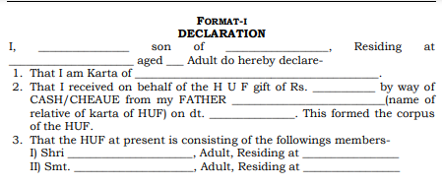
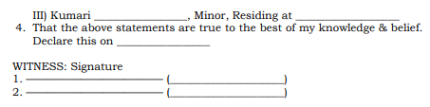
CA. Pankaj G. Shah | Indore | 9691893040| pankajgshah@gmail.com

Slide 18
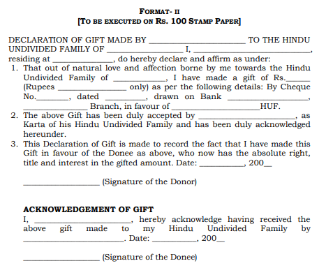
CA. Pankaj G. Shah | Indore | 9691893040| pankajgshah@gmail.com

Slide 19
Interesting issues
There can be more than one Karta of HUF
Darshan vs. Prabhu ILR (1946) All 692
Coparcenary commences from birth and not from the date of conception in mother's womb
T. S. Srinivasan v. CIT (1966) 60 ITR 36 (SC)
Income-tax law nowhere indicates that an HUF must have at least two male members
Gowli Buddanna v. CIT (1966) 60 ITR 293 (SC)
CA. Pankaj G. Shah | Indore | 9691893040| pankajgshah@gmail.com

Slide 20
Interesting issues
HUF once assessed as HUF continues to be so until a finding of partition is recorded by the A.O. u/s 171 of the IT Act not withstanding the fact that an individual has acquired under Hindu succession Act 1956 an absolute right, to a part of the family property.
Tumki Sah Vs. CIT 212 ITR 632, the S.C.
Where only surviving female members i.e. three wives of the deceased karta (whose son also died) who adopted son, was held to constitute a HUF.
CIT Vs. Veerappa Chettiar 76 ITR 467 (SC),
CA. Pankaj G. Shah | Indore | 9691893040| pankajgshah@gmail.com

Slide 21
Issues in capacity
Indian partnership Act
Can HUF be a partner?
Rashiklal & Co. vs. CIT (1998) (229 ITR 458)(SC)
In law, an HUF can never be a partner of a partnership firm
MCA Circular
LETTER F.NO.1/13/2012 CL-V, DATED 27-5-2016
‘Person’ includes a ‘Hindu Undivided Family’ as defined in sec. 2(31) of Income tax Act
CA. Pankaj G. Shah | Indore | 9691893040| pankajgshah@gmail.com

Slide 22
Karta can represent as partner
Supreme Court in Ram Laxman Sugar Mills vs. CIT [1967] 66 ITR 613
  a HUF is undoubtedly a “Person” with in the meaning of section 2(31), it is however not a juristic person for all purposes and cannot enter in to an agreement of partnership either with another HUF or Individual.
  It is open to the manager of a Joint Hindu family, as representing the family, to agree to become a partner with another person. And therefore any remuneration received by Karta would be the personal income of Karta and not the income of the HUF as there is no real connection between the investment of the assets of HUF and remuneration received by Karta.

Slide 23
The Law and Practice of Income tax
Basic elements of HUF ignored by digital processing

Slide 24
Amendment to Hindu Succession Act
Daughter has same rights as that of son
CA. Pankaj G. Shah | Indore | 9691893040| pankajgshah@gmail.com

Slide 25
Married daughter’s status
Daughter
Father’s HUF
Coparcener
Can demand partition
Can become Karta
Husband’s HUF
Member
CA. Pankaj G. Shah | Indore | 9691893040| pankajgshah@gmail.com

Slide 26
Daughter’s rights
09.09.2005 amendment
Daughter of coparcener equal to son
Daughter can demand partition
but Daughter in law cannot
Daughters children can also become coparcenar in Nana’s HUF
Husband may also become member of Father in law’s HUF
CA. Pankaj G. Shah | Indore | 9691893040| pankajgshah@gmail.com

Slide 27
Vineeta v. Rakesh Sharma (SC)
Daughter must be alive on 09.09.2005
HUF must exist on 09.09.2005
Registration of partition mandatory
Oral partition not allowed
CA. Pankaj G. Shah | Indore | 9691893040| pankajgshah@gmail.com

Slide 28
Female as Karta
Eldest child
Even daughter can become Karta in Father’s HUF
However she cannot become Karta in Husband’s HUF as not coparcenar
Jurisprudence
Sujata Sharma v. Manu gupta (Delhi)
Seth Govindram Sugar Mills (SC)
coparcenary must for Kartaship
CA. Pankaj G. Shah | Indore | 9691893040| pankajgshah@gmail.com

Slide 29
Management
The senior most member may give up his right of management and a junior member may be appointed as manager.
Narendrakumar J Modi v. CIT [1976] 105 ITR 109 (SC)
CA. Pankaj G. Shah | Indore | 9691893040| pankajgshah@gmail.com

Slide 30
Food for Thought
In father’s HUF only 3 member
Father, Mother and son
Father dies and son is minor
Who shall be Karta?
Shreya Vidyarthi (SC)
Guardian Manager
CA. Pankaj G. Shah | Indore | 9691893040| pankajgshah@gmail.com

Slide 31
Position of female relatives
Female Relative | Right to claim partition
Wife/Mother | No
Widow | ?
Daughter/ Sister | Yes
CA. Pankaj G. Shah | Indore | 9691893040| pankajgshah@gmail.com

Slide 32
Open issues
Will daughters husband shall become member in Father in law’s HUF?
Will children become coparcenar in Maternal Grandfather’s HUF?
CA. Pankaj G. Shah | Indore | 9691893040| pankajgshah@gmail.com

Slide 33
Effect of inter-religion marriage
If the daughter of a Hindu Father marries a man following /belonging to a different religion – say Muslim or Christian – whether the amendments made in 2005 will apply?
Marries after converting into husband’s religion or
Marries without conversion by marrying under Special Marriage Act 1954
CIT Vs. Pratapchand 36 ITR 262 (Punj. HC)
CA. Pankaj G. Shah | Indore | 9691893040| pankajgshah@gmail.com

Slide 34
Gift of interest in HUF
Guramma vs Mallappa AIR 1964 SC 510
  “No authority has so far been placed before us to sustain a gift to a stranger even on the ground of charity. It must be remembered that the manager has no absolute power of disposal over the HUF property. The Hindu law permits him to do so only within such limits. We cannot extend the scope of power on the basis of the wide interpretation given to the word pious purpose in Hindu Law in a different context. In the circumstances, we hold that the gift to stranger of a Joint family property by manager is void.
CA. Pankaj G. Shah | Indore | 9691893040| pankajgshah@gmail.com

Slide 35
Bequeathal of interest in HUF
Section 30 of Hindu Succession Act, 1956 read with Indian Succession Act, 1925
  a Hindu is entitled to bequeath his self-acquired property the way wishes.
CA. Pankaj G. Shah | Indore | 9691893040| pankajgshah@gmail.com

Slide 36
Tax planning through HUF

Slide 37
Important tax provisions
Section 64(2) – Clubbing
  if any property transferred
  by the individual to HUF,
  Without adequate consideration,
  then the income from such property shall be clubbed in hands of individual
Alternatives?
CA. Pankaj G. Shah | Indore | 9691893040| pankajgshah@gmail.com

Slide 38
Separate Assessable person
Basic exemption limit
  Rs.3 Lakhs
  (exemption of Rs.7 Lakh for individual only)
Can have a self occupied property
  S.54
  Notional rent
  S.80C benefit available
Planning (to get benefit of old and new scheme)
  Individual in new regime
  HUF in old regime
Gifts
  Upto Rs.50000 exempt

Slide 39
Corpus Creation
Gift from non relatives
Up to Rs.50000 not taxable
Assets passed through Will
No clubbing

Slide 40
Proprietorship concern
HUF can be proprietor of ‘business’
However HUF cannot involve in ‘profession’
Trading and other business
S.44AD benefit available
S.44ADA cannot be opted by HUF

Slide 41
Other tax saving options
Interest free loan to HUF
Not a gift so no clubbing on income therefrom
Obligation to repay – nominal interest may be charged
ITO vs. Nalinbhai M Shah [2005] 149 TAXMAN 28 (AHD.) (MAG.)
Such loan can be invested and income therefrom can be offered in hands of HUF

Slide 42
Other tax saving options
Asset/Equipments to be acquired by HUF
can give fixed rental income
Sub lease of Property taken on lease

Slide 43
Shares and Securities
Not advisable to have immovables in HUF
Demat can be opened in name of HUF
Investment in shares
primary market IPO’s
secondary through Exchange
Mutual Funds

Slide 44
Gifts
In existing HUF
Gift can be received from anyone
Benefit of exemption limit
Rs.250000
HUF can also receive estate through Will which is not taxable
CIT vs. Ghanshyamdas Mukim 118 ITR 930(P&H)
CA. Pankaj G. Shah | Indore | 9691893040| pankajgshah@gmail.com

Slide 45
Exempted Gift transactions of HUF
Gift from HUF to relative
Gift to HUF from member
CA. Pankaj G. Shah | Indore | 9691893040| pankajgshah@gmail.com

Slide 46
Gift from HUF
Vineetkumar Raghavjibhai Bhalodia v. ITO [2011] 12 ITR(T) 616 (Rajkot)
  In the given case a member of HUF received Gift from HUF, Assessing Officer was of the view that HUF is not covered in the definition of 'relative
  It was held that a gift received from 'relative', irrespective of whether it is from an individual relative or from a group of relatives is exempt from tax under provisions of section 56(2)(vi).
  HUF is a group of relatives and therefore, gift received from HUF would be exempt from tax under section 56(2)(vi)
CA. Pankaj G. Shah | Indore | 9691893040| pankajgshah@gmail.com

Slide 47
Gift to HUF
Subodh Gupta (HUF) v. PCIT [2018] 169 ITD 60 (Delhi - Trib.)
Only gift received by member of HUF is not chargeable to tax;
thus, where assessee HUF received gift of 75,000 equity shares from mother of Karta of assessee HUF,
not being member of assessee HUF, said sum would be chargeable to tax under Section 56(2)(vii)
CA. Pankaj G. Shah | Indore | 9691893040| pankajgshah@gmail.com

Slide 48
Benefits in taxation
Basic exemption limit
Slab rate benefit
Deduction u/s 80C of the Act
Ind – New regime – HUF – old regime
Deduction under section 80D of the Act of INR 15 k for insurance on health of its members
Deduction under section 80TTA of the Act of INR 10 k for interest on savings bank account
Income received by members from HUF property or income, exempt u/s. 10(2)
in the hands of member;
CA. Pankaj G. Shah | Indore | 9691893040| pankajgshah@gmail.com

Slide 49
Benefits in taxation
Benefit u/s. 23(2) of the Act for one self occupied property for the own use of the family;
Deduction u/s. 24(b) of the Act up to INR 200 k for interest on loan for acquisition of self occupied property;
Presumptive taxation of business income u/s. 44 AD;
Distribution of capital assets on total or partial partition of HUF not regarded as transfer u/s.47(i) – no capital gain to HUF
Exemption from capital gains u/s.54 (residential house property), 54B (rural agriculture land), 54F (investment in first or second residential house), 10(37) (compulsory acquisition of urban land);
CA. Pankaj G. Shah | Indore | 9691893040| pankajgshah@gmail.com

Slide 50
Partition (S.171)
A Joint Hindu Family consists of all persons lineally descended from a common ancestor and includes their wives and unmarried daughters.
No limit to the number of members an HUF may consist of.
Only a complete partition of HUF is recognized under the law.
HUF partition can be claimed by coparceners only.
Income in respect of the post-partition period is taxed as individual income of the concerned member.
CA. Pankaj G. Shah | Indore | 9691893040| pankajgshah@gmail.com

Slide 51
Partition
Full Partition
Recognized under Both Hindu Law and Income tax
Partial Partition
Not recognized under Income tax
Clubbing as if HUF has not parted away
Section 171 Income tax
Qua - members or property
CA. Pankaj G. Shah | Indore | 9691893040| pankajgshah@gmail.com

Slide 52
Partial Partition
Tax neutral partial partition
Alienate passive assets
Steps preceding partition qua member

Slide 53
Re-union
After partition of HUF, members may re-unite to form a new HUF.
  Earlier total partition now agreement to unite
Reunion allowed only with
  Father
  Brother
  Paternal uncle
CA. Pankaj G. Shah | Indore | 9691893040| pankajgshah@gmail.com

Slide 54
Reunion
It is not necessary that all the property belongs to HUF should be brought back in to the re-united joint family. This reunion is said to be VALID
CIT Vs A.M. Vaiyapuri Chettiar & Anr. (1995) 215 ITR 836 (Mad)

Slide 55
Reunion
Reunion can take place only when there was in existence a HUF and there was total partition of such HUF.
It can take place only between persons who were parties to the original partition and to support such reunion, there must be an agreement between the parties
To constitute a reunion there must be an intention of the parties to reunite in estate & interest and such intention is evident.
Reunite with
  Father, brother or paternal uncle

Slide 56
Re-union
Minor cannot be a part of reunion neither by self nor by someone on behalf of such minor.
CIT Vs Rupchand Routhmall (1963) 50 ITR 295 (Cal)
CA. Pankaj G. Shah | Indore | 9691893040| pankajgshah@gmail.com

Slide 57
Modes of Partition
Oral Partition
By a suit
Agreement or deed of partition
Arbitral award
Partition
CA. Pankaj G. Shah | Indore | 9691893040| pankajgshah@gmail.com

Slide 58
Notional Partition
On every death there is notional partition to align the share of coparceners
If 10 members each one has 1/10th share.
If deceased has bequeathed his share to a member than the legatee shall have 2/10th share
SC in M. Arumugam v. Ammaniammal
CA. Pankaj G. Shah | Indore | 9691893040| pankajgshah@gmail.com

Slide 59
Unequal partition
Not necessary that each partner gets equal share on partition
Apoorva Shantilal Shah v. CIT 141 ITR 558 SC
CA. Pankaj G. Shah | Indore | 9691893040| pankajgshah@gmail.com

Slide 60
Stamp duty applicable on partition
Duty on separated share of property
Largest share to be worked out and reduced from estate
Duty levied on remainder of estate
Eg. Largest share is 95% and balance members get 5% then duty on 5% only
Venkatappa Naidu AIT 1934 Mad 204
Computation
CA. Pankaj G. Shah | Indore | 9691893040| pankajgshah@gmail.com

Slide 61
Alienation of property
A Karta's right with regards to the family property is absolute
Karta requires the consent of all the other coparceners unless where:
There is a legal necessity
Dev Kishan v. Ram Kishan AIR 2002 Raj. 370, or
It is for the benefit of estate
Balmukund v. Kamlavati AIR 1964 SC 1385.
CA. Pankaj G. Shah | Indore | 9691893040| pankajgshah@gmail.com

Slide 62
BEEREDDY DASARATHARAMI REDDY Vs V. MANJUNATH AND ANOTHER (Supreme Court)(2022)
Right of the Karta to execute agreement to sell or sale deed of a joint Hindu family property is settled and is beyond cavil
A coparcener who has right to claim a share in the joint Hindu family estate cannot seek injunction against the Karta restraining him from dealing with or entering into a transaction from sale of the joint Hindu family property
CA. Pankaj G. Shah | Indore | 9691893040| pankajgshah@gmail.com

Slide 63
Way ahead
“ today when it has been seventy-two years since independence, it is high time that it is understood that justifying this institution on the ground of deep-rooted sentiments at the cost of the country's revenue may not be judicious".

Slide 64
Intestate Succession
Without making Will

Slide 65
Succession Law
Person dies
No Will
Hindu, Jain Sikh
Hindu Succession Act
Muslim
Shariat Law
Christian, Parsi, Jew
Indian Sucession Act
Testamentary Will
Hindus, Christian, Parsi, Jew, Sikh, Jain
Indian Succession Act
Muslim
Shariat Law

Slide 66
Hindu male (S.8-13) – self acquired
Class I heir
Class II heir
Agnate
Cognate
Government

Slide 67
Class I heir (in individual capacity in equal ratio)
Deceased
Son
Daughter
Mother
Widow

Slide 68
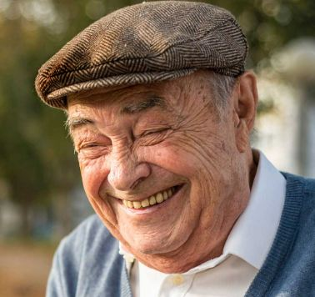

माँ
पत्नी
बेटा
बेटी
पोता
पोती
पडपोता
पडपोती
पोती की बेटी
नवासा
नवासी
नवासे की बेटी
नवासी का बेटा
नवासी की बेटी

Slide 69
Class II heirs
Father
Siblings
Grandparents
Parent’s siblings

Slide 70
Case Studies

Slide 71
Situation 1- Intestate male
माँ
पिता
पत्नी
बेटा
बेटी
बहु

Slide 72
Situation 2 - Intestate male
पत्नी
विधवा बहु
बहन
भाई
स्वर्गवासी बेटी का बेटा (नवासा)

Slide 73
Situation 3 - Intestate male
भाई
बहन
बहन
भाई
नाना

Slide 74
Situation 4 - Intestate male
चाचा की बेटी
मामा का बेटा

Slide 75
Is a step son Class I heir?
Income tax Act
Child includes Step and adopted
Hindu Succession Act
Natural born son
Adopted son
Step son through first marriage of wife cannot suceed as legal heir to estate of male

Slide 76
Status of Live in Relations
Live in
"an arrangement of living under which the couples which are unmarried live together to conduct a long-going relationship similarly as in marriage“
Radhika v. State of M.P. (SC)
a man and woman are involved in live in relationship for a long period, they will treat as a married couple and their child would be called legitimate.
125 Criminal Procedure Code
A woman living in relationship may also claim maintenance

Slide 77
Female Intestate

Slide 78
Female Intestate Hindu
Son, daughter, husband
Heirs of husband
Her Parents
Heirs of father
Heirs of mother

Slide 79
Female Intestate
Absolute property
Inheritance
Partition
In lieu of maintenance
By gift
Own skill
Purchase
Free to dispose such property
Can will away to whoever she likes

Slide 80
Life interest Sadhu Singh v. Gurudwara Sahib Narike (SC)
Husband gave life interest right to wife in a house property
After wife it was stated to devolve to his nephews
It was not absolute property of wife and she was not allowed to donate it to Gurudwara
Restricted right of enjoyment so she could not gift it as the property was not absolute property

Slide 81
Exceptions to free disposal
Property inherited from parents
Dies without children
Property will revert to father’s heirs
Property inherited from husband side
Dies without children
Property reverts to husband’s heirs

Slide 82
Situation 1 - Intestate female
Son
Husband
Mother and Father
daughter

Slide 83
Situation 2 - Intestate female
Ex Husband (Divorsed)
Mother and Father

Slide 84
Situation 3 - Intestate female
ननद का बेटा (भतीजा)
देवर

Slide 85
Situation 4 - Intestate female – house inherited from father – no child
चाचा
पति
बुआ
ननंद

Slide 86
Escheat
Property dwelves to the Government
In absence of legal heirs

Slide 87
Letter of Administration
Intestate death
Legal heirs to apply to court for LOA
Death certificate
List of legal heirs as per HAS
Value of estate
Application statement through lawyer
Public notice calling claims/objections

Slide 88
Problems in Intestate
Litigations amongst successors
Difficulty in transmission due to lack of consensus
Cross ownerships of assets/business
Joint ownership only stop gap arrangement
Therefore Will

Slide 89
Case studies
Sunitaji a widow having no children lived with her sisters children who took her care.
After her death her brother in law claimed her earned property
Her sisters children whom she intended to give didn’t get anything in absence of will

Slide 90
Case studies
Mahesh and his wife Sunita died in an accident
They had purchased flat after their marriage where father of Mrs. Sunita stayed with them
After their death Mahesh’s brother claim the property and made father of Sunita vacate

Slide 91
Case study
Mrs. Anita separated without divorse from her husband in 7 days of marriage
After her death her husband’s relatives claimer her property

Slide 92
How to find about deceased assets

Slide 93
Deceased Salaried employee
Every year declaration of investment is submitted to employer for TDS purposes
Contact employer for
  Tax saving Investments
  Insurance policies claimed
  Group Insurance benefits by employer

Slide 94
Investments in post office
Investments in post office can be searched in FINNACLE Software
  PAN,
  Aadhar
  Other Identification details

Slide 95
Financial instruments
Mutual fund investment registrar
  Karvy
  CAMS
Bank Account Statement
  Review of transactions for three years
  Shows investments made
  Premium paid for various policies
Computation and Income tax return
  Policies and investments
  Investment in immovable assets

Slide 96
Investment in Shares and Securities
NSDL Consolidated Account statement
Update your
  PAN details
  Email details
  Nominee details
  Aadhar no.

Slide 97
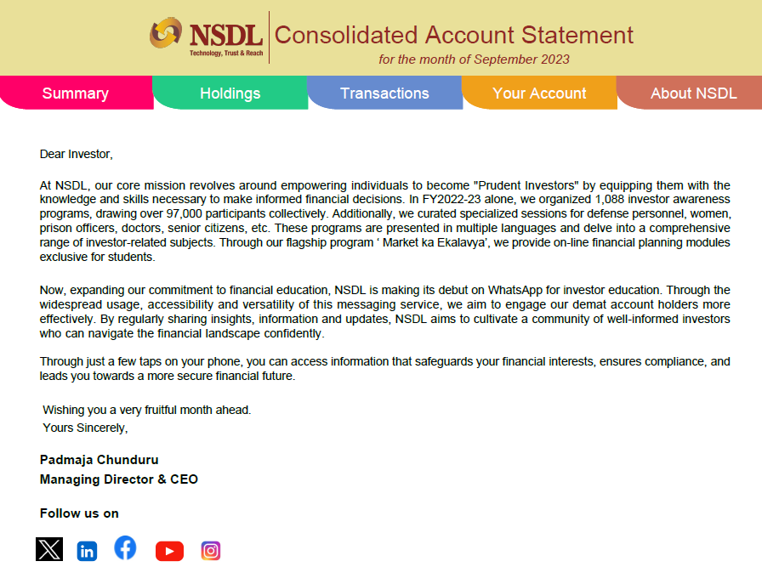

Slide 98
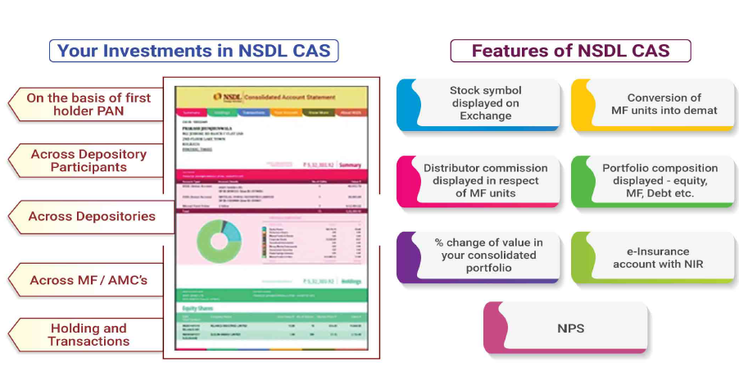

Slide 99
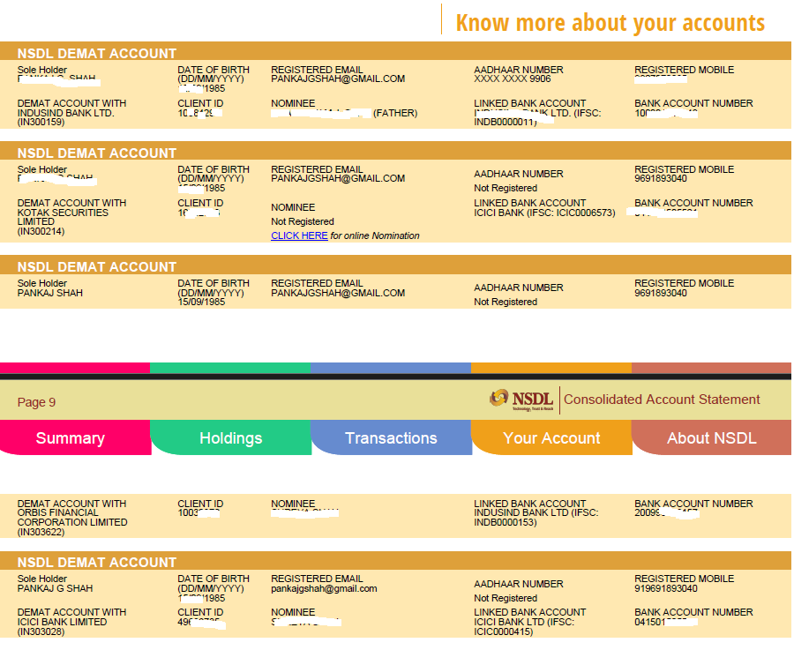

Slide 100
Immovable properties
Municipal corporation website
Property tax receipts
For agricultural land
Land records updated online
Area and owner details are available
Friends, CA and consultants

Slide 101
Modes of Estate planning

Slide 102
Modes
Trusts
Wills
Joint holding/ Nominations
Family arrangements

Slide 103
Testamentary Wills

Slide 104
Terms
Administrator
A person appointed by a competent authority to administer the estate when no executor is appointed or an executor appointed refuses to act as an executor.
Probate
A copy of a Will certified under the seal of a Court of competent jurisdiction with a grant of administration to the estate.
Codicil
A document which modifies or alters the provisions of the original Will and forms part of it.
Letter of Administration
A letter of the court appointing an administrator to the estate.
Succession Certificate
Issued by Civil Court of jurisdiction in respect of property of a person who has died intestate, i.e. and where letter of administration or probate is not compulsory.

Slide 105
Tetamentary will
Statute
Indian Succession Act, 1925
Legal declaration of testator’s intention
As regards is property
Manifests only after the testator’s death
Will not valid if testator alive
Speaks from the grave
Can be revoked as many times as possible

Slide 106
Capacity
Major person
Sound mind
Intoxicated person non in his senses cannot
Deaf, Dumb, Blind
Yes they can provided it is evident that they knew the contents
Ordinarily insane
During intervals of sanity

Slide 107
Why to make a will
Complete discretion on distribution of property after death
Reduces Succession disputes
For rewarding those who cared
Better to make a will of every one at even younger age
Can be revised numerous times

Slide 108
How to make
Write or type?
Designate legatee/beneficiaries
Make it detailed
Oral will – Soldiers/ Muslims

Slide 109
Essentials
Date
Very important as only last will prevails
Signature/ thumb mark
Witness
Atleast two witnesses
Appoint executor
Younger than testator
Else court to be approached for appointing executor

Slide 110
Generic
I leave all my money to my wife | Valid
I leave money to my wife | Void

Slide 111
Beneficiary
Any one?
Relative/ Friend/ Employee/ Servant
CA/ Lawyer
Stranger
Pets/Animals
Mumbai couple created trust and donated 5 crores for their two golden dogs
In US Karl Lagerfield’s cat is a beneficiary of Rs.2700 crore.

Slide 112
Digital assets
Email credentials
Bank account credentials
Bitcoins

Slide 113
Executor
Beneficiary
Common to have spouse as executor
CA/ Consultant
Provision of fee in the will
Primary and secondary
Capable to be testator
Willing to become

Slide 114
Witness
Section 67 of ISA
Witness or his spouse cannot be beneficiary
Bequeath shall become void
Must seen testator affixing the will
Need not to know the contents of will

Slide 115
Section 69 : Revocation by Marriage
Revocation of Will by testator’s marriage
Except
Hindus/Jains/Buddhists and Sikhs
Muslims

Slide 116
Registration of Will
Testator may register will with Sub-Registrar
Not compulsory but advisable
becomes public document for inspection
Raises strong presumption of genuineness of will
Registered will can be superceded by subsequent unregistered will
Notarisation can also be considered

Slide 117
Income tax – Registered will
Copy of Legal Heir Proof from the below list:
Legal Heir Certificate issued by Court of Law /Local Revenue Authority.
Surviving family member certificate issued by the Local Revenue Authority.
Family Pension certificate issued by Central/State Government.
Registered will.
Letter issued by the banking or Financial Institution in their letter head, with official seal and signature mentioning the particulars of nominee or joint account holder to the account of the deceased at the time demise.

Slide 118
Undue Influence
Mahesh Kumar (2012) 4 SCC 387
a case where a testator bequeathed all his wealth to one son in preference to the others
since he was living with that son and the attitude of the other sons was extremely hostile towards their parents.
The Court held that the fact that one son took care of the parents in their old age showed that there was nothing unnatural or unusual in the decision of the testator to give his property only to him.
Any person of ordinary prudence would have adopted the same course and would not have given anything to the ungrateful children from his / her share in the property.
Thus, the Court held that there was nothing invalid in the Will.

Slide 119
Joint wills
Husband and Wife both make a common will
Reciprocal promises
Cannot be changed unilaterally
Instrument to bind others to avoid
Remarriage
Arbitrary disposal
Otherwise not advisable as bottleneck

Slide 120
What can be willed
Can be willed
Self-acquired properties
Acquired by inherit­ance or gift, etc. and held exclusively
share in the properties of HUF under Will by member.
Cannot be willed
Tenancy rights not being transferable should not be made a subject matter of Will.
A Mohammedan under Will can bequeath only 1/3rd of his property,
the remaining 2/3rds part shall devolve on legal heirs as per the Mohammedan Law.
Notwithstanding this rule, a Mohammedan may bequeath his entire property under a Will provided his legal heirs otherwise entitled to his estate consent to such a disposition after his death — their consent before death is not valid.

Slide 121
Partnership
Succession of status of partner?
Subject to contract

Slide 122
Common clauses
a) | Name, age, address, religion | b) | Revocation of earlier Will
c) | List of relatives | d) | Appointment of executor
e) | Discharge of obligations | f) | Legacies and bequests to persons
g) | Residual estate | h) | Testimonium
i) | Execution | j) | Witness
k) | Safe custody

Slide 123
Codicil
A Will can be changed by the testator during his life time either
by making a new Will after revoking an old Will or
by amending the old Will by separate instrument made with the intention to make such an instrument a part of it.
This new instrument is known as Codicil. S. 2(d) defines it as an instrument made in relation to a Will and explaining, altering or adding to its dispositions which shall be deemed to form part of the Will

Slide 124
Stamp Duty
No stamp duty is payable on execution of a Will.
A Will can be made on a plain paper.

Slide 125
Probate
A probate is the grant of administration of the estate
A probate provides the conclusive evidence
of the execution of a Will
of the legacies and
of the legal character of legatees by confirming validity of Will.
It can be granted only to an executor.
by the court of competent jurisdiction based on Will.

Slide 126
Probate
Probate not compulsory in cases of a Hindu and a Mohammedan unless
  The estate consists of an immovable property situated in the cities of Mumbai and Chennai and Kolkata.
  Will is executed in the cities of Mumbai and/or Chennai and/or Kolkata and deals with an immovable property wherever located.
  A maximum court fee of Rs. 75,000 is payable in the State of Maharashtra for obtaining a probate.
No time limit is prescribed for filing an application for probate.
  However, delay is required to be explained where filed beyond a period of three years of death.

Slide 127
Succession Documents
Testate (Will)
Probate
Succession Certificate
Only for debt and securities
Intestate
Letter of Administration
Legal heir Certificate
Tehsildar
Creates no title (only management rights)

Slide 128
Fake reports / Myths
No. | Myth | Reality
1. | Will must be on Stamp paper | Can be handwritten on plain paper
2. | Legal format to be followed | No format
3. | Will cannot be changed once made | Can be changed end number of times
4. | Effective in person’s lifetime | Effective only after death of testator
5. | Cannot exclude close relatives Eg. Son, wife, etc. | Can bequeath anything to Charity/ servant/ friends

Slide 129
Fake reports / Myths
No. | Myth | Reality
6. | Will need not be dated | Last will prevails. Dating must
7. | Nomination prevails over will | Will prevails in all cases
8. | Married woman cannot make will | All women can make will
9. | No need of witness | Two witness are must
10. | Marriage revokes will | True. However not in case of Hindus

Slide 130
Ancestral Property
Property inherited from 3 generations above of male lineage
Father, grandfather, great grandfather
Deemed to be HUF property
Automatic right in ancestral property
Myth
Ancestral property cannot be alienated
Reality
Ancestral property can be lineated
Yudhister v. Ashok Kumar (SC)
Uttam v. Saubhag Singh (SC)
Surender Kumar (Del)
Arshnoor Singh (SC)

Slide 131
Thank you..
CA. Pankaj Shah
Chartered Accountant
pankajgshah@gmail.com
+91 9691893040

