Slide 1

Understanding Balance Sheet and Profit and loss
CA. Pankaj Shah
BBA, CS, LLB(Hons), FCA, DISA(ICA)

Slide 2
Why Financial Statements
Performance of a period
Financial health as on date
Notes:
Car six months driven in km, servicing, maintenance – Income statement, PL, activities and their result, comparison

Slide 3
Types of Financial Statements
Balance Sheet
Assets
Liabilities
Profit and Loss Accounts
Income
Expenditure
Notes to Accounts
Auditors Report

Slide 4
For whom
Owner/shareholders
Customers
Suppliers
Employees
Bankers
Government
Peers
Tax
Authorities

Slide 5
How many Financial statements
Income statement (Profit and loss)
Balance Sheet
Cash flow
Notes to accounts
Audit report

Slide 6
Language
Indian GAAP/ AS
IFRS
Ind-AS
Proprietorships
Partnerships
Unlisted companies
Multinationals
Large Corporate
Indian listed companies
Different Revenue recognition principles
Notes:
Supply - OCI

Slide 7
Fundamental Accounting Assumptions
Measurement
Historical cost
Fair Value
Status
Going Concern
Discontinued operations (Deemed supply)
Consistency
AS
IndAS

Slide 8
Method of accounting
Mercantile
Cash
Hybrid

Slide 9
Format types of Financials

Slide 10
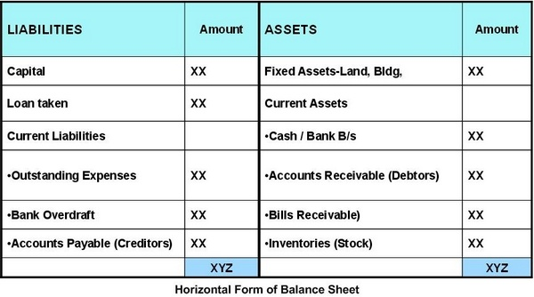
T- format of Balance Sheet

Slide 11
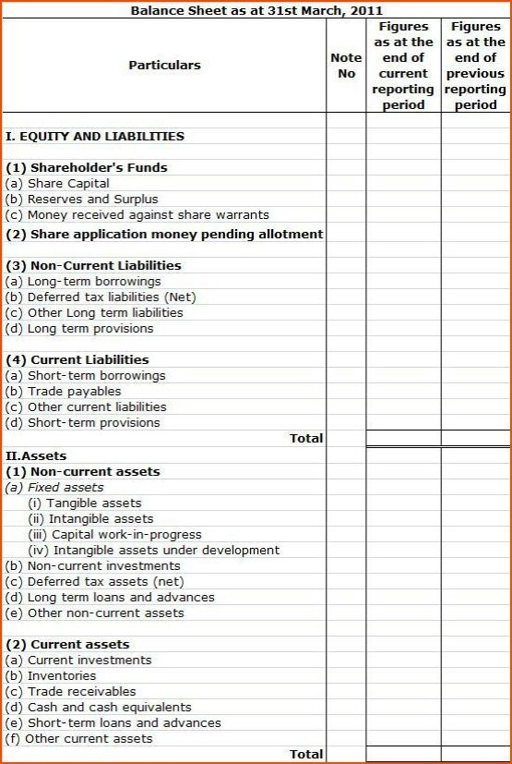

Slide 12
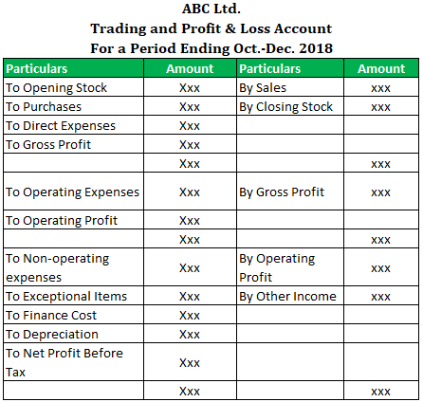
Profit and loss

Slide 13
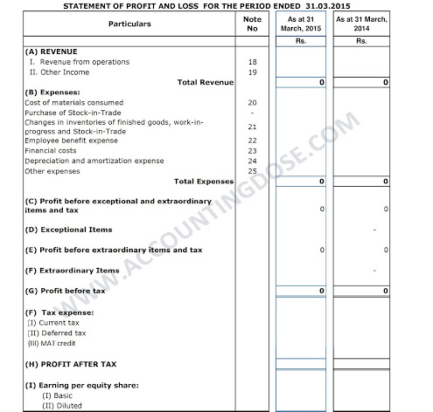

Slide 14
Schedule III

Slide 15
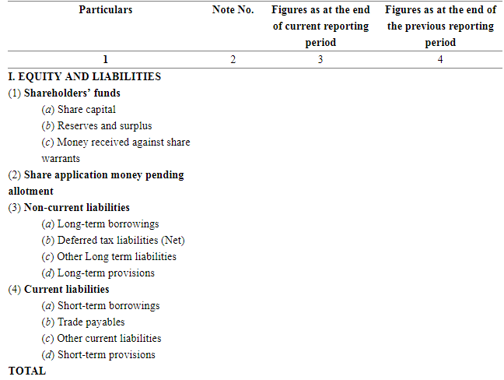

Slide 16
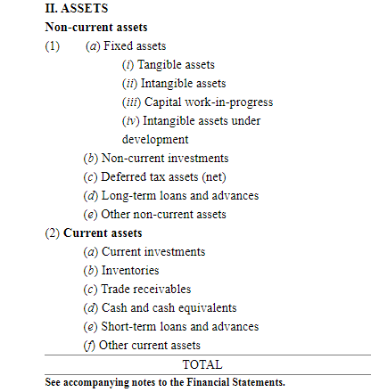

Slide 17
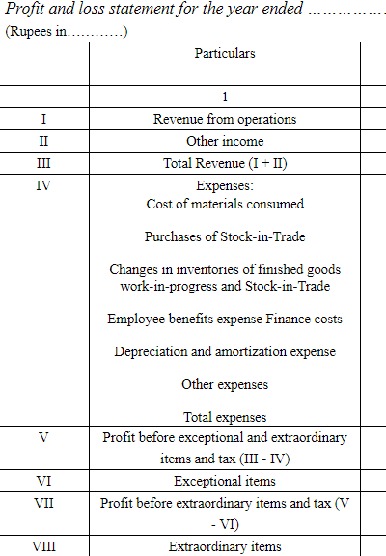

Slide 18
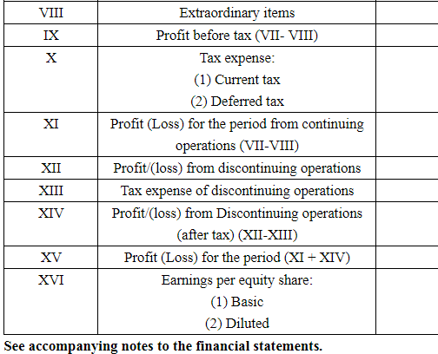

Slide 19
Notes to accounts

Slide 20
Assets
Non current assets
Fixed assets
Intangible
Capital WIP
LT
Investments
LT Loans and Advances
Deferred tax
Current assets
Current Investments
Inventories
Trade Receivables (Debtors)
Cash and Cash equivalents
ST Loans and Advances
Other Current assets
Tangible

Slide 21
LIABILITIES
Shareholders’ Funds
(a) Share Capital
(b) Reserves & Surplus
(c) Money received against share warrants
Share application money pending allotment
Non-current Liabilities
(a) Long-term borrowings
(b) Deferred tax liabilities (Net)
(c) Other long term liabilities
(d) Long-term provisions
Current Liabilities
(a) Short-term borrowings
(b) Trade payables
(c) Other current liabilities
(d) Short-term provisions
Creditors outstanding for more than 6 months
ITC Reversal

Slide 22
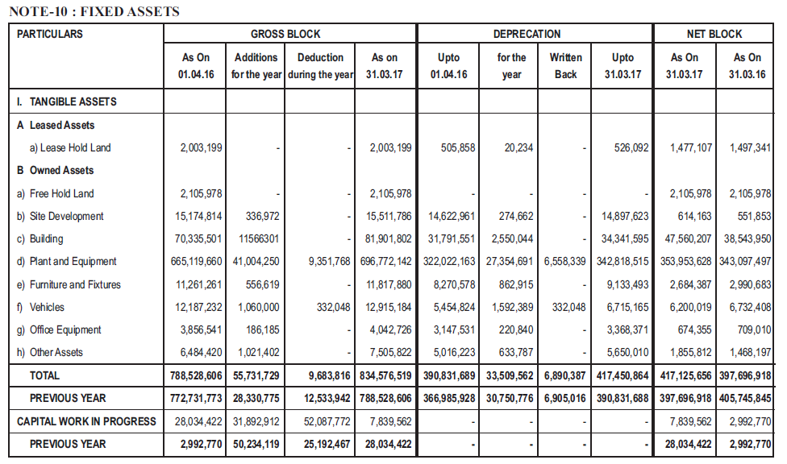

Slide 23
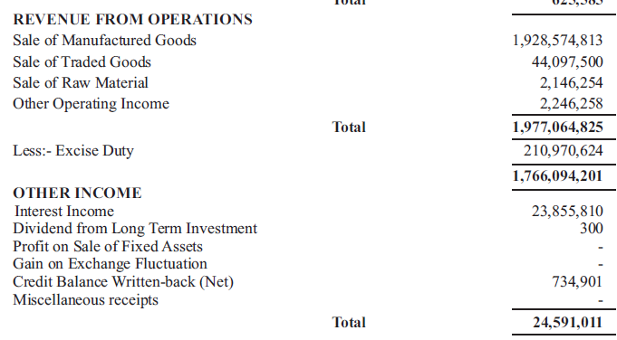

Slide 24
Recognition of Turnover/Inventory
Exclusive method
Inclusive method
Net of indirect taxes
Lesser value of
  Sale, Purchase
  Opening/closing stock
Reconciliation of turnover with GST required
As per Accounting Standards
Including indirect taxes
Higher value of
  Sale, purchase
  Opening closing stock
Matching with GST turnover(normally)
As per S.145A of Income tax

Slide 25
Notes to accounts – Other Income
includes discount received
May be unpaid creditors
ITC reversal
Other income includes other items of supply
Relevant for reconciliation

Slide 26
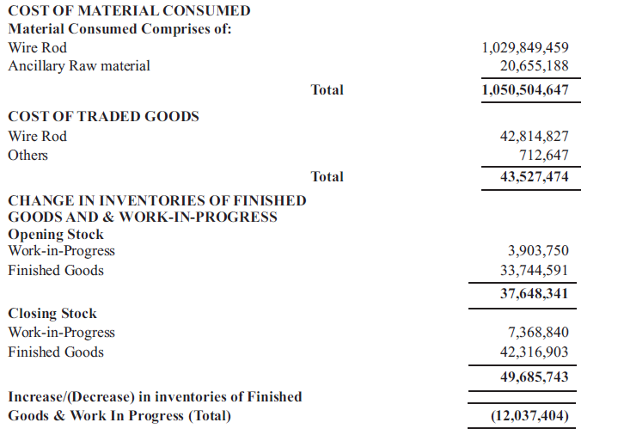
Taxes to be included in closing FG

Slide 27
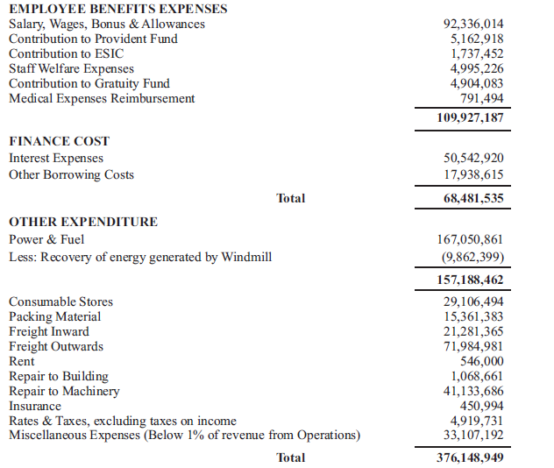

Slide 28
Notes to accounts - Expenses
Expenses on which Reverse charge applicable
  Freight Inward
  Freight outward (CIF cases)
  Advocate fee, etc.
    Legal and professional expenses
  Managerial remuneration
    Director’s Sitting fees

Slide 29
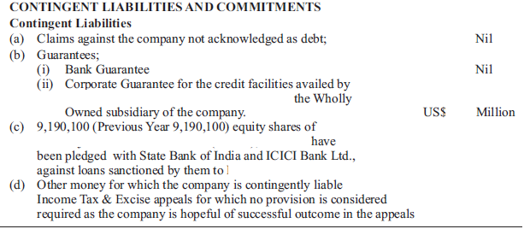

Slide 30
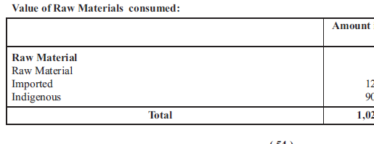
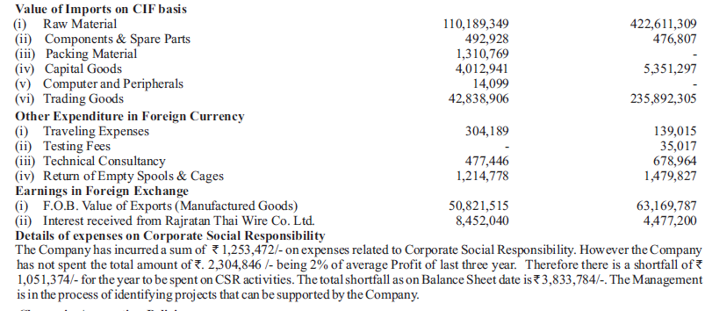

Slide 31
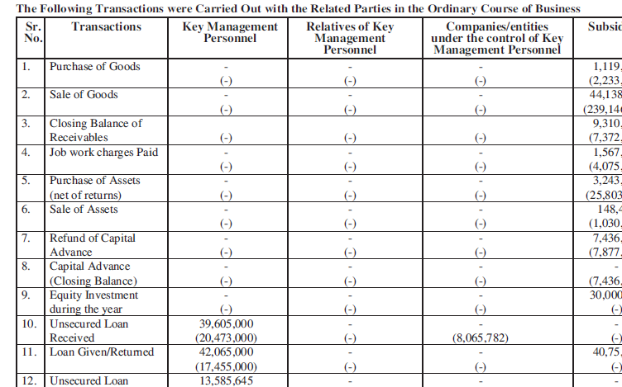
Related party transactions
GST Valuation rules are complied?

Slide 32
Notes to accounts
Same entity different locations and GSTIN
Neutralisation of interunit transfers
Reconciliation required

Slide 33
Other references
Significant accounting policies,
Directors Report
Contingent liabilities
CARO

Slide 34
CARO

Slide 35
CARO
Details of tangible and intangible assets
  Whether the records maintained by the company display the complete particulars on the details, quantity and situation of tangible and intangible assets.
    Fixed Asset Register
      Find blocked credit assets – motor car, immovables
  Whether the material discrepancies, if any noticed on physical verification have been accounted for in the books of accounts.
    If discrepancy noticed i.e. short then reverse ITC

Slide 36
CARO
Details of inventory and working capital
  Whether the management has carried out physical verification of inventory at reasonable intervals.
    Short inventory – supply
    Excess inventory – unrecorded purchase
  If any discrepancies of 10% or more in the aggregate for each class of inventory were noticed and if so, whether they have been properly dealt with in the books of accounts.

Slide 37
CARO
Details of investments, any guarantee or security or advances or loans given
  The total amount given during the year, and the balances due as at the balance sheet date with respect to such loans or advances and guarantees or security to subsidiaries, joint ventures and associates.
  The total amount during the year, and the balance due on the balance sheet date of such loans or advances and guarantees or security to persons other than associates, subsidiaries and joint ventures.
  In the case of investments made, guarantee or security provided, loans or advances granted, the report should indicate……..
GST position
  Section 2(102) of the CGST Act defines ‘services’ and states that anything other than goods is service.
  personal guarantee not ‘goods’
  said transaction will be considered as service
Controls & Switchgear Contactors Limited vs. DCIT.(Del)

Slide 38
CARO
Whether the company has:
Regularly deposited statutory dues.
Are any statutory dues pending for a period more than 6 months as on the balance sheet date.
In case of any disputed statutory dues, the amount of such dues, the forum before whom the dues are litigated.

Slide 39
CARO
Unrecorded income
Whether any transactions which are not recorded in the accounts have been disclosed or surrendered before the tax authorities as income during the year. The details of such income tax assessments should be disclosed.
Whether such undisclosed income has been recorded in the accounts during the year.

Slide 40
CARO
Non-cash transactions
  In case the company has undertaken non-cash transactions with their directors or other persons connected to the directors, whether the restrictions imposed are complied with.
GST Valuation rules

Slide 41
CARO
Frauds
Fund raising and utilisation
Cost Audit applicability
Pending litigation and status
Taxes, duties, statutory dues

Slide 42
CARO
Private placement, Preferential allotment
Inventory and Fixed Asset status
Short term and long term fund use
Section 36(1)(iii)
Section 43A
Loans to related party details

Slide 43
CARO
Default in payment to Banks and Financial Statements
Managerial Remuneration
Section 40A(2b)

Slide 44
Audit Report

Slide 45
Audit Report
To Members of Company
Opinion
True and Fair
Basis for Opinion
Responsibility of Management
Auditor’s Responsibility
Other Matter
Report on Other Legal and Regulatory Requirements
Annexure as per CARO reference

Slide 46
Governed by
Companies Act 2013
Companies (Accounts) Rules, 2014
Accounting Standards
Indian Accounting Standards
Schedule III – Presentation
Guidance Notes issued by ICAI

Slide 47
ANALYSIS OF FINANCIALS

Slide 48
Ratio analysis
Gross profit ratio
Indications of
unrecorded sale
bogus purchases
Other ratios

Slide 49
Other important concepts
Heavy Asset base companies
Light Asset base companies
P/E Ratio
Price to Book Value
Discounted Cash flow and projections to Banks
EPS
Ratio Analysis

Slide 50
Liquidity and Solvency

Slide 51
Capitalisation Ratios

Slide 52
Profitability and management efficiency

Slide 53
Management Efficiency

Slide 54
Due Diligence
Titles & ownership.
Various Government consents/ licences.
Correctness and completeness of all information supplied.
Product/service warranties, damages and other claims.
Contingent liabilities.

Slide 55
Recoverability of all current assets.
Registration of Intellectual properties.
Employee benefit plans.
Litigation/appeals, etc.
Non-contravention of regulation, loan covenants, contracts terms, etc.

Slide 56
RATIO ANALYSIS OF DATABASE FOR AUDIT BY GST DEPARTMENT
To detect wrong ITC availed,
To identify under valuation of goods as value-addition should involve adequate difference between the two,
To identify removal of goods without payment of duty,
To identify claiming of input tax credit on inputs used in exempted products, to identify
Fraudulent availment of credit like availment of credit without receipt/actual use of input,
To identify outward supplies made in the guise of exempted supplies,
To identify supply of essential parts of outward supply as exempted supplies,
To identify under valuation of outward supplies by overvaluing exempted outward supply etc.

Slide 57
Detailed Ratios for GST analysis
https://taxguru.in/goods-and-service-tax/ratio-analysis-database-gst-audit-department.html

Slide 58
Thank You
CA. Pankaj Shah
+91 9691893040
pankajgshah@gmail.com
G.J. Shah & Company
Chartered Accountants
Manas Bhawan, RNT Marg, Indore

