Slide 1
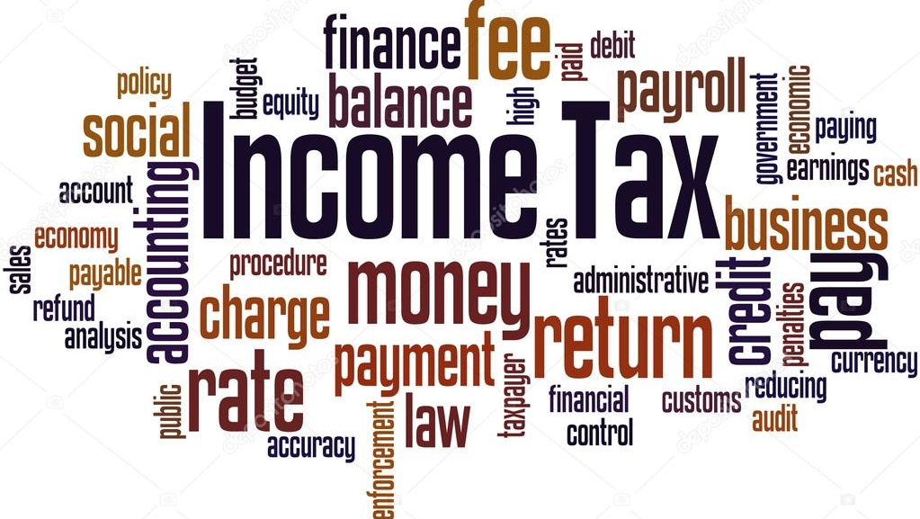
Analysis of Business Deductions under Income tax
By CA. Pankaj Shah
BBA, LLB(Hons), CS, FCA, DISA(ICA) Phd Scholar

Slide 2
Allowability
Section 28
Section 30 to 36
Section 37(1)
Real income concept

Slide 3
Other considerations
Subject to Section 40 to 43B
Income Computation and Disclosure Standards
Section 145 of the Act

Slide 4
Section 30-36

Slide 5
Rent, Rates, Taxes, Repairs And Insurance For Building [Section 30]
In respect of rent, rates, taxes, repairs and insurance for premises, used for the purposes of the business or profession, profession, the following deductions shall be allowed:
where the premises are occupied by the assessee:
  as a tenant — the rent paid for such premises; and further if he has undertaken to bear the cost of repairs to the premises, the amount paid on account of such repairs;
  otherwise than as a tenant — the amount paid by him on account of current repairs to the premises;
any sum paid (whether as owner or tenant) on account of land revenue, local rates or municipal taxes;
any insurance premium paid (whether as owner or tenant) in respect of insurance against risk of damage or destruction of the premises.

Slide 6
Repairs and insurance of machinery, plant and furniture [Section 31]
In respect of machinery, plant or furniture used for the purpose of business, the following deductions are allowable:
  amount paid on account of current repairs,
  any insurance premium paid in respect of insurance against risk of damage or destruction of the plant and machinery or furniture.

Slide 7
Section 31 vs 37(1)
If any expense is covered under section 30 to section 36 of the Income tax Act, 1961 and could not be allowed due to non satisfying condition laid down under section, same cannot be allowed under this residuary section. Laxman Sejram v CIT 54 ITR 763(1964) Gujarat.
Expenditure on replacement of old machines is in the nature of accumulated repairs and not current repairs. Therefore , the High court allowed such deduction under section 37 in place of section 31. Refer CIT v Gitanjali Mills Limited 265 ITR 681 (2004).

Slide 8
Repairs
Expenditure on additions/alterations to building is capital, if incurred by owner but revenue if incurred by tenant
Modi Spg. & Wvg. Mills Co. Ltd. v. CIT [1993] 200 ITR 544 (Delhi).
Expenditure on renovating/replacing parts of machinery necessitated by modernisation is revenue expenditure
Vanaja Textiles Ltd. v. CIT [1994] 208 ITR 161 (Ker.).
false ceiling, fixing tiles, replacing glasses, wooden partitions, replacement of electric wiring, earthing, replacement of GI pipes etc. were held to be revenue in nature.
CIT V. Hi Line Pens Pvt. Ltd. (306 ITR 182) (Del.)
Amway India Enterprise V. DCIT (27 SOT 344)

Slide 9
Heart Surgery
In this case, the assessee, a lawyer, claimed that his professional work had led to a heart attack and that the expenditure incurred by him on a heart operation was deductible u/s 31 on the ground that the heart was “plant” and the expenditure was incurred on “current repairs”.
It was also claimed that as his professional receipts increased substantially after the operation, the expenditure was “wholly & exclusively” for profession and deductible u/s 37(1). Held Disallowable
  Shanti Bhushan vs. CIT Delhi HC

Slide 10
Section 32 Depreciation

Slide 11
Depreciation
Where a vehicle is registered in the name of a Director, however it is in possession of company. Whether Depreciation is eligible?
The Hon'ble Supreme Court in Mysore Minerals Ltd Vs. CIT (239 ITR 775) held that the terms "own", "ownership" and "owned" are generic and relative terms. The term "owned" as occuring in section 32 (1) of the Act must be assigned a wider meaning. Anyone in possession of property in his own title exercising such dominion over the property as would enable others being excluded therefrom and having the right to use and occupy the property and / or to enjoy its usufruct in his own right would be the owner though a formal deed of title may no have been executed and registered as contemplated by the Transfer of Property Act, the Registration Act, etc.
Where due to lock out in Maruti plant, it did not funtion for 3 years. Whether Depreciation is available for those 3 years?
In Swati Synthetics Case (38 SOT 208), it is held that condition of ‘use’ is relevant only in which asset is purchased, thereafter it forms part of block and is passively used even if the plant is closed. Therefore depreciation is allowable in case of a closed unit too.

Slide 12
Depreciation on Intangibles
Item | Citation
Goodwill | SMIFS SECURITIES Ltd. (Supreme Court)
Skill and Knowhow of Labour | BOSCH LTD v. CIT (2009-TIOL-736-ITAT-BANG)
Brand Name | Raveendran Pillai 332 ITR 549 (Kerala HC)
Non Compete | Medicorp Tech. 21 DTR 69
Marketing and Commercial Rights | Skyline Caterers (20 SOT 266)

Slide 13
Section 36

Slide 14
Delay Employee contribution to PF
Checkmate
BBG Metals (cuttack ITAT)

Slide 15
143(1) adjustment for Employee contribution
Issue of employee contribution is debatable in nature
CBDT Instruction No.1814 dated 4thApril, 2009
explains the scope of the word “prima facie disallowance” under Section 143(1)(a) of the Act as being different from a debatable issue. It clarifies that a debatable issue is one where a claim made by an assessee on the basis of a decision of a Court / Tribunal.
A debatable claim cannot be disallowed by an intimation under Section 143(1)(a) of the Act;
AY 2021-22
Restricted to disallowance of deductions and not addition of income

Slide 16
Section 37 - Residuary

Slide 17
Condition for allowance under section 37
Such expenditure should not be covered under the specific section i.e. sections 30 to 36.
Expenditure should not be of capital nature
The expenditure should be incurred during the previous year.
The expenditure should not be of personal nature.
The expenditure should have been incurred wholly or exclusively for the purpose of the business or profession.
The business should be commenced.

Slide 18
Woodward Governor India (P.) Ltd. [2009] 312 ITR 254 (SC): Allowability tests
Whether mercantile system of accounting has been followed?
Whether same system is followed from the very beginning and if there was a change in the system, whether the change was bona fide?
Whether same treatment has been given to losses as well as gains accrued ?
Whether assessee has been consistent and definite in making entries in the account books in respect of losses and gains ?
Whether the method is as per nationally accepted Accounting Standards?
Whether the system adopted by the assessee is fair and reasonable or is adopted only with a view to reduce the incidence of taxation?

Slide 19
Relevance of book entries
Failure to make book entries is no bar to allow deduction
If an assessee under some misapprehension or mistake fails to make an entry in the books of account and if under the law, a deduction must be allowed by the ITO,
the assessee will not lose the right of claiming or will not be debarred from being allowed that deduction.
Kedarnath Jute Mfg. v. CIT [1971] 82 ITR 363 (SC)
Sutlej Cotton Mills v. CIT [1979] 116 ITR 1 (SC)

Slide 20
Allowable deduction test u/s 37(1)
To be an allowable expenditure under section 37(1), the money paid out or away
must be
(a) paid out wholly and exclusively for the purpose of the business or profession; and further
(b) must not be;
(i) capital expenditure;
(ii) personal expense; or
(iii) an allowance of the character described in sections 30 to 36

Slide 21
“wholly and exclusively”
‘Wholly and exclusively’ [as used in section 37(1)] does not mean ‘necessarily’. Such expense may be incurred voluntarily and without any necessity if it is for the promotion of the business
Sasoon J. David and Co. vs. CIT (118 ITR 261)(SC)
Bralco Metal Industries Pvt. Ltd. vs. CIT (206 ITR 477)(Bom)

Slide 22
Capital vs. Revenue

Slide 23
Capital v. Revenue Expenses
Expenses incurred on leased/rental premises are revenue in nature –
Malabar Mills 288 ITR 815
Modi Spg. & Wvg. Mills v. CIT 200 ITR 544
Amway India v. DCIT 27 SOT 344 (DELHI)
Supreme Court in CIT V. Ramaraju Mills (294 ITR 328) held that
if the production capacity remaining constant even after the replacement of the asset it is allowable as a revenue exp.
Benefit of enduring nature – Empire Jute (SC)

Slide 24
Following expenses have been held as revenue
Nature of Expense | Decision
Cost of water proofing of Roof Area | (322 ITR 590)
Renovation expenses including replacement of tiles, painting, false ceiling, portions etc. | (306 ITR 182) (Del.)
Replacement of a part of the machinery | 163 Taxman 201 (SC)
Reconstruction of Road | (100 Taxman 247)(Ahd)
Repairs to Boundary Wall | (2010-TIOL-648-HC-DEL-IT)
Internal furnishings, painting and polishing work, dismantling of old false ceiling, fees for interior designing, lift maintenance, etc. | 121 ITR 165 (Punj. & Har.). (104 ITD 427) (Del)

Slide 25
Abandoned Project
The assessee had incurred expenditure on engaging services of consultants for improving operational efficiencies inextricably linked to the existing business.
The project was abandoned, with no new asset to be created. The expenditure held to be revenue expenditure.
  Indo Rama Synthetics India Ltd v. CIT 333 ITR 18( 2011).
  Priya Village Road Show (Del HC)

Slide 26
Adhoc Disallowance / estimations

Slide 27
Adhoc Disallowances for Personal Expenses
There cannot be any adhoc disallowances for personal expenses in Companies
New Healthcare P. Ltd. 2009 13 ITJ 444 ITAT Indore
OTG Global Finance Ltd. 2008 11 ITJ 630 ITAT Indore
Jash Engineering Ltd 2007 9 ITJ 110 ITAT Indore

Slide 28
Lower Profits
Assessee may be incompetent or his method of business may be uneconomic.
No specific major Defects in books
Books cannot be rejected
Pandit Bros. v. CIT (26 ITR 159 )(Punj.)
S. Veeriah Reddiar v. CIT [1960] 38 ITR 152 (Ker.)
J.A. Trivedi (158 ITR 705)(MP)

Slide 29
Transactions with
Related Concerns

Slide 30
Interest u/s 40A(2)(b)
Interest on Unsecured Loans from relatives
Rate 18%
Bank Rate 13.25%
Balkishan Jagannath Goyal (I.T.A.No. 590/Ind/2009)
Prevailing market rate does not mean the basic Bank rate of interest
Bank loan is not available just on asking or personal guarantee, but so many other collateral securities are also insisted by the Bank in addition to hypothecation of stock worth more than the amount of loan sanctioned by the Bank, whereas loans from friends and relatives available just on asking depending upon personal relation.
Other indirect and hidden cost incurred for obtaining loan relating to processing fee, inspection fee, stock audit fee, legal documentation charges and the stamp duty expenses for mortgage and hypothecation cannot be left out.

Slide 31
Interest u/s 36(1)(iii)
Own as well as Borrowed Funds
Interest free Loans and Advances
Reliance Utilities (313 ITR 340)(Bom)
If there are funds available both, interest-free and over draft and/or loans are taken, then a presumption would arise that investments would be out of the interest-free fund generated or available with the company, if the interest-free funds are sufficient to meet the investments.

Slide 32
Brokerage and Commission

Slide 33
Commission
Identity of Agents
Payment through Account Payee cheques
Nature of Services for business purpose
CIT v. Pure Pharma (P) Ltd. (270 ITR 382 (MP))
Senairam Doongarmall v. CIT ([1961] 42 ITR 392 (SC)) held that it is the nature/quality of the payment that is decisive of the character of the payment and not the method of the payment of its measure.

Slide 34
Commission on Government Supplies
CIT. v. Electrical Construction Equipment Co. Ltd (182 ITR 510)
Department observations that since public sector undertakings place orders through tenders, there is absolutely no necessity of securing services of a middleman'.
Held In fact, it observed that such 'services become necessary for several purposes, such as passing information to the assessee about likely demand of their goods by the purchasers, helping the assessee in submitting tenders, to prepare, submit, follow and to inform at all stages the position of tenders and to help the assessee in getting the payments from buyers and also in case of dispute to get the matter settled.
Defence Minister has accepted necessity in Procurement

Slide 35
Conjectures and Surmises
No Disallowances on Conjectures and Surmises
Dhakeshwari Cotton Mills Limited v. CIT (26 ITR 775)(SC)
ITO cannot make assessment on a pure guess without any evidence or material and hence, such ad hoc disallowance is unjustified.

Slide 36
Salary

Slide 37
Salary
Cash Salary
PF provisions not complied
  In Addl.CIT v. Shree Ambica Auto Sales (ITA No.2042/AHD/2008) held that mere “non-deduction of PF” cannot be a ground for making disallowance of salary expenditure.
  ITO v. Durgawati Jitendra Tiwari (ITA 5373/Mum/2010) it is categorically held that “merely because the assessee has not deducted the PF and ESIC on such payment of wages does not mean that the said payments of wages have not been incurred wholly and exclusively for the purpose of the business

Slide 38
DCIT v. Arjun Bhowmick (ITA 1071/Kol/2010)
“Admittedly, assessee has produced a register, which contained payments to various labourers. Admittedly, this register does not contain the
  addresses of the labourers
  nor it contains revenue stamp,
  nor is it signed by the Labour Department,
  no PF has also been deducted.
Does all these wrongs in its entirety or individuality make the expenses incurred by the assessee deniable?
Can this defect be held to be changing the mode of payment of the assessee from one mode to another?
Here we would answer ‘no’……… ………………………………. A violation of the provisions of Provident Fund Act could have best lead to initiation of proceedings under the P.F. Act. Not maintaining the labour register as per the required Laws of the Labour Laws is a violation of the Labour Laws and not of the Income Tax Act. In short, violation of any law as long as the payment does not become illegal on account of such violation; the same cannot be hit under the Income Tax Act.”

Slide 39
Personal Expenses

Slide 40
Personal Expenses
Car expenses on vehicles given to directors for personal use
Allowable If as per the terms and conditions of their appointment,
‘remuneration’ as defined in the Explanation to section 198 of the Companies Act,
Sayaji Iron and Engg. Co. v. CIT [2002] 253 ITR 749 (Guj.)

Slide 41
Adhoc Disallowances for Personal Expenses
There cannot be any adhoc disallowances for personal expenses in Companies
New Healthcare P. Ltd. 2009 13 ITJ 444 ITAT Indore
OTG Global Finance Ltd. 2008 11 ITJ 630 ITAT Indore
Jash Engineering Ltd 2007 9 ITJ 110 ITAT Indore

Slide 42
Expenses on Abandoned Project
New project in Same line of business
Project Abandoned
CIT vs Graphite India Limited (221 ITR 420 – Cal.),
Nimbus Communications Limited vs ACIT (132 TTJ 351).
DCIT vs Assam Asbestos Limited (263 ITR 357 – Gau.).

Slide 43
Penalty
Compounding fees paid to RTO - Allowable
  Bharat C Gandhi 10 Taxmann.com 256
Deliberate violation of law – Disallowable
  Hero Cycles Ltd. 17 DTR 281
Payment for regularizing the default committed – Allowable
  Kaira Can Company Ltd. 32 DTR 485
Compensatory and contractual penalty – Allowable
  Mahalaxmi Sugar Mills Co. Ltd. v. CIT[1986] 157 ITR 683 (Delhi).

Slide 44
Advances Written off
Pik Pen Private Limited vs. ITO.( ITA 6847/Mum/2008)
CIT v. Mysore Sugar Co. Ltd. (46 ITR 649)
CIT VS. Anjani Kumar Co. Ltd. (2003) 259 ITR 114 (Raj)
Section 28 – Expenditure vs. loss

Slide 45
Section 14A
Investments capable of yielding tax free income
Expenses incurred in relation to Earning Exempt Income

Slide 46
No Exempt Income Earned During the Year
Shivam Motors P Ltd (All HC)
CIT vs. Corrtech Energy Pvt. Ltd (Guj HC)
CIT vs. Lakhani Marketing (P&H HC)
CIT vs. Holcim India P. Ltd (Delhi High Court)
Goel Zenith Agro (ITA 82/Rpr/16)
Cheminvest (Del HC)

Slide 47
TDS Disallowances
Reporting Disallowance for
Non deduction of TDS
Non deposit of TDS deducted
Second Proviso to Section 40(a)(ia)
If the Payee has offered the same to tax
Certificate of CA in form 26A
No disallowance
Conservative view to be adopted from Audit point of view
Notes:
MP High Court in case of Jawahrlal Agrawal has held that Proviso to Section 40(a)(ia) is retrospective. Similar amendment has been brought in Finance Act 2014. Such amendment also being curative and remedial should also be retrospective as per this jurisdictional High Court decision.

Slide 48
40(a)(ia)
Second Proviso to 40(a)(ia) retrospective
ACIT vs. Pratibha Exims Pvt. Ltd. (ITA 90/Ind./2013)
Gujarat Pipavav Port Ltd. vs. DCIT (614/Rjt/2012)
Shri Antony D. Mundackal Vs. ACIT (ITA 38/Coch/2013)

Slide 49
Wholly and exclusively
Expression “for the purpose of business” is wider in scope than the expression “for the purpose of earning profits” and
‘wholly and exclusively’ does not mean ‘necessarily’.
Jurisprudence
Sasoon J. David and Co. vs. CIT (118 ITR 261)(SC)
Bralco Metal Industries Pvt. Ltd. vs. CIT (206 ITR 477)(Bom)

Slide 50
Commercial Expediency
CIT vs. Gobald Motor Services P. Ltd. (100 ITR 240)
“it is not for the revenue to question the commercial expediency of the expense. Commercial expediency is a matter left entirely to the judgment of the Assessee.”
S.A. Builders v. CIT (288 ITR 1)(SC)
“the Revenue cannot justifiably claim to put itself in the arm-chair of the businessman or in the position of the board of directors and assume the role to decide how much is reasonable expenditure having regard to the circumstances of the case.
No businessman can be compelled to maximize its profit. The income tax authorities must put themselves in the shoes of the assessee and see how a prudent businessman would act.
The authorities must not look at the matter from their own view point but that of a prudent businessman.

Slide 51
Promotional Expenses
Gifts to foreign guests/ delegates who could be potential lenders – deductible expense
ICICI vs. IAC (32 ITD 315)
Expenses incurred by assessee company in connection with distribution of dry fruits on Diwali and New Year’s Day- Deductible
ITO vs. SLM Maneklal Industries Limited (17 ITD 515) (Ahm.)
Geetanjali Woollens vs. ACIT (54 TTJ 19) (Ahm)
Silver coins distributed as presents to employees/others on occasion of silver jubilee- allowable expense.
-Suessen Textiles Bearings Limited (43 TTJ 399) (Ahm.)

Slide 52
Promotional Expenses
Expenses on account of dry fruits etc. distributed among customers on festive occasions deductible
ITO vs. French Dyes and Chemicals (10 ITD 204)
Inaugration expenses deductible
Sunil Synchem Ltd. vs. CIT (205 ITR 298)
Delhi Cloth and General Mills vs. CIT (189 ITR 500)

Slide 53
40A(3)
Disallowance/deemed income under section 40A(3)
Electricity Payment to MPEB Companies
Padigela Rajeshwar Ginning Industries ITA 1137/Hyd/2011,
Trivedi Corporation (ITA 2844/Ahd/2006)
M.R. Soap (P.) Ltd. 32 TTJ 505 (DELHI)
New Limit Rs.10000

Slide 54
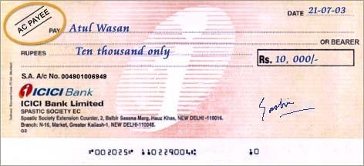
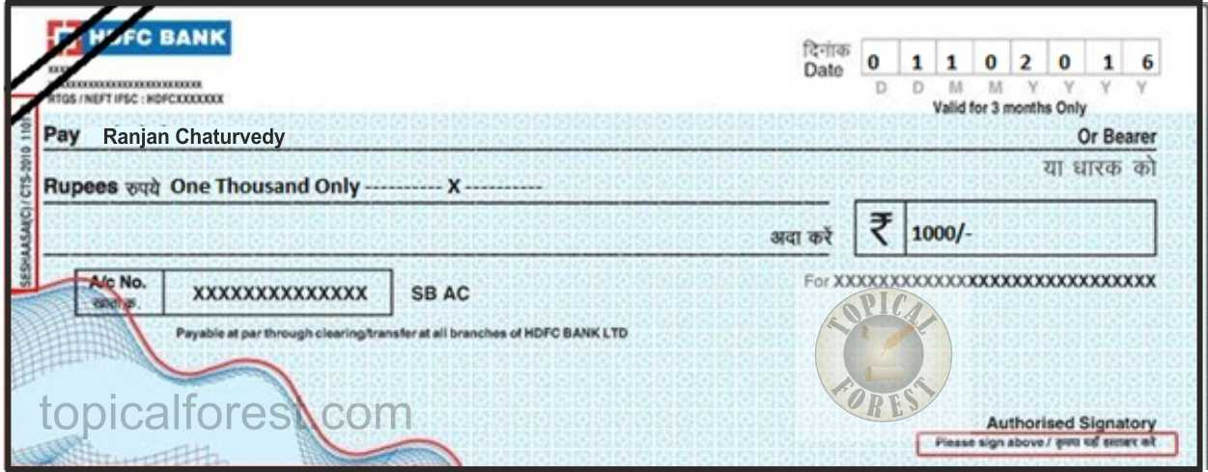

Slide 55
CROSSED CHEQUE vs. A/C PAYEE CHEQUE
There is clear distinction between a crossed cheque and an account payee cheque as in account payee cheque banks are directed to credit amount of an account payee cheque only in account of payee and no other person while crossed cheques are endorsed in favour of a person other than drawee making it difficult to trace constituent of money and thus, crossed cheque is violative of section 40A(3) - Rajmoti Industries v. Asstt. CIT [2014] 45 taxmann.com 72/223 Taxman 428 (Guj.)

Slide 56
Education cess not tax
Chambal Fertilisers & Chemicals Ltd vs. JCIT (Raj)
Education cess is not part of tax. Accordingly, the same is allowable as a deduction and disallowance u/s 40(a)(ii) cannot be made

Slide 57
Case study
An ecommerce company has incurred a huge spend on advertising and discounts on items sold through the website.
The ecommerce company has claimed huge losses as a result of the expenditure incurred.
Are the AO and CIT(A) correct in their actions?
The AO has however disallowed the expenditure on the basis that the same has lead to creation of an intangible and therefore cannot be allowed as a deduction. The CIT(A) has confirmed the action of the AO.

Slide 58
Case study contd..
Flipkart and Amazon
Globally, the e-commerce business has thrived on marketing through deep discounts
Empire Jute Co. Ltd. [1980] 124 ITR 1 (SC):
  If the advantage consists merely in facilitating the assessee's trading operations or enabling the conduct of the business to be carried on more efficiently or profitably while leaving the fixed capital untouched, the expenditure would be on revenue account, even though the advantage may endure for an indefinite future
Taparia Tools Limited(372 ITR 605)
  there is no concept of deferred expenditure and the amount has to be allowed as a deduction.

Slide 59
Case 2
In a case, deduction of performance bonus payment pertaining to AY 2017-18 was claimed in AY 2018-19 which was denied to an assessee since books were maintained on the basis of mercantile system of accounting.
This was despite the fact that the assessee could quantify the bonus only in the AY 2018-19 and, thus, its liability crystalized during such year. Is the bonus payment deductible in such subsequent year?

Slide 60
Quantification of the bonus liability depended upon figures that could be gathered only after closure of accounts and hence the entire exercise could be completed only in the subsequent year.
Thus as the liability crystallized and was discharged during such subsequent year, the bonus payment pertaining to an earlier year was deductible in the subsequent year, notwithstanding the mercantile method of accounting followed by the assessee –
Spencer's Retail Ltd. [2017] 77 taxmann.com 324 (Kol ITAT) following the ratio of the Supreme Court in Swadeshi Flour Mills Limited

Slide 61
Real income concept

Slide 62
Unexplained “net income”
Difference between explained expenditure Vs. unexplained “net income” i.e. unexplained income less unexplained expenditure. 
Jagdishchandra Virmani 106 TTJ 287 (Del)
Chander Mohan Mehta 71 ITD 245 (Pune)

Slide 63
Non applicability of Section 40A(3) and Section 40(a)(ia) on undisclosed income and expenses
CIT vs. Amman Steel & Allied Industries [2015] 377 ITR 568 (Madras)
  Provisions of section 40A(3) cannot be applied when assessable income has been arrived by applying a percentage rate on unaccounted turnover.
Chhattisgarh Steel Casting (P) Ltd. vs. ACIT (2008) 8 DTR (Bilaspur)(Trib) 14
  it held disallowance under s.40A(3) made by AO out of unrecorded purchases from the record seized by Excise Department was uncalled for where income was estimated.

Slide 64
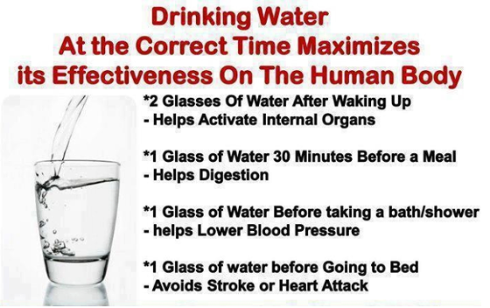
Health Tip

Slide 65
Thank You
CA. Pankaj G. Shah
+919691893040
pankajgshah@gmail.com

