Slide 1


Critical issues in Capital Gains under Income tax Act
CA. Pankaj G. Shah
F.C.A, C.S., LLB(Hons), BBA, DISA(ICA)

Slide 2
CHARGEABILITY
Should be a Capital asset
Transfer in the previous year
Gain/loss as a result of transfer
Not exempted or deductible under Section 54, 54B, 54D, 54EC, 54F, 54G and 54GA
Sale consideration
Cost of acquisition

Slide 3
“transfer”

Slide 4
​CIT vs. BalbirSinghMaini 398 ITR 531(SC)​
The effect of the aforesaid amendment is that, on and after the commencement of the ​​Amendment Act of 2001, if an agreement, like the JDA, is not registered, then it shall ​​have no effect in law for the purposes of Section53A. This being the case, in order ​​to qualify as a"transfer"of a capital asset under Section2(47)(v) of the Act, there must be a​ "​contract“ which can been forced in law under Section 53A of the Transfer​​ofPropertyAct. A reading of Section17(1A) and Section49 of the Registration Act ​​shows that in the eyes of law, in the absence of registration, there is no contract ​​which can be taken cognizance of , for the purpose specified in Section53A

Slide 5
Consequences
Combined reading of the new s.53A of TOPA, s. 17(1A) and proviso to s. 49 under the Registration Act clearly mandate that
any transaction involving allowing of the possession of the immovable property
to be taken or retained in part performance of a contract of the nature referred to in s.53A
shall not result in transfer if the agreement is not registered.

Slide 6
Registration relates back to execution date of agreement
Section 47 of the Registration Act, 1908, a registered document shall relate back to the date on which it is executed and not from the date on which it has been so registered.
Jitendra Mohan v. ITO [2007] 11 SOT 594 (Delhi), it has been held that it is the date of allotment which is relevant for the purpose of computing a holding period and not the date of registration of conveyance deed ; that section 47 of the Registration Act lays down that registration of a document operates retrospectively
Gurbax Singh v. Kartar Singh [2002] 254 ITR 112 (SC), it has been held that registration of a document would relate back to the date of its execution

Slide 7
Date of acquisition for holding period
Allotment date
Possession date
Registration
ACIT vs. Sanjay Kumath ([2014] 63 SOT 90 (Indore - Trib.)) Period of holding of a flat reckoned from date of allotment letter as such letter extinguished all rights of seller
Board vide Circular No. 672 after referring Circular No. 471 extended the facility of exemption under sections 54 & 54F in respect of allotment of flat/house.
Circular No. 471 dated 15.10.1986 and Circular No.672 dated 16.12.1993 held as under :—
"The allottee gets title to the property on the issue of the allotment letter and the payment of instalment is only a follow up action and taking the delivery of possession is only a formality."

Slide 8
50C Tolerance band
Not 10% variation allowed in 50C
10% of Actual sale consideration not Stamp Value
Retrospective
Chandra Prakash Jhunjhunwala [TS-462-ITAT-2019(Kol)]
Manoj Mittal vs ACIT ITA (4596/Del/2016) dtd 19.02.20

Slide 9
Indexed COA in Gift/Inheritance
“the year in which the asset was first held by the assessee”
Manjula Shah 16 Taxman.com 42 (Bom)
Jhanvi S Desai 7 TMI 496 (Bom)

Slide 10
Interesting issues
Amount paid to tenant for vacating the premises is allowed as expenses on transfer
Eagle Theatres 205 Taxman 449 (Delhi)

Slide 11
Contribution of immovable property in firm
Section 45(3)
Sale Consideration = Amount recorded in books of firm
Section 50C vs. 45(3)
DCIT v. M/s Amartara Pvt Ltd [2018] TIOL 125 (Mum T)
Madhya Pradesh Stamp Law
Article 49(c) of Schedule 1-A “Stamp duty on Instruments”
2% duty on contribution of property in firm

Slide 12
Compulsory acquisition
Compulsory acquisition in year 2018
Whether the same is taxable?
urban agricultural land
Non agricultural land

Slide 13
Compulsary acquisition
The Right to Fair Compensation and Transparency in Land Acquisition, Rehabilitation and Resettlement Act, 2013
Section 96 – Exemption from income tax, stamp duty and fees
all compensation are exempt irrespective of the fact if the land is classified as agricultural or non-agricultural under Income Tax Act as well as RFCTLARR Act.

Slide 14
Interest on Loan for Acquisition of Asset
CIT Vs. K. Raja Gopala Rao (2001 252 ITR 459 Mad)
Payment of consideration for the sale indisputably having been made with the borrowed funds, the borrowing directly related to the acquisition and, interest paid thereon would form part of the cost of acquisition.
ACIT v. C. Ramabrahmam(ITA 943/Mds/2012)
Deduction of interest on housing loan against income from house property does not preclude the taxpayer to include the same interest in the cost of acquisition of the house property at the time of computing capital gains on sale of such house property

Slide 15
Family Settlements
Existence of Dispute and friction
Bonafide Realignment of Interest and Rights
Not transfer
CIT v. A.L. Ramanatham (245 ITR 494)(Mad)
CIT v. Kay ARR Enterprises (299 ITR 348)(Mad)
Family Arrangement – Corporate Entity
B.A.Mohota Textiles Traders Pvt. Ltd. v. DCIT [2017] 82 taxmann.com 397 (Bombay HC)- While a family arrangement/settlement does not amount to a "transfer" u/s 2(47) as it only recognizes "pre-existing rights" between the parties, the same applies only to members of the families and not to transfers made by corporate entities. The corporate veil can never be lifted at the instance of the company itself because that would amount to its denying its own corporate existence. The fact that the Company is wholly owned by the members of the family is irrelevant.

Slide 16
Succession issues
Sum received by the taxpayer from legal heirs in consideration of taxpayer giving up his right to contest the will of the deceased.
PurvezA Poonawalla [ITA No.6476/MUM/2009 (AY 2006-07)]
“Right to sue” is not regarded as a capital asset- since not capable of being transferred
Baroda Cement & Chemicals (Guj) (HC) (158 ITR 636) ; CIT v J Dalmia [1985] 20 Taxman 86 (Delhi) ;
Patel Brass Woks v CIT [2007] 163 TAXMAN 279 (GUJ.)
As per the definition of “consideration” under Contract Act, taxpayer’s abstinence from contesting the will constituted consideration for payment. Thus, that sum received was not chargeable to tax under s. 56(2)(vii)

Slide 17

Joint Development Agreements

Slide 18
Joint development Agreement
A real estate developer owns certain parcels - currently held as Stock in trade (but earlier as capital assets). It enters into a JDA with a developer – XYZ Ltd.
At what point of time the income arising to ABC Ltd from development and sale of residential units become taxable under Act
On conversion of land into stock in trade
On entering into JDA
On sale of flats

Slide 19
Section 45(2) – The capital gains accruingh upto the date of conversion would become taxable only when the converted land parcels is “sold” or “otherwise transferred”.
“Sold” or “otherwise transferred” – For stock in trade, transfer takes place on conveyance
Even otherwise, no “transfer” when a mere license is granted to enter the land for development
Seshasayee Steels P LTd [2020](421 ITR 46)
Point of taxation in cases where JDA is entered into after conversion of capital asset to stock in trade
DCIT vs. Crest Hotels LTd 2001 78 ITD213 Mum
R. Gopinath (HUF) v. ACIT 2010 133 TTJ 595 Chennai
As and when such stock in trade is ultimately sold or transferred the frozen capital gains would be offered to tax proportionately as and when such stock in trade is sold alongwith the business income arising on the sale of stock

Slide 20
Joint Development Agreements
Builders comes and offer
Will it be liable to Capital Gain ?
What Amount ?
Which point of Time Capital Gain arise ?
Can avail benefit U/s 54/54F ?
Residential Property
Commercial Property

Slide 21
“Transfer”
Agreement for transfer not provide possession cannot be treated as transfer.
If authority to take permission from various authority is transfer, indicates passing complete control. (Chatrubhuj Dwarkadas Kapadia)
Entered in a MOA with Builder to get take all formality complete builder is acting as an agent. (Jasbir singh sarkaria)
Grant of a permissible right to build and rights vest with the assessee, not transfer. (Atam Prakash & Sons)

Slide 22
How to Compute Capital Gain in JDA
  Consideration
  50% Constructed Area Kind + Money
  - Take Guideline Value/ Stamp Valuation
  -Sec 50(D) If consideration is not determine take Market Value.
If you have provide old building and ask for scrap, benefit u/s 54 can not be availed.
Conversion of capital assets in to stock in trade and then enter in to agreement.

Slide 23
Transfer
Convert into Stock in trade
Conversion of stock in trade into capital Asset :- No specific provisions, beneficial to the assessee (ACIT v Bright Star Investment (P.) Ltd.)
Affidavits, Disclosure in B/S, Disclosure in Tax Audit Report
Capital Gain shall be computed in the year when such converted asset is Sold
Cost indexation shall be done till the year of conversion
Business Income also to be calculated in the year of Sale

Slide 24
Section 45(5A)
From AY 2018-19
  Individual and HUF only
Taxable in the year completion certificate received in full or part
  Sale consideration = stamp duty value on date of CC
Registered agreement
TDS
Issues
  Deduction u/s54/54F
  Unsold property – House property
  Prospective
  Part completion certificate received earlier

Slide 25
Hardship compensation
Capital receipt
where the assessee being a flat owner in a housing society receives a certain sum from the developer as corpus fund towards hardship caused to flat owners on redevelopment, the impugned amount has to be treated as capital receipt simpliciter which as per Section 2(24)(vi) of the Act is not taxable as income of the assessee.
Lawrence Rebello vs. ITO (ITAT Indore)

Slide 26
Deductions

Slide 27
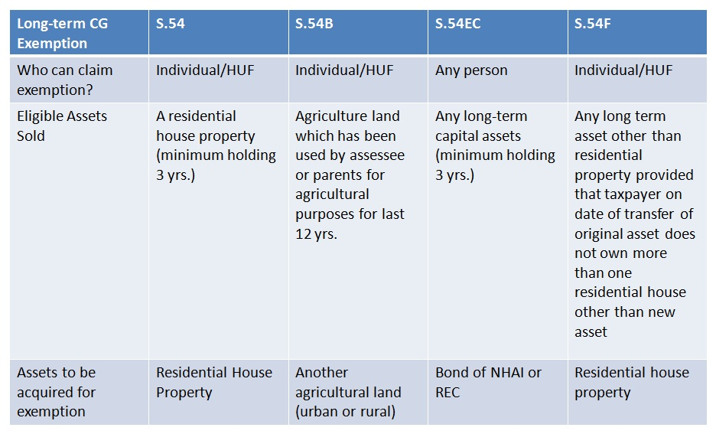
Capital Gains Exemption
LAND OR BUILDING
5 years

Slide 28
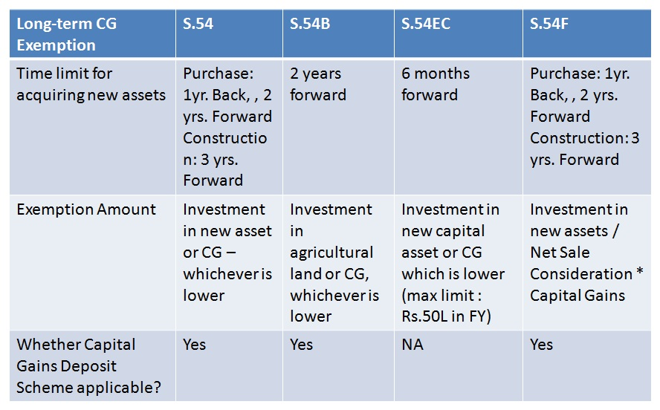
Capital Gains Exemption

Slide 29
Whether exemption u/s. 54/ 54F would be available if the construction could not be completed within 3 years?
Construction not at all started, only land purchased?
No exemption
Construction not done because of the fault of the builder/ developer?
Allowable- Rajeev B. Shah 71 taxmann.com 198 (Mum.)(SMC)
Construction started but completed after 3 years from date of transfer?
Smt. Usha Vaid 25 taxmann.com 188 (Asr.)
“Investment” of consideration/gains is important

Slide 30
Whether a small construction be claimed as being eligible for exemption?
Pawan Kumar Garg v. CIT [2009] 311 ITR 397/[2007] 164 Taxman 382 (Punj. & Har.)
The assessee had built two small rooms – which was held to be not a dwelling unit. The burden was on the assessee to prove the investment of LTCG within the stipulated time. The assessee was, accordingly, held not entitled to exemption under section 54F.
Rajesh Surana v. CIT [2008] 306 ITR 368 (Raj.),
The assessee’s claim for exemption was also rejected where a plot having a boundary wall with a garage-cum-room was claimed as a residential house.
Poonen v. Rathi Varghese AIR 1967 Ker.
Incidentally, the Kerala High Court has held that the place of residence could be understood as a place where a person intended to stay permanently other than casual stay.

Slide 31
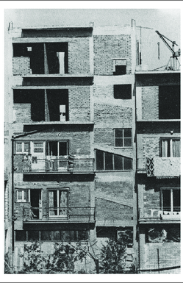
Assessee purchased a dipledated house. Did more construction.
Can exemption be claimed as he had
“purchased” and/or
“constructed” new house?

Slide 32
B. B. Sarkar v. CIT [1981] 132 ITR 150 (Cal.)
If an assessee is entitled to relief on fulfilment of either of the two conditions, i.e., either purchasing a house property within two years or constructing the house within three years, it would be improper to read that on fulfilment of both the conditions, he would be disentitled to that relief. Section 54 does not contemplate two kinds of relief; it only contemplates fulfilment of two alternative conditions. If both the conditions are satisfied within the time stipulated, the assessee does not become disentitled to the relief if the other conditions are fulfilled. If a floor is added to the new house, or if it is renovated, it remains as one house only. The Assessing Officer is, therefore, not justified in restricting exemption to investment on purchase only holding that the exemption under section 54 is admissible either for purchase or for reconstruction, but not for both

Slide 33
Extension of house
Extension is Independent dwelling unit
  assessee did construction of one of the floors which was independent. It was held that exemption is available. Ashok Kumar, HUF v. Asstt. CIT [1998] 65 ITD 352 (Delhi)
It is pertinent to note that mere construction by way of extension of the old existing house would not mean construction of a residential house as contemplated under section 54F.
  CIT v. V. Pradeep Kumar [2007] 290 ITR 90/[2006](Mad.).
  Mrs. Meera Jacob v. ITO [2009] 313 ITR 411 (Ker.).

Slide 34
Demolish and construction of new house
Similarly assessee purchased old house, demolished it and constructed a new house. It was held that the exemption is available. See : M. Vijaya Kumar v. ITO [2010] 122 ITD 15 (Bang.).

Slide 35
Sale of Multiple houses
New Residential House
Property 2
Property 3
Property 1
Ranjit Vithal Dass 137 ITD 267

Slide 36
Capital Gains of multiple years
Assessment Year | Capital Gains
2017-18 | *5,00,000
2018-19 | 6,00,000
Total | 11,00,000
*Invested in capital gain account scheme
Investment of 12,00,000 in new house on 30.06.2018
Whether capital gain of multiple years can be claimed against the same property?
Yes. See Smt Anagha Ajit Patnekar 9 SOT 685

Slide 37
Whether construction of the new residential house can begin prior to the date of transfer?
Whether same can be completed prior to date of transfer.

Slide 38
CIT v. J. R. Subramanya Bhat [1987] 165 ITR 571/[Kar]
Smt. Nimmagadda Sridevi 33 taxmann.com 306 (hyd.)
Construction can started prior to the date of transfer, but it shall be completed within 3 years of the date of transfer.
However, construction shall not be completed before the date of transfer. In it was held that assessee is not entitled to deduction under section 54F as construction was done before the date of transfer. Also, JT. CIT v. Raj Kumar Aggarwala & Sons [2005] 95 TTJ (Delhi) 315.

Slide 39
Whether exemption is available even if the new house does not comply with the Municipal Corporation norms/ no permission is obtained?

Slide 40
The requirement that the house shall be constructed with permission of municipal laws, cannot be read in section 54/ 54F.
B. Sivasubramaniam 45 taxmann.com 74 (Chennai)
it was clearly held that provisions of section 54F mandate construction of a residential house, within period specified, however, there is no condition that building plan of residential house should be approved by Municipal Corporation or any other competent authority.

Slide 41
Residential unit vs. house
Adjacent houses
Different floor - duplex

Slide 42
Whether investment in new house can be done out of loan funds?
J.V. Krishna Rao 24 taxmann.com 104 (Hyd.)
Merely because capital gains earned had been utilized for other purposes and borrowed funds were deposited in capital gains investment account, benefit of section 54F exemption cannot be denied.
See also
Pushpa vs ITO 31 taxmann.com 33 (Ker.)
ITO vs K.C. Gopalan (1999) 107 Taxman 591 (Ker.)

Slide 43
Whether exemption u/s. 54/ 54F can be claimed in respect of investment in the name of wife/ family member?
“the word “purchase” is not synonymous with the word “own” and to claim exemption u/s. 54 one need not become a complete owner of the newly acquired property.
Mrs. Shahzada Begum 5 ITD 292 (Trib. Hyd.)
Sri Rajaram vs ITO 19 ITD 141 (Hyd.)

Slide 44
Sr. No. | Section No. |  | Citation | Gist
1. | 54F | CIT vs Kamal Wahal 30 taxmann.com 34 (Del.) |  |  | ONLY IN NAME OF RELATIVE
2. | 54 | CIT vs. V. Natarajan 154 Taxman 399 (Mad.)
3. | 54F | N. Ram Kumar 25 taxmann.com 337 (Hyd.)
4. | 54B | Shri Ghanshyam Mali (ITA No. 547/ IND/ 2013)
5. | 54B | Kailash Narayan Chaturvedi (ITA No. 14/ IND/ 2015)
1. | 54B | CIT vs Gurnam Singh (2010) 372 ITR 278 ( P & H) |  |  | JOINTLY IN NAME OF ASSESSEE AND RELATIVE
2. | 54F | Ravinder Kumar Arora (2012) 21 taxmann.com 305 (Del.)
3. | 54, 54EC | DIT vs Mrs. Jennifer Bhide 15 taxmann.com 82 (Kar.)

Slide 45
Against the assessee
Kalya vs CIT 22 taxmann.com 67 (Raj.)
Investment in name of son and daughter-in-law. It was held that section 54B would require a literal interpretation of words “assessee”.
Jai Narain 306 ITR 335 (P & H)
Investment in name of son. It was held that section 54B would require a literal interpretation of words “assessee”.

Slide 46
Whether section 54EC benefit be claimed in respect of transfer of building/ plant etc. which are depreciable assets?

Slide 47
Depreciable Assets
No, Indexation available
Always be short term Capital Gain
Block Concept will be applicable
Gain on Sale of Depreciable assets held for more than 3 Years Taxed @ applicable to LTCG. (Manali Investment) (Ace Bulder)

Slide 48
Exemption on Depreciable Assets
Assessee sold Building for 50 Lakhs
Depreciation was claimed on such Building
Sale consideration on Sale of Land invested in REC Bonds.
Exemption u/s 54EC?
Assam Petroleum (262 ITR 587)(Gau)
Ace Builders (281 ITR 210)(Bom)

Slide 49
Section 50 creates a fiction as under:
Notwithstanding anything contained in clause (42A) of section 2, ……………………..the provisions of section 48 and 49 shall be subject to the following modifications………………..such excess shall be deemed to be the capital gains arising from the transfer of short-term capital assets”
The fiction created u/s. 50 is only in respect of section 48 and 49 and cannot extend to the purposes of making reinvestment u/s. 54EC.
The legal fiction created by the statute is to deem the capital gain as short-term capital gain and not to deem the asset as short-term capital asset. Therefore, it cannot be said that section 50 converts long-term capital asset into a short-term capital asset.”

Slide 50
Whether assessee could invest in construction of new house within due date u/s. 139(4)?

Slide 51
The issue is no more res-integra in the light of various judgments on the issue. U/s. 54-54F it is stated as under:
“The amount of the capital gain which is not appropriated by the assessee ………….. before the date of furnishing the return of income under section 139, shall be deposited………………”
Jurisprudence
Rajesh Kumar Jalan 286 ITR 274 (Gau)
(a) Nipun Mehrotra 297 ITR (Trib.) 110 (Bang.)
(b) Fatima Bai 32 DTR 243 (Kar.)
(c) P. Thirumoorthy 135 TTJ (Chennai)(UO) 75
(d) CIT vs Jagriti Agrawal 339 ITR 610 (P & H)

Slide 52
If the assessee files return and claims full value of consideration as the actual consideration, whether u/s. 143(1), department can made adjustment to adopt stamp value?

Slide 53
Powers u/s. 143(1) are limited to prima-facie mistake apparent on record. If the assessee has offered the actual consideration:
Grievance redressal mechanism.
It is not a prima-facie mistake.
A rectification or appeal against order u/s. 143(1) may be a proper solution.

Slide 54
If the assessee files return and claims full value of consideration as the actual consideration, will it be relevant for the Assessing Officer during assessment to make reference to the valuation officer?

Slide 55
Sunil Kumar Agarwal 372 ITR 83 (Cal.),
reference to the Valuation Officer shall be made u/s. 50C(2), even if the assessee did not pray for making reference to Valuation Officer.

Slide 56
Whether section 50C applies when the “building” which is under construction is transferred?

Slide 57
Section 50C applies on transfer of “land or building or both”.
A building under construction cannot be regarded as a “building”; as held in respect of Wealth-tax cases. [CWT vs Smt. Neena Jain 230 CTR 554 (P & H); also Apollo Tyres Ltd. 231 CTR 498 (Ker.)]
Thus, one of the arguments could be section 50C would not apply when the transfer takes place at the level the building is under construction.

Slide 58
Section 50C vs 54F ?

Slide 59
As per section 50C, the full value of consideration, “for the purposes of section 48”, shall be deemed to by the stamp value. The fiction is limited to section 48. U/s. 54F, the assessee investment is to be made of net consideration, which is the “full value of consideration” received or accruing as a result of transfer of the capital asset as reduced by any expenditure incurred wholly and exclusively in connection with such transfer.

Slide 60
A direct judgment in the favour of assessee was given in the case of Gyan Chand Batra 133 TTJ 482 (Jp.); Mohammed Shoib 29 DTR 306: 127 TTJ 459(Luck); DCIT vs Dr. Chalasani Mallikarjuna Rao 75 taxmann.com 270 (Vishak.); Raj Babbar 29 taxmann.com 11 (Mum.) applying the above analogy.
Dhanveer Singh Gambhir (ITAT Indore)

Slide 61
Section 54 (Amendment from AY 20-21)
Provided that where the amount of the capital gain does not exceed two crore rupees, the assessee may, at his option, purchase or construct two residential houses in India, and where such option has been exercised,—
(a) the provisions of this sub-section shall have effect as if for the words "one residential house in India", the words "two residential houses in India" had been substituted;
(b) any reference in this sub-section and sub-section (2) to "new asset" shall be construed as a reference to the two residential houses in India:
Provided further that where during any assessment year, the assessee has exercised the option referred to in the first proviso, he shall not be subsequently entitled to exercise the option for the same or any other assessment year.

Slide 62
54EC
From AY 2018-19
Investment time limit increased from 3 to 5 years
NHAI or REC bonds

Slide 63

If & Buts

Slide 64
Thank you
CA. Pankaj Shah
pankajgshah@gmail.com,
9691893040

