Slide 1
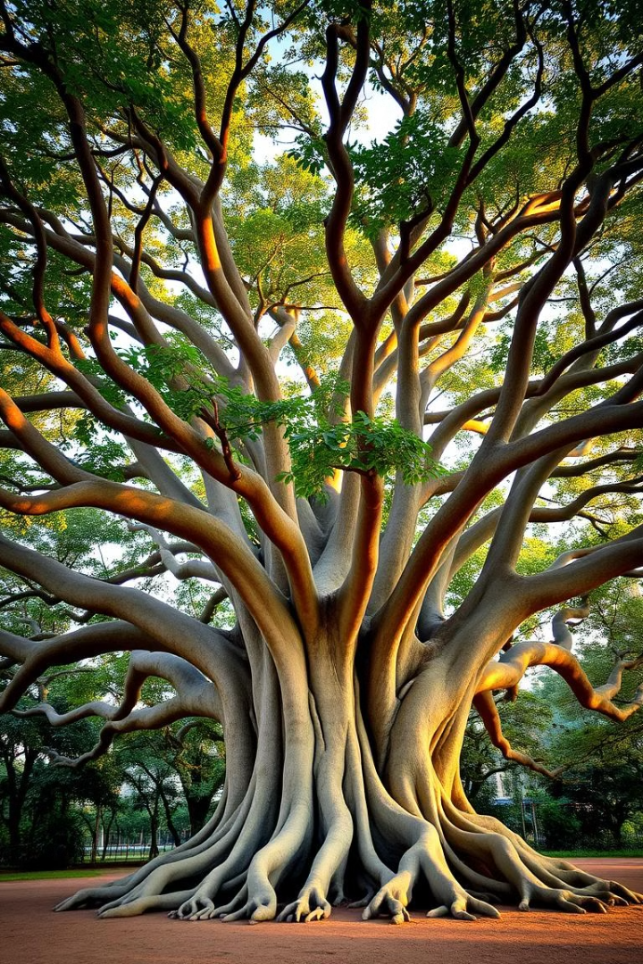
Estate and Succession Planning
- Intestate, Wills and Private Trusts
CA. Pankaj Shah
Chartered Accountant

Slide 2
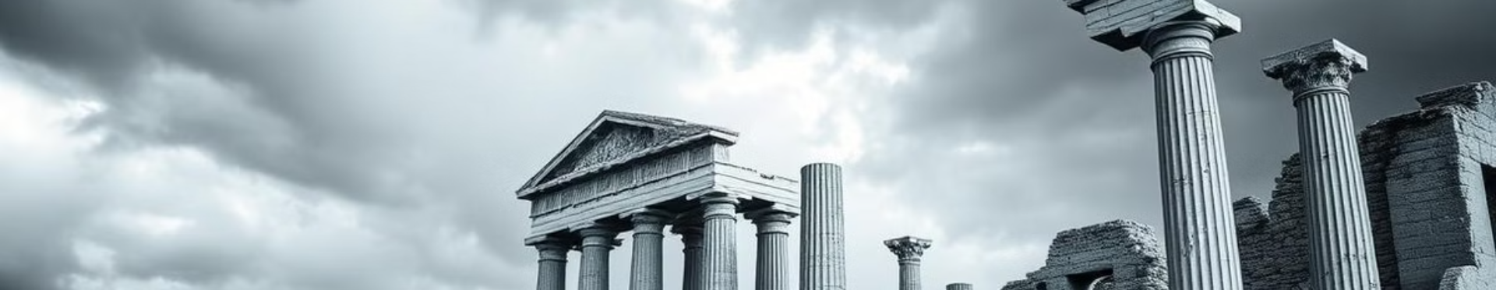
Lessons from History
Mahabharat: Mightiest empire fell due to unclear succession
Bhushan Group: 10 years dispute wiped USD$1billion market value.
Reliance: Timely planning and intervention by mother
Dabur Group: Succession planning resulted in growth

Slide 3
Litigation et al
34%
property-related
10%
family matters
Others
66%
76% of civil disputes are family and property disputes
41503 out of 46000 mediaition cases are family disputes
More than Rs.2 Lakh crores unclaimed in Banks, LIC, PF

Slide 4
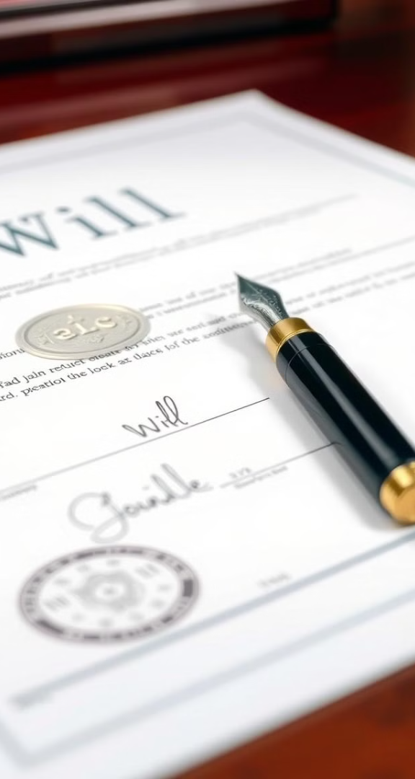
Modes of Succession
Nomination: Registering nominee
Intestate: Without making a will
Will: A legal document specifying intention.
Gift: Transferring during lifetime.
Trust: A legal arrangement for beneficiaries.

Slide 5
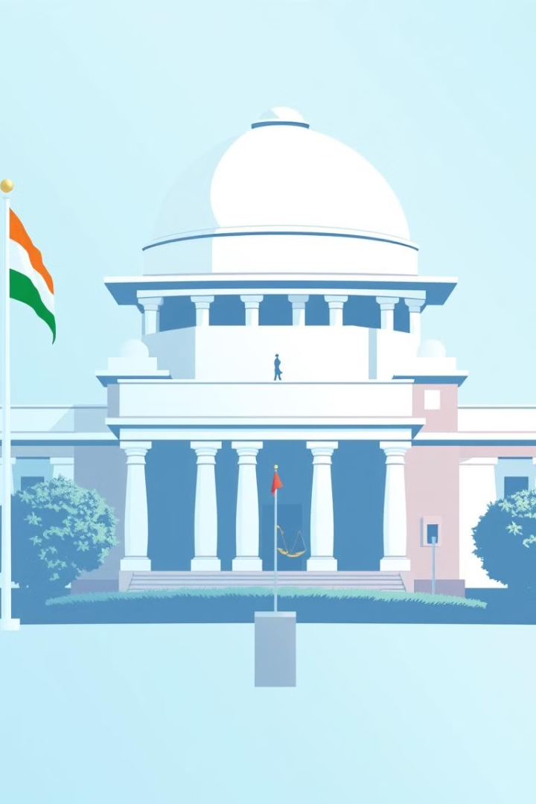
Succession Law
No Uniform law but a Code
Personal laws i.e. Hindu Succession Act. Muslim Personal Law. Indian Succession Act.
Jurisprudence made law

Slide 6

Intestate
Succession

Slide 7
Succession Laws
Person dies
No Will
Hindu, Jain Sikh
Hindu Succession Act
Muslim
Shariat Law
Christian, Parsi, Jew
Indian Sucession Act
Testamentary Will
Hindus, Christian, Parsi, Jew, Sikh, Jain
Indian Succession Act
Muslim
Shariat Law

Slide 8
Hindu male (S.8-13) – self acquired
Class I heir
Class II heir
Agnate
Cognate
Government

Slide 9
Class I heir (in individual capacity in equal ratio)
Deceased
Son
Daughter
Mother
Widow

Slide 10


माँ
पत्नी
बेटा
बेटी
पोता
पोती
पडपोता
पडपोती
पोती की बेटी
नवासा
नवासी
नवासे की बेटी
नवासी का बेटा
नवासी
की बेटी

Slide 11
Class II heirs
Father
Siblings
Grandparents
Parent’s siblings

Slide 12
Indian Succession Act (Intestate Rules)
Surviving heirs | Share of spouse | Share of children/parents
Spouse + Children | 1/3rd | 2/3rd equally among children
Spouse + no children | ½ | ½ to parents
Spouse along | Entire Estate | -
Children only |  | Entire Estate Equally divided
Same Rules for Men and Women

Slide 13
Case Studies

Slide 14
Situation 1- Intestate male
माँ
पिता
पत्नी
बेटा
बेटी
बहु

Slide 15
Situation 2 - Intestate male
पत्नी
विधवा बहु
बहन
भाई
स्वर्गवासी बेटी का बेटा (नवासा)

Slide 16
Situation 3 - Intestate male
भाई
बहन
बहन
भाई
नाना

Slide 17
Situation 4 - Intestate male
चाचा की बेटी
मामा का बेटा

Slide 18

Distribution mechanism

Slide 19
Distribution types
Per stirpe
  "by branch" or "by lineage".
    It is used to distribute property where the share of a deceased heir does not lapse but goes to his/her descendants (a branch), who take collectively what the deceased would have taken if alive.
Per capita
  Every eligible Class I heir gets an equal share.
    Even the children or widow of a predeceased son or daughter are treated as independent heirs, NOT as representatives of the deceased son's branch.

Slide 20
Applicability of Rules of distribution
Context | Rules
Coparcenary Property Partition | Per Stirpee
HUF Partition | Per Stirpee
Self-Acquired Property | Per capita
Intestate Succession under Section 8 HSA | Per capita

Slide 21
Special cases
Step Child, Adopted and Illegitimate

Slide 22
Is a step son Class I heir?
Income tax Act
Child includes Step and adopted
Hindu Succession Act
Natural born son
Adopted son
Step son through first marriage of wife cannot suceed as legal heir to estate of male

Slide 23
Adopted Children
S. 3(9) of Indian Succession Act
  "Child includes a legitimate child and also an adopted child."
S. 12 of the Hindu Adoption and Maintenance Act, 1956
  "An adopted child shall be deemed to be the child of his or her adoptive father and mother for all purposes with effect from the date of the adoption.“
Adoption not recognised
  Islamic law (Kafala), Christian and Parsi law,

Slide 24
Illegitimate Children
Aspect | Hindu Succession Act | Indian Succession act
Can illegitimate child inherit from father? | ❌ No | ❌ No
Can illegitimate child inherit from mother? | ✅ Yes | ❌ No
Are they recognized as legal heirs? | ✅ Yes (Mother’s line) | ❌ No
Section 3(9) of ISA defines "child" as:
"Child" includes a legitimate child and also an adopted child, but not an illegitimate child.
Section 3(1)(j) of HAS Explanation:
"The expressions 'related' or 'relatives' shall be construed to include illegitimate children in relation to their mother and to one another."

Slide 25
Jurisprudence
Bharatha Matha v. R. Vijaya Renganathan [(2010) 11 SCC 483]
  Even if a child is born from a marriage that is void (e.g., second wife while the first wife is alive), the child is legitimate with respect to the parents, meaning they can inherit self-acquired property of both mother and father.
Revanasiddappa & Anr. v. Mallikarjun & Ors. [(2011) 11 SCC 1]
  "The child born of such a relationship is innocent and is entitled to all the rights which are given to children born out of valid marriages."
  However, the inheritance is limited to the self-acquired property of the father, not ancestral coparcenary property.
Valliammal v. Subramaniam [(2004) 8 SCC 726]
  A child born out of a void marriage is entitled to inherit only the parents' property, not property through joint family or coparcenary property.

Slide 26
Status of Live in Relations
Live in
"an arrangement of living under which the couples which are unmarried live together to conduct a long-going relationship similarly as in marriage“
Radhika v. State of M.P. (SC)
a man and woman are involved in live in relationship for a long period, they will treat as a married couple and their child would be called legitimate.
125 Criminal Procedure Code
A woman living in relationship may also claim maintenance

Slide 27
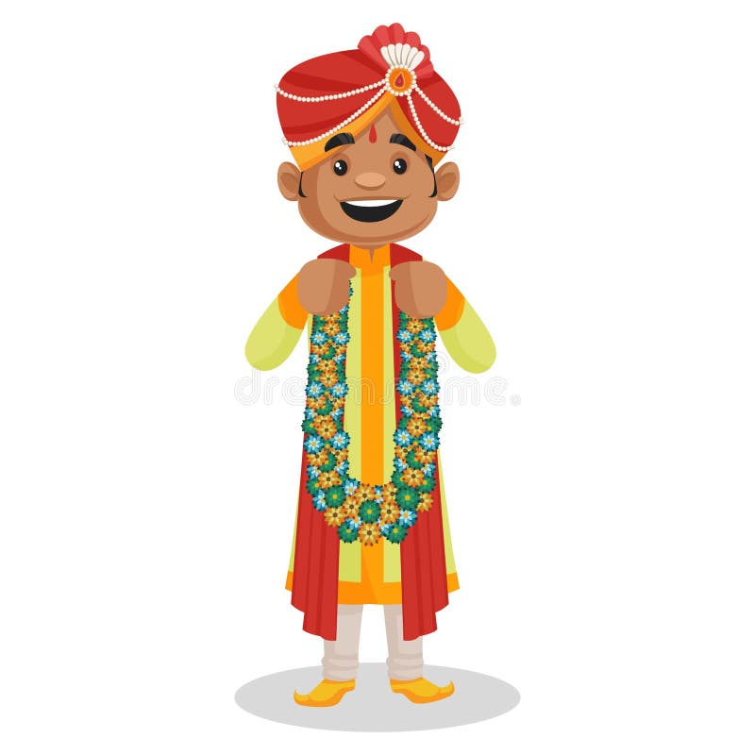

Inter religion marriage
If bride and groom following different religion marry under the Special Marriage Act then Indian Succession Act, 1925 (ISA) applies for both husband and wife and their children (Section 33 and 34 of ISA)

Slide 28
Section 33 and 34 of ISA
Wife and Children
  The property will be divided between the wife and children equally.
Wife only (no children, no parents)
  The wife inherits all the property.
Wife and no children but parents alive
  The wife gets half (50%) of the property.
  The parents get the remaining half (50%).

Slide 29

Islamic Succession Rules
Only 1/3rd passes through Will and remaining as per Shariat law
Sect specific Rules
  Sunni
  Shia
  Khoja
    Aga Khan, Zulfikar Ali Bhutto, M.A. Jinnah
    Muslim Personal Law (Shariat) Application Act, 1937

Slide 30

Female Intestate

Slide 31

Female Intestate Hindu
Son, daughter, husband
Heirs of husband
Her Parents
Heirs of father
Heirs of mother

Slide 32
Female Intestate
Absolute property
Inheritance
Partition
In lieu of maintenance
By gift
Own skill
Purchase
Free to dispose such property
Can will away to whoever she likes

Slide 33
Life interest Sadhu Singh v. Gurudwara Sahib Narike (SC)
Husband gave life interest right to wife in a house property
After wife it was stated to devolve to his nephews
It was not absolute property of wife and she was not allowed to donate it to Gurudwara
Restricted right of enjoyment so she could not gift it as the property was not absolute property

Slide 34
Exceptions to free disposal
Property inherited from parents
Dies without children
Property will revert to father’s heirs
Property inherited from husband side
Dies without children
Property reverts to husband’s heirs

Slide 35
Situation 1 - Intestate female
Son
Husband
Mother and Father
daughter

Slide 36
Situation 2 - Intestate female
Ex Husband (Divorsed)
Mother and Father

Slide 37
Situation 3 - Intestate female
ननद का बेटा (भतीजा)
देवर

Slide 38
Situation 5 - Ramesh and Jessica married under SMA. After intestate demise of Ramesh
Jessica
Mother of Ramesh
Ramesh’s son
Ramesh’s sister

Slide 39
Escheat
Property dwelves to the Government
In absence of legal heirs

Slide 40
Case studies
Sunitaji a widow having no children
lived with her sisters children who took her care.
On her death
  her brother in law claimed her earned property
  Her sisters children whom she intended to give didn’t get anything in absence of will

Slide 41
Case studies
Mahesh and his wife Sunita died in an accident
They had purchased flat after their marriage
  where father of Mrs. Sunita stayed with them
After their death
  Mahesh’s brother claimed the property and
  made father of Sunita vacate and became homeless

Slide 42
Case study
Mrs. Anita separated from her husband
  in 7 days of marriage
  without divorce
After her death
  her husband’s relatives claimed her property

Slide 43
Letter of Administration
Intestate death
Legal heirs to apply to court for LOA
Death certificate
List of legal heirs as per HAS
Value of estate
Application statement through lawyer
Public notice calling claims/objections

Slide 44
Problems in Intestate
Litigations amongst successors
Difficulty in transmission due to lack of consensus
Cross ownerships of assets/business
Joint ownership only stop gap arrangement
Therefore Will

Slide 45
How to find about deceased assets

Slide 46
Deceased Salaried employee
Every year declaration of investment is submitted to employer for TDS purposes
Contact employer for
  Tax saving Investments
  Insurance policies claimed
  Group Insurance benefits by employer

Slide 47
Investments in post office
Investments in post office can be searched in FINNACLE Software
  PAN,
  Aadhar
  Other Identification details

Slide 48
Financial instruments
Mutual fund investment registrar
  Karvy
  CAMS
Bank Account Statement
  Review of transactions for three years
  Shows investments made
  Premium paid for various policies
Computation and Income tax return
  Policies and investments
  Investment in immovable assets

Slide 49
Investment in Shares and Securities
NSDL Consolidated Account statement
Update your
  PAN details
  Email details
  Nominee details
  Aadhar no.

Slide 50
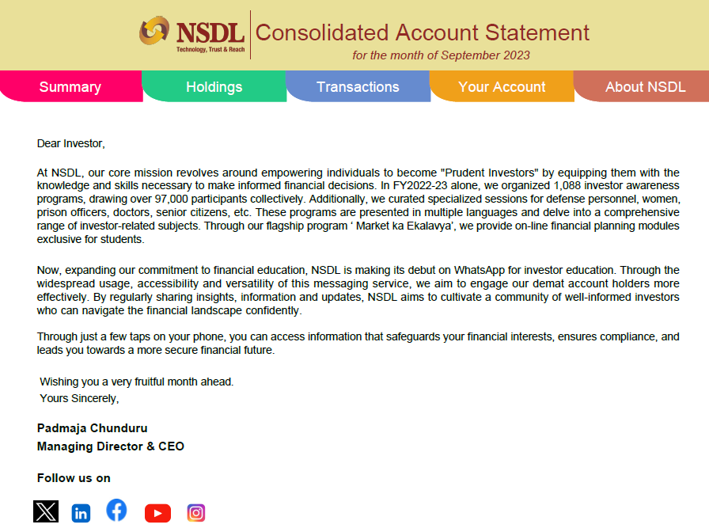

Slide 51
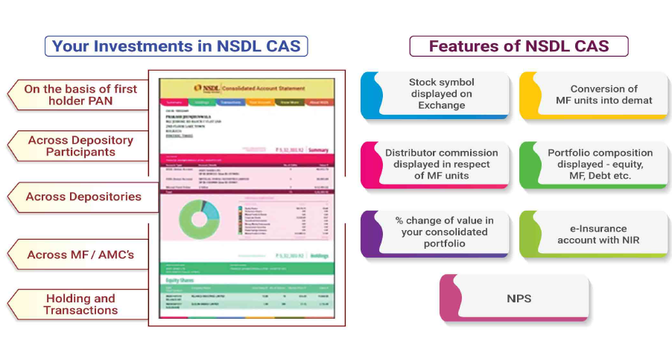

Slide 52
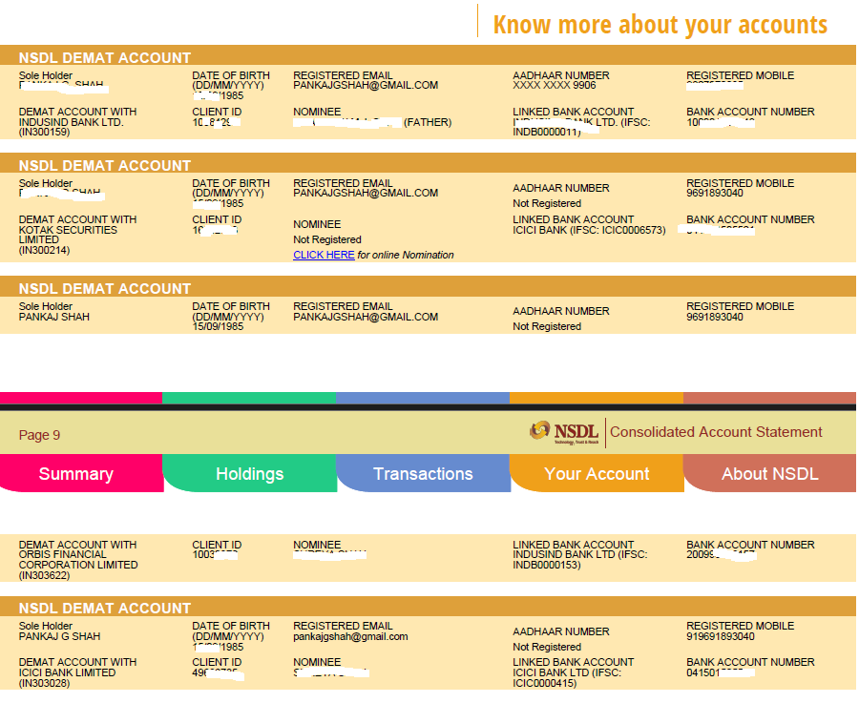

Slide 53
Immovable properties
Municipal corporation website
Property tax receipts
For agricultural land
Land records updated online
Area and owner details are available
Friends, CA and consultants

Slide 54
Testamentary Wills

Slide 55
Terms
Administrator
A person appointed by a competent authority to administer the estate when no executor is appointed or an executor appointed refuses to act as an executor.
Probate
A copy of a Will certified under the seal of a Court of competent jurisdiction with a grant of administration to the estate.
Codicil
A document which modifies or alters the provisions of the original Will and forms part of it.
Letter of Administration
A letter of the court appointing an administrator to the estate.
Succession Certificate
Issued by Civil Court of jurisdiction in respect of property of a person who has died intestate, i.e. and where letter of administration or probate is not compulsory.

Slide 56
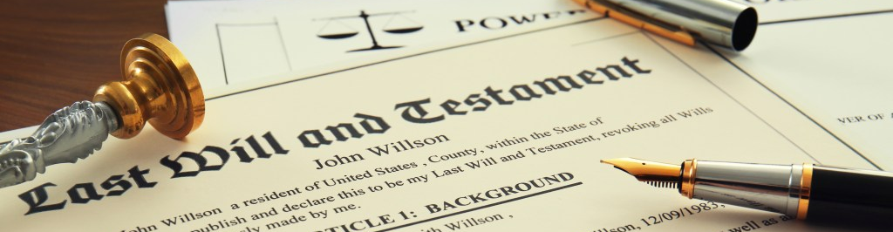
Testamentary
Will
Statute
  Indian Succession Act, 1925
Legal declaration of testator’s intention
  As regards is property
Manifests only after the testator’s death
  Will not valid if testator alive
  Speaks from the grave
Can be revoked as many times as possible

Slide 57
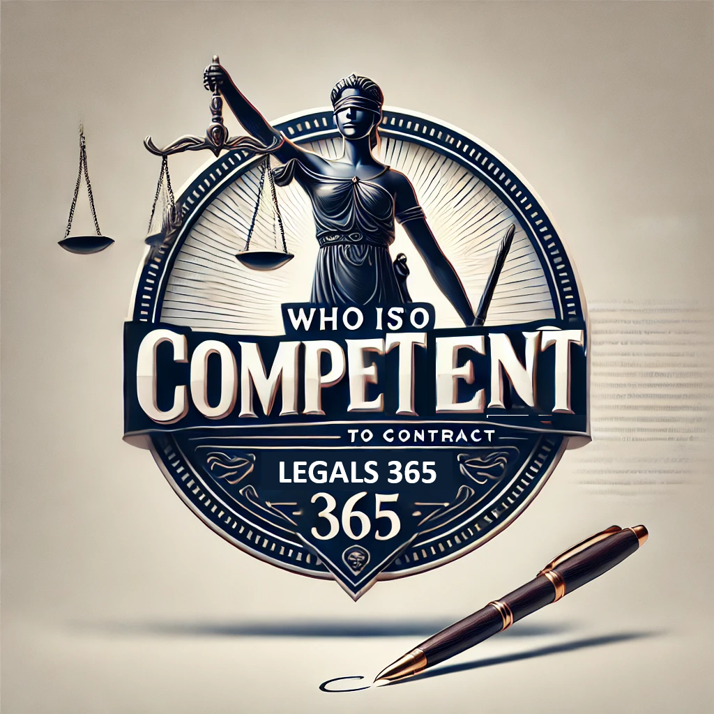
Capacity
Major person
Sound mind
  Intoxicated person
  not in his senses cannot
Deaf, Dumb, Blind
  Yes they can
  If they knew the contents
Ordinarily insane
  During intervals of sanity

Slide 58

Why to make a
Will
Complete discretion on distribution after death
Reduces Succession disputes
Rewarding who cared
Make as early as possible
Can be revised numerous times

Slide 59
How to make
Write or type?
Designate legatee/beneficiaries
Make it detailed
Oral will – Soldiers/ Muslims

Slide 60
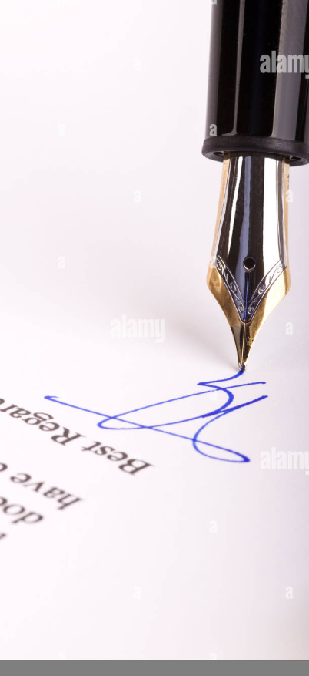
Essentials
Date
Very important as only last will prevails
Signature/ thumb mark
Witness
Atleast two witnesses
Appoint executor
Younger than testator
Else court to be approached for appointing executor
physical

Slide 61
Generic
I leave all my money to my wife | Valid
I leave money to my wife | Void

Slide 62
Beneficiary
Any one?
Relative/ Friend/ Employee/ Servant
CA/ Lawyer
Stranger
Pets/Animals
Mumbai couple created trust and donated 5 crores for their two golden dogs
In US Karl Lagerfield’s cat is a beneficiary of Rs.2700 crore.

Slide 63

Digital assets
Email credentials
Bank account credentials
Bitcoins

Slide 64

Executor
Beneficiary
Common to have spouse as executor
CA/ Consultant
Person (partner of a firm)
Provision of fee in the will
Primary and secondary
Capable to be testator
Willing to become

Slide 65
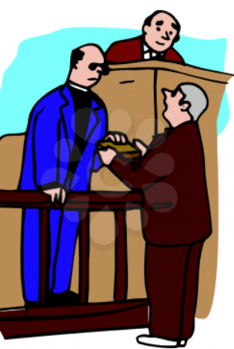
Witness
Witness or his spouse cannot be beneficiary
  Bequeath shall become void
    Section 67 of ISA
Essentials
  Must see testator affixing the will
  Need not know contents of will
  Video witnessing not allowed
  Affidavit advisable

Slide 66
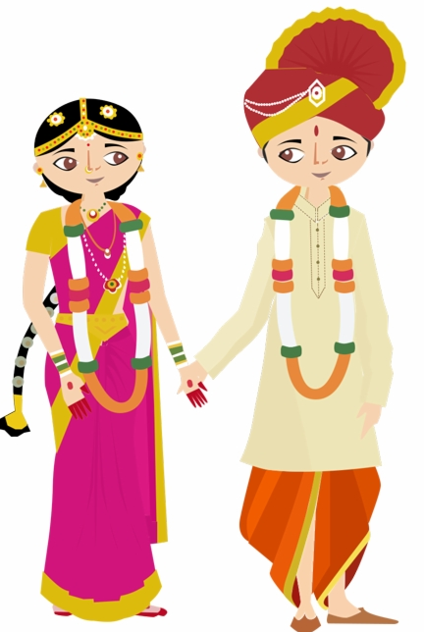
Revocation by Marriage
As per Section 69 : Revocation of Will by testator’s marriage
Except Hindus/ Jains/ Buddhists and Sikhs and Muslims

Slide 67
Registration of Will
Testator may register will with Sub-Registrar
Not compulsory but advisable
becomes public document for inspection
Raises strong presumption of genuineness of will
Registered will can be superceded by subsequent unregistered will
Notarisation can also be considered

Slide 68
Income tax – Registered will
Copy of Legal Heir Proof from the below list:
Legal Heir Certificate issued by Court of Law /Local Revenue Authority.
Surviving family member certificate issued by the Local Revenue Authority.
Family Pension certificate issued by Central/State Government.
Registered will.
Letter issued by the banking or Financial Institution in their letter head, with official seal and signature mentioning the particulars of nominee or joint account holder to the account of the deceased at the time demise.

Slide 69
Undue Influence
Mahesh Kumar (2012) 4 SCC 387
a case where a testator bequeathed all his wealth to one son in preference to the others
since he was living with that son and the attitude of the other sons was extremely hostile towards their parents.
The Court held that the fact that one son took care of the parents in their old age showed that there was nothing unnatural or unusual in the decision of the testator to give his property only to him.
Any person of ordinary prudence would have adopted the same course and would not have given anything to the ungrateful children from his / her share in the property.
Thus, the Court held that there was nothing invalid in the Will.

Slide 70
Joint wills
Husband and Wife both make a common will
Reciprocal promises
Cannot be changed unilaterally
Instrument to bind others to avoid
Remarriage
Arbitrary disposal
Otherwise not advisable as bottleneck

Slide 71
Beneficiary predeceasing testator
Doctine of Lapse
If legatee was lineal descendant of testator
Anti Lapse Rule
estate will devolve on the legal heirs of legatee.
Bequest will fail
Distributed to residuary legatee of testator

Slide 72
What can be willed
Can be willed
Self-acquired properties
Acquired by inherit­ance or gift, etc. and held exclusively
share in the properties of HUF under Will by member.
Cannot be willed
Tenancy rights not being transferable should not be made a subject matter of Will.
A Mohammedan under Will can bequeath only 1/3rd of his property,
the remaining 2/3rds part shall devolve on legal heirs as per the Mohammedan Law.
Notwithstanding this rule, a Mohammedan may bequeath his entire property under a Will provided his legal heirs otherwise entitled to his estate consent to such a disposition after his death — their consent before death is not valid.

Slide 73
Partnership
Succession of status of partner?
Subject to contract

Slide 74
Common clauses
a) | Name, age, address, religion | b) | Revocation of earlier Will
c) | List of relatives | d) | Appointment of executor
e) | Discharge of obligations | f) | Legacies and bequests to persons
g) | Residual estate | h) | Testimonium
i) | Execution | j) | Witness
k) | Safe custody

Slide 75
Codicil
A Will can be changed by the testator during his life time either
by making a new Will after revoking an old Will or
by amending the old Will by separate instrument made with the intention to make such an instrument a part of it.
This new instrument is known as Codicil. S. 2(d) defines it as an instrument made in relation to a Will and explaining, altering or adding to its dispositions which shall be deemed to form part of the Will

Slide 76
Stamp Duty
No stamp duty is payable on execution of a Will.
A Will can be made on a plain paper.

Slide 77
Probate
A probate is the grant of administration of the estate
A probate provides the conclusive evidence
of the execution of a Will
of the legacies and
of the legal character of legatees by confirming validity of Will.
It can be granted only to an executor.
by the court of competent jurisdiction based on Will.

Slide 78
Probate
Probate not compulsory in cases of a Hindu and a Mohammedan unless
  The estate consists of an immovable property situated in the cities of Mumbai and Chennai and Kolkata.
  Will is executed in the cities of Mumbai and/or Chennai and/or Kolkata and deals with an immovable property wherever located.
  A maximum court fee of Rs. 75,000 is payable in the State of Maharashtra for obtaining a probate.
No time limit is prescribed for filing an application for probate.
  However, delay is required to be explained where filed beyond a period of three years of death.

Slide 79
Succession Documents
Testate (Will)
Probate
Succession Certificate
Only for debt and securities
Intestate
Letter of Administration
Legal heir Certificate
Tehsildar
Creates no title (only management rights)

Slide 80
Fake reports / Myths
No. | Myth | Reality
1. | Will must be on Stamp paper | Can be handwritten on plain paper
2. | Legal format to be followed | No format
3. | Will cannot be changed once made | Can be changed end number of times
4. | Effective in person’s lifetime | Effective only after death of testator
5. | Cannot exclude close relatives Eg. Son, wife, etc. | Can bequeath anything to Charity/ servant/ friends

Slide 81
Fake reports / Myths
No. | Myth | Reality
6. | Will need not be dated | Last will prevails. Dating must
7. | Nomination prevails over will | Will prevails in all cases
8. | Married woman cannot make will | All women can make will
9. | No need of witness | Two witness are must
10. | Marriage revokes will | True. However not in case of Hindus

Slide 82
Ancestral Property
Property inherited from 3 generations above of male lineage
Father, grandfather, great grandfather
Deemed to be HUF property
Automatic right in ancestral property
Myth
Ancestral property cannot be alienated
Reality
Ancestral property can be lineated
Yudhister v. Ashok Kumar (SC)
Uttam v. Saubhag Singh (SC)
Surender Kumar (Del)
Arshnoor Singh (SC)

Slide 83
Ram Rakhpal 67 ITR164 SC
A son who inherits property from his father will be treated as his separate individual property and
it will not become the joint family property of son

Slide 84
Remarriage or conversion
Widow inheriting property of her husband cannot be divested on her subsequent marriage
Cherotte Sugthan v. Cherotte Bharati AIR 2008 1467
Hindu Female converting herself to Christianity after death of her husband does not disentitle her from inheriting her deceased husband’s property
K. Sivanandan vs. Maragathammal AIR 2013 Mad 30

Slide 85
Gifts
Immediate transfer or ownership on acceptance
Reduction of disputes
Stamp duty and tax implications
  Taxable if from non relative
  Clubbing of income from gifted asset
Conditional vs. Irrevocable
Share in HUF, tenancy rights, etc cannot be gifted
Maintenance and Welfare of Parents and Senior Citizens Act 2007 Section 23
  Implied, no need of express condition of revocation
  Subhashini v. District Collector (2018)(Mad)
  Darshan Singh v. Rampal Singh (2012)(P&H)

Slide 86
Joint holder and nomination

Slide 87
Joint Holder
Any asset movable or immovable can be joint
Joint is not beneficial owner
Either or survivor
Former or Survivor
Stop gap arrangement as becomes owner after death in both cases
Will shall prevail over joint holder

Slide 88
Nomination
Stop gap arrangement
  Nomination Must to ensure smooth transition
  Advisable to make the legatee in Will and nominee same person
Will vs. Nomination
  Will or intestate succession rules prevail always
  Noiminee only
    Custodian
  Nomination ends on execution of will
  Nomination by guardian to end after majority
  Section 72 of Companies Act 2013
    Shares vest in nominee
    Shakti Yezdani v. Jayanand Salgaonkar (Bom HC)

Slide 89
Joint ownership
Either or Survivor
Former or Survivor
A or B
B
A
B
Appointment by all joint owners
Nomination
Nomination only active if all joint holders expire
Ultimately both should sync with the Will

Slide 90
Hierarchy
Joint holder
Nominee
Will

Slide 91
Taxation aspects

Slide 92


Slide 93
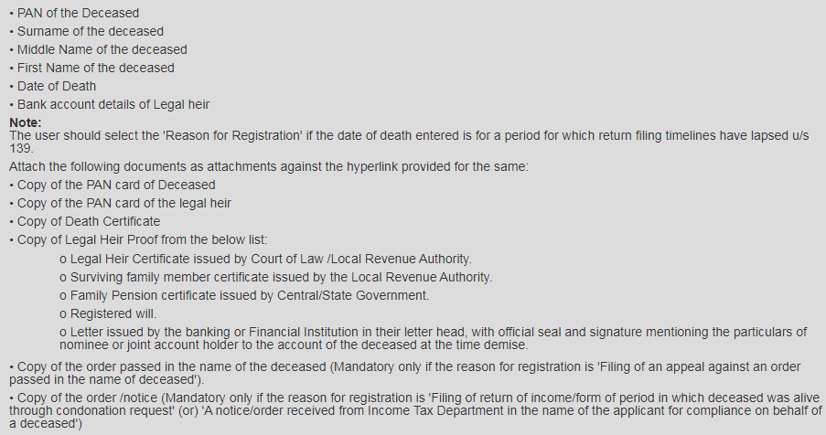

Slide 94
Taxability structure
For Period
Before death
Till date of death
After death
Before distribution
Executor
After distribution
Legatee
Legal representative

Slide 95
Succession
Testamentary
Executors
(S.168)
From Date of death to Date of distribution
Intestate
Legal heirs as Tenants in common
till the assets of the deceased are distributed by metes and bounds

Slide 96
Section 159
When a person dies,
Earlier period assessment pending.
assessment cannot be made on a dead person
Section 159 enables assessment of income
of a person who was alive during the relevant financial year but had died before filing the return of income or before the income was assessed
in hands of his legal representatives

Slide 97
Legal representatives
LR shall be liable to pay
any tax or
other sum
which the deceased would have been liable to pay if he had not died
“in the like manner and to the same extent” as the deceased.

Slide 98
Legal Representative
Separate assessments of income
in the hands of the LR which he has earned in his personal capacity and that which the deceased had earned prior to his death.
The two cannot be assessed as part of the same return of income of the LR
Arrears of tax of deceased cannot be adjusted against refund due to the LR in his individual capacity.

Slide 99
Legal Representatives
LR is deemed to be an assessee (S.159(3))
Liability of LR limited to the extent to which the estate
does not extend to the personal assets of LR.
If LR has disposed of any assets of the estate or creates charge thereon, then he may become personally liable to extent of value of asset disposed.
A legal representative gets assessed in the PAN of the deceased, but in a representative capacity.

Slide 100
Section 168
Income from estate of the deceased
  earned after the date of death
  but prior to the date of distribution of the assets amongst the legatees.
  Shall be taxable in hands of executor to the estate of the deceased.
The executor shall be assessed in respect of the income of the estate separately from his personal income.
Thus, there would be a separate PAN required for filing the return of the executor.

Slide 101
Section 168
Executor shall be so chargeable to tax u/s. 168 upto
  the date of completion of distribution of the estate in accordance with the will of the deceased.
If the estate is partially distributed in a given year, then,
  the income from the assets so distributed gets excluded
  from the income of the estate and gets included in the income of the legatee.
Legatee is chargeable to tax on income after the date of distribution.
Even if the executor is the sole beneficiary, it does not necessarily follow that he receives the income in latter capacity.
The executor retains his dual capacity and hence, he must be assessed as an Executor till the administration of the estate is not completed except to the extent of the estate applied to his personal benefit in the course of administration of the estate.

Slide 102
Status of Executor
S. 168 provides that the executor is assessable in the status of “individual”.
If, however, there are more executors than one, then, the assessment will be as if the executors were an AOP.
  Held in CIT vs. G. B. J. Seth and Anr (1982) 133 ITR 192 (MP), that though the assessment is on the executor or executors, for all practical purposes it is the assessment of the deceased.
  Further held that the status of AOP is for statistical purposes and that notwithstanding the status of the assesse being an AOP, the executors were entitled to claim set-off on account of the balance of brought forward losses incurred by the deceased prior to his death.

Slide 103
Issues of taxation on inheritance
Capital Gains
A transfer of a capital asset under a gift or a will is not regarded as “transfer” for the purposes of capital gains
Intestate
No separate provision
‘Transmission’ not ‘transfer’
No consideration
So no Capital gains in either of the cases
Testamanetary
Section 56(2)(x) is not applicable as proviso exempts, inter alia, money or property received
“under a will or by way of inheritance”.

Slide 104
Legal decisions
Surrender of right to contest a will
Purvez A. Poonawalla [ITA No. 6476/Mum/2009 for AY 2006-07],
it was held that sum received by the taxpayer from the legal heir of a deceased in consideration of the taxpayer giving up his right to contest the Will of the deceased is not chargeable to tax.
Expenses for probate
P.C. Mullick vs. CIT (6 ITR 206)(PC).
Expenses incurred in connection with obtaining probate are held to be not allowable expenses in an early decision of the Privy Council

Slide 105
Cost to previous owner
Section 49
provides that when a capital asset becomes the property of an assessee, inter alia, under a Will [section. 49(1)(ii)] or inheritance [section 49(1)(iii)(a)], the cost of acquisition of the asset shall be the cost to the previous owner.
Section 2(42A)
provides (in clause (i)(b) of Explanation 1) that in computing the period of holding the asset by an assessee who had acquired the property under a will or inheritance, the period of holding by the previous owner shall be counted. The asset will qualify as a long-term capital asset or a short term capital asset accordingly.

Slide 106
Private Trusts

Slide 107
The journey of Private Trusts
Till 1980’s
Tata Trusts
Shapoorji Palanji Trusts
During 1980’s to 2000
Infavourable tax treatments
Highest taxation rates made unpopular
The Return of the Trust
Inheritance tax proposal in Budget 2013
Corporate litigations
Singhania, Ambani bros, M.P. Birla Lodha case
Asset Protection, Insolvency Code

Slide 108
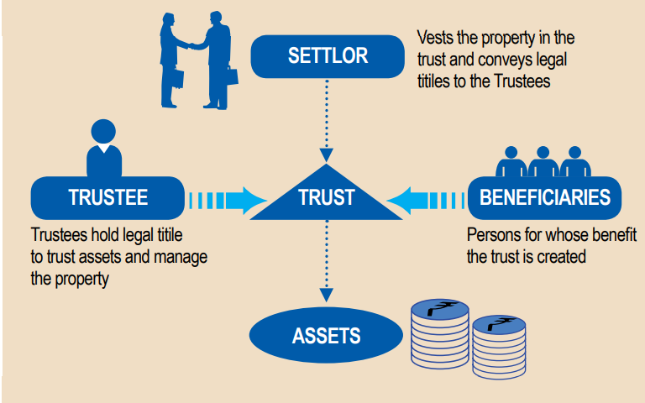
Structure
Notes:
2/3 rule

Slide 109
Components
Settlor
Trustee
Beneficiary
Protector
Transferor/ Donor/ Contributor
Notes:
Protector mainly in foreign trusts, eg. Dileep chokshi
Beneficiary must as per ITA or else Trust invalid
Trustee will be separately assessed as representative assessee

Slide 110
Trust Deed
Information
regarding the relevant parties – Settlor, Trustee, Beneficiary, etc
Trust property
Trustees
Beneficiaries
Terms of extinguishment of the Trust
Alternative dispute resolution, etc.
Amendment process and procedures
Rights, powers (and restrictions thereon), duties, liabilities and disabilities of Trustees, procedure for their appointment, removal, resignation or replacement and minimum/maximum number of Trustees
Rights, obligations and disabilities of beneficiaries, powers and procedure for addition and/or removal of beneficiaries, including the person who would be entitled to exercise such powers

Slide 111
Types of Trust
Specific Trust
Discretionary Trust
Irrevocable Trust
Deemed Revocable
Testamentary Trusts
Normally used for succession planning
no creditors claim, Estate duty and IBC applicability
Only hope in Discretionary and no right so no ED
Under Estate duty if shares were identified the levy was there

Slide 112
Other types of Trust
Generation skipping trust
Grantor Trust
Dynasty Trust
Living Trusts
Asset Protection Trust
Reduce inheritance tax by bypassing generation 37.5yrs
Revocable trusts control is with settlor and can undo
Avoid probate – California
Crummey Trusts
Generations and avoids estate duty
Property remains till settlor alive. Then to beneficiaries
Discretionary trusts to avoid Insolvency, creditors, divorce claims
Fixed contribution by gift within limit of gift tax exemption 15000 USD. Withdrawals in fixed span. Life insurance trusts

Slide 113
Governing provisions
Section 160
Representative assessee
S.161 – Determinate Trust
1 – like manner and same extent as benef.
1A – Business income – MMR on whole income
S.162
Right of RA to recover taxes paid
S.164 – Discretionary Trust
1 - MMR
Proviso Exceptions – normal rate as of AOP
S.166
Direct assessment of beneficiary
S.61, 63
Revocable transfer – income of transferor

Slide 114
Taxability
Taxed through a, i.e. the trustee – section representative assessee160(1)(iv)
Rate of tax and extent of taxation depends on the type of trust
Revocable Trust:
Section 61 – taxable in the hands of the transferor
Irrevocable Trust:
Taxable u/s. 161/164 depending upon whether it is determinate or indeterminate trust

Slide 115
Specific Trusts

Slide 116
Specific or Determinate Trusts
Identified beneficiaries or their class
Identified share
Beneficiaries
A
B
C
25%
25%
25%
ABC Charitable Trust
25%

Slide 117
Taxability
Taxable under Section 161
Tax liability co-extensive with that of the beneficiary;
‘in the like manner and to the same extent’ as the beneficiary,
U/s. 166, AO has an option to tax beneficiaries instead of the trustee
Practically in all specific trusts income is offered in hands of beneficiaries
once the income is assessed in the hands of beneficiary it cannot be assessed in the hands of Trust and vice versa - CIT v. Dr. David Joseph (214 ITR 658)
except in case of business income, which is taxed at MMR ;

Slide 118
Taxation rule
Specific Trust
Carries Business
Non testamentary
Income Taxable at MMR
Testamentary Trust*
Rate applicable to every beneficiary
No
Business
Rate applicable to every beneficiary
* Being only trust by testator settled for dependent relative and beneficiary also not beneficiary in any other Testamentary trust

Slide 119
CWT v/s Nizam’s Family (Remainder Wealth) Trust (Trustees of HEH)(SC)
held that the words 'in like manner and to the same extent ' have to be construed that there would have to be as many assessments on the trustees as there are beneficiaries with determinate and known shares.
In a number of cases it has been held that if the beneficiary is an individual then the status of the trustee would also be that of an individual. This would be so even if there is more than one beneficiary provided all of them are individuals.
The assessment will be taxed at individual rates of taxes applicable to total income of each beneficiary.

Slide 120
N.V. Shanmugham & Co’s case (SC)
A. There would have to be as many assessments on Trustees with determinate or known shares.
B. Assessment of the trustee would have to be made in the same status as that of the beneficiary whose income is sought to be taxed
C. The amount of tax payable by trustee would be the same as that payable by each beneficiary in respect of his beneficial interest, if he were to be assessed directly.
If there are two beneficiaries say one being an individual and the other being a Hindu Undivided Family, the trustee would be liable to tax with respect to the share of the individual beneficiary in the status of “individual” and with respect to the share of “HUF”.

Slide 121
Discretionary Trusts

Slide 122
Taxation of Discretionary Trusts
No right of beneficiary, only hope
At maximum marginal rate
subject to exceptions
Only in one case taxable in hands of beneficiary if income already distributed during the year
CIT v. Kamalini Khatau [209 ITR 101 (SC)
CWT v. Estate of Late Vikramsinhji of Gondal, (SC)
Taxable in the hands of ‘Trustee’

Slide 123
Discretionary Trusts
At Maximum Marginal Rate
Exceptions
Testamentary trust which is the only trust declared under will(exception even if there is business income)
Exempt PF/SF/GF Trusts
42.74 percent

Slide 124
Important principles
Taxability of long term capital gains @ 12.50%, at per the rate u/s 112 of the Act- even when income of discretionary trust taxable at MMR
SAE Office Trust [271 ITR 159 (Del)]
CIT v. Dr. David Joseph (214 ITR 658)
once the income is assessed in the hands of beneficiary it cannot be assessed in the hands of Trust and vice versa
Circular No. 157 dated 26.12.1974:
assessment can be made either on trustee or on beneficiary, not both

Slide 125
Deemed Revocable Trusts
Notes:
Mr X settles a Trust and his son also contributes money in the same Trust

Slide 126
Revocable Trusts
Section 61 - income arising by virtue of revocable transfer of the assets- chargeable to income tax as the income of transferor
Section 62 - if the trust settled is not revocable during the life time of the beneficiary, but revocable thereafter, then:
During the lifetime of the beneficiary: income taxed as per s.161 or 164 as applicable;
After the power to revoke arises: income taxed as income of the transferor
Section 63 - transfer is deemed revocable by statutory fiction if:
There is a provision in the trust deed that part or whole of the income or assets will be re -transferred to the transferor- i.e. the Settlor/ transferor is also Beneficiary

Slide 127
Deemed Revocable trust
Settlor = Beneficiary
Transferor/Contributor = beneficiary
Makes Trust a pass through vehicle
Issues in foreign trusts

Slide 128
Testamentary Trusts

Slide 129
Status of Trusts
Trust is assessed as an individual or an AOP?
Section 2(31) does not cover ‘trust’ specifically in the definition of ‘person’
Trustee is only a representative and his status follows that of the beneficiaries
For an AOP, the persons need to come together for common purpose
CIT v. Shri Krishna Bandar Trust [201 ITR 989 (Cal)]
CIT Vs Marsons Beneficiary Trust [188 ITR 224 (Bom)]
Deepak Family Trust [211 ITR 575 (Guj)]
CWT v Trustees of H.E.H Nizams Family (Remainder of Family Trust) [(1977) 108 ITR 555 (SC)]

Slide 130
Status
If all beneficiaries are individual trust is also an individual
Nizam’s Family Trust, 108 ITR 555(SC)
LR Patel Family trust v. ITO, 262 ITR 520(Bom)
Marsons Beneficiary Trust, 188 ITR 224(Bom)
CIT v. S.A.E. Head Office Trust, 271 ITR 159(Del.)
DIT v. Shardaben Mafatlal Trust 247 ITR 1(Bom)
If different types of persons are beneficiaries
Like individual, company, charitable trust are beneficiaries
Status of trustee may be relevant in such cases

Slide 131
Status of Discretionary Trust with individuals
taxable as individuals and hence,
Shardaben Mafatlal Trsut [( 247 ITR 1 (Bom)];
Venu Suresh Sanjay Trust [221 ITR 649 (Mad)];
Ramesh Mahesh Sanjay Trust [231 ITR 752 (Mad)]
entitled to deduction/ benefits available to individual
Deepak Family Trust [211 ITR 575 (Guj)];

Slide 132
Escheat
Article 296 of Indian Constitution - Escheat
the reversion of property to the state, or (in feudal law) to a lord, on the owner's dying without legal heirs.
Interlocking companies, aggressive tax planning structures

Slide 133
Example of Trust Structures

Slide 134
Nuclear Family
Single Trust may be created
Specific or Discretionary would depend on various considerations
Inheritance tax return
Disability of children
Divorce issues
Creditors claim

Slide 135
Corporate family with NR children
Indian Industrialist with children NR abroad
Specific trust may make it difficult for them
FATCA
Taxation in India also
Discretionary Trust advisable

Slide 136
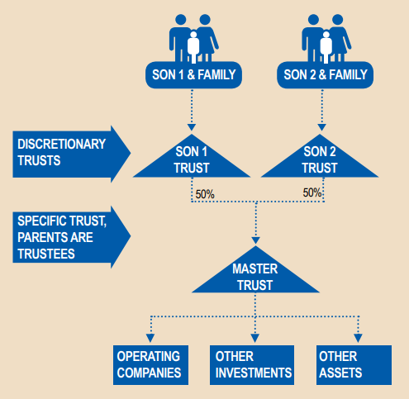
Corporate family business – 2 bros.

Slide 137
Complex version
Multiple master Trusts.
In this example, a family of father and two sons owned two businesses.
They decided to have:
Two master Trusts for holding the two businesses through existing companies
One master Trust for owning other assets
Three baby Trusts for each segment of the family

Slide 138
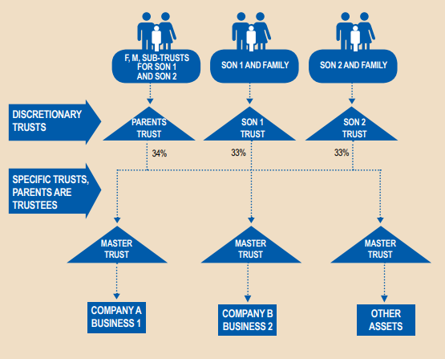

Slide 139
MIGRATION of assets to the structure
Not all assets would be directly owned by the settlor, which can easily be settled into the Trust.
In some cases, they may be owned by companies, partnership firms, LLP, even Hindu Undivided Families.
In such case, the existing structure would first need to be unwound before the properties are introduced into the Trust.
Methods to unwind (below and combinations)
Settlement into a Trust
Gift of assets
Sale of assets/business/shares
Family arrangement/settlement
Primary infusion
Mergers/demergers

Slide 140
Migration strategy to keep in mind
Income tax
Stamp duty
SEBI
FEMA
Laws of foreign jurisdictions
Potential levy of inheritance tax/estate duty

Slide 141
Professional Trustees
Banks
Financial Institutions
Administration Fee
Protector
Notes:
35Lakhs for great grand son. He received Rs.80000

Slide 142


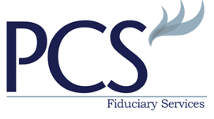





Slide 143
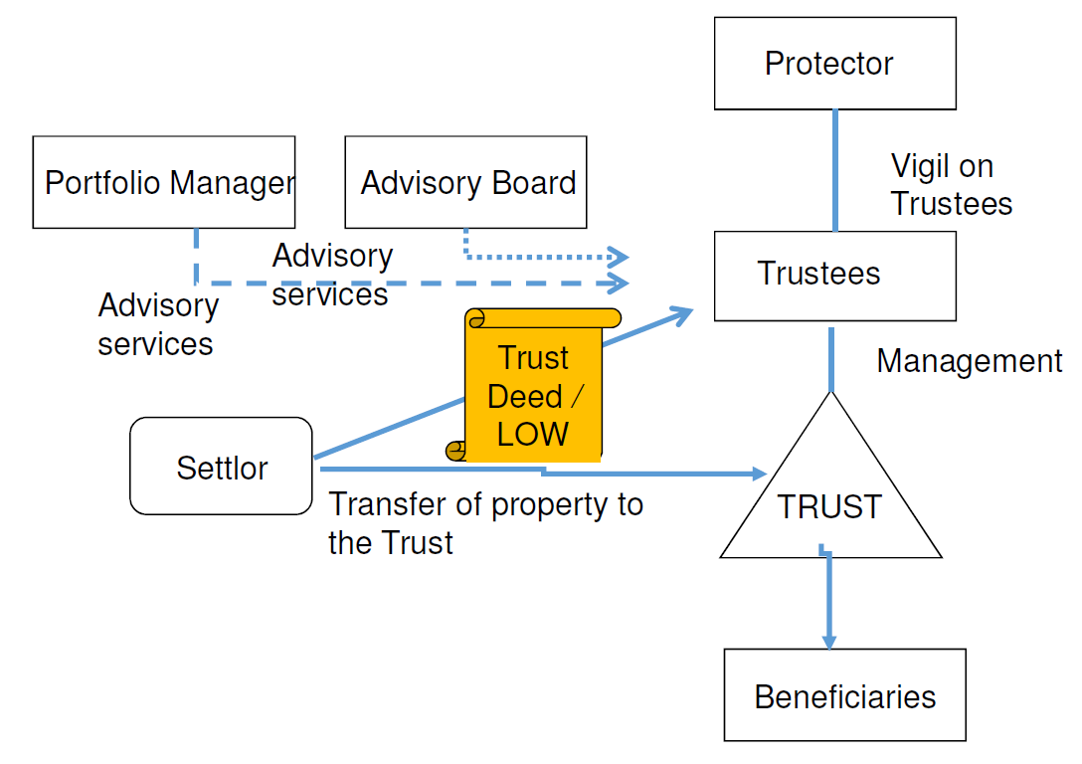

Slide 144
Need for Professional Trustee
Technical burden
  Does your family want to spend the time and effort after the death or incapacity of a loved one?
  Does your family have the financial awareness, astuteness and acumen?
  Do you “carry the ball” with the family finances?
Family dynamics
  Is this a second marriage situation?
  Are you living with a non-related party?
  Is there a family business?
  Is there a history of litigation between family members?
  Are there spendthrifts in the family?
  Are there other family issues?

Slide 145
Need for Professional Trustee
Complicated administration
  Can your family member handle the accounting and record keeping demands?
  Is there a complex disposition of assets?
  Do you have difficult tax situations?
Special assets
  Is there a closely held business?
  Is there non-residential real estate?
  Are there oil and gas mineral interests?
  Are there many receivables and payables?

Slide 146
Keep it flexible
Earlier estate duty on Transferor but Possibility of new law with inheritee paying tax may be there
Scope for alterations, modifications be provided to meet unforeseen situations

Slide 147
Advisable to set up Trust
Child with special needs
Wealth exceeding Rs.5 Crore
Family disputes

Slide 148
Professional Trustee costs (approx)
Establishment cost - Rs.5 Lakhs by MNC’s
Annual Maintenance fees if Professional Trustee around 2-5% p.a.

Slide 149
Stamp duty on Trust
Initial settlement with nominal amount
No duty on subsequent transfer of movable assets
Applicable duty on transfer of immovable property in Trust as per State law

Slide 150
Registration
Section 17 of Registration Act
  A non testamentary instrument declaring right title interest in immovable property valuing Rs.100 or more is required to be registered

Slide 151
Jurisprudence on legality
A trust for an unborn child is a valid trust
CIT vs. Rakesh Mohan (All HC)
Specific trust becoming discretionary and vice versa
if the shares are specified later the specific trust from the date of the specification
Devshi Trust’s case Bom HC
Similarly determinate may become discretionary
Mani Enterprises case Guj HC

Slide 152
Mehra Trust’s case Allahabad HC
A trust has to be certain as to its beneficiary.
Where a trust is created for the two minors provided for the contingency of pre-decease of either of them, but not for the contingency of both, the AO held the trust to be invalid on grounds of uncertainty as regards the beneficiaries.
The High Court found that in such a case, Section 77 of the Trust Act would provide for extinguishment of the trust, so that it will revert back to the settlor.
There is therefore no uncertainty as presumed by-the AO. The trust was held to be valid.
Where it is for the benefit of an individual, it is expected that an alternative beneficiary should be provided in case of pre-decease of such individual before maturity of the trust.

Slide 153
End of Trust (S.77 of Indian Trust Act)
When its purpose is completely fulfilled; or
When its purpose becomes unlawful; or
When the fulfilment of its purpose becomes impossible by destruction of the trust-property or otherwise ;or
When the trust being revocable, is expressly revoked.

Slide 154
Rule of Perpetuity
A trust cannot last forever. It must end no later than the lifetime of someone who is already alive at the time the trust is created (or shortly after).
This is done to prevent people from tying up property for infinite generations.

Slide 155
Maximum Duration
In other words, the maximum duration of a trust can be upto the date of demise of a person who is living on the date of creation of the trust.
It is not necessary that the person with whose life the duration of the trust is linked should also be a beneficiary of the trust.

Slide 156
Solution
In England (origination of Rule of Perpetuity)
  to settle a trust with duration upto the date of death of the last surviving lineal descendent of a named Royal King living at the time of creation of the trust.
In India clause used is
  The Trust hereby created shall continue and remain in force until the expiration of 21 years after the death of the last surviving lineal descendant of Mohandas Karamchand Gandhi, living at the date of this Deed, or until such earlier date as the Trustees may unanimously determine in writing to wind up the Trust and distribute the Trust Property, provided always that such distribution is in accordance with the provisions of this Deed.

Slide 157
Rule of Perpetuity (sec.14 of TPA)
Trust created cannot have perpetual existence
transfer of property cannot take effect after the life time of one or more persons living at the date of such transfer.
Borrowed from the English law
Applying the same concept,
shall have a finite life as specified in the section.
In other words, the maximum duration of a trust can be upto the date of demise of a person who is living on the date of creation of the trust.
which has interestingly being done away in England. It is not necessary that the person with whose life the duration of the trust is linked should also be a beneficiary of the trust. In England, it is a practice to settle a trust with duration upto the date of death of the last surviving lineal descendent of a named Royal King living at the time of creation of the trust.
in India, we may think of creating the trust for a duration that is linked with the life of the last surviving lineal descendent (male or female) of, say, Mohandas Karamchand Gandhi living on the date of creation of the trust. We may thus try to have the trust for a duration as much extended as possible.

Slide 158
Unborn children S.13 TPA
Transfer of property for the benefit of unborn persons shall not take effect except
in one situation, namely, where the interest created under such transfer in favour of unborn persons extends to the whole of the remaining interest of the transferor.
Section does not render the trust invalid if it has unborn persons as beneficiaries.
It only says that the interest of the unborn person shall not take effect if it does not extend to the whole of the remaining interest of the transferor.
If a person desires to have unborn persons (grandchildren and great grandchildren) as beneficiaries in the trust.
If there are other beneficiaries as well, and the trust is discretionary, then the interest of the unborn persons cannot take effect.
Hence, in order to overcome this difficulty, the ideal course
to somehow have a separate trust where the beneficiaries include unborn persons and the whole of the remaining interest of the transferor goes to such persons on termination.

Slide 159
Example: Unborn child provisions
Suppose Mr. A makes a trust with ₹10 Crore:
  If he says:
    "My sons will get ₹7 Crore"
    "My unborn grandchildren will get ₹3 Crore“
    ❌ This is NOT allowed under Section 13 of the law.
But if he says:
  "My sons will get the income (interest/dividends) during their lifetime"
  "After my sons, whatever is left (the full remaining property) will go to my unborn grandchildren"
  ✅ This is allowed.

Slide 160
Rationale
How will you divide the property properly when you don’t even know who the unborn beneficiaries are yet?
  How many grandchildren will there be?
  When will they be born?
  Will they all be treated equally?
Because of this uncertainty, the law says:
  It is okay to give property to unborn people, but only if you give them the full leftover amount (whatever is left after giving to the living people), not just a fixed or partial share.

Slide 161
Example: Unborn child
If the deed has a clause
    "Each unborn grandchild will get ₹50 lakh"
  But when the time comes, you have 20 grandchildren instead of 2, or maybe only 1.
This can create big legal fights, uncertainty, or even invalid trusts because:
    The property may not be enough.
    Or, you might end up giving too much or too little.
Therefore
  don’t try to divide property between living and unborn people at the same time,
  just give the unborn people the whole leftover property after the living ones are done.

Slide 162
Litigation
Mediation
  Report by the Vidhi Centre for Legal Policy
  out of approximately 46,000 court-referred mediation cases, around 41,503 were family disputes .
​Family succession disputes
  study by Daksh, an NGO
  approximately 66% of civil cases were property-related, and 10% pertained to family matters, totaling 76% of litigation involving property and family disputes .

Slide 163
Against accumulation (S.17 TPA)
This section provides a limitation of the trust to accumulate the income beyond a certain period.
The effect of this provision may be eliminated by providing for discretion to the trustees to spend and / or distribute the income in the same or subsequent years.

Slide 164
Minor children tax planning
Separate Specific trust set up for each minor child
Specific mention in Deed that
so long as the minor child is a minor, then during such period of minority no part of the income of such a Trust would be spent on the minor child
No clubbing of the income of the minor child’s trust in parent’s hands
CIT v. M R. Doshi [1995] 211 ITR 1 (SC)
Taxable in trust hands and slab benefit available as separate assessee without clubbing

Slide 165
Thank you
CA. Pankaj Shah
9691893040

