Slide 1
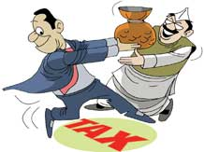
NOTICES FOR DONATION TO PENNY
POLITICAL PARTIES
CA. PANKAJ SHAH
LLB(Hons), BBA, CS, FCA, DISA,
Insolvency Professional, Registered Valuer (SFA)

Slide 2
Deductions under Income tax
Donation to political parties deductible
80GGB – Indian company
80GGC – any person except local authority

Slide 3
Section 80GGB/80GGC
Explanation.—For the purposes of sections 80GGB and 80GGC, "political party" means a political party registered under section 29A of the Representation of the People Act, 1951 (43 of 1951).
Registered
Recognised
Unrecognised

Slide 4
Registered Unrecognised Political Parties (RUPP)?
Registered unrecognised parties are those parties which are
  either newly registered or
  which have not secured enough percentage of votes in the assembly or general elections to become a state party or
  those which have never contested elections since being registered.

Slide 5
Registered Unrecognised Political Parties
8 National
54 State
2796 RUPP’s

Slide 6
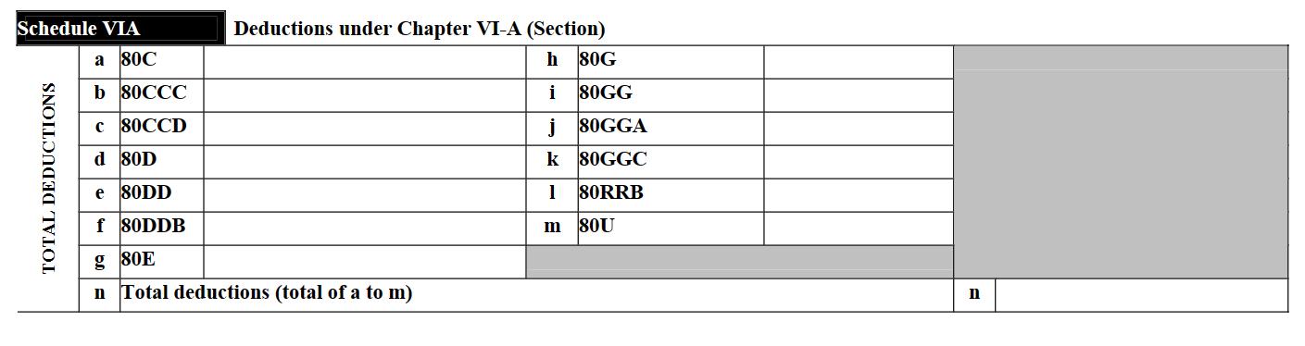
Disclosure in ITR

Slide 7
Income tax Search
Search action in 2021-22
On 23 RUPP
Offices at Ahmedabad

Slide 8
Findings in search
35 bogus intermediaries
3 major exit providers
Incriminating documents
Bogus donation receipts
Diaries containing details of commiussion
Loose papers
Whatsapp chats
Statement of persons involved
Commission 1.5% to 5 %
07.09.2022 Search on 23 RUPP
02.02.2021
Search on Manavadhikar Party, Kisan Party, AISECT, etc

Slide 9
INDIAN NATIONAL CONGRESS (I) vs. INSTITUTE OF SOCIAL WELFARE & ORS. (SC) [2002] 5 SCC 685
Election Commission of India does not have power to de-register a political party for non-compliance with the conditions for the grant of such registration

Slide 10
Reassessment Notices
Assessment Year 2019-20
Donations ranging from Rs.25,000 to Rs.5,00,000
Assessee’s
Salaried and small proprietors

Slide 11
Reassessment
Notice
Reply
Order (fit case)
Return
within 7 – 30 days
Show cause u/s.148A
S.148A(d)
Notice u/s 148
in response to S.148

Slide 12
Options for AY 2019-20
Return in response to Section 148 notice
Surrender deduction
Tax 30%
Interest @ 1% per month for 50 months
Penalty for misreporting @ 200% of tax
Claim
Tax 30%
File appeal (No penalty till appeal)
Interest 1% for 50 months
Penalty only after decision of appeal
Immediate payment
20% payable till appeal

Slide 13
Impact of Surrender in return
Particulars | Amount
Donation | 100000
Tax | 30000
Interest till return u/s 148 | 15000
Penalty (misreporting) | 60000
Total liability | 105000
 | 105%*
*the above calculation is an approximate demonstration of impact

Slide 14
Penalty 270A
Charge
Underreporting
File for immunity
Form 68
Misreporting
contest

Slide 15
Dispute Resolution Scheme S.245MA
Returned income upto 50 Lakhs
Aggregate Addition/variation upto 10 Lakhs
Non applicability to Search and Survey cases
Immunity from Penalty and Prosecution

Slide 16
Impact on Intermediaries
Certain intermediaries have sent receipts to clients
Whatsapp
Email
Donors have filed complaints
Ultimate beneficiaries
Caution to be exercised

Slide 17
Scope of Reassessment
AO is free to ask about
Cash deposit in bank account
Credits in account
Disallowance of other deductions claimed
Source of other investments
As per the SOPs issued for faceless assessment - The questionnaire shall seek specific and focused information and evidences on the points of enquiry as provided in the specific grounds that led to reopening of the assessment u/s 148.

Slide 18
Amnesty Scheme
More than 5 Lakh appeals pending at CIT(A)
Government approach to reduce litigation
Common man and small salaried taxpayer involved
Possibility of VSVS-2 cannot be ruled out
Recent GST amnesty scheme

Slide 19
Remedy
Litigate or surrender
AY 2019-20
AY 2020-21
Eligible for Updated return
AY 2021-22
AY 2022-23

Slide 20
Litigation
Rebuttal, Jurisprudence and Representation

Slide 21
All notices are invalid?
Search on
02.02.21
Manavadhikar Party, Kisan Party of India, etc
Jurisdiction under S.153C
07.09.22
23 RUPPs
Jurisdiction u/s.148 not 148A

Slide 22
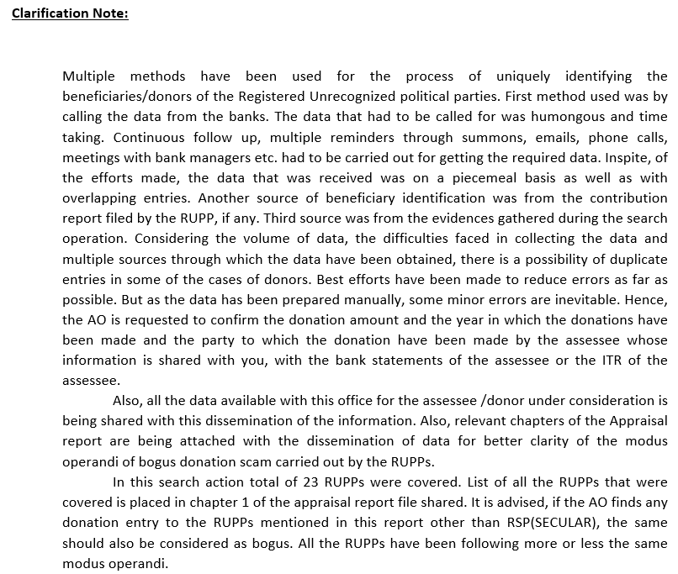
Order to be passed on “material on record” and not on suspicion
(2022) 447 ITR 698 (Raj) Abdul Majeed vs. ITO

Slide 23
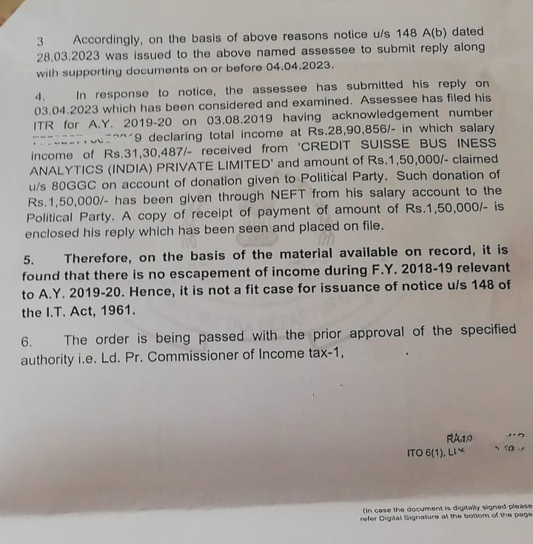

Slide 24
Technical flaws in notice
Notice u/s 148 of Act
To be issued by FAO
Incorrect information
Reasons state X party actual Y party
Approval u/s 151
Specified authority
Mechanical approval
Sagar Enterprises vs. ACIT (2002) 257 ITR 335 (Guj) (HC)
Notification No.18/2022 dated 29.03.22
Authentication and Issue
No DSC or signature
Not served on email within limitation
Mere upload on Portal not service
S R Cold Storage (Allahabad HC) 11.08.22

Slide 25
Notice is unsigned
(2023) 451 ITR 27 (Bom) PRAKASH KRISHNAVTAR BHARDWAJ vs. ITO
the notice under s. 148 having no signature affixed on it, digitally or manually, the same is invalid and would not vest the AO with any further jurisdiction to proceed to reassess the income of the petitioner.
[2022] 444 ITR 41 (Allahabad) Daujee Abhushan Bhandar (P.) Ltd. VS. UOI
considering the provisions of sections 282 and 282A of the Act, 1961 and the provisions of section 13 of the Act, 2000 and meaning of the word "issue" we find that firstly notice shall be signed by the assessing authority and then it has to be issued either in paper form or be communicated in electronic form by delivering or transmitting the copy thereof to the person therein named by modes provided in section 282 which includes transmitting in the form of electronic record
[2022] 448 ITR 1 (Allahabad) Vikas Gupta vs. UOI
an unsigned approval in an electronic record said to be pushed through electronic mode at a particular point of time could not be said to be a valid satisfaction under section 151 for assumption of jurisdiction by Assessing Officer to issue notice to an assessee under section 148

Slide 26
Wrong information
(2022) 6 NYPCTR 1450 (Del) GDR FINANCE & LEASING(P) LTD. vs. ITO
Information incorrect – alleged transaction with X entity –However, no transaction with such entity – therefore, notice and order bad in law. Quashed.
(2023) 7 NYPCTR 25 (Del) G4S SECURE SOLUTIONS (INDIA) (P) LTD. vs. ACIT
No prior inquiry and based on incorrect information - In our view, had such an enquiry been conducted before issuance of the notice, then the kind of flaws that have emerged, to which we have made a reference above, would not have, possibly, occurred. - As noticed above, instead of conducting an independent enquiry, the respondents/revenue relied upon the information supplied by the CGST authorities.

Slide 27
Cannot travel beyond SCN
(2023) 330 CTR (Chhattisgarh) 317 U.S. ASSOCIATES vs. PCIT
In the absence of the same being reflected in the notice, the assessment yet being made of the said amount would be prima facie bad in the light of the judgment of the Supreme Court in case of Commr. of Customs vs. Toyo Engineering India Ltd. 2006 (7) SCC 592 wherein in para 16 the Supreme Court has emphatically held that the Department cannot travel beyond the show-cause notice. Order and notice set aside
(2022) 6 NYPCTR 1175 (Del) CATCHY PROP-BUILD (P) LTD. vs. ACIT
Having perused the paper book and having heard learned counsel for the parties, this Court is of the view that in the notice issued under s. 148A(b) of the Act, the petitioner was never asked to explain the source of funds that were used by Manu Garments to purchase the shares of BertMarketing (P) Ltd. Keeping in view the aforesaid, the present writ petition along with applications is allowed and the show-cause notice issued under s. 148A(b) of the Act as well as the order passed under s. 148A(d) of the Act and the notice issued under s. 148 of the Act for the asst. yr. 2018-19 are quashed. However, if the law permits, the respondents/Revenue to take further steps in the matter, they shall be at liberty to do so.
146 taxmann.com 547 (Delhi) Usha Rani Girdhar v. Income-tax Officer*
This Court in Catchy Pro-Build (P.) Ltd. v. Asstt. CIT [2022] 145 taxmann.com 510/448 ITR 671 High Court has held, " if the foundational allegation is missing in the notice issued under section 148A(b) of the Act, the same cannot be incorporated by issuing a supplementary notice".

Slide 28
Jurisdiction
Returned income > 15 Lakhs
Yes
Circle
No
Ward
Notice from Non jurisdictional AO invalid
Jawaharlal Agrawal vs. ITO 2018 91 taxmann.com 185 (Agra)
CIT vs. Poonamchand Surana 2014 41 taxmann.com 330 Raj

Slide 29
Material to be supplied
Insight portal screenshot is ‘information’ not material
Material has to be supplied even in response to S.148(A)(d) notice
Micro Marble Rajasthan HC
Writ Petn. No. 10184 of 2022 (Bom) Anurag Gupta vs. ITO

Slide 30
Rationale
Why?
Agenda, Ideology and objectives
Who?
Influencer
Leader
Mode?
Cash
Cheque

Slide 31
Onus to prove
Section 68-69D not applicable
Onus on the department to prove
Accuser to prove
Not possible to prove cash return
No name in statement

Slide 32
C.Vasantlal [1962] 45 ITR 206 (SC)
Third party material
Can be used only after confrontation
Full statements to be demanded
Name of Assessee in statement?

Slide 33
Doctrine of Impossibility
LIC of India’s 219 ITR 410 (SC)
The law does not contemplate or require the performance of an impossible act.
impotentia excusat legem
No control over political parties

Slide 34
Andaman Timber Industries
[2015] 62 taxmann.com 3 (SC)
When statements of witnesses are made basis of demand, not allowing Assessee to cross-examine witnesses is a serious flaw which makes order nullity, as it amounts to violation of principles of natural justice

Slide 35
Common Cause v. Union of India
394 ITR 220 (SC)
Entries in loose papers/sheets are irrelevant and not admissible under section 34 of the Evidence Act.
As to the value of entries in the books of account, such statement shall not alone be sufficient evidence to charge any person with liability, even if they are relevant and admissible, and that they are only corroborative evidence. Even then independent evidence is necessary as to trustworthiness of those entries which is a requirement to fasten the liability;
The Court has to be on guard while ordering investigation against any important Constitutional functionary, officers or any person in the absence of some cogent legally cognizable material. When the material on the basis of which investigation is sought is itself irrelevant to constitute evidence it is not admissible in evidence.

Slide 36
Impact of Subsequent withdrawal of registration
Donation receipt and payment through cheque
Sufficient evidence for claim
Subsequent withdrawal of registration does not militate the deduction of Assessee
State of Maharashtra vs. Suresh Trading Co 1998 taxmann.com1747 (SC)
Ramdas Manaklal Gandhi vs. UOI (2000) 108 Taxman 590

Slide 37
ACIT v. Armee Infotech
[2022] 136 taxmann.com 128 (Ahmedabad - Trib.)

Slide 38
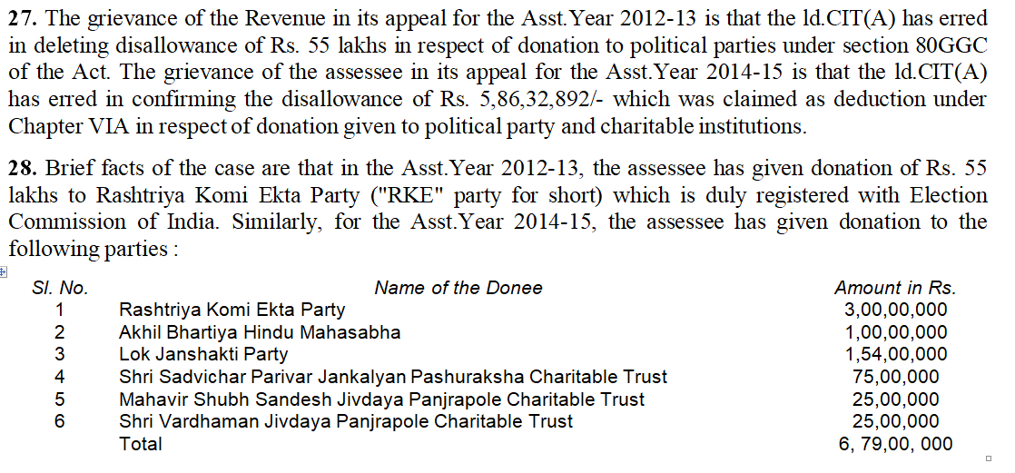

Slide 39
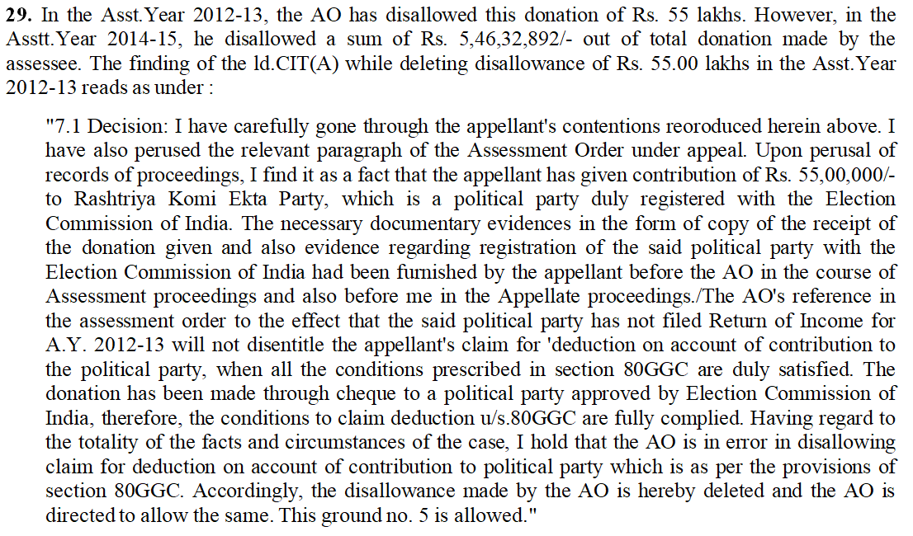

Slide 40
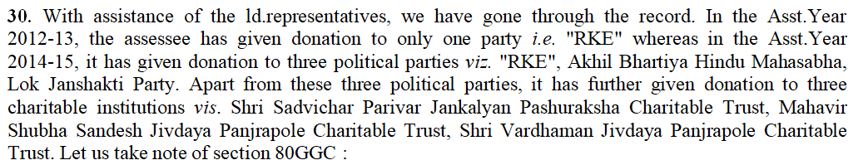
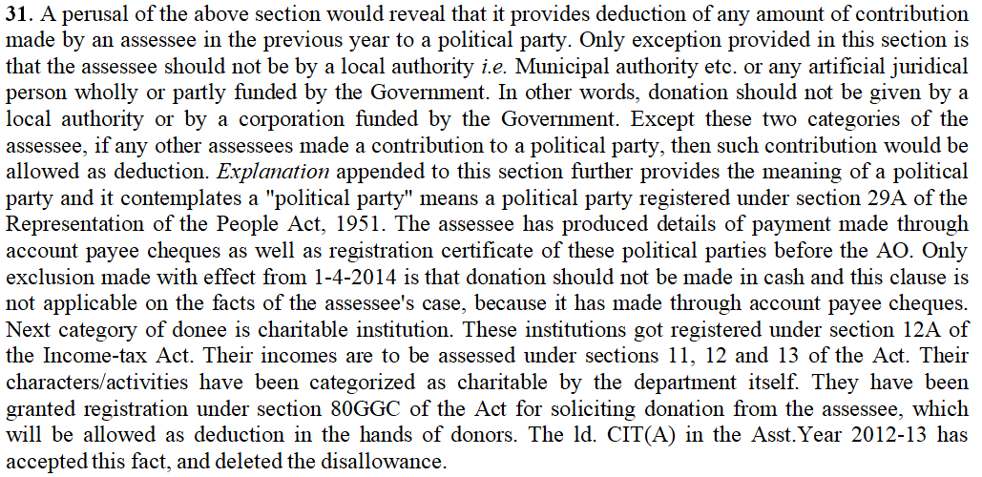

Slide 41
32. The case of the Revenue in the Asst.Year 2014-15 is that the assessee failed to prove, whether ultimately, the donees have used these monies ? The AO has devoted a lot of energy in conducting such inquiry as to how these monies have been incurred by the recipients. To our mind, the authorities below have misdirected themselves. The donees are taxable entities in themselves. If they misused their position and failed to conduct themselves in regard with requirement of law, then this amount could be taxable in his hands. Act nowhere put obligation upon the donor to ensure how the funds are utilized by the donee towards their objects. Due to this reason, we are of the view that whole angle of inquiry at the end of the AO is misdirected. It is for the AO to verify whether these charitable institutions have utilized funds for charitable objects or not, in their own cases, and if they failed to utilize funds for their objects, then their charitable status could be cancelled. Registration under section 12AA could be cancelled as per the procedure contemplated in section 12AA(3) of the Act. The funds which were not used for objects of the Trust, that can be brought to tax under section 13(3) of the Act. A perusal of the scheme of Income-tax Act, it would reveal that once the donation has been made, the donee is not under obligation to keep a track of the donation, and nothing left in his hand which can ask for return of these amounts. There is no such provision provided in the Act. If a duly recognized institution, for the purpose of receiving donation, somebody makes donation and then how the donation would be bogus, if the donee failed to use it for the object which has been made eligible to receive the donation. How the donor could dictate terms after donations are made ? No donee will be under influence of the donor for arranging its affairs. Therefore, there is fallacy in the approach of the ld.AO as well as the ld.CIT(A) for disallowing the donations made by the assessee. We do not find merit in the grounds of Revenue raised in the Asst.Year 2012-13. The ld.CIT(A) has rightly deleted the disallowance of Rs. 55.00 lakhs. This ground of appeal is rejected. On the same analogy, the grounds appeal raised by the assessee in the Asst.Year 2014-15 for disallowance of Rs. 5,86,32,892/- is allowed.

Slide 42
Thank you
CA. Pankaj Shah
pankajgshah@gmail.com
+91 969 189 3040

