Slide 1
Income tax Bill 2025
Pankaj Shah
Chartered Accountant

Slide 2
वासांसि जीर्णानि यथा विहाय नवानि गृह्णाति नरोऽपराणि
तथा शरीराणि विहाय जीर्णा न्यन्यानि संयाति नवानि देही”
~ Shrimad Bhagvat Gita
अर्थात: जैसे मनुष्य पुराने वस्त्रों को त्याग कर, नए वस्त्रों को ग्रहण करता है, वैसे ही जीवात्मा पुराने शरीरों को त्यागकर दूसरे नए शरीरों को प्राप्त होता है

Slide 3
Simplified Income tax
To Replace 64 year old ITA, 1961
Simplification of language
Redundant provisions are removed
Reducing Litigation
Ease of Reading
Compliance reduction

Slide 4
Key differences
Particulars | Old Act | IT Bill 2025
Chapters | 47 | 23
Sections | 819 | 546
Type of section | Alphanumeric | Numeric
Words | 5.12 Lakh | 2.60 Lakh

Slide 5
Concept
Overall structure is exactly same
Only language and presentation simplified
85% of content is also same
No reliefs in Income tax Bill

Slide 6
Tax year
Previous year and Assessment year
Tax year
  Starting from 1st April
  Financial year concept remains

Slide 7
Interpretation
After provisions ‘interpretation’ is separately given for reference and definition related to the provision

Slide 8
Category of changes
Renumberings of sections
Tables and formulaes
Conversion of proviso to subsection
Change in content and provision

Slide 9
Renumbering
Constitutes 75% of total changes
Major change in the Bill
Utility provided to see corresponding section
Earlier law
  Section 115A, 115B, 115BB, 115BBE, BAB, ……….115VT
  Now serially numbered

Slide 10
Tabulation
Ease of reading and understanding
Due dates in table format
TDS sections in category and table
Immovable property related TDS
TDS on purchase (194IA)
TDS on Rent (194I)
TDS on JDA
TDS on NRI for property sale
TDS on compensation for compulsory acquisition

Slide 11
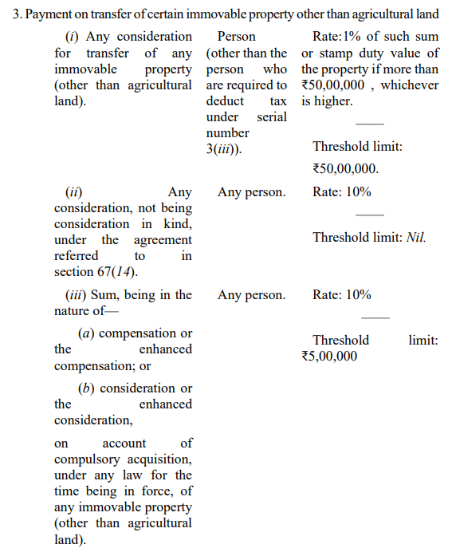
Issues due to tabulation (Heading)

Slide 12
Redundant provisions continue
Various redundant provisions still continue to be part of New law
Eg. Partnership firm was required to file certified copy of deed with first return in manual regime
After online returns circular was issued to exempt this requirement
New law has continued with the provision to file copy of deed with the first return

Slide 13

Reference to old Act
117 times reference made to 1961 Act
Eg. Income definition

Slide 14
TDS Tabulation
Merger of 46 sections in one section
Section 393
  largest section
  Running in 15 pages
Difficulties
  Earlier every section of TDS was self contained code.
Tabulation of MAT/AMT creates confusions

Slide 15
Issues in Interpretation
Interpretation v/s Exception
Difficulty in reading

Slide 16
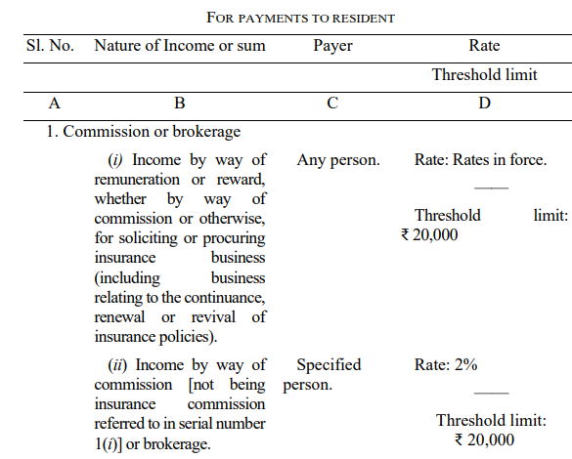
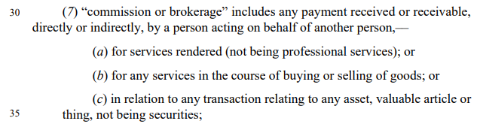

Slide 17
Substantive changes
Hidden in the drafting
Eg. Change in Residential status
  For the purpose of employment

Slide 18
AMT
Earlier provisions of AMT applied to firms claiming Chapter VI-A deduction
Now no such condition for application
Implication
  LTCG to firm – 12.5%
  AMT - 15%

Slide 19
Drafting error and FA 2025
Provisions of Finance Bill 2025 have not been incorporated in New Bill
Many drafting errors have crept in

Slide 20
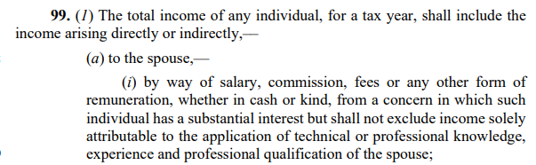

Slide 21
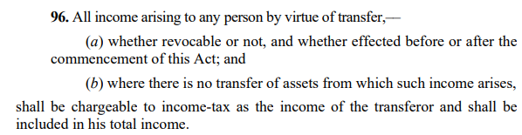

Slide 22
Clarification before Enactments
No refund if late filing of ITR
  Section 263(1)(a)(ix) of the income tax bill indicates that filing within the due date is compulsory to claim a refund
  Hue and cry on social media
Clarification by IT department
  there is no change in the refund-related provisions in the bill.

Slide 23
Lineal ascendant/ descendant
Maternal relatives also included
Earlier only paternal ascendant or descendant

Slide 24
Conversion of Proviso
No proviso and explanation in New Bill
All proviso converted to subsections
Ease of reading
Conversion of proviso to sub-section and redrafting may change meaning and may invite litigation

Slide 25
Major changes in Charitable Regime
Not for profit organization instead of charitable
Separate Chapter
Detailed study needs to be done
Simplification desired

Slide 26
Draconian provisions
Section 115BBE was introduced for demonetization only
However, it still continues in new bill
Representations are being made

Slide 27
Unlearn, Learn, Relearn

Slide 28
Thank You
Pankaj Shah
Chartered Accountant
9691893040
pankajgshah@gmail.com

