Slide 1
Signing of reports, certificates, audits, provisional and projections by CA
Pankaj Shah
Chartered Accountant

Slide 2
Issuance of Certificates
Networth, Turnover, ITR true copy, UDIN missed, etc.

Slide 3
Types of attestation
Audit
Certificate
Report
Opinion
Mere seal and sign on any paper without any of above not allowed
CA. Pankaj Shah | 969 189 3040 | pankajgshah@gmail.com |

Slide 4
Certificates
Guidance Note on Audit Reports and Certificates for Special Purpose 2016
Type of certificate
Reasonable assurance
Limited assurance
CA. Pankaj Shah | 969 189 3040 | pankajgshah@gmail.com |

Slide 5
Common Certificates
Reasonable Assurance
Certification of Turnover for past 3 years
Certification of Net worth of the Company
Certification on Derivative Exposure to be submitted to bank
Certificate on compliance with requirements of Buy Back
Annual Performance Report (APR) Certificate / Overseas Direct
Investment (ODI) Certificate
Limited Assurance
Certification of details of prosecution against company or directors
Transactions entered in earlier years for which sufficient evidences are not available
CA. Pankaj Shah | 969 189 3040 | pankajgshah@gmail.com |

Slide 6
REPORT
+
A separate line on document stating
“to be read with the enclosed statement of even date”
shall be inserted towards the end of the certificate, above the signature and such statement shall be enclosed with the certificate
CA. Pankaj Shah | 969 189 3040 | pankajgshah@gmail.com |

Slide 7
Standard on Related Services
SRS 4400
Engagement to perform agreed upon procedures regarding financial information
SRS 4410 (Revised)
Compilation engagement
CA. Pankaj Shah | 969 189 3040 | pankajgshah@gmail.com |

Slide 8
Agreed upon procedures
Due diligence when buying or selling a business
Verifying cash balances
Checking security balances
Income tax provisions
The report requires a description of the purpose along with the agreed-upon procedures in adequate detail for enabling the user of such report to clearly understand the extent and nature of the work performed. The auditor should clearly mention in this report that an audit or a review hasn’t been performed.
CA. Pankaj Shah | 969 189 3040 | pankajgshah@gmail.com |

Slide 9
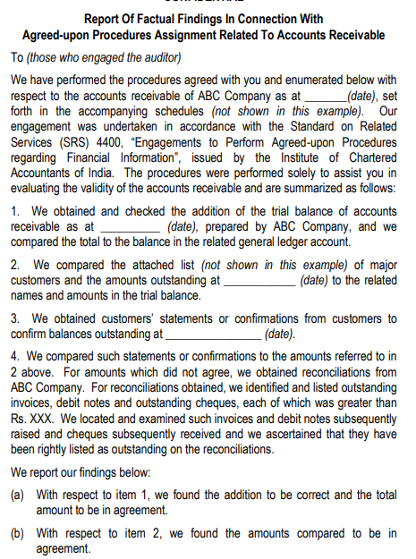
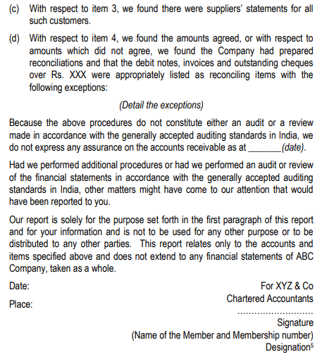

Slide 10
Attested True copy – ITR’s
CA not eligible to attest true copy
However opinion and manner of verification can be given with Practitioner’s Report
CA. Pankaj Shah | 969 189 3040 | pankajgshah@gmail.com |

Slide 11
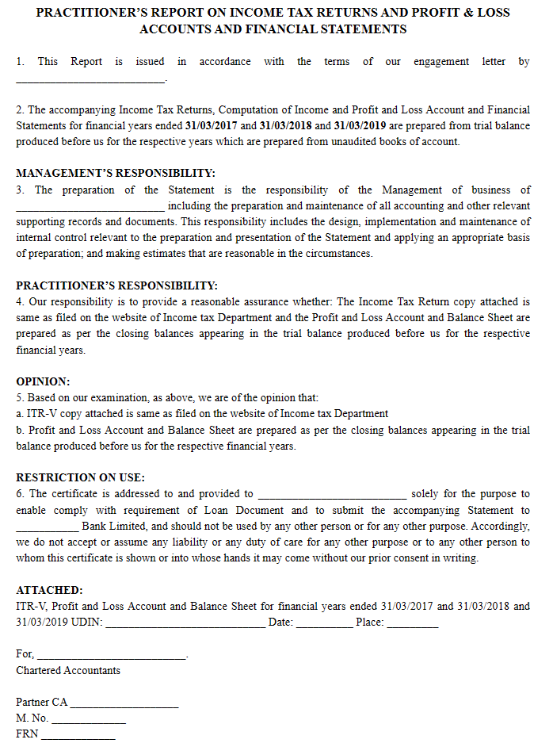
CA. Pankaj Shah | 969 189 3040 | pankajgshah@gmail.com |

Slide 12
CA. Pankaj Shah | 969 189 3040 | pankajgshah@gmail.com |

Slide 13
AUP vs. Certificate
AUP
Certificate
SRS 4400
Reporting on factual findings based upon procedures agreed with engaging party
No assurance expressed
GN on Reports or Certificates for Special purposes
Issuing an opinion/conclusion
Assurance expressed
CA. Pankaj Shah | 969 189 3040 | pankajgshah@gmail.com |

Slide 14
Compilation Engagements SRS 4410
Practitioner’s report of compilation engagement
Uses accounting and financial reporting expertise
To assist management in preparation and presentation of
Financial information of entity
Purpose of the report of the practitioner is
  to communicate in clear terms the extent and nature of compilation engagement, and
  his/her role and responsibilities in such compilation engagement.
  The practitioner’s report isn’t a tool for expressing the opinion or conclusion on financial information.
CA. Pankaj Shah | 969 189 3040 | pankajgshah@gmail.com |

Slide 15
Provisional financial statements

Slide 16
Provisional Financial Statements
Compilation engagement
Statutory audit cannot compile so attestation by other CA
Responsibilities of Practitioner
Engaged to help the management with preparing
Presenting the historical financial information without acquiring an assurance on such information
Reporting on such engagement as per SRS
CA. Pankaj Shah | 969 189 3040 | pankajgshah@gmail.com |

Slide 17
ACCOUNTANT’S COMPILATION REPORT
[To Management of ABC Company]
We have compiled the accompanying financial statements of ABC Company based on information you have provided. These financial statements comprise the Balance Sheet of ABC Company as at March 31, 20XX, the statement of Profit and Loss, and Cash Flow Statement for the year then ended, and a summary of significant accounting policies and other explanatory information.
We performed this compilation engagement in accordance with Standard on Related Services 4410 (Revised), Compilation Engagements.
We have applied our expertise in accounting and financial reporting to assist you in the preparation and presentation of these financial statements on the basis of accounting described in Note X to the financial statements. We have complied with relevant ethical requirements.
These financial statements and the accuracy and completeness of the information used to compile them are your responsibility. Since a compilation engagement is not an assurance engagement, we are not required to verify the accuracy or completeness of the information you provided to us to compile these financial statements. Accordingly, we do not express an audit opinion or a review conclusion on whether these financial statements are prepared in accordance with the basis of accounting described in Note X.
As stated in Note X, the financial statements are prepared and presented in accordance with accounting principles generally accepted in India excluding current investments which have been valued at fair value rather than being carried at the lower of cost and fair value. The financial statements are prepared for the purpose described in Note Y to the financial statements. Accordingly, these financial statements may not be
For XYZ and Co.
Chartered Accountants
Firm’s Registration Number
Signature
Name of Member
Membership Number

Slide 18
Reporting requirement in Practitioners report
Report title Addressee
Statement that report is compiled based on financial information provided by management
Responsibilities of management
Practitioners responsibilities
Compliance with SRS
Explanation that it is not assurance or audit opinion
Purpose of report
Date Signature Place UDIN
CA. Pankaj Shah | 969 189 3040 | pankajgshah@gmail.com |

Slide 19
Projections
CA. Pankaj Shah | 969 189 3040 | pankajgshah@gmail.com |

Slide 20
Projected Financial information
Certifying projections
3400 SAE – Examination of prospective financial information
Forecast – Best estimate assumptions
Not unreasonable
Projection – Hypothetical assumption
Consistent with purpose
Engagement – intended use
Report in format
Not a certificate
misconduct as per CA Act Schedule 2 para 1 clause (3)
CA. Pankaj Shah | 969 189 3040 | pankajgshah@gmail.com |

Slide 21
Prospective financial information report
Title | Addressee | Identification of the prospective financial information
Reference to the applicable standards on auditing
Statement from management for its responsibilities including underlying assumptions
Reference to the purpose and/or restricted distribution of prospective financial information as applicable
Examination procedures included the examination on the test basis, evidence supporting the assumptions, forecast or disclosure
Statement of negative assurance if assumptions provide a reasonable basis
Opinion if the prospective financial information is properly prepared on the basis of assumptions and presented per the financial reporting framework
Date of report
Place of signature
Signature with UDIN
CA. Pankaj Shah | 969 189 3040 | pankajgshah@gmail.com |

Slide 22
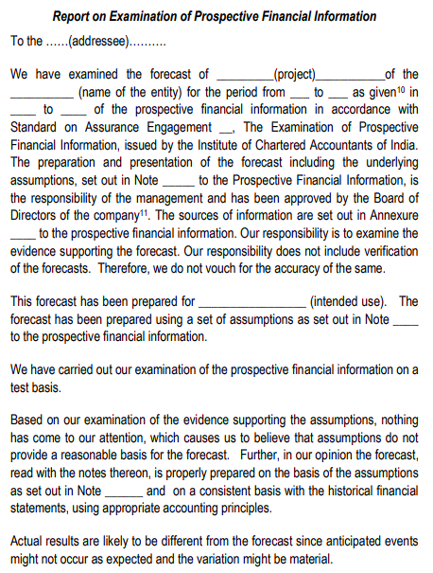

Slide 23
Other issues

Slide 24
Reports not signed by client
Common practice -obtain one signed report from client
Auditor signs 3 copies and gives to client
Physical Report signed only by auditor submitted at various forums
Violation of Section 215 of Companies Act
Name removed for 1 year
  CA. Sandhya Vasandani (M.No.128973)’s case

Slide 25
Proxy auditor
Counsel of the Respondent pleaded that his client i.e the Respondent had just signed the financial statements and the actual auditor was CA. Tarang Shah.
His client had merely signed based on reliance on another auditor and had refunded the fee to CA. Tarang Shah.
The Committee on the same, clarified to him, that since the signatures on the financial statement and the Audit Report were of the Respondent and hence the accountability for true and fair view of the documents, signed by her, lies with the Respondent only.
Name removed from the Register of Members for a period of 01(One) year with effect from 24th March, 2023

Slide 26
Undated audit report
All the audit reports were undated.
Audit Report was revised without due Procedure
Misconduct – Gross negligence
  (V. Ayyadurai vs. M. Rajkumar- Page 408 of Vol. II of Part I of the Disciplinary Casesof April, 2015 Judgement delivered on 10th December, 2013)

Slide 27
Revision of audit report
Auditor failed to state not only the reasons for revising the audit report issued by him
Also failed to inform the Charity Commissioner of Trust that his earlier report should not longer be relied upon.
Misconduct – Gross Negligence
  (Shekhar Purushottamrao Kannao vs. Sanjay S. Khandekar Re: [PR-125/13-DD/121/2013/DC /428/2014] Judgement delivered on 7th November, 2017)

Slide 28
Ensure zero audit fees outstanding
When a significant part of fees due from an ‘audit client’ remains unpaid for a long time, the firm shall determine:
Whether the overdue fees might be equivalent to a loan to the client; and
Whether it is appropriate for the firm to be re-appointed or continue the audit engagement
Legal position
A self-interest threat might be created if a significant part of fees is not paid before the audit report for the following year is issued.
It is generally expected that the firm will require payment of such fees before such audit report is issued.
The requirements and application material set out in Section 511 with respect to “Loans and Guarantees with an Audit Client” might also apply to situations where such unpaid fees exist.

Slide 29
Audit report - Inventory
Inventory has been accepted as certified by the management
Existence and condition of material asset
Alternative procedures to be applied

Slide 30
NFRA order 11.07.2023
Inventory
  The auditor is required to attend the physical inventory counting as it forms a considerable part of the financial statement.
  Also, no working papers were found in the audit file evidencing that the alternative audit procedures were performed by the EP after he failed to perform physical inventory counting on the reporting date.
  This is a clear violation of SA 501.
Receivables
  The auditor failed to obtain direct confirmation from parties having a significant and material balance of trade receivables and trade payables. Moreover, the auditor failed to perform alternative audit procedures in the absence of confirmations, as required by SA 505.

Slide 31
Format Pre-requisites

Slide 32
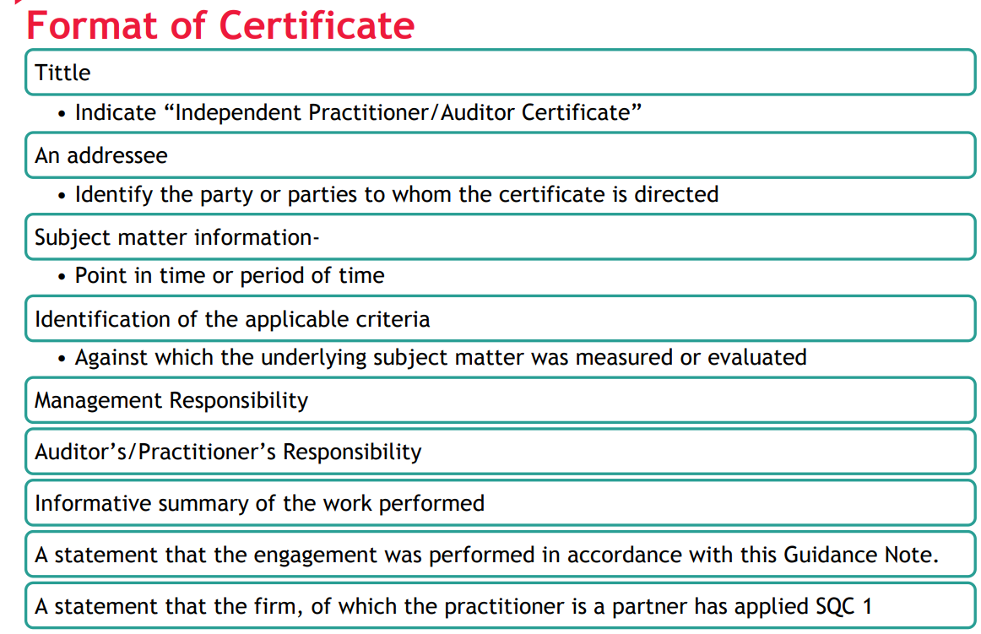

Slide 33
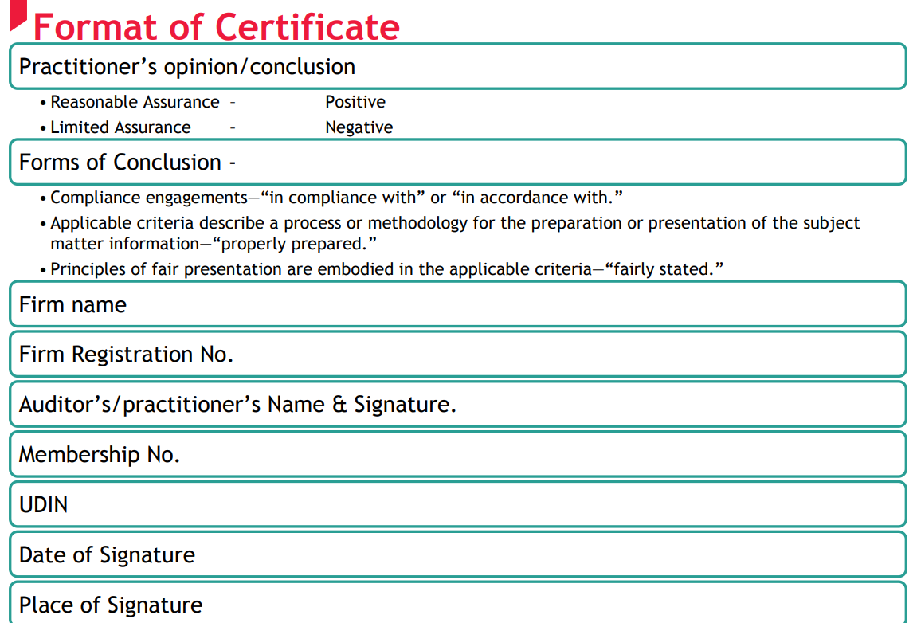
CA. Pankaj Shah | 969 189 3040 | pankajgshah@gmail.com |

Slide 34
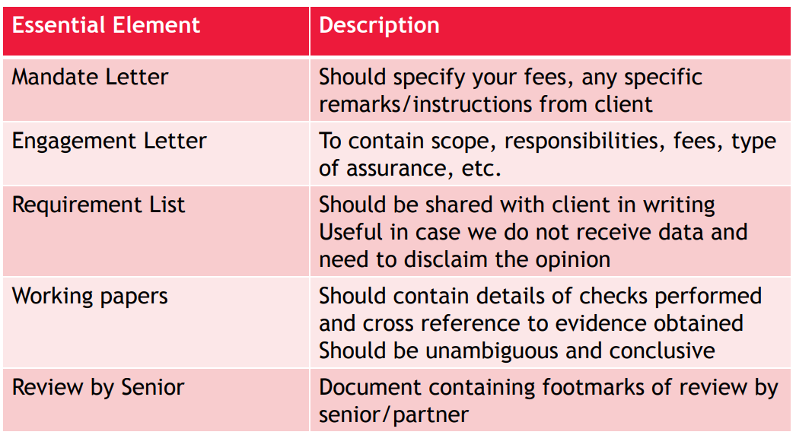
Documentation
CA. Pankaj Shah | 969 189 3040 | pankajgshah@gmail.com |

Slide 35
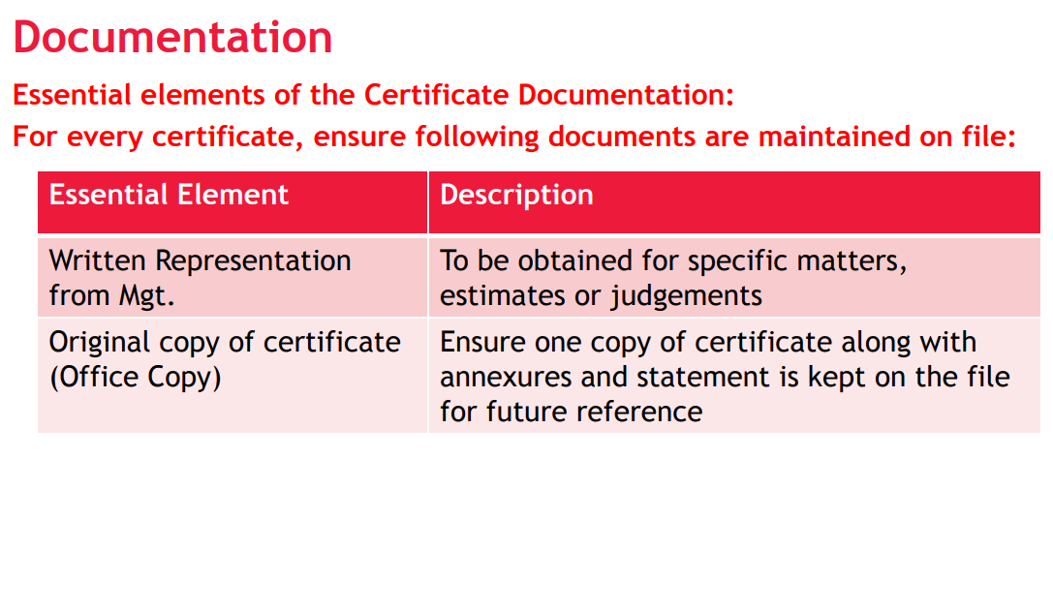
CA. Pankaj Shah | 969 189 3040 | pankajgshah@gmail.com |

Slide 36
Way ahead…..
Compulsory peer review on the way
Engagement letter with scope
Management Representation
Documentation of evidences relied upon
Attestation with UDIN
CA. Pankaj Shah | 969 189 3040 | pankajgshah@gmail.com |

Slide 37
Thank You
CA. Pankaj Shah | 969 189 3040 | pankajgshah@gmail.com |

