Slide 1
Preparation of Financials for Non corporate, NGO’s
CA. Pankaj Shah
Chartered Accountant

Slide 2
General Purpose Financial Statement for non corporate
Accounting Standards are pillar for sound financial reporting system of an entity
Relevant and reliable information about the entity to its stakeholders
Enhances Quality, comparability and comprehensiveness

Slide 3
Non corporate entities
Other than Company and LLP
Includes
  Sole Proprietorship firms
  Hindu Undivided Family
  Partnership
  Association of Person
  Registered Societies
  Non Profit Organisation, Public Trusts
  Private Trusts
  Statutory Corporations, Autonomous bodies

Slide 4
Exceptions
Format specifically prescribed by Regulator
  Maharashtra Public Trust Rules
Guidance note on
  Educational Institutes
  Political Parties
Companies
  Governed by Schedule III

Slide 5
Formats prescribed by ASB ICAI applies to
Non Corporate entities
LLPs
All professionals
Other stakeholders
Effective Date
  Financial statements covering periods beginning on or after April 1, 2024
Non compliance
  Second Schedule Part I - Clause(9) “ fails to invite attention to any material departure from GAAP
  Clause (7) “Gross negligence”

Slide 6
Applicable Accounting Standards
Exemption from some standards to MSME
Level I, II, III and IV for application
  In June 2022, ASB has issued the Technical Guide on Financial Statements of Non-corporate Entities to deal with applicability of Accounting Standards to the non-corporate entities and recommending formats of the financial statements for the Non-Corporate entities
Exemptions to MSME

Slide 7
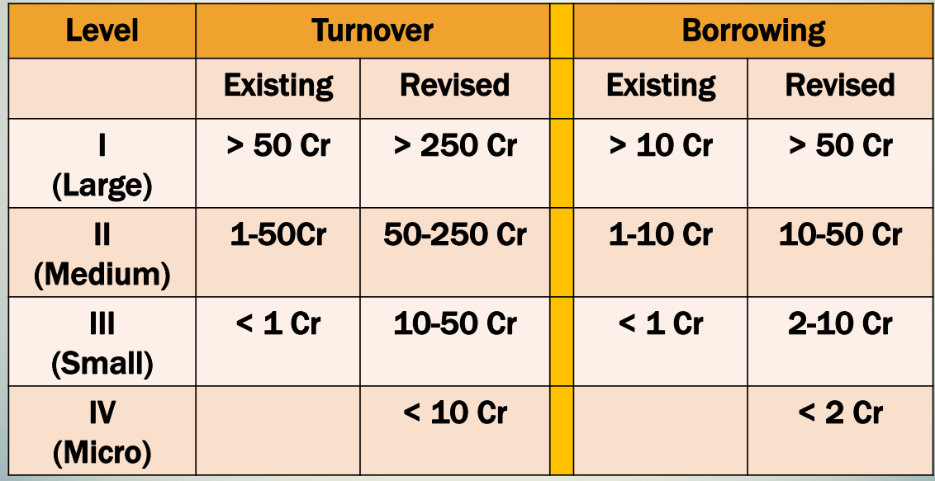
Level classification
Level II, III and IV are also MSME

Slide 8
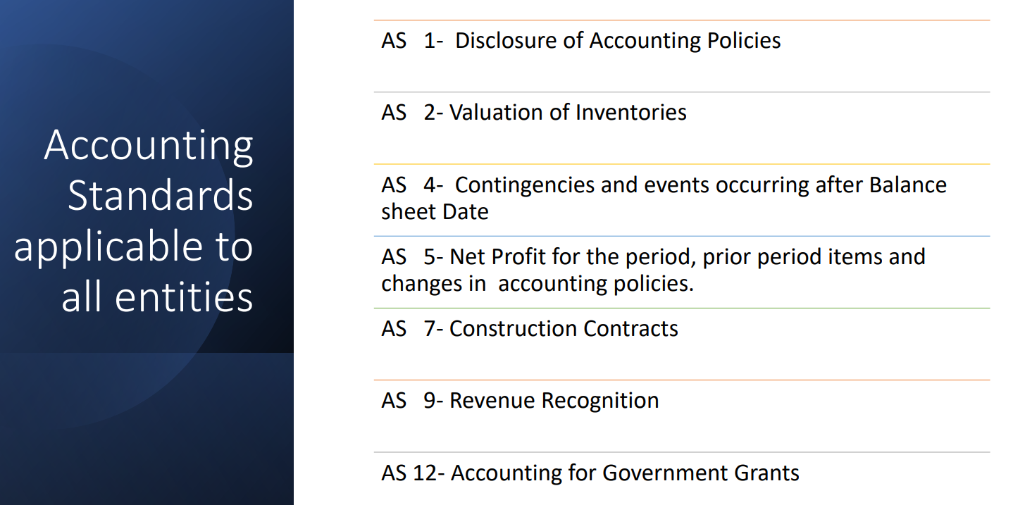

Slide 9
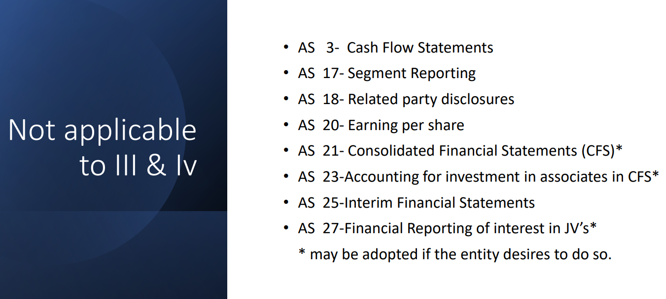

Slide 10
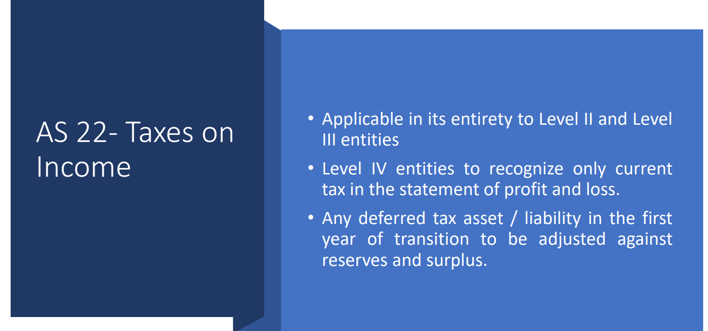

Slide 11
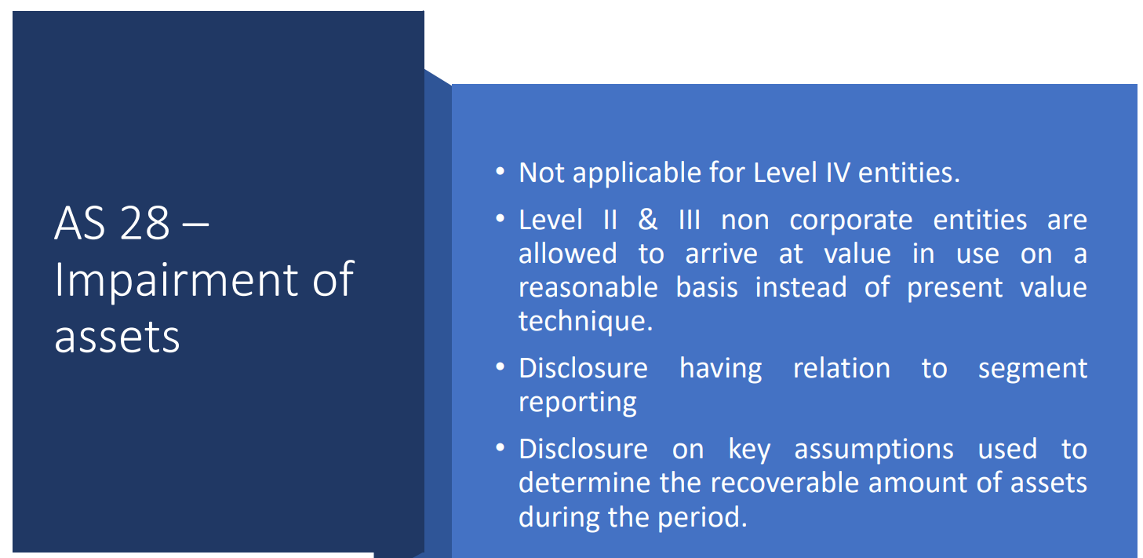

Slide 12
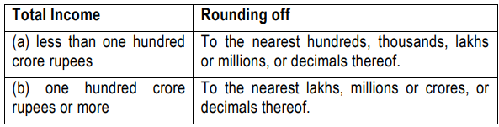
Rounding off
(Para4 page15 of GN)
Once a unit of measurement is used, it should be used uniformly in the
Financial Statements

Slide 13
Comparative Para 5 page 15 of GN
Except in the case of the first Financial Statements prepared by the Non Corporate entity (after its incorporation)
the corresponding amounts (comparatives) for the immediately preceding reporting period for all items shown in the Financial Statements including notes shall also be given

Slide 14
Current and Non current
Current
  Liability or asset having period of 12 months
Non current
  Maturity or liability beyond 12 months

Slide 15
Components of Financial Statements
Balance Sheet
Statement of Profit & Loss
Cash Flow Statement (if applicable)
Notes to Accounts
  Significant Accounting Policies
  Schedules

Slide 16
Significant Accounting Policies

Slide 17
Significant Accounting Policies
Preparation as per GAAP
  under the historical cost convention
  on accrual basis
Revenue Recognition policy
Property Plant and Equipment
Inventory Valuation
Provisions and Estimates

Slide 25
Nature of the Security to be specified separately.
Terms of repayment of terms loans and other loans may be stated.
Where loans guranteed by partners/proprietors/owners aggregate of such amount under each head may be disclosed.

Slide 33
Same for Unsecured loans and advances

Slide 41

Accounting for Non Profit organizations and their Financial Formats

Slide 42
Need for Standardization
Mandatory CSR under Companies Act
Listing of NPO’s on Social Stock Exchanges
Foreign contributions by International foundations
Regulatory regime under respective NPO Acts

Slide 43
Applicability of Accounting Standards
Section 8 Companies
Notified Indian Accounting Standards (Ind-AS)
Accounting Standards notified under Co. Act
Non Corporate Trust/Societies
Accounting Standards prescribed by ICAI

Slide 44
Special features of NPO’s
Nature of Receipts
Grants
Donations
Revenue from Property under Trust
School fee, Hospital fee
Other income
Conditions
Restrictions on use by donor
Un-restricted
Statutory restrictions on use
for organizational needs
Accumulation S.11(2)

Slide 45
Unrestricted Funds
Corpus
  Provided by founders for initiation of NPO
  No repayment is anticipated
Designated funds
  Reserved by Management for particular purposes or future obligations
General Funds
  All other funds not designated or corpus
  For routine organizational expenses and needs

Slide 46
Restricted Funds
Corpus donation
Funds which are donated with specific conditions which the NPO has accepted to follow

Slide 47
Donation in kind
Donation of land to NPO
Jewellery or precious stones to Religious NPO’s

Slide 48
Elements of Financial Statements of NPO

Slide 49
Financial Statements
Balance Sheet
Income and Expenditure account
Notes, other statements and explanatory material
  being integral part of financial statements
  Supplementary schedules

Slide 50
Balance Sheet
Snapshot of Financial Position as on particular date
Resources and obligations – Assets, Liabilities, Funds

Slide 53
Common points to take care
Assets and Liabilities not to be set off
  Even if related to same project/program
  Separate disclosure required for both
Movement, change and balance of various funds should be clearly disclosed

Slide 54
Income and Expenditure Account
Prepared in place of profit and loss account
Fund based accounting preferred so recommended to have separate ‘Restricted’, ‘Unrestricted’ and ‘Total’ columns
‘Unrestricted’ can be further classified in General and Designated

Slide 57
Additional information
For compilation of information reportable in
Form 10B, FCRA Returns

Slide 58
Separate schedules/disclosure
Foreign contribution received and paid
Income applied outside India
Transaction with Related parties
  Donors contribution over Rs.50,000 and transactions with them, if any
Vendors over 50 Lakhs payments
Object wise bifurcation of application
  Relief to poor, Education, Medical Relief, GPU, etc.
Incidental object wise revenue and expenses
TDS Compliances

Slide 59
Separate schedules/disclosure
Cash
  receipt over Rs.2000
  Expenses over Rs.10000
Anonymous donations (5% limit)
Capital expenditure not claimed as Application
  (Eligible for Depreciation)
Outstanding creditors and Provisions
  Not allowable as expenditure

Slide 60
Separate schedules/disclosure
Assets sold and New asset purchased
  Capital gain purposes (Cl.36 of Form 10B)
Source of Application
  Loan/Corpus, Accumulation, General Funds
Corpus/ Loans after 01.04.21
  Repayment considered as application
Investment
  Permissible mode u/s 11(5)
  Non permissible modes
Donation to other NPO’s
  Registered with similar object
  Others

Slide 61
Balance Sheet of XYZ Trust
Liabilities | Amount | Assets | Amount
Corpus Fund | xx | Fixed Assets | xx
Building Fund | 10 | New Building | 10
Construction | 40 | Construction in progress | 20
General Reserve | xx | Current Assets | xx
Mahaprasad Fund | xx
Akhand Abhishek fund | xx
Total | xx | Total | xx

Slide 62
  Nature of books of account or other document as provided in rule 17AA
  Cash book
  Ledger
  Journal
  Copies of bills, whether machine numbered or otherwise serially numbered, wherever such bills are issued by the assessee, and copies or counterfoils of machine numbered or otherwise serially numbered receipts issued by the assessee.
  Original bills wherever issued to the person and receipts in respect of payments made by the person .
  Any other book that may be required to be maintained in order to give a true and fair view of the state of the affairs of the person and explain the transactions effected. Continue…..

Slide 63
  Books of account, as referred in Serial No. 1 to 6, for business undertaking referred in sub-section (4) of section 11 of the Act
  Books of account, as referred in Serial No 1 to 6,, for business carried on by the assessee other than the business undertaking referred to in sub-section (4) of section 11 of the Act
  Record of all the projects and institutions run by the person containing details of their name, address and objectives
  Record of income of the person during the previous year as per rule 17AA(1)(d)(ii)
  Record of application of income etc. out of income during the previous year as per rule 17AA(1)(d)(iii)
  Record of application of income out of the income of any previous year preceding the current previous year as per rule 17AA(1)(d)(iv)
  Continue…..

Slide 64
  Record of voluntary contribution made with a specific direction that they shall form part of the corpus, as per rule 17AA(1)(d)(v)
  Record of contribution received for the purpose of renovation or repair of temple, mosque, gurdwara, church or other place notified under clause (b) of sub-section (2) of section 80G which is being treated as corpus, as per rule 17AA(1)(d)(vi)
  Record of loan and borrowings as per rule 17AA(1)(d)(vii)
  Record of properties as per rule 17AA(1)(d)(viii)
  Record of specified persons as per rule 17AA(1)(d)(ix)
  Any other documents containing any other relevant information as per rule 17AA(1)(d)(x).

Slide 65
Ensure
Generally accepted accounting principles
True and fair view
Comparative financial statements
Disclosure of significant accounting policies
Audit reports compliant to SA 700

Slide 66
Optional or Mandatory?
Guidance Note
Applicability on Auditor
Code of ethics
Auditee’s responsibility?
Exceptions
  Separate format under respective statute

Slide 67
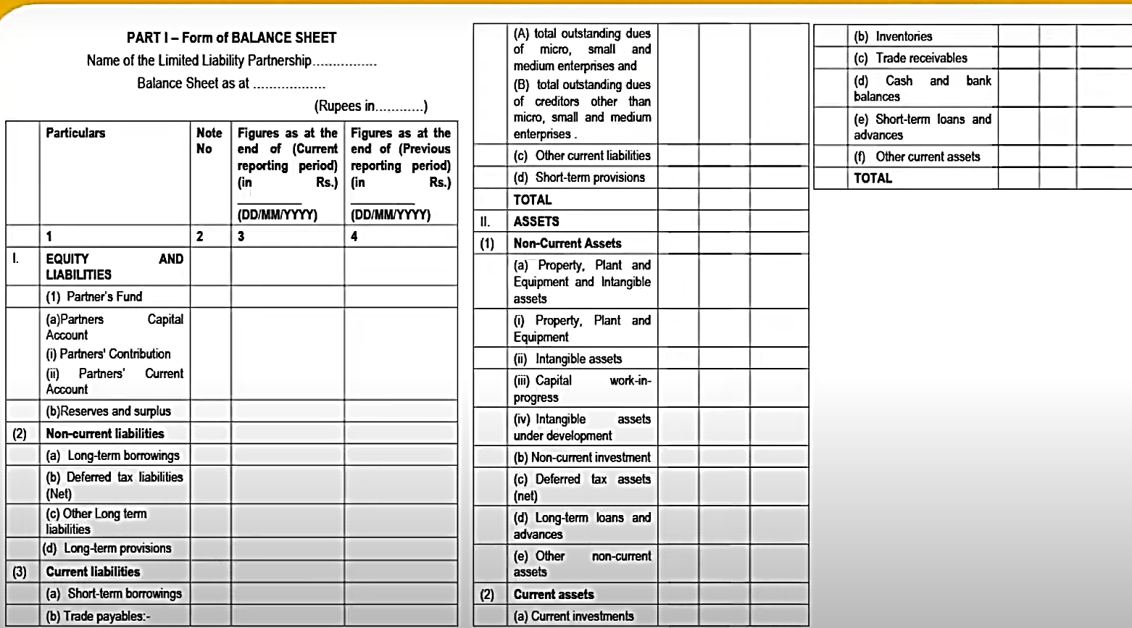
Format for LLP

Slide 68
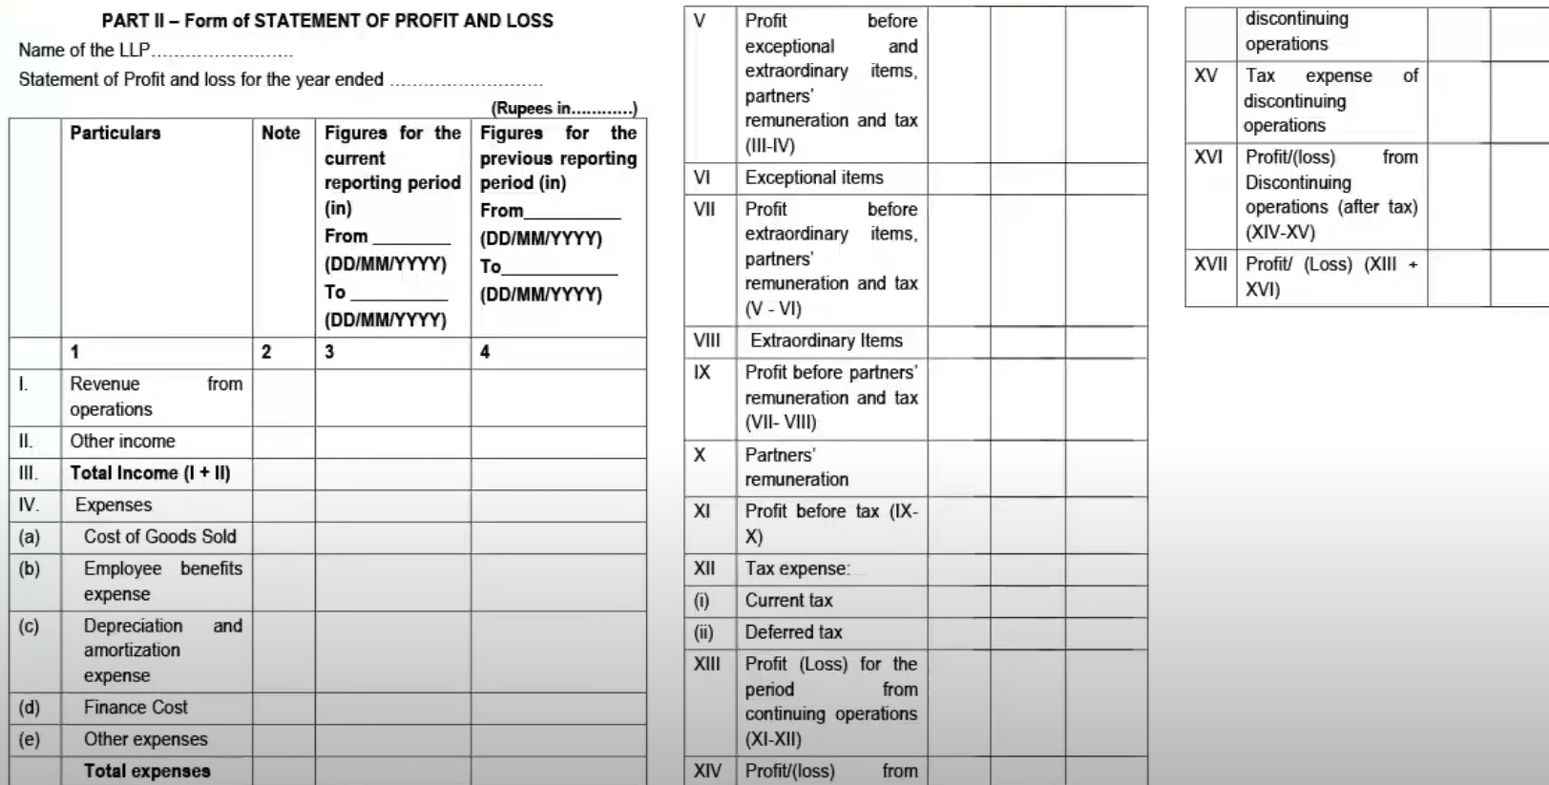

Slide 69
Cash Flow Statement
Operating activities
Investing activities
Financing activities

Slide 70
Provisional financial statements

Slide 71
Compilation Engagements SRS 4410
Practitioner’s report of compilation engagement
Uses accounting and financial reporting expertise
To assist management in preparation and presentation of
Financial information of entity
Purpose of the report of the practitioner is
  to communicate in clear terms the extent and nature of compilation engagement, and
  his/her role and responsibilities in such compilation engagement.
  The practitioner’s report isn’t a tool for expressing the opinion or conclusion on financial information.
CA. Pankaj Shah | 969 189 3040 | pankajgshah@gmail.com |

Slide 72
Provisional Financial Statements
Compilation engagement
Statutory audit cannot compile so attestation by other CA
Responsibilities of Practitioner
Engaged to help the management with preparing
Presenting the historical financial information without acquiring an assurance on such information
Reporting on such engagement as per SRS
CA. Pankaj Shah | 969 189 3040 | pankajgshah@gmail.com |

Slide 73
ACCOUNTANT’S COMPILATION REPORT
[To Management of ABC Company]
We have compiled the accompanying financial statements of ABC Company based on information you have provided. These financial statements comprise the Balance Sheet of ABC Company as at March 31, 20XX, the statement of Profit and Loss, and Cash Flow Statement for the year then ended, and a summary of significant accounting policies and other explanatory information.
We performed this compilation engagement in accordance with Standard on Related Services 4410 (Revised), Compilation Engagements.
We have applied our expertise in accounting and financial reporting to assist you in the preparation and presentation of these financial statements on the basis of accounting described in Note X to the financial statements. We have complied with relevant ethical requirements.
These financial statements and the accuracy and completeness of the information used to compile them are your responsibility. Since a compilation engagement is not an assurance engagement, we are not required to verify the accuracy or completeness of the information you provided to us to compile these financial statements. Accordingly, we do not express an audit opinion or a review conclusion on whether these financial statements are prepared in accordance with the basis of accounting described in Note X.
As stated in Note X, the financial statements are prepared and presented in accordance with accounting principles generally accepted in India excluding current investments which have been valued at fair value rather than being carried at the lower of cost and fair value. The financial statements are prepared for the purpose described in Note Y to the financial statements. Accordingly, these financial statements may not be
For XYZ and Co.
Chartered Accountants
Firm’s Registration Number
Signature
Name of Member
Membership Number

Slide 74
Reports not signed by client
Common practice -obtain one signed report from client
Auditor signs 3 copies and gives to client
Physical Report signed only by auditor submitted at various forums
Violation of Section 215 of Companies Act
Name removed for 1 year
  CA. Sandhya Vasandani (M.No.128973)’s case

Slide 75
Undated audit report
All the audit reports were undated.
Audit Report was revised without due Procedure
Misconduct – Gross negligence
  (V. Ayyadurai vs. M. Rajkumar- Page 408 of Vol. II of Part I of the Disciplinary Casesof April, 2015 Judgement delivered on 10th December, 2013)

Slide 76
Thank you

Slide 77
