Slide 1
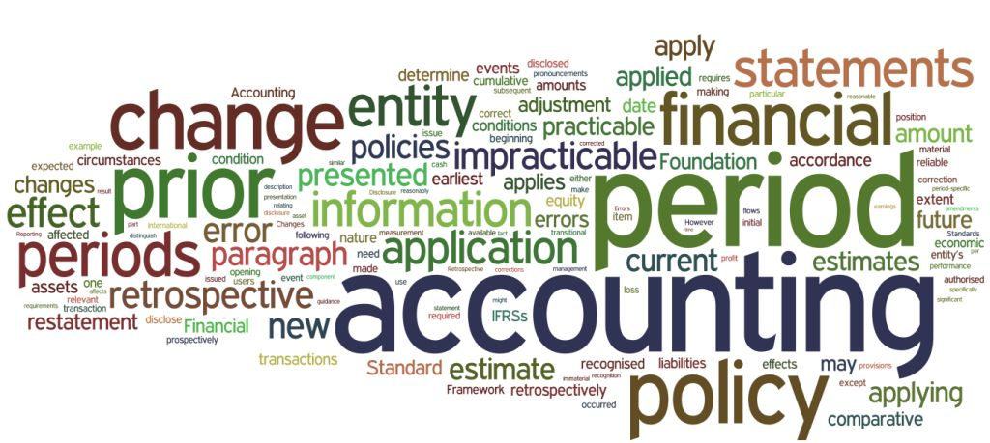
Income Computation and Disclosure Standards
CA. Pankaj Shah
F.C.A., C.S., LLB (Hons.), D.I.S.A.(ICA), B.B.A., Insolvency Professional, Registered Valuer

Slide 2
The Journey to ICDS
1996
Tax Accounting Standards I and II
(AS 1 and 5)
2010
Harmonizing TAS & AS by ICAI
2012
Issues ICAI AS W/o any modification
2015
Notified ICDS w.e.f. 01.04.2015
2016
Revised ICDS + FAQ’s
2017
Delhi HC struck down various provisions of ICDS
2018
Legal sanction accorded to ICDS provisions in Act

Slide 3
Bird’s eye view
Act wins over ICDS
Not for maintaining books as against TAS
Separate working to be maintained

Slide 4
Applicability
Appllicable to all except
Individual or HUF not required to get books audited u/s 44AB
Mercantile System of Accounting
Computing Income from
Business and Profession
Other Sources

Slide 5
Applicability
Case Studies
Individual having commission income of Rs.50 Lakhs
HUF having turnover of 50 Lakhs and Net profit of Rs. 3 Lakhs
Company having Sales of Rs.2000 and income of Net profit of Rs.1000
Partnership having turnover of Rs. 10 Lakhs and Net profit u/s 44AD of 5 Lakhs
Individual having turnover of Rs. 25 Lakhs and Gross Total income of Rs 1 Lakh
No
Yes
Yes
Yes
No

Slide 6
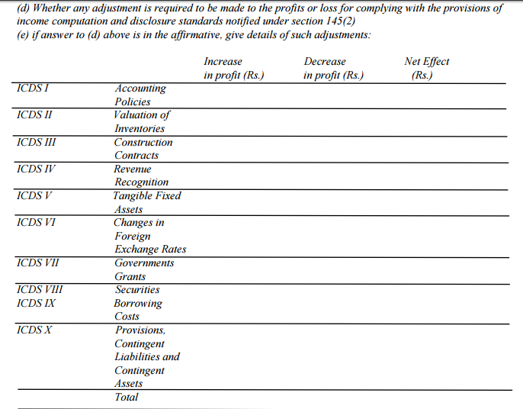
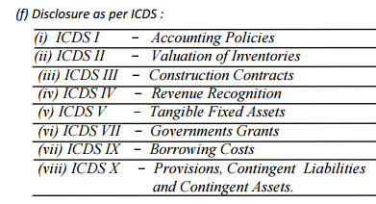
Form 3CD
ITR 3 and 5. Impact is not considered in computing in utility

Slide 7
Computation of Income
Particulars | Amount | Amount
Profit from Business profession | XXX
Income from Other Sources | XXX
Total |  | XXX
Add/Less: Adjustments as per ICDS |  | XXX
PROFIT / LOSS AS PER ICDS |  | XXX
Add/Less: Adjustments as per Act (Additions/ Disallowances / Deductions) |  | XXX
TOTAL INCOME |  | XXX

Slide 8
Consequences for non compliance
Best Judgment Assessment
Non satisfaction on correctness or completeness of the accounts of the assessee ; or
method of accounting is not regularly followed ;or
Income not computed as per ICDS

Slide 9
Basis of Profits
Profits are to be computed as per commercial accounting principles
Miss Dhun Dadabhai Kapadia v. CIT [63 ITR 651(SC)]
CIT v. UP State Dev. Corporation 225 ITR 703 SC
Now profits as per accounting principles modified by ICDS

Slide 10
Notified Standards
ICDS | Dealing with | ICAI AS
I | Accounting Policies | 1
II | Valuation of Inventories | 2
III | Construction Contracts | 7
IV | Revenue Recognition | 9
V | Tangible Fixed Assets | 10
VI | Effects of changes in foreign exchange rates | 11
VII | Government Grants | 12
VIII | Securities | 13
IX | Borrowing Costs | 16
X | Provisions, Contingent Liabilities and Contingent Assets. | 29

Slide 11
ICDS - I
Accounting Policies

Slide 12
ICDS –I ACCOUNTING POLICIES
SCOPE
Deals with Significant Accounting Policies
FUNDAMENTAL ACCOUNTING ASSUMPTIONS
Going concern
Consistency
Accrual
SELECTION OF ACCOUNTING POLICY
Substance over form
Expected M2M loss not to be recognized

Slide 13
Fundamental changes
Accelerate accrual
Double taxation due to MAT
Committee Logic
To avoid differential treatment of loss and income, concept of prudence to be removed
Prudence omitted

Slide 14
Mark to Market
Export Sales 01.03.18
50000USD
Rs.60/$
Year end 31.3.18
50000USD
Rs.65/$
Payment Recd. 10.04.18
50000USD
Rs.62/$
MTM Gain
Rs.2,50,000

Slide 15
Mark to Market Concept
MTM/Expected losses will not be allowed
FAQ MTM profits also not to be taxed

Slide 16
TREATMENT
OF MTM
Allowable/Taxable
Monetary Items
Cash
Receivables
Payables
Not Allowable/Taxable
Non monetary items
Fixed Assets
Forex derivatives
Currency Futures

Slide 17
Mark to Market
Particulars | Enter rate | Year end rate 31.3.18 | MTM Gain/(Loss)
Foreign Currency Creditors | 50000$ @ Rs.60 =30,00,000 | 50000@ 65 =3250000 | (Rs.2,50,000)
USD Future June contract | 1 lot of 10000$ @ Rs.62 | 1 lot of 10000$ @ Rs.68 | (Rs.60000)
Foreign Currency Balance in NRO Account | 10000$ @ Rs.60 =6,00,000 | 10000@ 65 =6,50, 000 | Rs.50,000
UK Pound Future July contract | 2 lot of 5000 UKP @ Rs.80 | 2 lot of 5000 UKP @ Rs.85 | Rs.50,000
Allowable
Not
Allowable
Taxable
Not
Taxable

Slide 18
Fundamental changes
Materiality omitted
Additions of Petty items
Committee Logic
Materiality is not known to Income tax
Calculator, etc. written off
Companies Act – Rs.5000 limit

Slide 19
Mitigation
Scope of ICDS
‘Significant’ accounting policies
Selection of Policy
True and ‘fair’ view
Not True and ‘correct’ view
Impliedly Materiality exists

Slide 20
FAQ 1
ICDS is applicable for computation of income and not for the purposes of maintenance of books of accounts. However, Para I of ICDS I states that it deals with significant accounting policies. Accounting policies are applied for maintenance of hooks of accounts and preparing financial statements. What is the interplay between ICDS-I and maintenance of hooks of accounts?
Answer: As stated in the Preamble, ICDS is not meant for maintenance of books of accounts or preparing financial statements. Persons are required to maintain books of accounts and prepare financial statements as per accounting policies applicable to them.
For example, companies are required to maintain books of account and prepare financial statements as per requirements of Companies Act 2013.
The accounting policies mentioned in ICDS-I being fundamental in nature shall be applicable for computing income under the heads “Profits and gains of business or profession” or “Income from other sources”.

Slide 21
Change in Accounting Policy
ICAI AS
ICDS
Required by statute
Result in a more appropriate preparation and Presentation
Required by any Accounting Standard
“Reasonable cause” FAQ
Flexibility
Eg. Change in business model, availability of new technology to gather accounting information, etc

Slide 22
Change in an accounting policy
Material Impact
Disclose
Year of change
Year in which such change has first material impact
No Material Impact
No disclosure required

Slide 23
Disclosures in TAR Cl.13(f)(i)
No need to Disclose if Going concern, Consistency and Accrual are followed
Historical Cost convention
Use of Estimates
Accounting Policies
  Revenue Recognition
  Inventory valuation policy
  Provisions
  Tangible Assets
  Forex policy if applicable
  Borrowing Costs, if applicable

Slide 24
ICDS - II
Valuation of Inventories

Slide 25
Measurement
Inventory to be valued at Lower of
Cost or
Net Realisable value

Slide 26
Trading Account
Expenses | Qty | Amount | Income | Qty | Amount
Op. Stock | 100 kg | 10000 | Sales | 600kg | 120000
Purchases | 1000kg | 100000
Profit
Closing Stock 500kg 50,000
600kg 60000
Purpose of Inventory valuation is to set off the cost of unsold value from purchase debited to ascertain correct profit
Inventory Valuation cannot result in profit

Slide 27
Other Issues (Revised)
Standard costing method of inventory valuation permitted if standard cost approximates actual cost
Weighted Average and FIFO accepted
LIFO not acceptable
Notes:
Recoverable taxes not to be reduced from cost. Same as 145A

Slide 28

Cost Formulae – FIFO, WEIGHTED AVG.

Slide 29
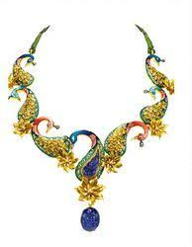



Specific Identification method (LIFO)

Slide 30
First-in First-out and Weighted Average Cost Formula
16. Cost of inventories, other than the inventory dealt with in paragraph 13……………..
PARA 13
“13. The Cost of inventories of items
(i) that are not ordinarily interchangeable; and
(ii) goods or services produced and segregated for specific projects shall be assigned by specific identification of their individual costs.
14. 'Specific identification of cost' means specific costs are attributed to identified items of inventory.”

Slide 31
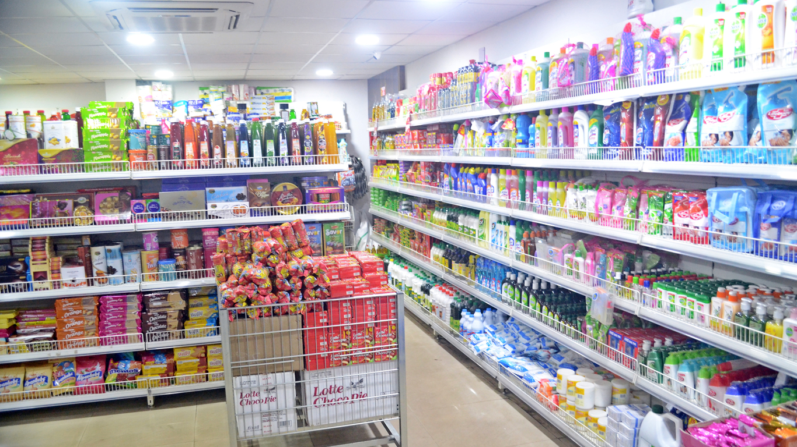
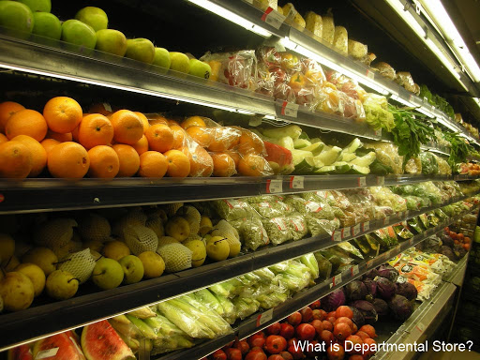
Retail Method

Slide 32
Retail Method
In respect of retail method of measuring inventory, cost is determined by reducing appropriate percentage of gross margin from the sales value.
ICDS now requires that an average percentage for each retail department under retail method is to be mandatorily used

Slide 33
WIP for Service Providers
AS
Excludes WIP of Service Providers
ICDS 
Definition of Inventory (all tangible)
(i) held for sale in the ordinary course of business;
(ii) in the process of production for such sale;
(iii) in the form of materials or supplies to be consumed in the production process or in the rendering of services.
Revenue Recognition
Percentage Completion method
The cost of services in case of a service provider shall consist of labour and other cost of personnel…………….
Short period Services taking <90 days

Slide 34
Disclosures
General Disclosure
Raw materials, work-in-progress, finished goods, goods for trade and stores, spares, etc. are valued at cost or net realisable value, whichever is lower.
Goods in transit are valued at cost to date.
‘Cost’ comprises all costs of purchase, costs of conversion and other costs incurred in bringing the inventory to the present location and condition.
The cost formulae used is either ‘first in first out’, or ‘specific identification’, or the ‘average cost’, as applicable.

Slide 35
Specific Disclosure
Carrying cost of inventory as on Balance Sheet date is as follows:
  Finished goods………..,
  Traded goods…………….,
  Work in progress………………,
  Raw materials……………

Slide 36
ICDS - VIII
Securities

Slide 37
Securities
Deals with Securities as Stock in trade
Lower of Cost or NRV
Category wise Valuation

Slide 38
Shares | Cost | NRV | Notional Gain / Loss | Accounting Standard
Satyam | 1000 | 100 | (900) | 100
Infosys | 100 | 2000 | 1100 | 100
ICDS |  |  |  | 200

Slide 39
Para 12 of ICDS 8
“Notwithstanding anything contained in para 9,10 and 11, at the end of previous year, securities not listed on recognised stock exchange; or listed but not quoted on a recognised stock exchange with regularity from time to time, shall be valued at actual cost initially recognised.”
* Stock is unsold as on 31.03.2017. As per para 12, the said securities need to be valued at cost. Thus, the incremental impact is on profit. (200 -20)
Closing Inventories | 31.03.2016 (Cost) | 31.03.2016 (NRV) | 31.03.2017 (ICDS)*
A Ltd. (Quoted _not Traded) | 100.00 | 10.00
B Ltd. (Quoted _not Traded) | 100.00 | 10.00
Total | 200.00 | 20.00 | 20.00
Valuation (For computation) |  | 20.00 | 200.00
Profits/(Loss) to be recognised |  | (180.00) | 180.00

Slide 40
Inventory of Derivatives
Securities to be valued at lower of cost or NRV
‘Securities’ defined in SCRA
Includes Derivative contracts for trading purposes
Impliedly MTM loss is to be allowed
However MTM gain is not to be recognised
Bucket Approach
Notes:
If the derivatives have been treated as stock-in-trade then there is nothing unusual in the assessee valuing each derivative by applying the rule cost or market whichever is lower. Edelweiss Capital v. ITO (ITA 5324/M/07)

Slide 41
Derivative Future contracts (Expiry 15.04.18) | Enter date 15.03.18 | Year end 31.03.18
NIFTY | 10100 | 9100
BANKNIFTY | 25000 | 25500
Total | 35100 | 34600

Slide 42
Disclosure
No Disclosure Requirement in this ICDS

Slide 43
ICDS - III
Construction Contracts

Slide 44
Retention money
Retention money now included in CR
CIT v. P & C Constructions 318 ITR 113 (Mad.)
Income = Right to Receive
E.D.Sasoon 26 ITR 27(SC)
To remove unintended judicial interpretations
FAQ
Retention money needs to be recognised as revenue on billing if there is reasonable certainty of its ultimate collection, even if such receipt is contingent on satisfaction of certain performance criteria
Retention includes “Progress / Running bills”

Slide 45
Revised Transitional Provisions
complete grandfathering in respect of construction contracts which commenced on or before 31.03.16 but not completed by the said date
therefore contract revenue and contract costs from such construction contracts shall be recognised based on the method regularly followed by the assessee’s prior to 31.03.16

Slide 46
Construction Contracts
Only Percentage Completion Method
Don’t recognize expected losses
Omission of Prudence
Mismatch with MAT Liability
In Project Completion method income is deferred
Notes:
CIT vs. Triveni Engineering 49DTR 253 (Del),
CIT vs. Advance Construction 275 ITR 30 (Guj)),

Slide 47
Expected Losses
Implication of non –allowance of expected loss.
Expected loss in the year 1styear of a 3 year contract was Rs . 300.
Actual Loss on completion of the contract in the third year was Rs. 240.
Year | Book Profit | Profit as per I.T.
I | (300) | (100)
II | - | (100)
III | 60 | (40)

Slide 48
Construction Contracts
Early stage of contract not beyond 25%
If during early stage of contract, the outcome of the contract cannot be estimated reliably, both AS and ICDS require that the contract revenue is recognised only to the extent of costs incurred.
Notes:
CIT v. P & C Constructions (P.) Ltd. [2009] 318 ITR 113 (Mad.)

Slide 49
Treatment of Incidental Income
AS/Ind AS –
Allows reduction of any incidental income from the contract costs.
Committee Report –
It is judicially settled that pre-construction income is not reduced from cost of construction.
ICDS –
Allows reduction of incidental income other than interest, dividend or capital gains.
Notes:
in the case of Tuticorin Alkali Chemicals and Fertilizers Limited vs. CIT (227 ITR 172), wherein the Court has held that interest income earned by the assessee from surplus funds available during the setting up of a factory would be revenue in nature and thus, taxable as income in the year of accrual. However, in its latter decision in the case of CIT vs. Bokaro Steel Ltd. (236 ITR 315), the Court has held that if the assessee receives any amount (for instance, interest income from advances given to contractors or any other incidental income) which is inextricably linked with the process of setting up the plant, then such receipts will go on to reduce the cost of the plant. Hence, it was held that such receipts are capital in nature and cannot be taxed as income.

Slide 50
Construction contracts
Not to Reduce
Interest
Dividend
Capital Gains
Other incidental income
Rent of equipments to others etc.

Slide 51
Applicability on Real Estate
FAQ - Presently no ICDS notified for
real estate developers,
built operate transfer projects and
leases
Shall be governed by the existing provisions of Act and ICDS, as may be applicable (Q.12)
Sale after complete construction
Advance booking – construction services rendered

Slide 52
Real Estate Developers
Department insists on Percentage completion method
CASS reason
Conditions
Significant risk and rewards are transferred
At 25% project activity is complete
10% advance of agreement value is received
whether percentage completion method followed?
25% area is secured (booking done)

Slide 53
Case 1
There are 10 plots in a project
10% Advance received in respect of 8
Revenue recognition for only 8 projects

Slide 54
Case 2
Total Saleable area = 20000 sq ft.
Estimated Project Cost = 600 Lakhs
(Land = 300 Construction = 300)
Cost incurred till date = 360 Lakhs
Land = 300 construction = 60)
Total area sold = 5000 sq ft.
Sale consideration agreed = 200 Lakhs
Amount realized till year end = 50 Lakhs
Notes:
No revenue recognition

Slide 55
25% area sold
More than 10% advance received on it
60% of total project cost incurred
25% of construction cost not incurred

Slide 56
Case 3
Total Saleable area = 20000 sq ft.
Estimated Project Cost = 600 Lakhs
(Land = 300 Construction = 300)
Cost incurred till date = 390 Lakhs
Land = 300 construction = 90)
Total area sold = 5000 sq ft.
Sale consideration agreed = 200 Lakhs
Amount realized till year end = 50 Lakhs
Notes:
No revenue recognition

Slide 57
Stage of completion
  Contract cost incurred / Estimated total contract cost
  390/600 = 65%
Sale agreement for consideration = 200 Lakhs
  65% of 200 Lakhs
Revenue to be recognized = 130 Lakhs
Prop.Contract cost = 5000/20000 * 390 Lakhs = 97.5 Lakhs
Contract Profit/Income = 32.5
Work in progress = 390 – 97.5 = 292.5

Slide 58
FAQ 14
Whether ICDS is applicable to revenues which arc liable to tax on gross basis like interest, royalty and fees for technical services for non-residents u/s. 115A of the Act.
Answer: Yes, the provisions of ICDS ‘hall also apply for computation of these incomes on gross basis for arriving at the amount chargeable to tax.
115A – Gross basis – no return required, no books so no ICDS
Tax treaty – ‘….paid basis’ shall prevail

Slide 59
Revenue Recognition
Export Incentives
AS – AS-9 Not applicable
ICDS - On making claim

Slide 60
General Disclosure
Stage of completion has been determined by the Management based on
  Contract costs incurred as a percentage of total estimated contract costs estimated and
  also considering current technical data, forecasts and estimates of net expenditure to be incurred in future including for contingencies, etc.

Slide 61
Specific Disclosure
Contract revenue Rs………………
Contract costs Rs…………..
Retention money Rs……………….. deducted
Advance for existing contracts Rs………….
Contract profits of Rs………………..

Slide 62
ICDS - IV
Revenue Recognition

Slide 63
Revenue Recognition
Significant Risks and Rewards are transferred
Reasonable certainty of ultimate collection

Slide 64
Revenue Recognition
Reasonable Certainty
Services
Sale of Goods
Yes
No
Use of resources by others yielding interest, royalty and Dividend
No

Slide 65
Interest on NPA
ICDS Interest on NPA to be recognized on Time basis
AS – Not to be recognized if uncertain
INCOME = Right to Receive
E.D. Sassoon & Co. Ltd. (SC) (26 ITR 27),
Interest, to be recognized on time basis.

Slide 66
FAQ on Interest
Interest accrues on time basis
royalty accrues on the contractual term
therefore needs to be recognised even when the criteria of reasonable certainty of ultimate collection is not met.
Any subsequent non-recovery in either cases can be claimed as bad debts under S.36(1)(vii) of the ITA. (Banks only)
Further, specific provisions of ITA (e.g. S.43D) shall prevail over the provisions of ICDS (Q.13) (NBFC)

Slide 67
Interest Income of Assessee
Interest income booked under IOS
No provision for Bad debts in Other Sources

Slide 68
Issues
Uncertain revenue – Provision for Bad debts
Applicability of MAT on Provisions
Revenue Recognition of Finance Lease
Revenue once recognized cannot be reversed

Slide 69
Revised ICDS IV –Refund Interest
ICDS earlier required all types of interest income to be recognised on time basis
It included even income receivable from Government on refunds.
ICDS is amended to provided that ‘Interest on refund of any tax, duty or cess shall be deemed to be the income of the previous year in which such interest is received.
Notes:
43 taxmann.com 123 (Andhra Pradesh HC) M. Jaffer Saheb v. CIT
Section 5, read with section 244, of the Income-tax Act, 1961 - Income - Accrual of (Interest on refund) - Assessment year 1990-91 - Whether once income has legally accrued to assessee, i.e. assessee has acquired a right to receive same, though its valuation may be postponed to future date, determination or quantification of amount does not postpone accrual - Held, yes - As a result of Tribunal's order, dated 16-6-1989, granting substantial relief to assessee for assessment year 1982-83, assessee received refund alongwith interest for period from 30-10-1985 to 31-8-1989 which was brought to tax by Assessing Officer in assessment year 1990-91 ignoring claim of assessee to spread over said amount for respective assessment years - Whether interest on refund accrued from previous year relevant to assessment year 1982-83 and was chargeable to tax in respective years for which same was paid - Held, yes [Para 16] [In favour of assessee
2011] 9 taxmann.com 265 (Kerala)
HIGH COURT OF KERALA
Smt. K. Devayani Amma
v.
Deputy Commissioner of Income-tax*
C.N. RAMACHANDRAN NAIR AND V.K. MOHANAN ,JJ.
IT APPEAL NO. 1701 OF 2009†
OCTOBER 28, 2009
Section 5, read with section 244 of the Income-tax Act, 1961 - Income - Accrual of - Assessment year 1994-95 - Whether interest, under section 244(1A) accrues to assessee only when assessee is found to be eligible for refund of excess tax on revision of assessment based on orders in appeal and it is assessable to tax in assessment year in which such interest is granted to assessee along with refund - Held, yes
[1995] 212 ITR 385 (ORI.)
HIGH COURT OF ORISSA
Commissioner of Income-tax
v.
Sri Popsingh Rice Mill
G.B. PATNAIK AND K.L. ISSRANI, JJ.
SPECIAL JURISDICTION CASE NO. 82 OF 1991
DECEMBER 17, 1994
Section 5, read with section 244 of the Income-tax Act, 1961 – Income – Accrual of – Assessment year 1982-83 – Whether income received by assessee by way of interest under section 244 on refund determined and quantified under section 240 was assessable only in year of receipt and not earlier on accrual basis – Held, yes

Slide 70
Changes in revised ICDS IV
  Recognition of revenue on straight line basis:
    AS/Ind AS–
      In PCM, when services are provided by an indeterminate number of acts over a specific period of time, revenue is recognised on a straight line basis over the specific period unless there is evidence that some other method better represents the pattern of performance.
    Similar exception was not provided in ICDS IV.
    ICDS IV is now amended to provide for a similar exception.
    Thus, service contracts for a specific period can be recognised on time basis instead of stage of completion contract. (Eg. AMC Contracts)

Slide 71
Changes in revised ICDS IV – 90 Days
Recognition of revenue on CPM for short contracts:
  In case of short services, which fall in two financial years, application of PCM created practical difficulties as well as served no purpose.
  Eg: Professional Consultancy services, Insurance agents, banking services, logistic services, etc.
  To address this issue ICDS IV amended to provide
    “7. Revenue from service contracts with duration of not more than ninety days may be recognised when the rendering of services under that contract is completed or substantially completed.”
  Since PCM has practical applicability only on long contracts, the duration should have been 12 months.

Slide 72
Interest free deposit
Ind As
Valuing Interest free deposit at amortised cost and book loss at initiation
Every year notional interest income to be booked
Eg. 100 given today for 5 years – Rs.60 today
ICDS
No deduction in first year
No income every year
MAT impact

Slide 73
Long term investments/bonds
Effective Interest rate (Ind AS)
Effective Interest Rate
Market Interest
Actual Interest (ICDS)
Discount
Market Interest (Reverse IT)
Capital
Revenue (ICDS)

Slide 74
Ind AS
Annuity
Contractor’s profit
Operation & Maintenance services
ICDS
Capitalise Cost
Depreciation
BOT
Cost construction services (Cons period)

Slide 75
Service Providers – Percentage Completion
Implication of following project completion method for books of accounts?
  e.g. service contract will take 3 years for execution and expected profit is Rs. 300.
Year | As per Income tax | Books | Tax @ 30% | MAT @ 18.5%
I | 100 | - | 30 | -
II | 100 | - | 30 | -
III | 100 | 300 | 30 | 55.5
TDS Mismatch:
  ICDS does not require raising of a bill - if the transaction is covered by TDS then complication will increase, as the tax would be deducted in the year in which the bill is raised

Slide 76
Double taxation due to MAT
Nagarjuna Fertilisers 373 ITR 252 (AP High Court)
  “the legislature has taken every precaution to ensure that no amount is subject to taxation twice. Mere inclusion of amounts in profit and loss did not make much difference from income-tax perspective. Bringing an amount to tax (which has already suffered tax) under section 115JB (or section 115J) has been quoted to be an anomaly (if not absurdity). ”

Slide 77
ICDS - V
Tangible Fixed Assets

Slide 78
New AS 10- Property, plant and equipment
Machinery spares to be capitalised on consumption as per New AS-10
ICDS V requires it to be charged to P&L as per Old AS-10
Deferred tax liability

Slide 79
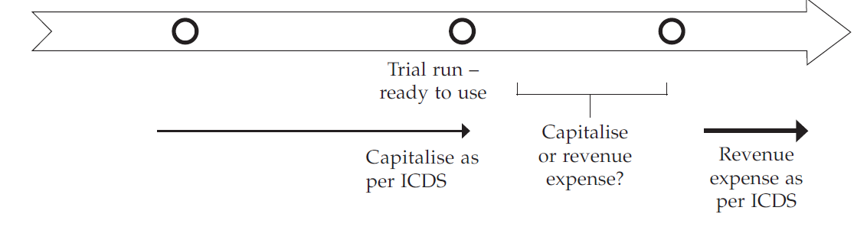
Period of Capitalization
Revenue as per AS
Construction of Asset
Trial Run
Ready to use
Commercial Production
FAQ says the pre commercial production cost to be capitalised

Slide 80
Depreciation as per Section 32
Actual Cost as per Section 43(1)
Income from sale treated as capital gains on which ICDS not applicable

Slide 81
ICDS-VI
Effects of changes in
Foreign Exchange currency rates

Slide 82
Fluctuation on Foreign Loan for acq.
Indian Asset
SC – capital receipt/expense
ICDS charge to P/L
Foreign Asset
Capitalise S.43A

Slide 83
Exchange Difference on Conversion
FCTR
ICDS
P&L
AS
Non Integral

Slide 84
ICDS VII
Government Grants

Slide 85
Amendment
S.2(24)((xviii)
All subsidies and grant are now taxable
Amendment not part of Finance Bill
Exception
Carbon credit
Prepayment of sales tax deferral loan

Slide 86
Government Grants
Grant Received
Depreciable Asset
Specific
Specific Reduction
Non Specific
Reduction from All assets
Non Depreciable
P&L

Slide 87
Government Grants
Recognition cannot be postponed after actual receipt
Receipt is not concluding evidence for accrual of income –Godhra Electricity (SC)
Conditional grant
Accrual Override

Slide 88
ICDS - IX
Borrowing Costs

Slide 89
Definition of Qualifying Asset
As per AS
As per ICDS
Qualifying asset is an asset that necessarily takes a substantial period of time to get ready for its intended use or sale.
Ordinarily, twelve months is considered as substantial period of time
For General Borrowings
  Assets that necessarily require a period > 12 months for the acquisition, construction or production
  For Specific Borrowing
    No Threshhold

Slide 90
Formula for Capitalisation
Non Specific Borrowing Cost × Average Cost of QA on First and Last day of P.Y.
---------------------------
Average Total Assets on First and Last day of P.Y.
Qualifying Asset ?
Flaws?

Slide 91
Average QA- how to determine
QA appears on first and last day
The average of the QA as appearing on first and last day of the PY
QA does not appear on first day or both on first and last day
½ the cost of QA
QA does not appear on last day
The average of the cost of QA as appearing on the first day and that on the date of put to use or completion as the case may be.

Slide 92
Para 7
The capitalisation of borrowing costs shall commence on the date on which funds were specifically borrowed for acquisition
Para 8
Capitalisation of borrowing costs shall cease when such asset is first put to use;
View: Assets put to use will not be Qualifying Assets

Slide 93
Disallowed Interest
Borrowing cost considered for capitalisation shall exclude borrowing cost which are specifically disallowed under the specific provisions of the ITA (Q.20)
  Section 14A
  Section 40(a)(ia)
  Section 43B

Slide 94
Issues
Whether general borrowing costs should be attributed to cost of inventory of real estate ?
36(1)(iii) v. ICDS
No provision for suspension of capitalization in the ICDS.
Bill discounting charges and other similar charges are covered under the definition of borrowing cost (Q.21)
Allocation of general borrowing cost amongst different qualifying assets shall be done on asset-by-asset basis

Slide 95
ICDS - X
Provisions, Contingent Liabilities and Assets

Slide 96
Issues
“Reasonably Certain” in place of “Probably”
Restriction on recognition of Contingent Liability
Contingent Asset to be recognised on certainty of inflow of economic benefits

Slide 97
Onerous Contract
AS
present obligation under the contract is recognized and measured as a provision.
ICDS
Does not deal with recognition of loss arising out of onerous contract

Slide 98
Difference between ICDS and AS

Slide 99
ICDS I - Accounting Policies
S. No | Accounting Standard 1 – Significant Accounting Policies | ICDS I – Accounting Policies
1 | Scope the disclosure of significant accounting policies followed in preparing and presenting financial statements | This ICDS deals with significant accounting policies
2 | Meaning of the term Accounting Policies The accounting policies refer to the specific accounting principles and the methods of applying those principles adopted by the enterprise in the preparation and presentation of financial statements | The accounting policies refer to the specific accounting principles and the methods of applying those principles adopted by the person
3 | Selection of the Accounting Policies Prudence and Materiality are recognised as considerations governing the selection of accounting policies | The concept of prudence and materiality are not recognised in ICDS. ICDS provides that "marked to market loss" or an "expected loss" shall not be recognised unless the recognition of such loss is in accordance with the provisions of any other ICDS
Notes:
Decisions may be overruled -

Slide 100
ICDS I - Accounting Policies
S. No | Accounting Standard 1 – Significant Accounting Policies | ICDS I – Accounting Policies
4 | Change in Accounting Policy Change in accounting policy should be made only if it is required by statute, accounting standard or if such change will result in more appropriate presentation of financials | An accounting policy shall not be changed without any reasonable cause
5 | Disclosure of Accounting policies All significant accounting policies should be disclosed in the financial statements of the enterprise | All significant accounting policies adopted by a person shall be disclosed. ICDS is silent about where such disclosure is required to be made. Disclosure in Tax audit report Cl.13
Notes:
Decisions for ‘reasonable cause’

Slide 101
S. No | Accounting Standard 2- Valuation of Inventories | ICDS II – Valuation of Inventories
1 | Scope Applies to share, debentures and financial instruments held as stock-in-trade | Does not apply to shares, debentures and financial instruments held as stock in trade covered by ICDS VIII
2 | Inventories of service providers AS-2 has not prescribed any method of valuation of inventories in the case of a service provider | Para 6 of ICDS provides mechanism for valuation of inventory of service provider
3 | Method of Valuation Standard Cost method is also permitted for valuation of inventory | ICDS does not recognise standard cost method for valuation of inventory
4 | Opening Inventory AS – 2 does not mention specifically valuation of of opening inventory | Opening Inventory The value of the inventory of a business as on the beginning of a previous year shall be the same as the value of inventory at the end of the immediately preceding previous year. If the business commenced during the previous year, it shall be cost of inventory available on the day of commencement of business.
Notes:
Point 3 – Method of valuation permitted – Specific identification, FIFO, weighted average and retail method.

Slide 102
S. No | Accounting Standard 2- Valuation of Inventories | ICDS II – Valuation of Inventories
5 | Change in Method of Valuation AS-2 read with AS-5 provides that the method of valuation of inventories may be changed if it is considered that the change would result in a more appropriate presentation. | The method of valuation of inventory once adopted by a person in any previous year shall not be changed without a reasonable cause
6 | Duty Drawback Duty drawback was to be deducted while computing cost of purchase as per AS-2 | No such specific exclusion has been made by ICDS
7 | Exclusions from Cost of Inventories Selling and distribution costs to be excluded while computing cost of inventories | Under ICDS, only selling cost is required to be excluded while computing cost of inventories
8 | Valuation of Inventory in case of certain dissolutions No specific mention of valuation of inventory in case of dissolution in AS | ICDS provides that inventory on the date of dissolution of partnership firm or AOP or BOI shall be valued at the net realizable value
Notes:
No implication of including duty drawback inline with section 145A of the Act.

Slide 103
ICDS III – Construction Contracts
S. No | Accounting Standard 7- Construction Contracts | ICDS III – Construction Contracts
1 | Retention Money AS-7 is silent on retentions | ICDS provides that retention money is to be included in contract revenue
2 | Expected Losses Para 35 of AS allows recognition of future/anticipated losses immediately | ICDS III is silent on treatment of future/anticipated losses.
3 | Incidental Income Incidental income allowed to be set off against contract cost | Incidental income in the nature of interest, dividend and capital gains not allowed to be set off against contract cost

Slide 104
ICDS III – Construction Contracts
S. No | Accounting Standard 7- Construction Contracts | ICDS III – Construction Contracts
4 | Early stages of Contract Revenue shall not be recognized during early stages of contract. What is "early stages" is not defined in the AS – 7. | During early stages of a contract, where the outcome of the contract cannot be estimated reliably contract revenue is recognised only to the extent of cost incurred. The early stages of contract shall not extend beyond 25% of the stage of completion
5 | Recognition of Incentive payments/ claims Only when (i) negotiations are sufficiently advanced that it is probable that customer will accept the claim and (ii) amount is reliably measurable | ICDS omits the requirement that negotiations are sufficiently advanced stage, instead
Notes:
Guidance Note on Accounting for Real Estate Transactions(Revised 2012) has the following criteria:
(a) All critical approvals necessary for commencement of the project have been obtained.
(b) 25% of the expense on construction and development has been incurred
(c) Atleast 25% of the saleable project area is secured by contracts or agreements with buyers.
(d) Atleast 10 % of the total revenue as per the agreements of sale or any other legally enforceable documents are realisedt

Slide 105
ICDS IV – Revenue Recognition
S. No | Accounting Standard 9- Revenue Recognition | ICDS IV – Revenue Recognition
1 | Recognition of revenue from service transactions AS-9 recognises both the "proportionate completion method" and "completed service contract method" for recognition of revenue from service transactions | Revenue from service transactions shall only be recognised by following the "percentage completion method". Requirements of TAS for Construction Contracts to apply mutatis mutandis for recognition of revenue and associated expenses for a service transaction
2 | Reasonable Certainty No significant uncertainty exists regarding collection | Revenue shall be recognised when there is reasonable certainty of its ultimate collection
3 | Interest “Interest accrues, in most circumstances, on the time basis determined by the amount outstanding and the rate applicable. Usually, discount or premium on debt securities held is treated as though it were accruing over the period to maturity.” | “Interest shall accrue on the time basis determined by the amount outstanding and the rate applicable. Discount or premium on debt securities held is treated as though it were accruing over the period to maturity

Slide 106
ICDS IV – Revenue Recognition
S. No | Accounting Standard 9- Revenue Recognition | ICDS IV – Revenue Recognition
4 | Dividend AS 9 lays down the criteria for recognition of dividend | ICDS provides that dividend to be recognised in accordance with the provisions of the Act
5 | Royalties Royalties accrue in accordance with the terms of the relevant agreement and are usually recognised on that basis unless, having regard to the substance of the transactions, it is more appropriate to recognise revenue on some other systematic and rational basis | Royalties shall accrue in accordance with the relevant agreement and shall be recognised on that basis unless, having regard to the substance of the transactions, it is more appropriate to recognise revenue on some other systematic and rational basis
Notes:
Section 8 of the Income Tax Act deals with Dividend Income

Slide 107
S. No | Accounting Standard 10 - Accounting For Fixed Assets | ICDS V – Tangible Fixed Assets
1 | Definition Fixed asset is an asset held with the intention of being used for the purpose of producing or providing goods or services and is not held for sale in the normal course of business. | “Tangible fixed asset” is an asset being land, building, machinery, plant or furniture held with the intention of being used for the purpose of producing or providing goods or services and is not held for sale in the normal course of business.
2 | Expenditure incurred after trial run but prior to commercial production According to Para 9.4, expenditure incurred during the interval between the date on which project is ready to commence commercial production and date on which actual commercial production is commenced, to be charged to the statement of profit and loss | Para 8 of ICDS is silent on this aspect, though it states that expenditure incurred on test runs should be capitalised and those incurred after commercial production to be treated as revenue. .
3 | Aggregation of individually insignificant items Para 8 of AS provides that individually insignificant items can be aggregated and an enterprise may decide to expense an item which could otherwise be included as fixed asset, because the amount of expenditure is not material. | ICDS is silent on the same

Slide 108
S. No | Accounting Standard 10- Accounting For Fixed Assets | ICDS V – Tangible Fixed Assets
3 | Marked to market loss/gain Para 38 of AS 11 provides for recognition of mark to market gain/loss on contracts that are intended for trading or speculation purposes | Para 11(5) of ICDS requires premium, discount or exchange difference on contracts intended for trading, speculation purposes, firm commitment or a highly probable forecast transaction to be recognised at the time of settlement.
4 | Asset acquired for non-monetary consideration The fair value of the asset/securities given up or fair value of the asset acquired, whichever is more clearly evident, should be recorded as actual cost. | The fair value of tangible fixed assets so acquired shall be its actual cost
5 | Various points dealt with in AS 10 Para 13 – Revaluation of Fixed Assets Para 14 – Retirement and Disposal Para 15.1 – Fixed asset acquired on hire purchase Para 16- Fixed assets of special types (Goodwill) | ICDS is silent on these points, except Para 18 of ICDS V provides that transfer of tangible fixed asset shall be dealt with in accordance with the Act

Slide 109
ICDS VI – Effects of Changes in Foreign Exchange Rate
S. No | Accounting Standard 11- Changes in Foreign Exchange Rates | ICDS VI – Effect of changes in Foreign Exchange Rates
1 | Scope Firm commitments and highly probable transactions excluded from the scope. | ICDS VI deals with forward contracts entered to hedge the foreign currency risk of a firm commitment or a highly probable forecast transaction.
2 | Non integral operations As per Para 26 of AS, Exchange differences on translation of foreign currency non-integral foreign operations requires accumulation of such exchange difference in foreign currency translation reserve until disposal of investment | Para 9 of ICDS such exchange difference provides that shall be recognized as income or expense

Slide 110
ICDS VII – Government Grants
S. No | Accounting Standard 12 - Accounting for Government Grants | ICDS VII – Government Grants
1 | Scope This Standard deals with accounting for government grants. Government grants are sometimes called by other names such as subsidies, cash incentives, duty drawbacks, etc. | ICDS VII deals with the treatment of Government grants. The Government grants are sometimes called by other names such as subsidies, cash incentives, duty drawbacks, waiver, concessions, reimbursements, etc.
2 | Recognition of Government Grants Government grants available to an enterprise are considered for inclusion in accounts: (i) where there is reasonable assurance that the enterprise will comply with the conditions attached to them; and (ii) where such benefits have been earned by the enterprise and it is reasonably certain that the ultimate collection will be made. Mere receipt of a grant is not necessarily a conclusive evidence that conditions attaching to the grant have been or will be fulfilled. | Government grants should not be recognised until there is reasonable assurance that the person shall comply with the conditions attached to them, and The grants shall be received. Recognition of Government grant shall not be postponed beyond the date of actual receipt.

Slide 111
ICDS VII – Government Grants
S. No | Accounting Standard 12 - Accounting for Government Grants | ICDS VII – Government Grants
3 | Grant for non-depreciable asset(land) Para 14 of AS requires Government Grant for non-depreciable asset (say, land) to be credited to capital reserve account. | Under ICDS , such grants are covered under Para 9 which reads as under: “The Government grants other than covered by paragraph 5, 6, 7, and 8 shall be recognised as income over the periods necessary to match them with the related costs which they are intended to compensate.”
4 | Grant in the nature of promoter’s contribution As per Para 10 of AS 12, grant of the nature of promotor’s contribution are to be treated as capital reserve | ICDS does not cover grant in the nature of promoter’s contribution

Slide 112
ICDS VIII – Securities
S. No | Accounting Standard 13 – Accounting for investments | ICDS VII – Securities
1 | Scope Covers long-term and current investments but does not cover stock-in-trade | Applicable only to investments held as stock in trade
2 | Valuation of Security Para 15 of AS 13, permits comparison of actual cost with the net realisable value category wise and based on individual security | ICDS does not permit comparison of actual cost with the net realisable value category wise.
3. | Method of valuation Para 22 of AS allowed FIFO and weighted average method for valuation of Investments | Para 13 of ICDS allows only FIFO method

Slide 113
ICDS VIII – Securities
S. No | Accounting Standard 13 – Accounting for investments | ICDS VII – Securities
4 | Security acquired in exchanged for asset Transaction of exchange of securities for consideration received partly in form of securities and partly in the form of other assets | ICDS silent on the same
5 | Valuation AS 13 requires comparison of actual cost with fair value at the year end | Security held as stock in trade shall be valued at actual cost initially recognized or net realizable value at the end of that previous year, whichever is lower

Slide 114
S .No | Accounting Standard 16 – Borrowing Costs | ICDS IX – Borrowing Costs
1 | Qualifying Asset Qualifying asset defined as an asset that takes substantial period f time, usually 12 months to get ready for intended use | “Qualifying asset” means: land, building, machinery, plant or furniture, being tangible assets; know‐how, patents, copyrights, trade marks, licences, franchises or any other business or commercial rights of similar nature, being intangible assets; inventories that require a period of twelve months or more to bring them to a saleable condition.
2 | Computation of borrowing Costs : Simple formula for computing of borrowing costs | Complex mechanism for computing the borrowing costs, comparatively (discussed in later slide)
3. | Commencement of Capitalisation: Commencement of capitalisation of borrowing costs requires incurring of the expenditure for qualifying asset | Para 7(a) of ICDS on commencement of capitalisation of borrowing cost specifically incurred for qualifying asset from the date of borrowing irrespective whether funds have been utilised or not

Slide 115
S .No | Accounting Standard -16 | ICDS IX
4 | Suspension of borrowing cost Para 17 of the AS provides for suspension of capitalisation of borrowing costs | No such provision specified in ICDS
5 | Cessation of Capitalization: Cessation of capitalisation when substantially all the activities are completed | Cessation of capitalisation when asset is first put to use
6 | Various points dealt with AS-16 Certain exchange differences on foreign currency loans, to the extent regarded as an adjustment to interest cost, Income from temporary investment of borrowed funds was reduced from borrowing cost to be capitalised | ICDS is silent on these issues, other than providing that it would be subject to provisions of section 43A of the Act and Rule 115
Notes:
E.g.
For point 4 – If construction of building is not progressing due to dispute pending in court than, as per AS-16 borrowing cost in the extended period of contract to be charged to profit and loss account, whereas, as per ICDS – IX the same needs to be capitalized.

Slide 116
ICDS X- Provisions, Contingent, Liabilities and Contingent Assets
S .No | Accounting Standard 29 - Provisions, Contingent Liabilities and Contingent Assets | ICDS X- Provisions, Contingent Liabilities and Contingent Assets
1 | Recognition of provision A provision should be recognised when : it is probable that an outflow of resources embodying economic benefits will be required to settle the obligation; | A provision should be recognised when : it is reasonably certain that an outflow of resources embodying economic benefits will be required to settle the obligation
2 | Recognition of contingent asset Contingent Asset recognised when inflow of resources is ‘virtually certain’ | Contingent year in which the change occurs. asset must be assessed continually and when it becomes ‘reasonably certain’ that inflow of economic benefit will arise, the asset and related income are recognised – in the previous
3 | Reversal of provision Provision to be reversed when it is no longer probable that outflow of resources would be required. | Provision to be reversed if it is no longer reasonably certain that an outflow of resources embodying economic benefits will be required to settle the obligation

Slide 117
ICDS X- Provisions, Contingent, Liabilities and Contingent Assets
S . No | Accounting Standard 29 - Provisions, Contingent Liabilities and Contingent Assets | ICDS X- Provisions, Contingent Liabilities and Contingent Assets
4 | Reimbursement Reimbursement to be recognized when it is virtually certain that reimbursement would be received | Reimbursement substitutes the words ‘virtually certain’ with the words ‘reasonably certain’
5 | Enactment of Law when a new law is to be enacted, an obligation in that regard arises only when it is virtually certain that the law would be enacted | Enactment of Law obligation arises on enactment of the legislation

Slide 118
FAQ’S

Slide 119
1: What is the interplay between ICDS-I and maintenance of hooks of accounts?
Answer: As stated in the Preamble, ICDS is not meant for maintenance of books of accounts or preparing financial statements BUT The accounting policies mentioned in ICDS-I being fundamental in nature shall be applicable for computing income

Slide 120
Question 2: Certain ICDS provisions arc inconsistent with judicial precedents. Whether these judicial precedents would prevail over ICDS?
The ICDS have been notified after due deliberation and after examining judicial views for bringing certainty on the issues covered by it. Certain judicial pronouncements were pronounced in the absence of authoritative guidance on these issues under the Act for computing Income. Since certainty is now provided by notifying ICDS under section 145(2), the provisions of ICDS shall be applicable

Slide 121
Question 3: Does ICDS apply to non-corporate taxpayers who are not required to maintain hooks of account and/or those who are covered by presumptive scheme of taxation like sections 44AD, 44AE, 44ADA, 44B, 44BB, 44BBA, etc. of the Act?
Answer: ICDS is applicable to specified persons having income from business or profession’ or ‘Income from other sources’. Therefore, the relevant provisions of ICDS shall also apply to the persons computing income under the relevant presumptive taxation scheme. For eg., for computing presumptive income of a partnership firm u/s 44AD of the Act, the provisions of ICDS on Construction Contract or Revenue recognition shall apply for determining the receipts or turnover, as the ease may be.

Slide 122
Question 4: If there is conflict between ICDS and other specific provisions of the Income-tax rules,1962(`the Rules’) governing taxation of income like rules 9A, 9B etc. of the Rules, which provisions shall prevail?
Answer: ICDS provides general principles for computation of income. In case of conflict, if any, between the provisions of Rules and ICDS, the provisions of Rules, which deal with specific circumstances, shall prevail.

Slide 123
Question 5: How will ICDS apply to companies which adopted Ind-AS?
Answer: ICDS shall apply for computation of taxable income under the head ” Profit and gains of business or profession” or “Income from other sources” under the Income Tax Act. This is irrespective of the accounting standards adopted by companies i.e. either Accounting Standards or Ind-AS.

Slide 124
Question 6: Whether ICDS shall apply to computation of Minimum Alternate Tax (MAT) under section 115JB of the Act or Alternate Minimum Tax (AMT) under section 115JC of the Act?
Answer: Since, the provisions of ICDS are applicable for computation of income under the regular provisions of the Act, the provisions of ICDS shall not apply for computation of MAT.
AMT under section 115JC of the Act is computed on adjusted total income which is derived by making specified adjustments to total income computed as per the regular provisions of the Act. Hence, the provisions of ICDS shall apply

Slide 125
Question 7: Whether the provisions of ICDS shall apply to Banks, Non-banking financial institutions, Insurance companies, Power sector, etc.?
Answer: The general provisions of ICDS shall apply to all persons unless there arc sector specific provisions contained in the ICDS or the Act. For example, ICDS VIII contains specific provisions for banks and certain financial institutions and Schedule 1 of the Act contains specific provisions for Insurance business.

Slide 126
Question 8: Para 4(ii) of ICDS-I provides that Market to Market ( MTM) loss or an expected loss shall not he recognized unless the recognition is in accordance with the provisions of any other ICDS. Whether similar consideration applies to recognition of MTM gain or expected incomes?
Answer: Same principle as contained in ICDS-I relating to MTM losses or an expected loss shall apply mutatis Mutandis to MTM gains or an expected profit.

Slide 127
Question 9: ICDS-I provides that an accounting policy shall not he changed without ‘reasonable cause’. The term ‘reasonable cause’ is not defined. What shall constitute `reasonable cause’?
Answer: Under the Act, ‘reasonable cause’ is an existing concept and has evolved well over a period of time conferring desired flexibility to the tax payer in deserving cases.

Slide 128
Question 10: Which ICDS would govern derivative instruments?
Answer: ICDS –VI (subject to para 3 of ICDS-VIII) provides guidance on accounting for derivative contracts such as forward contracts and other similar contracts. For derivatives, not within the scope of ICDS-VI, provisions of ICDS-1 would apply.

Slide 129
Question 11: Whether the recognition of retention money, receipt of which is contingent on the satisfaction of certain performance criterion is to be recognized as revenue on billing?
Answer: Retention money, being part of overall contract revenue, shall be recognised as revenue subject to reasonable certainty of its ultimate collection condition contained in pars 9 of on Construction contracts.

Slide 130
Question 12: Since there is no specific scope exclusion for real estate developers and Build -Operate- Transfer (BOT) projects from ICDS IV on Revenue Recognition, please clarify whether ICDS-III and ICDS-IV should be applied by real estate developers and BOT operators. Also, whether ICDS is applicable for leases.
Answer: At present there is no specific ICDS notified for real estate developers, BOT projects and leases. Therefore, relevant provisions of the Act and ICDS shall apply to these transactions as may be applicable.

Slide 131
Question 13: The condition of reasonable certainty of ultimate collection is not laid down for taxation of interest, royalty and dividend. Whether the taxpayer is obliged to account for such income even when the collection thereof is uncertain?
Answer: As a principle, interest accrues on time basis and royalty accrues on the basis of contractual terms. Subsequent non recovery in either cases can be claimed as deduction in view of amendment to 5.36 (1) (vii). Further, the provision of the Act (e.g. Section 43D) shall prevail over the provisions of ICDS.

Slide 132
Question 14: Whether ICDS is applicable to revenues which arc liable to tax on gross basis like interest, royalty and fees for technical services for non-residents u/s. 115A of the Act.
Answer: Yes, the provisions of ICDS ‘hall also apply for computation of these incomes on gross basis for arriving at the amount chargeable to tax.

Slide 133
Question 15: What shall be the treatment of expense incurred after the conduct of test runs and experimental production but before commencement of commercial production?
Answer: As clarified in Para 8 of ICDS-V, the expenditure incurred till the plant has begun commercial production, that is, production intended for sale or captive consumption, shall be treated as capital expenditure.

Slide 134
Question 16: What is the taxability of opening balance as on 1st day of April 2016 of Foreign Currency Translation Reserve (FCTR) relating to non-integral foreign operation, if any, recognised as per Accounting Standards (AS) 11?
Answer: FCTR balance as on 1 April 2016 pertaining to exchange differences on monetary items for non-integral operations, shall be recognised in the previous year relevant for assessment year 2017-18 to the extent not recognised in the income computation in the past.

Slide 135
Question 17: For subsidy received prior to ^{1st} day of April 2016 but not recognised in the books pending satisfaction of related conditions and achieving reasonable certainty of receipt, how shall the same he recognised under ICDS on or after 1st day of April 2016?
Answer: All government grants actually received prior to 1.4.16 shall he deemed to have been recognised on its receipt in accordance with Para 4(2) of ICDS-VII and accordingly will be outside the transitional provision and therefore the government grants received on or after 1st day of April 2016 and for which recognition criteria provided in Para 5 to Para 9 of ICDS-VII is also satisfied thereafter, the same shall be recognised as per the provisions of ICDS-VII. The grants received prior to 1.4.16 shall continue to be recognised as per the law prevailing prior to that date.
For exampletotal subsidy entitlement of 10 Crore an amount of 6 Crore is recognised in the books of accounts till 31.3.16 and recognition of balance 4 Crore is deferred pending satisfaction of related conditions and/or achieving reasonable certainty of The balance amount of 4 Crore will be taxed in the year in which related conditions are met and reasonable certainty is achieved. If these conditions are met over two years, the amount of 4 Crore shall be taxed over the period of two years. The amount of 6 Crore for which recognition criteria were met prior to 1.4.16 shall not be taxable post 1.4.16.
But if the subsidy is already received prior to 1.4.16, Para 13 of ICDS-VII shall not apply even if some of the related conditions are met on or after 1.4.16. This is in view of Para 4(2) of ICDS-VII which provides that Government grant shall not be postponed beyond the date of actual receipt. Such grants shall continue to be governed by the provisions of law applicable prior to 1.4.16.

Slide 136
Question 18: If the taxpayer sells a security on the 30.4.17. The interest payment dates are December and June. The actual date of receipt of interest is on the 30.6.17 but the interest on accrual basis has been accounted as income on the 31.3.17. Whether the taxpayer shall he permitted to claim deduction of such interest i.e. offered to tax but not received while computing the capital gain?
Answer: Yes, the amount already taxed as interest income on accrual basis shall be taken into account for computation of income arising from such sale.

Slide 137
Question 20: There are disallowances under sections like 14A, 43(1), 40(a)(i), 40(a)(ia), 40A(2)(b), etc of the Act. Whether borrowing costs to be capitalized under ICDS-IX should exclude portion of borrowing costs which gets disallowed under such specific provisions?
Answer: Since specific provisions of the Act override the provisions of ICDS, it is clarified that borrowing costs to be considered for capitalization under ICDS IX shall exclude those borrowing costs which are disallowed under specific provisions of the Act. Capitalization of borrowing cost shall apply for that portion of the borrowing cost which is otherwise allowable as deduction under the Act.

Slide 138
Question 21: Whether bill discounting charges and other similar charges would fall under the definition of borrowing cost?
Answer: The definition of borrowing cost is an inclusive definition. Bill discounting charges and other similar charges are covered as borrowing cost.

Slide 139
Question 22: flow to allocate borrowing costs relating to general borrowing as computed in accordance with formula provided under Para 6 of ICDS-IX to different qualifying assets?
Answer: The capitalization of general borrowing cost under ICDS-IX shall he done on asset-by-asset basis.

Slide 140
Question 23: What is the impact of Para 20 of ICDS X containing transitional provisions?
Answer: Para 20 of ICDS X provides that all the provisions or assets and related income shall be recognised for the previous year commencing on or after 1st day of April 2016 in accordance with the provisions of this standard after taking into account the amount recognised, if any, for the same for any previous year ending on or before 31st day of March, 2016.
The intent of transitional provision is that there is neither ‘double taxation’ of income due to application of ICDS nor there should be escape of any income due to application of ICDS from a particular date.

Slide 141
Question 24: Expenditure on most post-retirement benefits like provident fund, gratuity, etc. are covered by specific provisions. There are other post-retirement benefits offered by companies like medical benefits. Such benefits are covered by AS-15 for which no parallel ICDS has been notified. Whether provision for these liabilities are excluded from scope of ICDS X?
Answer: It is clarified that provisioning for employee benefit which are otherwise covered by AS 15 shall continue to he governed by specific provisions of the Act and are not dealt with b^{y} ICDS-X.

Slide 142
Question 25: ICDS-I requires disclosure of significant accounting policies and other ICDS requires specific disclosures. Where is the taxpayer required to make such disclosures specified in ICDS?
Answer: Net effect on the income due to application of ICDS is to be disclosed in the Return of income. The disclosures required under ICDS shall he made in the tax audit report in Form 3CD. however, there shall not be any separate disclosure requirements for persons who are not liable to tax audit.

Slide 143
Delhi HC in case of CTC
ICDS-I : It does away with the concept of 'prudence' and is contrary to the Act and to binding judicial precedents. Therefore, it is unsustainable in law.
ICDS-II : It pertains to valuation of inventories and eliminates the distinction between a continuing partnerships in businesses after dissolution from the one which is discontinued upon dissolution. It fails to acknowledge that the valuation of inventory at market value upon settlement of accounts on a partner leaving which is distinct from valuation of the inventory in the books of the business which is continuing one.

Slide 144
ICDS III - By deploying ICDS-III in a manner that seeks to bring to tax the retention money, the receipt of which is uncertain/conditional, at the earliest possible stage, irrespective of the fact that it is contrary to the settled position, in law, and to that extent para 10 (a) of ICDS III is ultra vires.
Para 12 of ICDS III, read with para 5 of ICDS IX, dealing with borrowing costs, makes it clear that no incidental income can be reduced from borrowing cost. This is contrary to the decision of the SC in CIT vs. Bokaro Steel Limited [1999] 102 Taxman 94 (SC).

Slide 145
ICDS-IV requires an assessee to recognise income from export incentive in the year of making of the claim, if there is 'reasonable certainty' of its ultimate collection.
Proportionate completion method as well as the contract completion method have been recognized as valid methods of accounting under the mercantile system of accounting by the SC in CIT vs. Bilhari Investment Pvt. Ltd. [2008] 168 Taxman 95. Therefore, to the extent that para 6 of ICDS-IV permits only one of the methods, i.e., proportionate completion method, is ultra vires.
(5) ICDS-VI : It states that marked to market loss/gain in case of foreign currency derivatives held for trading or speculation purposes are not to be allowed that is not in consonance with the ratio laid down by the SC

Slide 146
ICDS-VII : It provides that recognition of governmental grants cannot be postponed beyond the date of accrual receipt. It is in conflict with the accrual system of accounting. To this extent, it is held to be ultra vires.
ICDS-VIII : It pertains to valuation of securities.
a. For those entities which aren't governed by the RBI to which Part A of ICDS-VIII is applicable, the accounting prescribed by the AS has to be followed which is different from the ICDS.

Slide 147
Thank You
CA. Pankaj G. Shah
G.J. Shah & Company
Chartered Accountants
Mob + 91 969 189 3040
pankajgshah@gmail.com

