Slide 1
Presumptive taxation 44AD,44ADA and 44AE
Pankaj Shah
Chartered Accountant

Slide 2
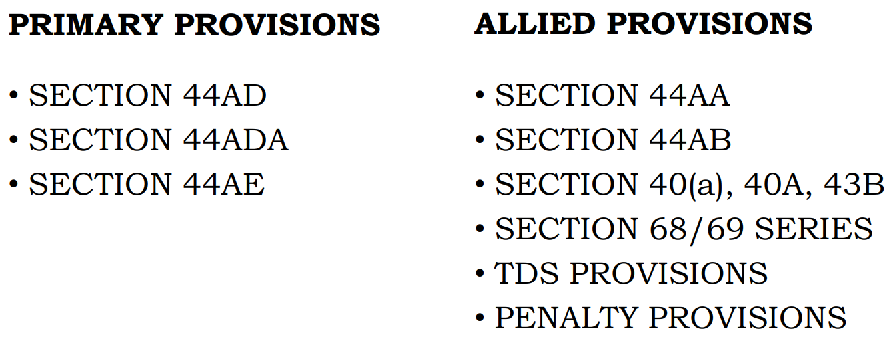
Provisions (since 1994)

Slide 3
Automatic or optional
Option needs to be exercised
If benefit of not maintaining books needed
Unless you opt you don’t fall in 44AD
Unlike pre 2017 regime

Slide 4
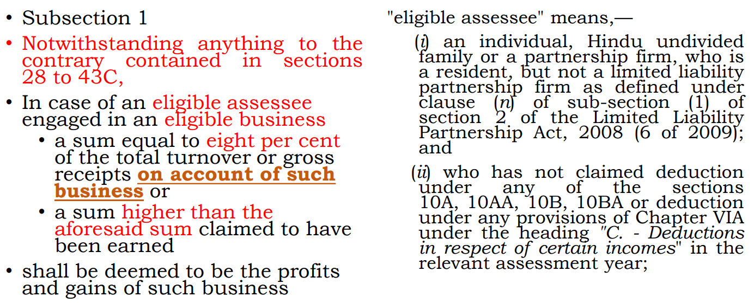
S.44AD
Non resident is not eligible assessee
Limited liability partnership

Slide 5
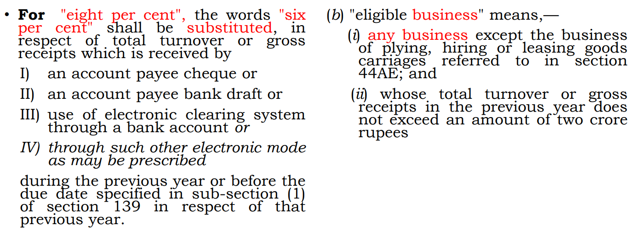
Contd..

Slide 6
Eligible business
Real Estate development
  Land owners’ share
  After conversion of capital asset into stock in trade
    Ensure corresponding debits
    Offer a higher percentage 40-60%
Investment in Partnership
  • Investing in partnership is not amounting to “business”
    Tara Devi Behl 218 ITR 541 (P&H)

Slide 7
Ineligible business
Carrying on specified profession as per 44AA(1)
Person earning commission or brokerage
Person carrying on agency business

Slide 8
Turnover limits
Turnover/Gross receipts
  Upto Rs.2 crore
  Upto Rs. 3 crore
  (If more than 95% receipt in banking)
Professional receipts
  Upto Rs.50 Lakhs
  Upto Rs.75 Lakhs (if 95%+ receipts in bank)
Separate limit for business and profession to be seen

Slide 9
Presumptive profit
Business
6% of turnover through banking
Should be received before due date of filing return
8% of other turnover
Specified Profession
50% of receipts

Slide 10
Deductions deemed to be allowed
All deduction from S.30-38 deemed to be allowed
Depreciation deemed to allowed
Deduction of remuneration deemed to have been allowed
Advance tax to be paid by 15th March

Slide 11
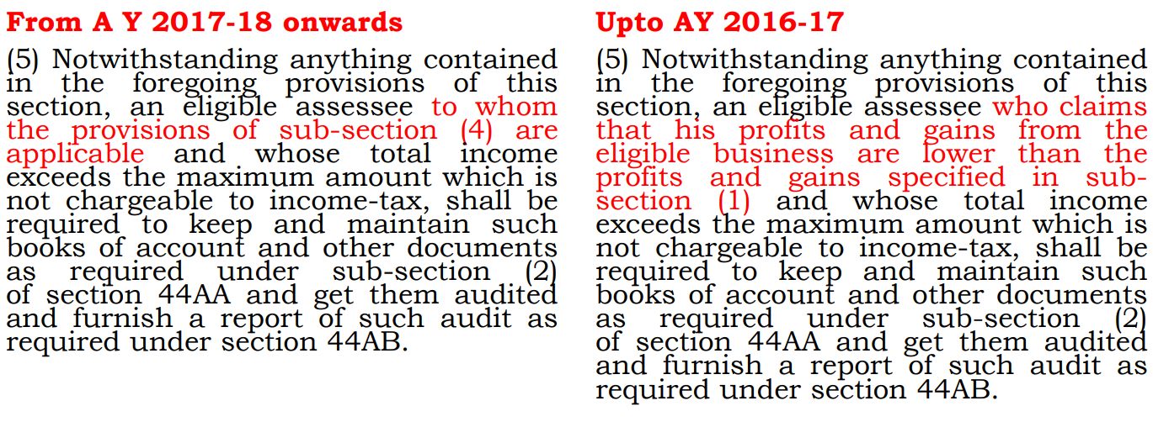
Audit?

Slide 12
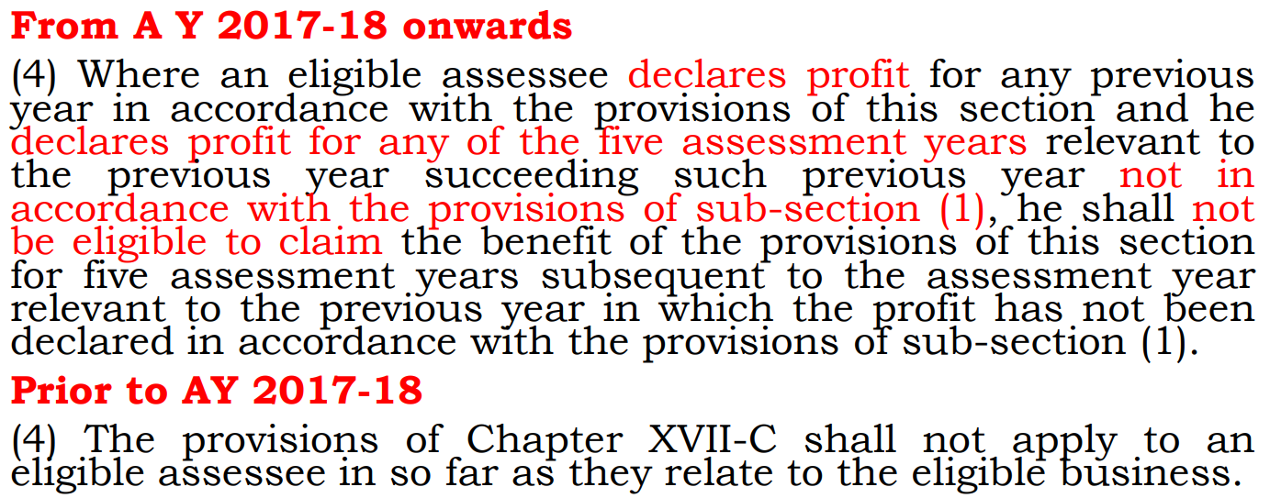

Slide 13
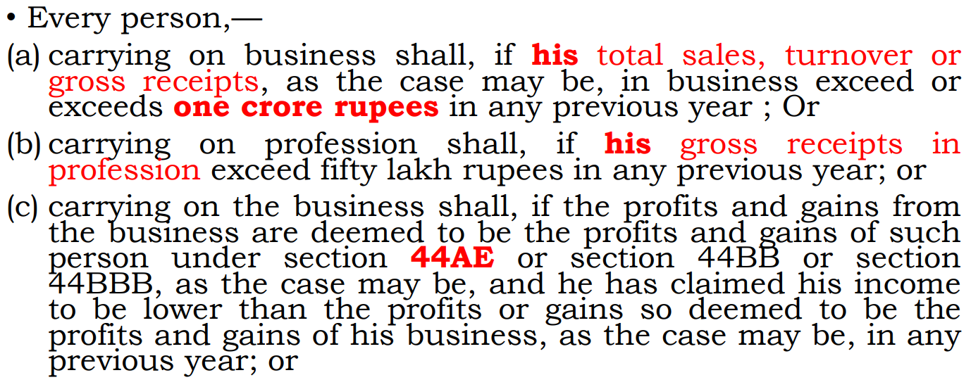
Section 44AB

Slide 14
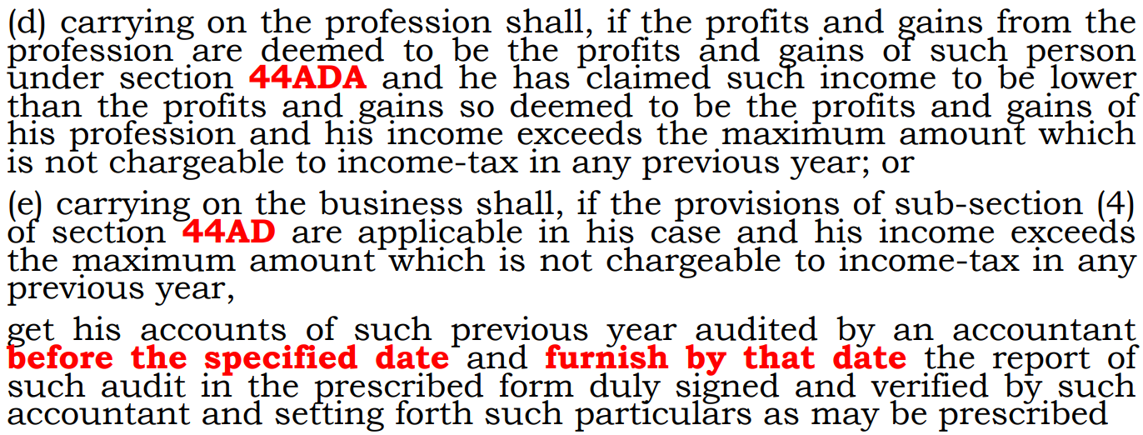
Section 44AB

Slide 15
Higher limits
Limit 10 crore
If 95% of receipts and payments through banking channels
Upto 1 crore
No audit
1 – 2 crore
No audit only if 44AD opted and 8/6% offered
2-10 crore – No audit and no presumptive profit
If 95% Receipt and payment through bank

Slide 16
Issue 1
Assessee engaged in business and profession. Can he claim
S.44AD for business
S.44AD(6)
S.44ADA for profession

Slide 17
CAN S.44AD and 44ADA be opted together
Law does not permit a professional to opt for S.44AD
However in ITR form practically many cases of simultaneous claim of S.44AD and S.44ADA

Slide 18
Specified Profession
Engineering
Legal
Architectural profession
Accountant
Medical
Technical consultant
Interior decoration
Authorized Representative
Company Secretary
Film Artist
Information Technology

Slide 19
Non specified profession
Teacher
Sports coach
Freelancer
Marketing Adviser
HR Consultants
Graphics designer
Translator
Artists (excl. film artist)

Slide 20
Issue 2
Business and Non specified profession
S.44ADA for profession
S.44AD for business

Slide 21
Issue 3:
Person engaged in ‘vocation’
Profession includes ‘vocation’
But not specified profession
S.44AD is applicable on ‘business’
So vocation not eligible
Reference
CBDT Circular 641/1992
Ram Kripal Tripathi 125 ITR 408
Does not involve Substantial intellectual inputs
Tailor, hair cutting, electrician, carpenter, driver

Slide 22
Issue 4
Person engaged in business
Has been claiming 44AD in earlier years
This year Turnover less than 1 crore
offering less than 8%
Has commission of Rs.100
Audit requirement?
S.44AD(6)
S.44AD(4) not applicable as excluded and not opted out

Slide 23
Issue 5:
F&O transactions
Turnover (for only calculation of limit)
Aggregate positive and negative difference
In options add premium paid
In books
Income on credit and loss on debit side
Salaried persons involved in FNO
S.44AD not automatic
No audit requirement if books maintained
Balance sheet – Broker balance and capital
Profit and loss – income and loss and expenses
Personal balance sheet not required
Savior : S.44AD(6)

Slide 24
Issue 6:Turnover
(inclusive or exclusive of GST)
S.2(112) of CGST defines turnover to exclude CGST, SGST, IGST
Accounting standards provide exclusive system of accounting
Contrary S.145A
Provision in context of excise
Not for bringing goods to location and condition
GST on outward supply
S.145 for method of accounting and not for computation

Slide 25
Issue 7 : Allowances
Carry forward of loss allowable
Not deduction
Current year loss
Adjustment not deduction
Partners remuneration
Deduction u/s 30-38
S.40(a), 40(a)(ia), 40A(3)
Deemed to be allowed
Non obstante 44AD
Unabsorbed depreciation ?

Slide 26
Issue 8:
Section 44AD and 43B(h)
Books are not maintained and
Section 44AD states
  “Notwithstanding anything to the contrary contained in sections 28 to 43C, ……………
  Any deduction allowable under the provisions of sections 30 to 38 shall, for the purposes of sub-section (1), be deemed to have been already given full effect to and no further deduction under those sections shall be allowed.”
  No Disallowance in 44AD cases
| CA Pankaj Shah | 969 189 3040 |

Slide 27
Issue 9 : S.43CA vs. 44AD
44AD : Non obstante 28-43C
Turnover deeming provision
Provisions complementary to each other

Slide 28
TDS Requirement
If in earlier Year
Business turnover exceeds 1 crore
Profession exceeds 50 Lakhs
The condition of getting audited is changed due to increase in tax audit limit
Implications
40(a) N.A.
Other provisions shal apply

Slide 29
Section 68 and 44AD
S. 68
“sum found credited in the books of accounts”
No books maintained in 44AD
Not required to explain every entry included in turnover
Other provisions of S.69 may apply

Slide 30
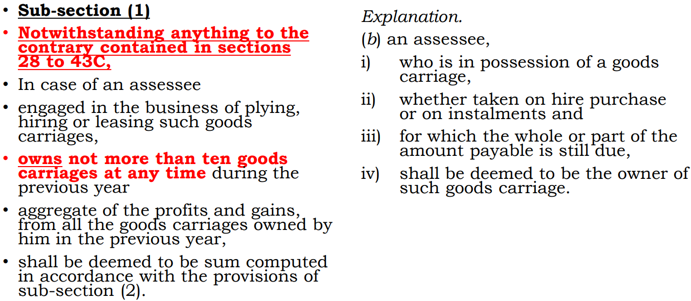
Section 44AE

Slide 31
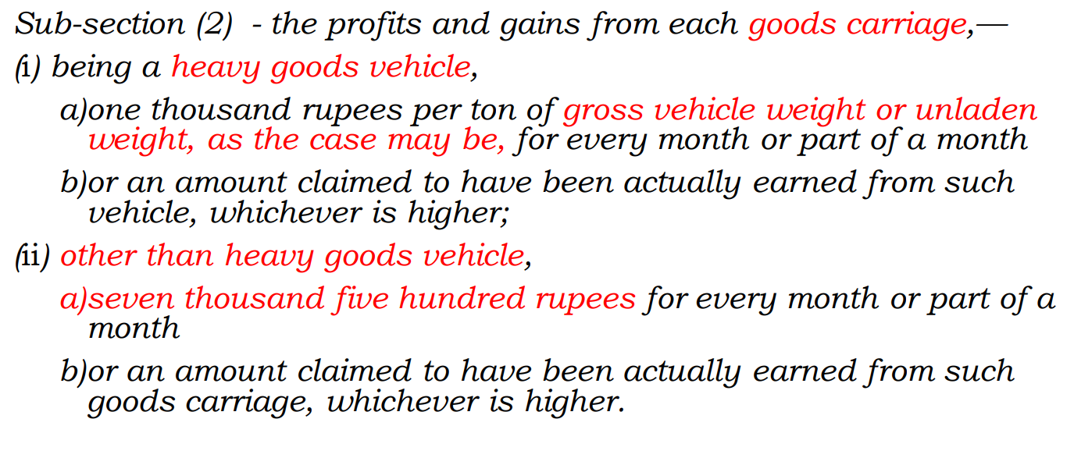

Slide 32
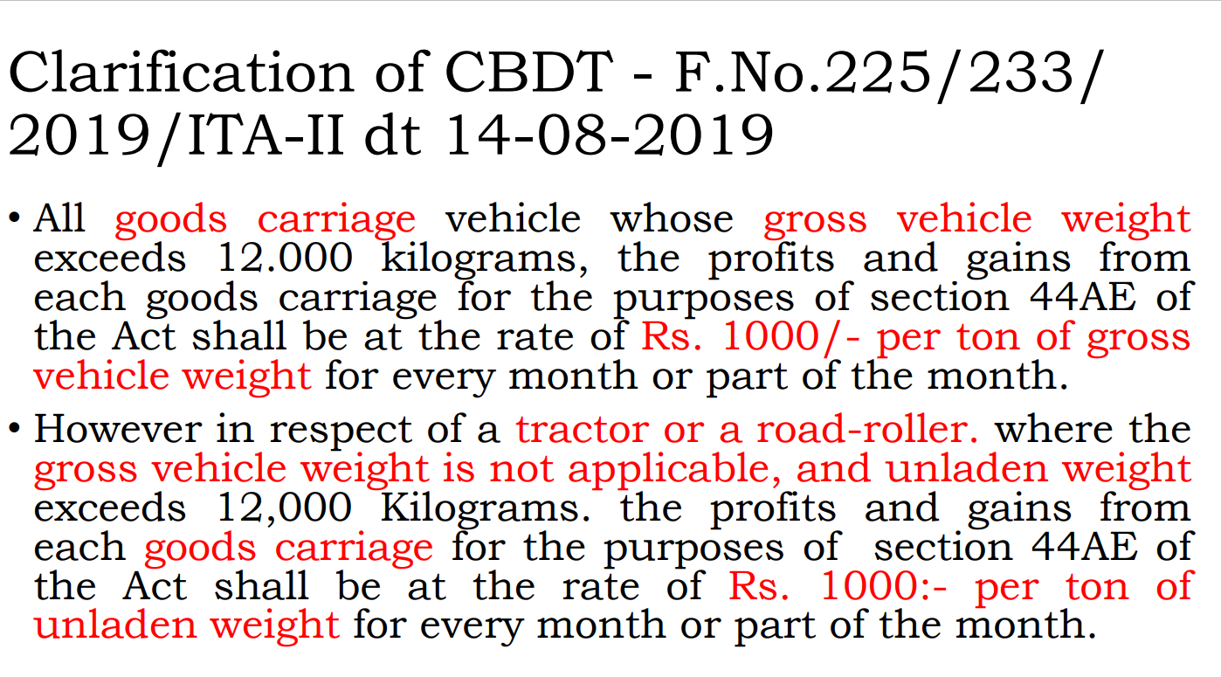

Slide 33
Deductions allowable
Remuneration to partners

Slide 34
Eligible person for 44AE
All type of Assessee can avail the benefit of this section including
LLP,
AOP,
BOI,
Company

Slide 35
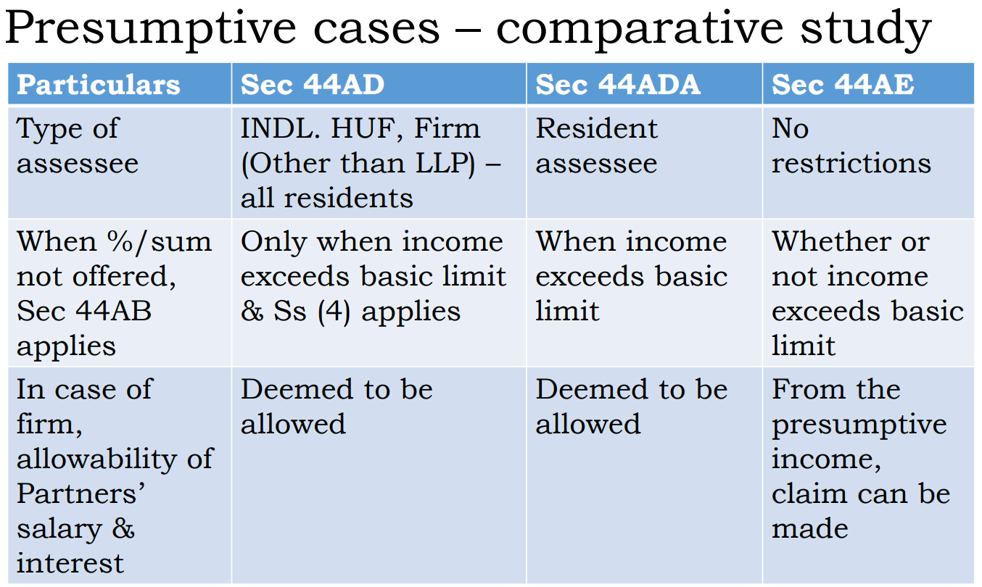

Slide 36

Disallowance under Section 43B(h)
CA. Pankaj Shah
Chartered Accountant

Slide 37
MSMED 2006
Micro, Small, Medium Enterprises (MSMEs)
  Entities that are involved in the production, manufacturing and processing of goods and commodities.
  Backbone of the Indian economy
  India has approximately 6.3 crore MSMEs.
Contribution
  29% of India’s GDP,
  employ over 120 million people,
  enormous share of more than 40% in the exports
  more than 45% in the manufacturing sector.
| CA Pankaj Shah | 969 189 3040 |

Slide 38
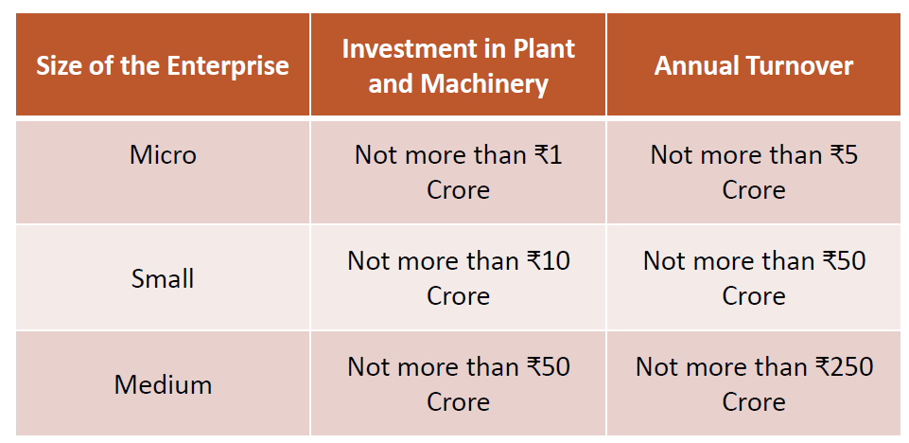
Classification
| CA Pankaj Shah | 969 189 3040 |

Slide 39
Computation of Limits
Investment in plant and machinery or equipment means “the net investment in plant and machinery or equipment” (net of depreciation as per IT Act and IT Rules) and not original cost or book value.
“Net Turnover” means Total turnover less export turnover.
One PAN – One enterprise
  All units with Goods and Services Tax Identification Number (GSTIN) listed against the same Permanent Account Number (PAN) shall be collectively treated as one enterprise and the turnover and investment figures for all of such entities shall be seen together and only the aggregate values will be considered for deciding the category as micro, small or medium enterprise.
| CA Pankaj Shah | 969 189 3040 |

Slide 40
S.43B
Certain deductions to be only on actual payment
43B Notwithstanding anything contained in any other provision of this Act, a deduction otherwise allowable under this Act in respect of—
……………..
……………..
(h) any sum payable by the assessee to a micro or small enterprise beyond the time limit specified in section 15 of the Micro, Small and Medium Enterprises Development Act, 2006 (27 of 2006),
| CA Pankaj Shah | 969 189 3040 |

Slide 41
Payment made before due date of filing of return
“Provided that nothing contained in this section except the provisions of clause (h) shall apply in relation to any sum which is actually paid by the assessee on or before the due date applicable in his case for furnishing the return of income under sub-section (1) of section 139 in respect of the previous year in which the liability to pay such sum was incurred as aforesaid and the evidence of such payment is furnished by the assessee along with such return.”
Benefit of allowance on payment till due date not available
| CA Pankaj Shah | 969 189 3040 |

Slide 42
Micro and Small Enterprise Development Act
Section 15: Liability of buyer to make payment.
15. Where any supplier, supplies any goods or renders any services to any buyer, the buyer shall make payment therefor on or before the date agreed upon between him and the supplier in writing or, where there is no agreement in this behalf, before the appointed day:
Provided that in no case the period agreed upon between the supplier and the buyer in writing shall exceed forty-five days from the day of acceptance or the day of deemed acceptance.
| CA Pankaj Shah | 969 189 3040 |

Slide 43
Unregistered Supplier?
Section 15 refers to “supplier” and “buyer”
  “supplier” means a micro or small enterprise, which has filed a memorandum with the authority referred to in sub-section (1) of section 8, …..
  The term “buyer” is defined u/s 2(d) of MSMED Act to mean whoever buys any goods or receives any services from a supplier for consideration
How to know if the supplier is registered or not?
| CA Pankaj Shah | 969 189 3040 |

Slide 44
Registration
Udyog Aadhar/EM-II
Not valid from 30.06.2022
No automatic migration
Not MSME now
Udhyam Registration
| CA Pankaj Shah | 969 189 3040 |

Slide 45
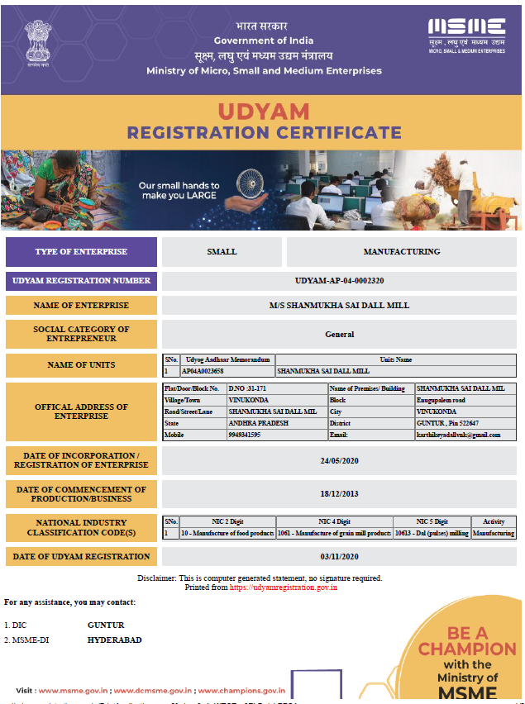

Slide 46
Time Limit
Written agreement
Yes
Agreed period
(subject to max 45 days) from Date of Acceptance
No
15 days
Before Appointed date
Date of Acceptance or Deemed Acceptance:
(a) the day of the actual delivery of goods or the rendering of services; or
(b) where any objection is made in writing by the buyer regarding acceptance of goods or services within fifteen days from the day of the delivery of goods or the rendering of services, the day on which such objection is removed by the supplier;

Slide 47
Day of deemed acceptance
Further, the day of deemed acceptance means where no objection is made in writing by the buyer regarding acceptance of goods or services within fifteen days from the day of the delivery of goods or the rendering of services, the day of the actual delivery of goods or the rendering of services.
| CA Pankaj Shah | 969 189 3040 |

Slide 48
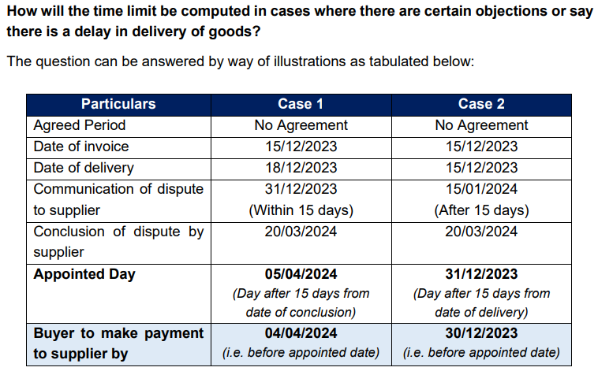

Slide 49
Date of invoice
Date of invoice is not relevant
Date of actual delivery is important
However PO and invoice can together be considered as written agreement
| CA Pankaj Shah | 969 189 3040 |

Slide 50
Appointed date
Acceptance date
15 days
Appointed day
| CA Pankaj Shah | 969 189 3040 |

Slide 51
No Agreement cases
Date of invoice | Date or delivery | Appointed date as per MSME | Date of payment | Allowable in
02.03.24 | 02.03.24 | 17.03.24 | 25.03.24 | 2023-24
03.03.24 | 03.03.24 | 18.03.24 | 03.04.24 | 2024.25
05.03.24 | 18.03.24 | 02.04.24 | 01.04.24 | 2023-24
05.03.24 | 18.03.24 | 02.04.24 | 02.04.24 | 2024-25

Slide 52
Written agreement cases
Date of invoice | Date or delivery | Agreement Days/ Credit period | Due Date as per Agreement | Due date as per MSME | Paid on | Allowable in
03.03.24 | 03.03.24 | 15 | 18.03.24 | 18.03.24 | 28.03.24 | 2023-24
03.03.24 | 03.03.24 | 15 | 18.03.24 | 18.03.24 | 06.04.24 | 2024-25
06.03.24 | 18.03.24 | 15 | 02.04.24 | 02.04.24 | 02.04.24 | 2023-24
03.02.24 | 20.02.24 | 60 | 20.04.24 | 05.04.24 | 08.04.24 | 2024-25

Slide 53
Applicable to any Payer
Any Assessee
Irrespective of payer being an MSME or not
| CA Pankaj Shah | 969 189 3040 |

Slide 54
Googly
Interplay with Indian Contract Act 1872
S. 24
  Agreements void, if considerations and objects unlawful in part.—If any part of a single consideration for one or more objects, or any one or any part of any one of several considerations for a single object, is unlawful, the agreement is void.
S.65
  Obligation of person who has received advantage under void agreement, or contract that becomes void.

Slide 55
Actual payment
Date of tender is relevant
Not date of actual clearing of amount
| CA Pankaj Shah | 969 189 3040 |

Slide 56
Actual payment
CIT v. Ogale Glass Works Ltd. [1954] 25 ITR 529 (SC)
  when a cheque is not dishonoured but encashed, the payment relates back to the date of tendering of cheque. The date of payment would be the date of delivery of the cheque
CIT v. Punalur Paper Mills Ltd.[2019] 111 taxmann.com 50 (Kerala)
| CA Pankaj Shah | 969 189 3040 |

Slide 57
Traders?
Payment made to Trader registered under MSMED
  (e) “enterprise” means an industrial undertaking or a business concern or any other establishment, by whatever name called, engaged in the manufacture or production of goods, in any manner, ………. or engaged in providing or rendering of any service or services;
| CA Pankaj Shah | 969 189 3040 |

Slide 58
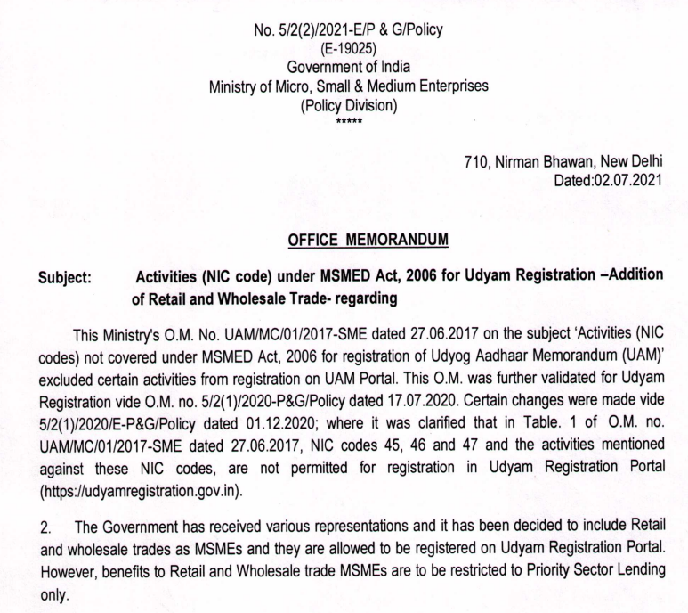
Traders?
| CA Pankaj Shah | 969 189 3040 |

Slide 59
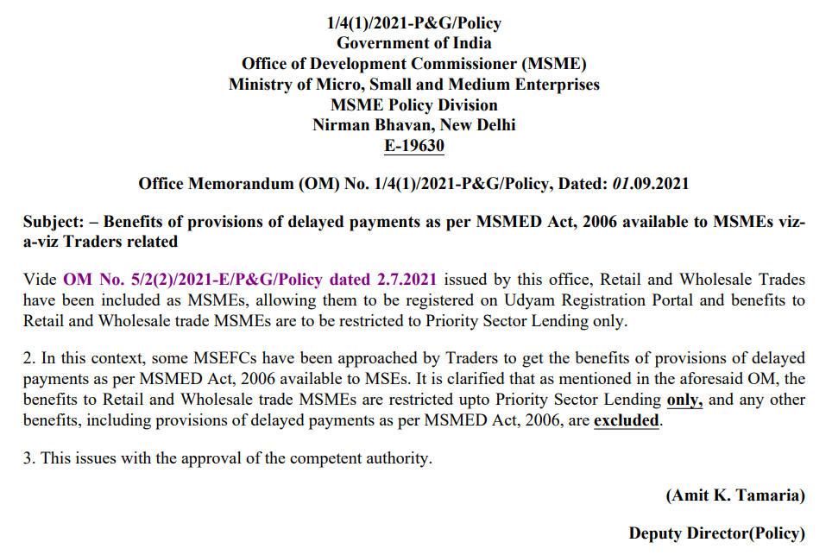
| CA Pankaj Shah | 969 189 3040 |

Slide 60
Supply of goods before registration
Not a supply from Micro or small enterprise unless registration obtained
No disallowance of pre registration supply
No retrospective effect
In Gujarat State Civil Supplies Corpn. Ltd. v. Mahakali Foods Pvt. Ltd. [SLP(C) No. 12884/2020], the Apex Court held that in order to seek the benefit under the MSMED Act, the seller should be registered under the MSMED Act, as on the date of entering into the contract. If any registration is obtained subsequently, the same would have an effect prospectively and would apply to the supply of goods and rendering services subsequent to the registration.
| CA Pankaj Shah | 969 189 3040 |

Slide 61
Supplier both Manuf. & Trader
The MSME registration and S. 15
qua a person and not qua a segment.
Adventurous that S. 43B(h)
would not apply qua the trading segment, unless courts take such a view.

Slide 62
Opening balances
Not applicable on opening balance
As the same is not claimed as expense
| CA Pankaj Shah | 969 189 3040 |

Slide 63
Capital expenditure
Not claimed as deduction u/s 37(1)
S.43B not applicable on capital expenses
| CA Pankaj Shah | 969 189 3040 |

Slide 64
Status of supplier
Automatic updation of supplier on portal
Based on 2 year old data fetched from GST
Status on registration certificate relevant
| CA Pankaj Shah | 969 189 3040 |

Slide 65
Advisory to MSME
OM No.2(28)/2007-MSME(Pol) dated 26.08.2008
  It is advisable that the Micro or small enterprises should mention/ get printed on their letter heads, supply order sheets, invoices, bills, relevant documents, the Entrepreneurs Memorandum number….., so that there always remain an identification of being an MSE supplier”
| CA Pankaj Shah | 969 189 3040 |

Slide 66
Dear Vendor,
Respected Sir/ Ma’am,
Ref: The Micro, Small and Medium Enterprises Development Act, 2006.
With reference to the above subject, we request you to kindly inform us whether you are registered under the Micro, Small, and Medium Enterprises Development Act, 2006. If yes, then select your category mentioned in your registration certificate.
⃝ Micro enterprise
⃝ Small enterprise
⃝ Medium enterprise
In support of your selection of your any of above categories, kindly send us a scanned copy of your UDYAM REGISTRATION CERTIFICATE.
We request you to respond to this mail within 15 days from the date of this email. If your company is not registered under the MSMED Act, 2006, please send us the confirmation of non-applicability, for our records.
If we don’t receive a response within the specified timeframe, we will assume that your Company is not registered under the MSMED Act, 2006.
Please send the required information to our email at ………………@gmail.com without fail. We would appreciate your cooperation in this matter.
With kind regards

Slide 67
Payment to be considered FIFO/Invoice wise
Depends on communication
If payment is made invoice wise and is so conveyed then allowed
If nothing mentioned then FIFO
| CA Pankaj Shah | 969 189 3040 |

Slide 68
GST Component
Unpaid GST
Input credit availed
No Disallowance
GST charged as expense
Disallowed
| CA Pankaj Shah | 969 189 3040 |

Slide 69
Late payment interest
16.Date from which and rate at which interest is payable.—
Where any buyer fails to make payment of the amount to the supplier, as required under section 15, the buyer shall, notwithstanding anything contained in any agreement between the buyer and the supplier or in any law for the time being in force, be liable to pay compound interest with monthly rests to the supplier on that amount from the appointed day or, as the case may be, from the date immediately following the date agreed upon, at three times of the bank rate notified by the Reserve Bank.
| CA Pankaj Shah | 969 189 3040 |

Slide 70
Interest not allowable under Income tax
23.Interest not to be allowed as deduction from income.—Notwithstanding anything contained in the Income-tax Act, 1961 (43 of 1961), the amount of interest payable or paid by any buyer, under or in accordance with the provisions of this Act, shall not, for the purposes of computation of income under the Income-tax Act, 1961, be allowed as deduction.
| CA Pankaj Shah | 969 189 3040 |

Slide 71
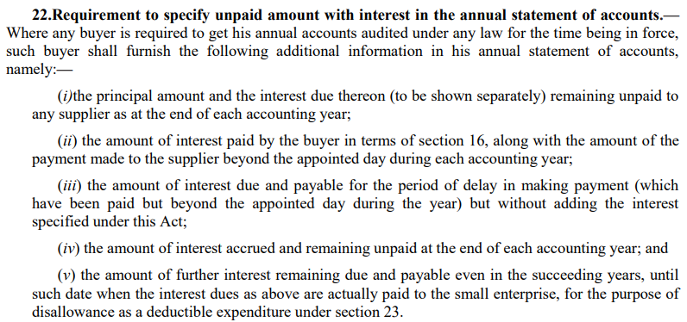
Disclosure requirement
| CA Pankaj Shah | 969 189 3040 |

Slide 72
TDS on Interest to MSME
If provision made in books
No question of S.40(a)(ia)
However Assessee may be treated in default
Penalty u/s 271C of Act

Slide 73
Form MSME-1
Samsung R&D Institute India-Bangalore Private Limited
  Half yearly filing
  Did not provide complete disclosures in Form MSME I for specific transactions
ROC Imposed penalties as per Section 405(4) Co Act
  Default Instance I (266 days): Rs. 2,85,000 Each on the company and its 2 directors.
  Default Instance II (85 days): Rs. 1,04,000 Each on the company and its 2 directors.
  Total Penalty amounted to Rs. 11,67,000.

Slide 74
Section 44AD and Disallowance
Books are not maintained and
Section 44AD states
  “Notwithstanding anything to the contrary contained in sections 28 to 43C, ……………
  Any deduction allowable under the provisions of sections 30 to 38 shall, for the purposes of sub-section (1), be deemed to have been already given full effect to and no further deduction under those sections shall be allowed.”
  No Disallowance in 44AD cases
| CA Pankaj Shah | 969 189 3040 |

Slide 75
Impact of cancellation
If registration surrendered by Micro or small enterprise
No benefit available under law
Subsidies under MSME
Concessional interest of 1% Not available

Slide 76
Auditor to ensure
Steps taken by management to obtain details of registration of vendors?
Verify invoices, PO and communication of supplier
Prepare a list of MSME suppliers
Management representation
Disclaimer in Notes to accounts and audit report
| CA Pankaj Shah | 969 189 3040 |

Slide 77
S.43B vs. 40(a)(ia)
Harmonious interpretation
S.43B
S.40(a)(ia)
| CA Pankaj Shah | 969 189 3040 |

Slide 78
Questions?

Slide 79
