Slide 1

Direct taxation on Real Estate
PANKAJ SHAH
Chartered Accountant

Slide 2
CHARGEABILITY
Should be a Capital asset
Transfer in the previous year
Gain/loss as a result of transfer
Not exempted or deductible under Section 54, 54B, 54D, 54EC, 54F, 54G and 54GA
Sale consideration
Cost of acquisition

Slide 3
“transfer”

Slide 4
​CIT vs. BalbirSinghMaini 398 ITR 531(SC)​
The effect of the aforesaid amendment is that, on and after the commencement of the ​​Amendment Act of 2001, if an agreement, like the JDA, is not registered, then it shall ​​have no effect in law for the purposes of Section53A. This being the case, in order ​​to qualify as a"transfer"of a capital asset under Section2(47)(v) of the Act, there must be a​ "​contract“ which can been forced in law under Section 53A of the Transfer​​ofPropertyAct. A reading of Section17(1A) and Section49 of the Registration Act ​​shows that in the eyes of law, in the absence of registration, there is no contract ​​which can be taken cognizance of , for the purpose specified in Section53A

Slide 5
Consequences
Combined reading of the new s.53A of TOPA, s. 17(1A) and proviso to s. 49 under the Registration Act clearly mandate that
any transaction involving allowing of the possession of the immovable property
to be taken or retained in part performance of a contract of the nature referred to in s.53A
shall not result in transfer if the agreement is not registered.

Slide 6
Registration relates back to execution date of agreement
Section 47 of the Registration Act, 1908, a registered document shall relate back to the date on which it is executed and not from the date on which it has been so registered.
Jitendra Mohan v. ITO [2007] 11 SOT 594 (Delhi), it has been held that it is the date of allotment which is relevant for the purpose of computing a holding period and not the date of registration of conveyance deed ; that section 47 of the Registration Act lays down that registration of a document operates retrospectively
Gurbax Singh v. Kartar Singh [2002] 254 ITR 112 (SC), it has been held that registration of a document would relate back to the date of its execution

Slide 7
Date of acquisition for holding period
Allotment date
Possession date
Registration
ACIT vs. Sanjay Kumath ([2014] 63 SOT 90 (Indore - Trib.)) Period of holding of a flat reckoned from date of allotment letter as such letter extinguished all rights of seller
Board vide Circular No. 672 after referring Circular No. 471 extended the facility of exemption under sections 54 & 54F in respect of allotment of flat/house.
Circular No. 471 dated 15.10.1986 and Circular No.672 dated 16.12.1993 held as under :—
"The allottee gets title to the property on the issue of the allotment letter and the payment of instalment is only a follow up action and taking the delivery of possession is only a formality."

Slide 8
50C Tolerance band
Not 10% variation allowed in 50C
10% of Actual sale consideration not Stamp Value
Retrospective
Chandra Prakash Jhunjhunwala [TS-462-ITAT-2019(Kol)]
Manoj Mittal vs ACIT ITA (4596/Del/2016) dtd 19.02.20

Slide 9
Indexed COA in Gift/Inheritance
“the year in which the asset was first held by the assessee”
Manjula Shah 16 Taxman.com 42 (Bom)
Jhanvi S Desai 7 TMI 496 (Bom)

Slide 10
Interesting issues
Amount paid to tenant for vacating the premises is allowed as expenses on transfer
Eagle Theatres 205 Taxman 449 (Delhi)

Slide 11
Large piece of land sold in small parcels business profit or capital gain
Narendra J. Bhimani 169 ITD 245 (Rajkot – Trib.)
  Assessee sold certain plots of land and offered resultant gain to tax as capital gains.
  AO found that assessee converted an agricultural land into non-agricultural land, floated plotting scheme with due permission of the authorities and eventually sold such plots. AO treated Business income
Held as capital gains for following ratio
  Land was purchased years back;
  Land was all along held as “capital asset”;
  With the passage of time and rapid urbanization,“sellable standard unit size” had considerably come down; Further, since land was in residential area, where smaller sized plots are required by the end users, assessee had to divide the land holding into plots in order to get the market price for land;
  It was a one-off transaction;
  Even sale consideration was not ploughed back in land investments;

Slide 12
Determination of cost of acquisition when capital asset was of different nature as on 01/04/2001
01.04.2001 – Status Agricultural land
31.03.2005 – Diverted into non agricultural
01.04.2022 – Sold non Agricultural land
Cost of acquisition – Agricultural or Diverted?
  Shri Pravinbhai J. Pandya (ITA No.3290/Ahd/2010)

Slide 13
New regime -22.07.2024
Capital asset
Converted into Stock in trade on 01.07.2024
Stock in trade sold in April 2025
Capital Gain in AY 2026-27
  Rate on capital gains 12.5% or 20%

Slide 14
Contribution of immovable property in firm
Section 45(3)
Sale Consideration = Amount recorded in books of firm
Section 50C vs. 45(3)
DCIT v. M/s Amartara Pvt Ltd [2018] TIOL 125 (Mum T)
Madhya Pradesh Stamp Law
Article 49(c) of Schedule 1-A “Stamp duty on Instruments”
2% duty on contribution of property in firm

Slide 15
Capital contribution in Firm S.56(2)(x)
In case of introduction of a capital asset as capital contribution by Partners in Partnership Firms, can section 56(2)(x) be invoked in the hands of the firm?
Sunil Siddharthbhai 156 ITR 509 (SC)
Contributing partner derives consideration which is not measurable in present
It lies in the womb of future
CIT vs. Marudhar Hotel (P) Ltd. [2004] 269 ITR 310 (Rajasthan HC)
Difference between the value of asset introduced and amount at which it was recorded in the books of the firm was held to be not liable to gift-tax

Slide 16
Transactions
Asset flows from
Firm to Partner (distribution)
Partner to Partner (sale of share)
ADMISSION (contribution of immovable)
45(3)
Partner’s hands taxable
9B
45(4)
45(1)
CA. PANKAJ SHAH | pankajgshah@gmail.com | +91 969 189 3040

Slide 17
Taxability
Section 45(4)
Capital gains
Section 9B
Business income or Capital gains
Reconstitution
Receive Capital asset or money
Dissolution or Reconstitution
Stock in trade or capital asset
Tax on gains of partner payable by firm
Tax on gains of firm payable by firm
Receipt
Deemed transfer

Slide 18
Section 45(4) Computation
A | Taxable income capital gains
B | Value of Money received | Date of receipt
C | FMV of capital asset received | Date of receipt
D | Balance in Capital account in books of firm | Date of reconstitution
CA. PANKAJ SHAH | pankajgshah@gmail.com | +91 969 189 3040

Slide 19
Example 1
Retirement cases As per CBDT Circular 14 of 2021

Slide 20
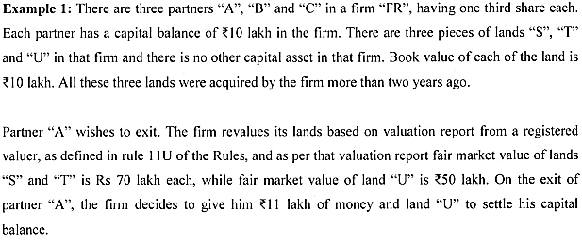
Indexed Cost of acquisition of Land U is 15 Lakhs
CA. PANKAJ SHAH | pankajgshah@gmail.com | +91 969 189 3040

Slide 21
Section 9B for Partner A
FMV of land U = 50 Lakhs
Index cost - 15 Lakhs
Capital Gains = 35 Lakhs
Section 45(4) for Partner A
B= FMV of land U = 50 Lakhs (Cost 10 and Index cost 15 L)
C= Money received = 11 Lakhs
D= Balance of Capital = 21 Lakhs
Taxable = 40 Lakhs (LTCG as per circular)
(Original Rs.10 Lakhs
FMV of land 50 Lakhs – Book value 10 Lakhs = 40 Lakhs –Rs7 Lakhs (Tax) = 33 Lakhs
Distribute 11 Lakhs to Partner A
Revised Capital balance = 21 Lakhs)
*Value of Rs.40 Lakhs as per S.45(4) shall be attributed to remaining lands ‘S’ and ‘T’
CA. PANKAJ SHAH | pankajgshah@gmail.com | +91 969 189 3040

Slide 22
Compulsory acquisition
Compulsory acquisition in year 2018
Whether the same is taxable?
urban agricultural land
Non agricultural land

Slide 23
Compulsary acquisition
The Right to Fair Compensation and Transparency in Land Acquisition, Rehabilitation and Resettlement Act, 2013
Section 96 – Exemption from income tax, stamp duty and fees
all compensation are exempt irrespective of the fact if the land is classified as agricultural or non-agricultural under Income Tax Act as well as RFCTLARR Act.

Slide 24
Interest on Loan for Acquisition of Asset
CIT Vs. K. Raja Gopala Rao (2001 252 ITR 459 Mad)
Payment of consideration for the sale indisputably having been made with the borrowed funds, the borrowing directly related to the acquisition and, interest paid thereon would form part of the cost of acquisition.
ACIT v. C. Ramabrahmam(ITA 943/Mds/2012)
Deduction of interest on housing loan against income from house property does not preclude the taxpayer to include the same interest in the cost of acquisition of the house property at the time of computing capital gains on sale of such house property

Slide 25
Family Settlements
Existence of Dispute and friction
Bonafide Realignment of Interest and Rights
Not transfer
CIT v. A.L. Ramanatham (245 ITR 494)(Mad)
CIT v. Kay ARR Enterprises (299 ITR 348)(Mad)
Family Arrangement – Corporate Entity
B.A.Mohota Textiles Traders Pvt. Ltd. v. DCIT [2017] 82 taxmann.com 397 (Bombay HC)- While a family arrangement/settlement does not amount to a "transfer" u/s 2(47) as it only recognizes "pre-existing rights" between the parties, the same applies only to members of the families and not to transfers made by corporate entities. The corporate veil can never be lifted at the instance of the company itself because that would amount to its denying its own corporate existence. The fact that the Company is wholly owned by the members of the family is irrelevant.

Slide 26
Section 56(2)(x)(b) – Immovable property
Without consideration
  Stamp duty value will be IFOS
  (If exceeding Rs.50000)
Inadequate consideration
  Stamp duty value – Actual Consideration= Difference will be IFOS
  (If difference is exceeding Rs.50000 or 10% of acutal cons.

Slide 27
Rural Agricultural land
ITO vs. Trilokchand Sain 101 taxmann.com 391(Jp)
  Agricultural land is an immovable property
  Immaterial whether it is capital asset or SIT
Mubarak Gafur Korabu [TS-8832-ITAT-2019(PUNE)-O]
  held that agricultural land purchased by assesee is not governed by the provisions of section 56(2)(vii)(b) of the Act since it is not a 'capital asset'. Further, the Pune Bench observed that clause (c) is also not attracted in view of the definition of the term 'property', which inter-alia, covers immovable properties which are capital assets.
  The decision of the Jaipur Bench of the ITAT in case of Trilok Chand Sain was distinguished on the ground that the said decision failed to take cognizance of the provisions of section 56(2)(vii)(c) of the Act.

Slide 28
Land held as Stock in trade
Satendra Koushik v. ITO [TS-5942-ITAT-2019(JAIPUR)-O]
  provisions of section 56(2)(vii)(b) were invoked on purchase of land by the assesee engaged in real estate business.
  held that section 56(2)(vii) has application to 'property' which is in the nature of a capital asset of the recipient and therefore does not apply to stock-in-trade, raw material and consumable stores.
  It also held that provisions of section 56(2)(vii) were introduced as a counter evasion mechanism to prevent laundering of unaccounted income and the intent is not to tax transactions entered in the normal course of business or trade.
  Ultimately, the matter was remanded back to the assessing officer for deciding the matter afresh.

Slide 29
Section 56(2)(x)(b) – Immovable property
Date of agreement and the date of Registration not same
Stamp duty value
Consideration through Banking channels (received on or before agreement)
Value as on Date of Agreement
Not through Banking channels
Value as on Date of Registration

Slide 30
Section 56(2)(x)(b) – Immovable property
Valuation made by SVA is revised in any appeal or revision proceedings later on, Section 155(15) provides for modification of the order of assessment u/s 154, within 4 years from the end of the financial year in which such revision has taken place.
Request to refer to the DVO
Assessing Officer bound to refer to DVO if requested
  -M/s Fortuna Structures Pvt. Ltd. v ACIT (2008)(60 itatindia 886)(Lucknow)
  -Meghraj Baid v ITO 23 SOT 25 (Jodh.)
  -Kalpataru Kalpataru Industries Industries v ITO (ITA No. 5540/Mum/2007)
  -Abbas T. Reshamwala v ITO (ITA No. 3093/Mum/2009)

Slide 31

Joint Development Agreements

Slide 32
Section 45(5A) in The Income Tax Act, 1961
Notwithstanding anything contained in sub-section (1), where the capital gain arises to an assessee, being an individual or a Hindu undivided family, from the transfer of a capital asset, being land or building or both, under a specified agreement, the capital gains shall be chargeable to income-tax as income of the previous year in which the certificate of completion for the whole or part of the project is issued by the competent authority; and for the purposes of section 48, the stamp duty value, on the date of issue of the said certificate, of his share, being land or building or both in the project, as increased by the consideration received in cash, if any, shall be deemed to be the full value of the consideration received or accruing as a result of the transfer of the capital asset :

Slide 33
Proviso
Provided that the provisions of this sub-section shall not apply where the assessee transfers his share in the project on or before the date of issue of the said certificate of completion, and the capital gains shall be deemed to be the income of the previous year in which such transfer takes place and the provisions of this Act, other than the provisions of this sub-section, shall apply for the purpose of determination of full value of consideration received or accruing as a result of such transfer.

Slide 34
Area Sharing
"specified agreement" means a registered agreement in which a person owning land or building or both, agrees to allow another person to develop a real estate project on such land or building or both, in consideration of a share, being land or building or both in such project, whether with or without payment of part of the consideration in cash;

Slide 35
Joint development Agreement
A real estate developer owns certain parcels - currently held as Stock in trade (but earlier as capital assets). It enters into a JDA with a developer – XYZ Ltd.
At what point of time the income arising to ABC Ltd from development and sale of residential units become taxable under Act
On conversion of land into stock in trade
On entering into JDA
On sale of flats

Slide 36
Section 45(2) – The capital gains accruing upto the date of conversion would become taxable only when the converted land parcels is “sold” or “otherwise transferred”.
“Sold” or “otherwise transferred” – For stock in trade, transfer takes place on conveyance
Even otherwise, no “transfer” when a mere license is granted to enter the land for development
Seshasayee Steels P LTd [2020](421 ITR 46)
Point of taxation in cases where JDA is entered into after conversion of capital asset to stock in trade
DCIT vs. Crest Hotels LTd 2001 78 ITD213 Mum
R. Gopinath (HUF) v. ACIT 2010 133 TTJ 595 Chennai
As and when such stock in trade is ultimately sold or transferred the frozen capital gains would be offered to tax proportionately as and when such stock in trade is sold alongwith the business income arising on the sale of stock

Slide 37
Joint Development Agreements
Builders comes and offer
Will it be liable to Capital Gain ?
What Amount ?
Which point of Time Capital Gain arise ?
Can avail benefit U/s 54/54F ?
Residential Property
Commercial Property

Slide 38
“Transfer”
Agreement for transfer not provide possession cannot be treated as transfer.
If authority to take permission from various authority is transfer, indicates passing complete control. (Chatrubhuj Dwarkadas Kapadia)
Entered in a MOA with Builder to get take all formality complete builder is acting as an agent. (Jasbir singh sarkaria)
Grant of a permissible right to build and rights vest with the assessee, not transfer. (Atam Prakash & Sons)

Slide 39
How to Compute Capital Gain in JDA
  Consideration
  50% Constructed Area Kind + Money
  - Take Guideline Value/ Stamp Valuation
  -Sec 50(D) If consideration is not determine take Market Value.
If you have provide old building and ask for scrap, benefit u/s 54 can not be availed.
Conversion of capital assets in to stock in trade and then enter in to agreement.

Slide 40
Section 45(5A)
From AY 2018-19
  Individual and HUF only
Taxable in the year completion certificate received in full or part
  Sale consideration = stamp duty value on date of CC
Registered agreement
TDS
Issues
  Deduction u/s54/54F
  Unsold property – House property
  Prospective
  Part completion certificate received earlier

Slide 41
Case Study : Real estate business structuring
Shri Ramlal has an ancestral agricultural land admeasuring 10 acres having fair market value of Rs. 6 crore. Shyamlal a builder has approached to enter into a ratio deal with Ramlal to carryout development of property and it is planned that a saleable area of 2 Lakh sq.ft will be constructed. They have decided that to share the revenue or property 50:50
The agreement is entered on 01.04.22 and an advance of Rs.2 crore is given to Ramlal out of which Rs.1 crore is security deposit
The project is completed on 01.04.23 and the stamp duty value of Ramlal’s share is 10 crore. Ramlal has sold one fifth of his saleable area in 2023-24.
Ramlal will be taking 2 adjacent residential houses worth Rs.2 crore and 1 residential house in another block worth Rs.1 crore on 01.07.2024 against his share
What is the most tax efficient structure and tax implications of the transactions?

Slide 42
Discussion : Real estate structuring
TDS under Section S.194IC
  Consideration
  Security deposit
194-IC. Notwithstanding anything contained in section 194-IA, any person responsible for paying to a resident any sum by way of consideration, not being consideration in kind, under the agreement referred to in sub-section (5A) of section 45, shall at the time of credit of such sum to the account of the payee or at the time of payment thereof in cash or by issue of a cheque or draft or by any other mode, whichever is earlier, deduct an amount equal to ten per cent of such sum as income-tax thereon.]

Slide 43
Discussion : Real estate structuring
Section 45(5A)
Section 45(2)
Applies only to individual and HUF
Taxable on receipt of Completion Certificate as Capital gains
Irrespective of sale immediate outgo of capital gains tax
Convert into stock in trade
Liability to pay capital gain freezes but crystallises only on actual sale
Joint development agreement of asset held as stock in trade would not be taxable (akin to jobwork)
Business income proportion is eligible for S.44AD benefit if consideration within limits

Slide 44
Illustrative working of tax under S.45(5A) and S.45(2)

Slide 45
Transfer
Convert into Stock in trade
Conversion of stock in trade into capital Asset :- No specific provisions, beneficial to the assessee (ACIT v Bright Star Investment (P.) Ltd.)
Affidavits, Disclosure in B/S, Disclosure in Tax Audit Report
Capital Gain shall be computed in the year when such converted asset is Sold
Cost indexation shall be done till the year of conversion
Business Income also to be calculated in the year of Sale

Slide 46
Conversion of Company to LLP
Company having land
Sold to a buyer
Profit taxable in hands of Co
Dividend taxable in hands of shareholder

Slide 47
Hardship compensation
Capital receipt
where the assessee being a flat owner in a housing society receives a certain sum from the developer as corpus fund towards hardship caused to flat owners on redevelopment, the impugned amount has to be treated as capital receipt simpliciter which as per Section 2(24)(vi) of the Act is not taxable as income of the assessee.
Lawrence Rebello vs. ITO (ITAT Indore)

Slide 48
Compulsory acquisition
Compulsory acquisition in year 2018
Whether the same is taxable?
urban agricultural land
Non agricultural land

Slide 49
Compulsary acquisition
The Right to Fair Compensation and Transparency in Land Acquisition, Rehabilitation and Resettlement Act, 2013
Section 96 – Exemption from income tax, stamp duty and fees
all compensation are exempt irrespective of the fact if the land is classified as agricultural or non-agricultural under Income Tax Act as well as RFCTLARR Act.

Slide 50
Family Settlements
Existence of Dispute and friction
Bonafide Realignment of Interest and Rights
Not transfer
CIT v. A.L. Ramanatham (245 ITR 494)(Mad)
CIT v. Kay ARR Enterprises (299 ITR 348)(Mad)
Family Arrangement – Corporate Entity
B.A.Mohota Textiles Traders Pvt. Ltd. v. DCIT [2017] 82 taxmann.com 397 (Bombay HC)- While a family arrangement/settlement does not amount to a "transfer" u/s 2(47) as it only recognizes "pre-existing rights" between the parties, the same applies only to members of the families and not to transfers made by corporate entities. The corporate veil can never be lifted at the instance of the company itself because that would amount to its denying its own corporate existence. The fact that the Company is wholly owned by the members of the family is irrelevant.

Slide 51
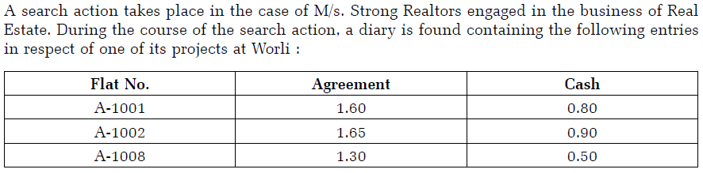
On Money - Real Estate Developer
The assessing officer observed that the agreement value mentioned as 1.60 stands for Rs.1.60 Crores and so on. Accordingly the assessing officer concluded that total Rs. 2.20 Crore is cash received by the assessee on account of on money on sale of the above flats.

Slide 52
Poser 1
Whether the addition can be made on the basis of the entries in the Diary in a situation where no excess cash is found during the course of search?

Slide 53
Poser 2
Would it make a difference if instead of a Diary which does not bear any signature of any person, the above entries are found in the form of an excel worksheet in the computer of accountant of the assessee?

Slide 54
Poser 1
No excess cash found –
Onus to prove that on money has been received by the seller is on the department
CIT v Smt Sunita Dhadda 100 taxmann com 525 (SLP dismissed at 100 taxmann com 526 )
Diary found is not regular books of accounts of the assessee
Common Cause v Union of India 394 ITR 220 ( CBI v V C Shukla 1998 3 SCC 410)
Section 34 of Indian Evidence Act 1872
Entries in books of account, including those maintained in an electronic form regularly kept in the course of business are relevant whenever they refer to a matter into which the Court has to inquire, but such statements shall not alone be sufficient evidence to charge any person with liability
It will be considered as a dumb document
In absence of cash found – addition cannot be made merely on basis of a diary or excel sheet or a print out.

Slide 55
Poser 3
Whether it will be legally permissible for the assessing officer to contend that the cash of Rs. 2.20 Crores is received but the same would have been already spent in some way and therefore, the same is not found during the search?
If answer to above is yes, whether the assessee can claim benefit of deduction for the same on the pretext that the amount spent is towards business expenses which has been incurred out of the on money received?

Slide 56
Poser 3
Assessing Officer cannot make a loose observation that the amount would have been received and also spent on some unknown item. Surmises and suspicions cannot be the basis of addition
  Dhakeshwari Cotton Mills Ltd v CIT 26 ITR 775
  Lalchand Bhagat Ambica Ram v CIT 37 ITR 288
Any claim for deduction will need to be suitably supported by evidences

Slide 57
Poser 4
Can the assessee contend that the amount mentioned as 0.80 cannot be interpreted as 0.80 Crore but it represents reimbursement of some expenses incurred on behalf of the buyers of the flats and the same represents Rs. 80,000/- and not 80 Lakhs?

Slide 58
Poser 4
Decoding is based on corroborative agreement
Agreement value Rs 1,60,00,000 mentioned as 1.60 Considering this it is difficult to contend that 0.80 denotes 80,000

Slide 59
Poser 5
What will be the position if cash of Rs. 2.40 Crores is found in excess of the cash balance at the time of search?

Slide 60
Poser 5
When excess cash found
the notings of Diary will become relevant
Diary is no more a dumb document
Onus of proving that the notings do not reflect receipt of on money will be shifted on the assessee
Whether the On Money will be added under specified sections or will be business income
Amount of Rs 2.20 Crores will be added to the Turnover of the assessee on the basis of method of accounting followed

Slide 61
Poser 6
In a case where apart from the above diary the investigation team also finds some vouchers for expenses incurred on construction which are not recorded in the books of accounts
  whether the assessing officer can make addition of Rs. 2.20 Crores + also addition for unrecorded expenses say – Rs. 1.80 Crores (Balance Rs. 40 Lakhs are found at the time of Search

Slide 62
Poser 6
Can Rs 1.80 Crore be said to be unexplained once the on money is admittedly received
  Once ‘On Money’ was considered as revenue receipt, any expenditure out of such on money could not be treated as unexplained expenditure
  Doing so would amount to double addition
  CIT v Golani Brothers 85 taxmann com 355 Bom HC)
Only net Rs.40 L (2.20-1.80) would be income
  Telescoping benefit should be given

Slide 63
Poser 6
Pr. CIT v. Aliasgar Anvarali Varteji 96 taxmann.com 231 ( Guj )
  Where entire unaccounted income found during search was offered as part of overall disclosure and negative balance in books of account was on account of payment made out of said unaccounted income, assessee could not be denied benefit of telescoping of original disclosure
Dhanvarsha Builders Developers Pvt Ltd v DCIT 102 ITD 375
  Seized Material should be read as a whole for computation of income
  Expenditure as emerging from seized documents shall be allowed to assessee
Where computation is made de hors books of accounts provisions of section 40 A(3) are not applicable

Slide 64
Poser 7
The assessing officer takes a view that the assessee is having habit of receiving cash for sale of flats and the same is in the range of 38% to 55% of the agreement value.
The assessing officer accordingly makes an addition at 40% of agreement value for all the flats in the project. Whether this action of the assessing officer can be justified?

Slide 65
Poser 7: Extrapolation
No Material has been found
Jurisprudence
CIT v B Nagendra Baliga 363 ITR 410 Kar
Assessing Officer is not entitled to extrapolate the undisclosed income detected in the course of search for a particular period to the entire block period on estimate basis
CIT v Ghodawat Pan Masala Products P Ltd 250 ITR 570 Bom
Assessing officer recast trading account on the basis of certain stock found during the course of search The GP ratio so computed was applied to entire block period Held not permissible
Fort Projects P Ltd v DCIT 145 TTJ 340 Kol
Directly covering the case of on Money on sale of Flat in absence of any evidence
Samrat Beer Bar v ACIT 75 ITD 19 (Pune)
Extrapolation of sales Held not allowed
in relation to other flats In absence of any material, the addition is only on suspicions. Not justified as per settled principle of law

Slide 66
On money admitted by Builder – fate of buyers
Section 132 (4A)
Unless the document indicating the on money transaction is counter signed by the assessee or in the hand writing of the assessee the same cannot be considered as conclusive evidence in the case of the assessee
The Statement can be an information but not evidence
Addition made merely on the basis of the statement without any corresponding evidence not justified
Pr.CIT v Vivek Prahladbhai Patel (66 taxmann com 41) Guj
Assessee should rebut the statement
Seek copy of statement of builder
Cross examination of person whose statement is recorded

Slide 67
On money – implications on builder
Section 115BBE
Section 269SS
Section 269ST
Section 271AAD

Slide 68
Jurisprudence
Asst CIT v Mohinder Singh 100 taxmann com 333 Chd Trib
  Buyer’s case – Denied payment of on money
  Amount disclosed in the Agreement is the final amount and statement of buyer is not relevant
  Oral Evidence is to be ignored when there is a written evidence contrary to oral evidence Sec 92 of Indian Evidence Act, 1872
Paramjit Singh v ITO 323 ITR 528 (P H)
  No oral evidence is admissible once documents contain all terms and conditions
  Sale consideration disclosed in sale deed in instant case was to be accepted and no oral evidence could have been adduced to contradict such sale consideration

Slide 69
Deductions under Section 54 to 54F of Income tax

Slide 70
Deductions

Slide 71
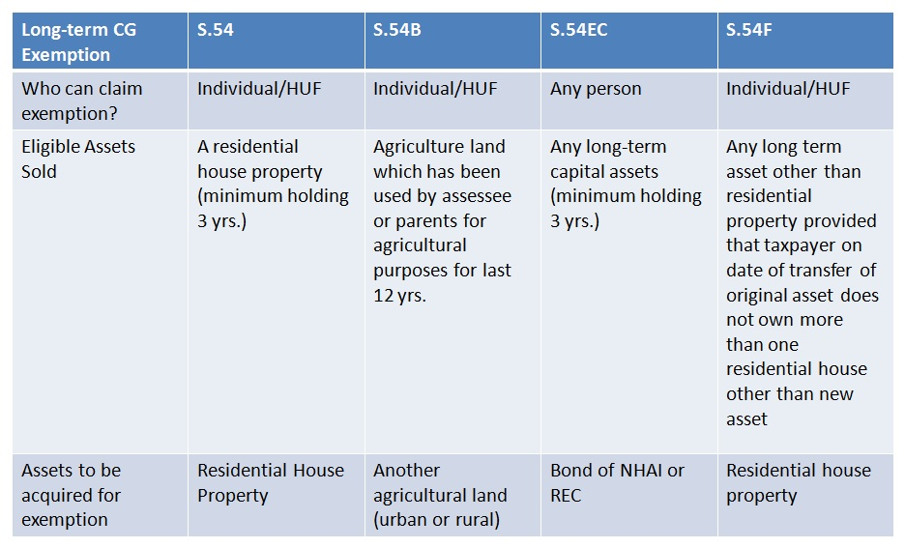
Capital Gains Exemption
LAND OR BUILDING
5 years

Slide 72
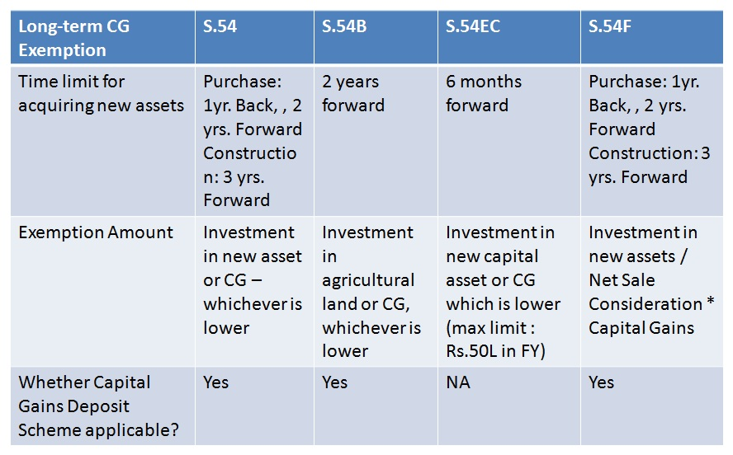
Capital Gains Exemption

Slide 73
Whether exemption u/s. 54/ 54F would be available if the construction could not be completed within 3 years?
Construction not at all started, only land purchased?
No exemption
Construction not done because of the fault of the builder/ developer?
Allowable- Rajeev B. Shah 71 taxmann.com 198 (Mum.)(SMC)
Construction started but completed after 3 years from date of transfer?
Smt. Usha Vaid 25 taxmann.com 188 (Asr.)
“Investment” of consideration/gains is important

Slide 74
Whether a small construction be claimed as being eligible for exemption?
Pawan Kumar Garg v. CIT [2009] 311 ITR 397/[2007] 164 Taxman 382 (Punj. & Har.)
The assessee had built two small rooms – which was held to be not a dwelling unit. The burden was on the assessee to prove the investment of LTCG within the stipulated time. The assessee was, accordingly, held not entitled to exemption under section 54F.
Rajesh Surana v. CIT [2008] 306 ITR 368 (Raj.),
The assessee’s claim for exemption was also rejected where a plot having a boundary wall with a garage-cum-room was claimed as a residential house.
Poonen v. Rathi Varghese AIR 1967 Ker.
Incidentally, the Kerala High Court has held that the place of residence could be understood as a place where a person intended to stay permanently other than casual stay.

Slide 75
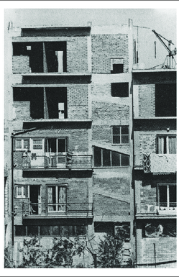
Assessee purchased a dipledated house. Did more construction.
Can exemption be claimed as he had
“purchased” and/or
“constructed” new house?

Slide 76
B. B. Sarkar v. CIT [1981] 132 ITR 150 (Cal.)
If an assessee is entitled to relief on fulfilment of either of the two conditions, i.e., either purchasing a house property within two years or constructing the house within three years, it would be improper to read that on fulfilment of both the conditions, he would be disentitled to that relief. Section 54 does not contemplate two kinds of relief; it only contemplates fulfilment of two alternative conditions. If both the conditions are satisfied within the time stipulated, the assessee does not become disentitled to the relief if the other conditions are fulfilled. If a floor is added to the new house, or if it is renovated, it remains as one house only. The Assessing Officer is, therefore, not justified in restricting exemption to investment on purchase only holding that the exemption under section 54 is admissible either for purchase or for reconstruction, but not for both

Slide 77
Extension of house
Extension is Independent dwelling unit
  assessee did construction of one of the floors which was independent. It was held that exemption is available. Ashok Kumar, HUF v. Asstt. CIT [1998] 65 ITD 352 (Delhi)
It is pertinent to note that mere construction by way of extension of the old existing house would not mean construction of a residential house as contemplated under section 54F.
  CIT v. V. Pradeep Kumar [2007] 290 ITR 90/[2006](Mad.).
  Mrs. Meera Jacob v. ITO [2009] 313 ITR 411 (Ker.).

Slide 78
Demolish and construction of new house
Similarly assessee purchased old house, demolished it and constructed a new house. It was held that the exemption is available. See : M. Vijaya Kumar v. ITO [2010] 122 ITD 15 (Bang.).

Slide 79
Sale of Multiple houses
New Residential House
Property 2
Property 3
Property 1
Ranjit Vithal Dass 137 ITD 267

Slide 80
Capital Gains of multiple years
Assessment Year | Capital Gains
2017-18 | *5,00,000
2018-19 | 6,00,000
Total | 11,00,000
*Invested in capital gain account scheme
Investment of 12,00,000 in new house on 30.06.2018
Whether capital gain of multiple years can be claimed against the same property?
Yes. See Smt Anagha Ajit Patnekar 9 SOT 685

Slide 81
Whether construction of the new residential house can begin prior to the date of transfer?
Whether same can be completed prior to date of transfer.

Slide 82
CIT v. J. R. Subramanya Bhat [1987] 165 ITR 571/[Kar]
Smt. Nimmagadda Sridevi 33 taxmann.com 306 (hyd.)
Construction can started prior to the date of transfer, but it shall be completed within 3 years of the date of transfer.
However, construction shall not be completed before the date of transfer. In it was held that assessee is not entitled to deduction under section 54F as construction was done before the date of transfer. Also, JT. CIT v. Raj Kumar Aggarwala & Sons [2005] 95 TTJ (Delhi) 315.

Slide 83
Whether exemption is available even if the new house does not comply with the Municipal Corporation norms/ no permission is obtained?

Slide 84
The requirement that the house shall be constructed with permission of municipal laws, cannot be read in section 54/ 54F.
B. Sivasubramaniam 45 taxmann.com 74 (Chennai)
it was clearly held that provisions of section 54F mandate construction of a residential house, within period specified, however, there is no condition that building plan of residential house should be approved by Municipal Corporation or any other competent authority.

Slide 85
Residential unit vs. house
Adjacent houses
Different floor - duplex

Slide 86
Whether investment in new house can be done out of loan funds?
J.V. Krishna Rao 24 taxmann.com 104 (Hyd.)
Merely because capital gains earned had been utilized for other purposes and borrowed funds were deposited in capital gains investment account, benefit of section 54F exemption cannot be denied.
See also
Pushpa vs ITO 31 taxmann.com 33 (Ker.)
ITO vs K.C. Gopalan (1999) 107 Taxman 591 (Ker.)

Slide 87
Whether exemption u/s. 54/ 54F can be claimed in respect of investment in the name of wife/ family member?
“the word “purchase” is not synonymous with the word “own” and to claim exemption u/s. 54 one need not become a complete owner of the newly acquired property.
Mrs. Shahzada Begum 5 ITD 292 (Trib. Hyd.)
Sri Rajaram vs ITO 19 ITD 141 (Hyd.)

Slide 88
Sr. No. | Section No. |  | Citation | Gist
1. | 54F | CIT vs Kamal Wahal 30 taxmann.com 34 (Del.) |  |  | ONLY IN NAME OF RELATIVE
2. | 54 | CIT vs. V. Natarajan 154 Taxman 399 (Mad.)
3. | 54F | N. Ram Kumar 25 taxmann.com 337 (Hyd.)
4. | 54B | Shri Ghanshyam Mali (ITA No. 547/ IND/ 2013)
5. | 54B | Kailash Narayan Chaturvedi (ITA No. 14/ IND/ 2015)
1. | 54B | CIT vs Gurnam Singh (2010) 372 ITR 278 ( P & H) |  |  | JOINTLY IN NAME OF ASSESSEE AND RELATIVE
2. | 54F | Ravinder Kumar Arora (2012) 21 taxmann.com 305 (Del.)
3. | 54, 54EC | DIT vs Mrs. Jennifer Bhide 15 taxmann.com 82 (Kar.)

Slide 89
Against the assessee
Kalya vs CIT 22 taxmann.com 67 (Raj.)
Investment in name of son and daughter-in-law. It was held that section 54B would require a literal interpretation of words “assessee”.
Jai Narain 306 ITR 335 (P & H)
Investment in name of son. It was held that section 54B would require a literal interpretation of words “assessee”.

Slide 90
Whether section 54EC benefit be claimed in respect of transfer of building etc. which are depreciable assets?

Slide 91
Depreciable Assets
No, Indexation available
Always be short term Capital Gain
Block Concept will be applicable
Gain on Sale of Depreciable assets held for more than 3 Years Taxed @ applicable to LTCG. (Manali Investment) (Ace Bulder)

Slide 92
Exemption on Depreciable Assets
Assessee sold Building for 50 Lakhs
Depreciation was claimed on such Building
Sale consideration on Sale of Land invested in REC Bonds.
Exemption u/s 54EC?
Assam Petroleum (262 ITR 587)(Gau)
Ace Builders (281 ITR 210)(Bom)

Slide 93
Section 50 creates a fiction as under:
Notwithstanding anything contained in clause (42A) of section 2, ……………………..the provisions of section 48 and 49 shall be subject to the following modifications………………..such excess shall be deemed to be the capital gains arising from the transfer of short-term capital assets”
The fiction created u/s. 50 is only in respect of section 48 and 49 and cannot extend to the purposes of making reinvestment u/s. 54EC.
The legal fiction created by the statute is to deem the capital gain as short-term capital gain and not to deem the asset as short-term capital asset. Therefore, it cannot be said that section 50 converts long-term capital asset into a short-term capital asset.”

Slide 94
Whether assessee could invest in construction of new house within due date u/s. 139(4)?

Slide 95
The issue is no more res-integra in the light of various judgments on the issue. U/s. 54-54F it is stated as under:
“The amount of the capital gain which is not appropriated by the assessee ………….. before the date of furnishing the return of income under section 139, shall be deposited………………”
Jurisprudence
Rajesh Kumar Jalan 286 ITR 274 (Gau)
(a) Nipun Mehrotra 297 ITR (Trib.) 110 (Bang.)
(b) Fatima Bai 32 DTR 243 (Kar.)
(c) P. Thirumoorthy 135 TTJ (Chennai)(UO) 75
(d) CIT vs Jagriti Agrawal 339 ITR 610 (P & H)

Slide 96
If the assessee files return and claims full value of consideration as the actual consideration, whether u/s. 143(1), department can made adjustment to adopt stamp value?

Slide 97
Powers u/s. 143(1) are limited to prima-facie mistake apparent on record. If the assessee has offered the actual consideration:
Grievance redressal mechanism.
It is not a prima-facie mistake.
A rectification or appeal against order u/s. 143(1) may be a proper solution.

Slide 98
If the assessee files return and claims full value of consideration as the actual consideration, will it be relevant for the Assessing Officer during assessment to make reference to the valuation officer?

Slide 99
Sunil Kumar Agarwal 372 ITR 83 (Cal.),
reference to the Valuation Officer shall be made u/s. 50C(2), even if the assessee did not pray for making reference to Valuation Officer.

Slide 100
Whether section 50C applies when the “building” which is under construction is transferred?

Slide 101
Section 50C applies on transfer of “land or building or both”.
A building under construction cannot be regarded as a “building”; as held in respect of Wealth-tax cases. [CWT vs Smt. Neena Jain 230 CTR 554 (P & H); also Apollo Tyres Ltd. 231 CTR 498 (Ker.)]
Thus, one of the arguments could be section 50C would not apply when the transfer takes place at the level the building is under construction.

Slide 102
Section 50C vs 54F ?

Slide 103
As per section 50C, the full value of consideration, “for the purposes of section 48”, shall be deemed to by the stamp value. The fiction is limited to section 48. U/s. 54F, the assessee investment is to be made of net consideration, which is the “full value of consideration” received or accruing as a result of transfer of the capital asset as reduced by any expenditure incurred wholly and exclusively in connection with such transfer.

Slide 104
A direct judgment in the favour of assessee was given in the case of Gyan Chand Batra 133 TTJ 482 (Jp.); Mohammed Shoib 29 DTR 306: 127 TTJ 459(Luck); DCIT vs Dr. Chalasani Mallikarjuna Rao 75 taxmann.com 270 (Vishak.); Raj Babbar 29 taxmann.com 11 (Mum.) applying the above analogy.
Dhanveer Singh Gambhir (ITAT Indore)

Slide 105
Section 54 (Amendment from AY 20-21)
Provided that where the amount of the capital gain does not exceed two crore rupees, the assessee may, at his option, purchase or construct two residential houses in India, and where such option has been exercised,—
(a) the provisions of this sub-section shall have effect as if for the words "one residential house in India", the words "two residential houses in India" had been substituted;
(b) any reference in this sub-section and sub-section (2) to "new asset" shall be construed as a reference to the two residential houses in India:
Provided further that where during any assessment year, the assessee has exercised the option referred to in the first proviso, he shall not be subsequently entitled to exercise the option for the same or any other assessment year.

Slide 106
54EC
From AY 2018-19
Investment time limit increased from 3 to 5 years
NHAI or REC bonds

Slide 107
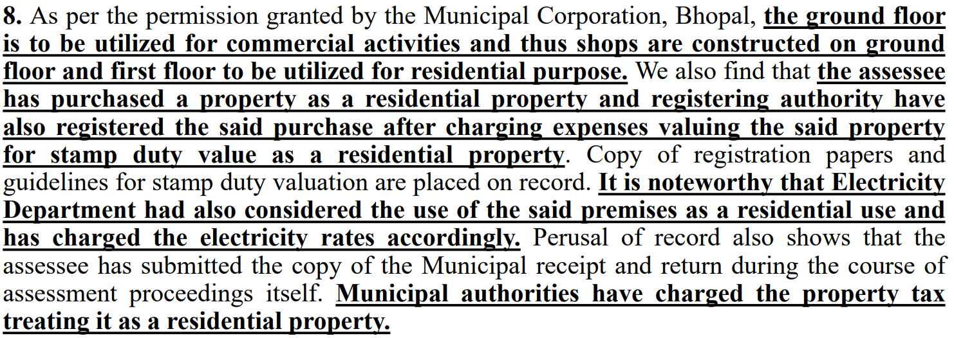
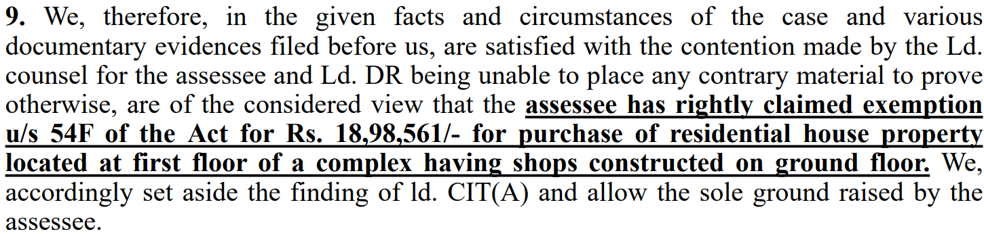
Whether benefit of exemption u/s. 54/54F is available in case the new asset is used partly for residential and partly for commercial purpose?
Ashok Kukreja v. Income-tax Officer [2021] 132 taxmann.com 102 (Indore - Trib.)

Slide 108
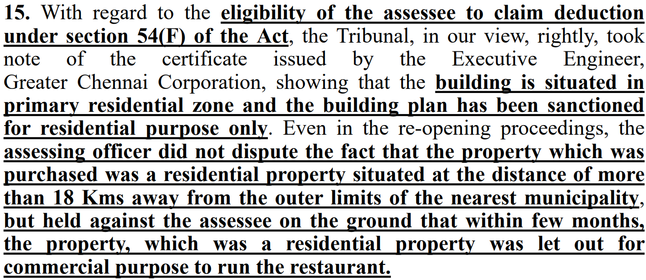
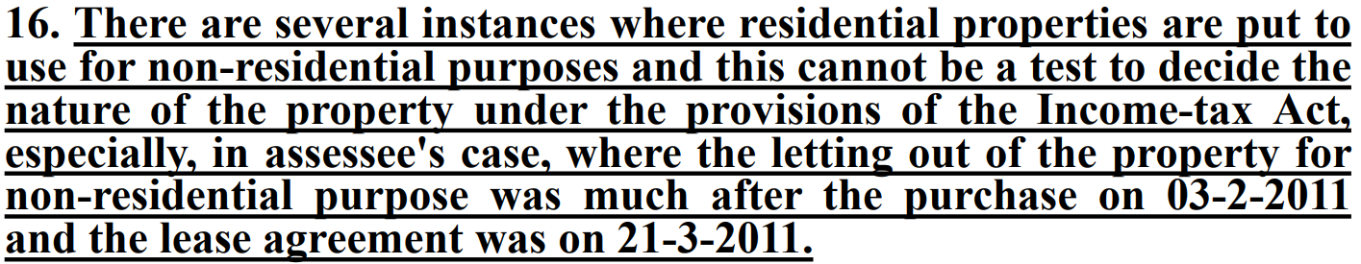
Whether benefit of exemption u/s 54/54F is available in case the new asset is used for commercial purpose in future?
HIGH COURT OF MADRAS Commissioner of Income Tax, Chennai v. Ramesh Shroff [2020] 120 taxmann.com 403 (Madras)

Slide 109
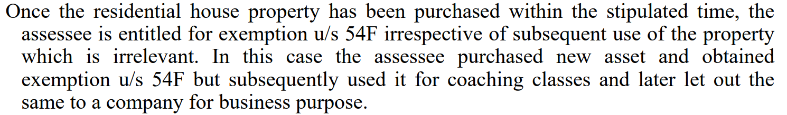
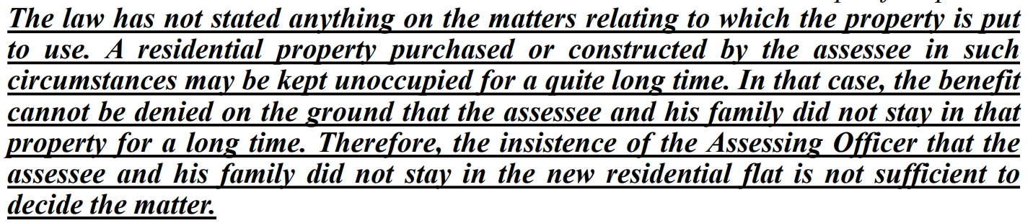
S K Luthra v. ITO [2007] 11 SOT 646 (Mumbai)[30-08-2006]

Slide 110
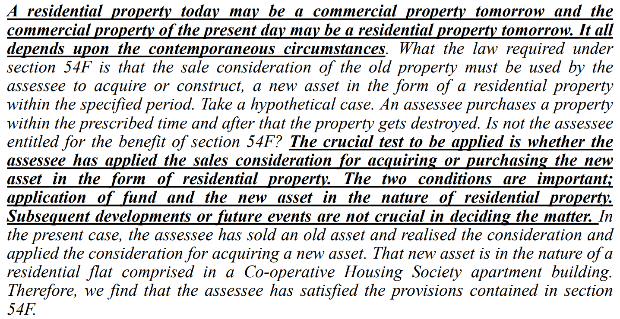

Slide 111
Whether after purchase of residential house expenditure incurred on making the house habitable would also qualify for deduction u/s 54/54F
Mumbai Bench of ITAT in the case of Saleem Fazelbhoy v. Dy. CIT [2007] 106 ITD 167 (Mum.) held that
  expenditure incurred in making the house habitable will also qualify for exemption u/s 54/54F as unless a house purchased is fit enough for living, it cannot be said to be a residential. However no exemption is allowable if expenditure is incurred to make the house comfortable as there is a difference between 'habitable' and 'comfortable'.

Slide 112
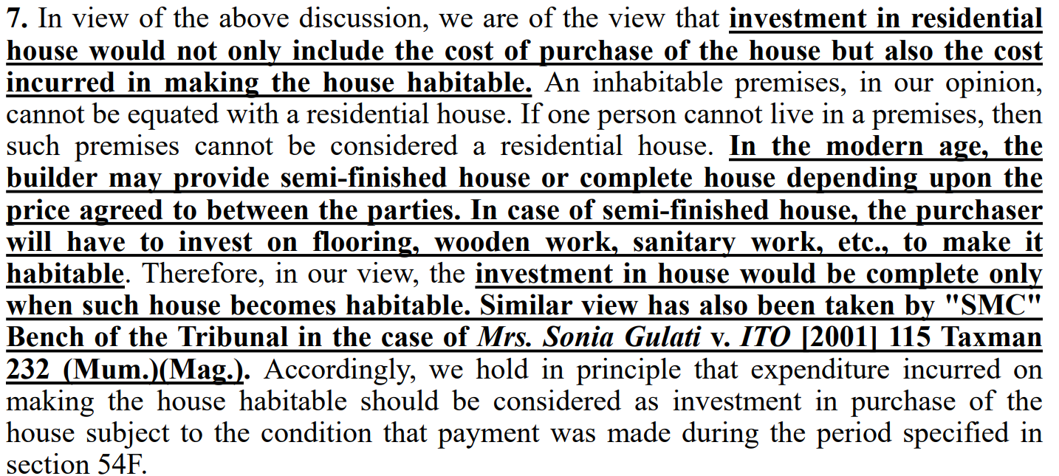

Slide 113
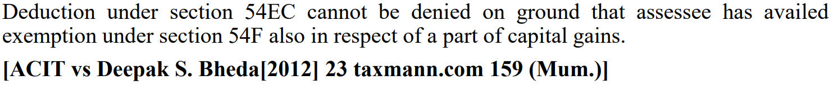
Whether the benefit under section 54EC and 54F can be taken simultaneously?

Slide 114
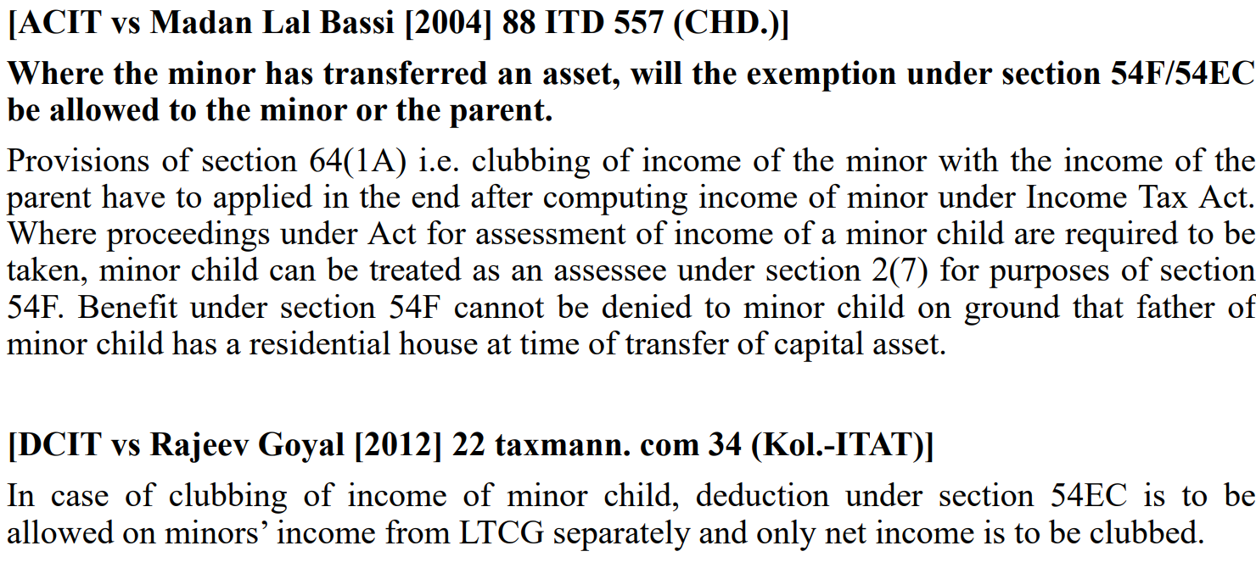
Where the minor has transferred an asset, will the exemption under section 54F/54EC be allowed to the minor or the parent.

Slide 115
Thank you
Pankaj Shah
Chartered Accountant
| pankajgshah@gmail.com | +91 969 189 3040 |

