Slide 1
TDS Mismatch and SFT transactions
CA. Pankaj Shah

Slide 2
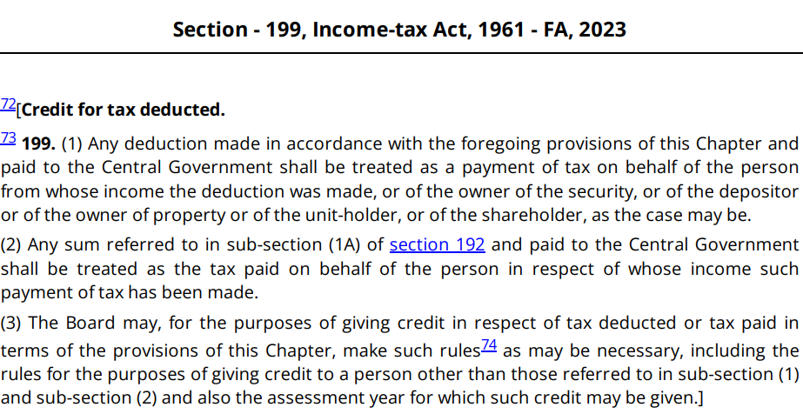
Rule 37BA – Credit in year when income offered - Except Section 194N

Slide 3
Claim
TDS
Current Year
Carryforward
Brought forward and utilize
Unclaimed TDS
Form 71 S.155(20)

Slide 4
Carryforward of TDS
In ITR you have option to carry forward TDS to subsequent year in which income is offered
  TDS on 31.03.2022
  Invoice on 01.04.2022
  TDS in AY 2022-23 and Credit in AY 2023-24
  Carry forward to next year

Slide 5
Form 71 S.155(20) unclaimed TDS
Income offered in earlier year AY 2022-23
TDS deducted in subsequent year Ay 2023-24
Due to lapse of due dates revision of return for AY 2022-23 not possible
File Form 71 in four years from date of TDS deduction
Credit shall be granted in AY 2022-23
  Interest from date of filing form 71 with refund

Slide 6
Missed credit and return
AY 2022-23 Return not filed
Subsequently 1Lakh TDS reflected in Form 26AS
Due date for belated return expired
  Updated return – No refund will be granted
  S.119(2b) application for allowing to file return
  Challenge S.143(1) in appeal – fresh claim

Slide 7
TDS later displayed
AY 2022-23 – TDS in Form 26AS – 1 Lakh
On 05.04.2023 further TDS of 50,000 appears
Remedy
  No updated return allowed for refund
  S.119(2b) application

Slide 8
Carry forward in Updated return
TDS later realized/appearing in Form 26AS
  File updated return with nominal income
Use carry forward of additional TDS in subsequent year
S.199 – technical breach

Slide 9
Aadhar PAN not linked
20% TDS is made applicable
If Aadhar PAN were not linked on date of deduction
Subsequently Aadhar PAN linked
Short deduction demand raised
CBDT Circular – 31st May missed
Remedy
  Date of deduction may be changed

Slide 10
Officers of the Tax Department must not take advantage of ignorance of an assessee as to his rights
Circular :No. 14(XL-35), dated 11-4-1955.
Officers of the Department must not take advantage of ignorance of an assessee as to his rights. Although, the responsibility for claiming refunds and reliefs rests with assessees on whom it is imposed by law, officers should—
1. Draw their attention to any refunds or reliefs to which they appear to be clearly entitled but which they have omitted to claim for some reason or other;
2. Freely advise them when approached by them as to their rights and liabilities and as to the procedure to be adopted for claiming refunds and reliefs.

Slide 11
Appeal mechanism
AO/CPC ought to have allowed credit of tax though not claimed by the Assessee as per CBDT Circular
This not granting credit is grievance against which appeal can be filed
Fresh claim can be made in appeal proceedings
  PCIT v. Karnataka State Co-operative Federation Ltd. [2021] 128 taxmann.com 1 (Karnataka)
    Assessee's fresh claim before appellate authority is entertain able even if same is not claimed in the original return of income nor assessee has filed revised return of income to make such claim.

Slide 12
TDS Certificate to supersede Form 26AS in case of variation between two
LSG Sky Chef (India) (P.) Ltd. v. Dy. CIT [2014] 45 taxmann.com 256 (Mumbai)
  Form No. 26AS is a statement generated at end of revenue, and the assessee cannot be in any manner held responsible for any discrepancy therein or for non-matching of TDS reflected therein with the assessee's claims.

Slide 13
TDS credit shall be allowed to employee even if TDS isn't deposited by employer
The Assessing Officer cannot deny credit of TDS to the employee if the employer had actually deducted the TDS but not deposited it in the Central Government Account.
In such cases, the only course of action that remains with the income-tax department is resorting to Section 201 and recovering TDS from the employer.
  Kartik Vijaysinh Sonavane v. DCIT [2021] 132 taxmann.com 293 (Gujarat)

Slide 14
TDS of other person
Tax of wrong person deducted
Give detail of TDS of other person
  Rule 5A – spouse income
  (Rule 37BA(2))
    deductee files a declaration with the deductor and the deductor reports the tax deduction in the name of the other person in the information
    The declaration filed by the deductee under clause (i) shall contain the name, address, permanent account number of the person to whom credit is to be given, payment or credit in relation to which credit is to be given and reasons for giving credit to such person.
    The deductor shall issue the TDS certificate in the name of the person in whose name credit is shown in the information relating to deduction of tax referred to in sub-rule (1) and shall keep the declaration in his safe custody

Slide 15
AO cannot deny TDS credit to HUF merely because TDS certificates were issued in name & PAN of Karta
Naresh Bhavani Shah (HUF) v. CIT [2017] 84 taxmann.com 53 (Gujarat)
  Where income on which tax has been deducted at source is assessable in hands of a person other than deductee, credit can be given to such other person, provided three conditions contained in rule 37BA(2) are satisfied.

Slide 16
Illustration
TDS was initially deducted using the operating PAN of the deductee.
Subsequently, the PAN linked to Aadhar was delinked and surrendered by the deductee.

Slide 17
TDS not deducted
S.201 r.w.s. Second Proviso to 40(a)(ia)
Form 26A
  Certificate from CA that deductee has offered the income
  Tax on such amount is paid with interest
  No disallowance u/s 40(a)(ia) – assessee not in default
Hindustan Coca Cola (SC)
  Tax cannot be recovered from deductor if deductee has paid the same

Slide 18
TDS deducted but not deposited
Penalty
Prosecution 276B
  25Lakhs or 2 months delay
Remedy
  Reasonable cause – financial stringency
  Limitation ground
  Compliance – paid in full with interest voluntarily

Slide 19
Salary mismatch
Inclusion of Exempt Allowances in Basic Salary in Form 16 by Employer Poses Risk of TDS Errors

Slide 20
Probable Solution
Present Total Salary in Gross Salary Column; Deduct Exempt Allowance Separately to Mitigate TDS Errors.

Slide 21
Inconsistent Income Classification in TDS Reporting
Discrepancies in reporting Head of income in case of income from house property or other sources in Form 26AS and ITR
Debatable provision of TDS applicability
Eg. 194J instead of 194C (44ADA vs. 44AD

Slide 22
Probable Solution
It is advisable to accurately specify the income-wise head in Schedule TDS while filing the Income Tax Return (ITR). This ensures proper alignment between the reported TDS under sections like 194I and the corresponding heads of income, preventing confusion and facilitating accurate tax assessment.

Slide 23
Commission Income Discrepancies
Disparity between commission income reported on a net basis in Income Tax Returns (ITR) and the deduction by e-commerce operators from the gross product value

Slide 24
Probable Solution
Reflect the gross turnover in the books of the commission agent for TDS claim purposes. However, this approach may trigger a GST mismatch in turnover, as GST is payable on commission income alone.
Careful consideration and preparation for potential GST-related notices are advised in such cases

Slide 25
Trust / Beneficiary
Income of the Trust/AOP is taxed in the hands of beneficiary or member
However, TDS is deducted on the PAN of the Trust/AOP Income of such Trust/AOP not included in the income of beneficiary/member.

Slide 26
Merger/Demerger
Merger TDS is processed under the old entity's PAN
Demerger- TDS is deducted and deposited on the PAN of the previous company

Slide 27
Probable Solution
It is advisable to explicitly state in the tax return that the TDS amount has been claimed in other company’s hand, providing comprehensive details in Schedule TDS.

Slide 28
Delayed Deduction
The deductor may have delayed to file the TDS Return in reporting. Consequently, the TDS amount may not be reflected in your Form 26AS, leading to a mismatch.

Slide 29
Probable Solution
Initially claim the TDS in one's own hands during the filing of the income tax return. As TDS returns can be revised at a later stage, allowing for the correction of PAN details.
New claim of TDS may not be available during the rectification process.

Slide 30
TDS was deducted by the buyer in current financial year, and corresponding turnover was booked in the subsequent year

Slide 31
Probable Solution
It is recommended to carry forward the proportionate TDS credit to the next financial year for accurate reconciliation.
Sec 155 amendment

Slide 32
Any other demand
Go to E-portal
Services
Rectification
Reprocess the Return

Slide 33
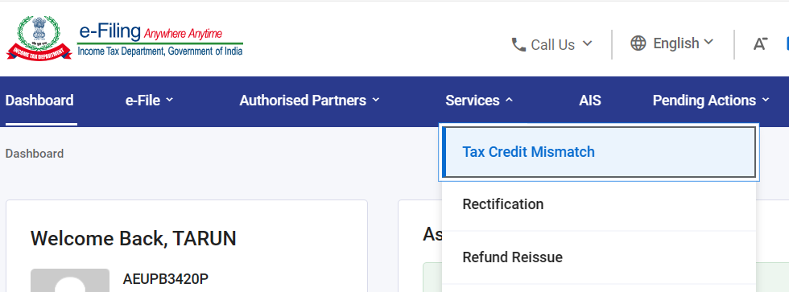
TDS mismatch feature

Slide 34
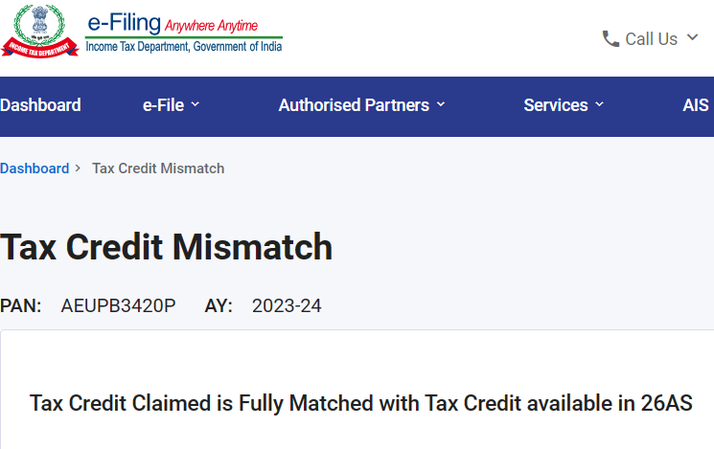

Slide 35
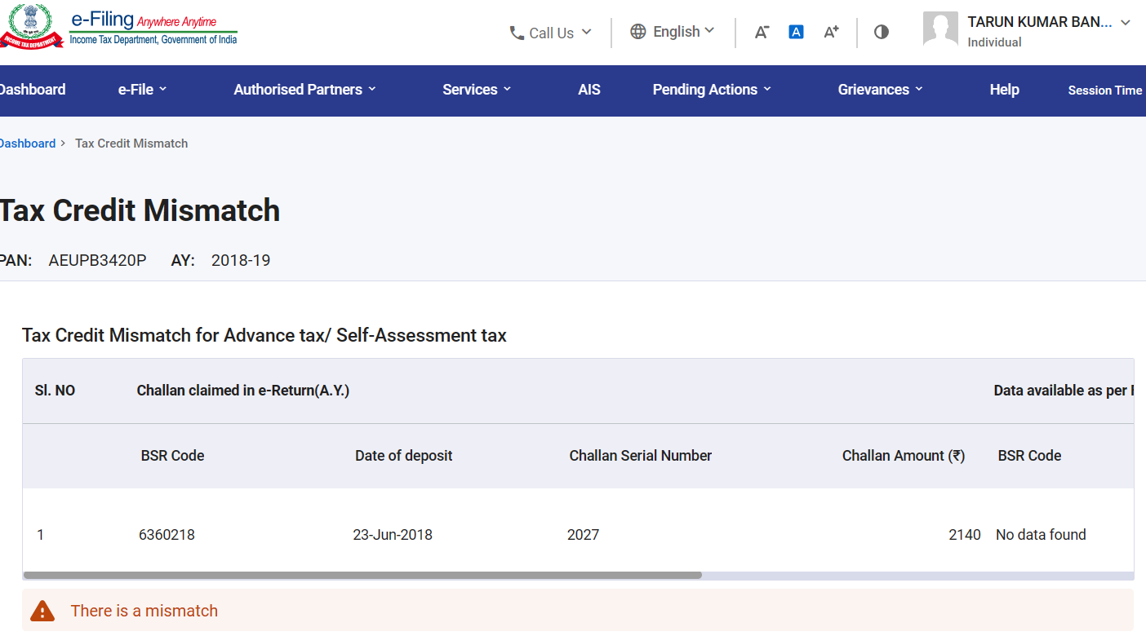
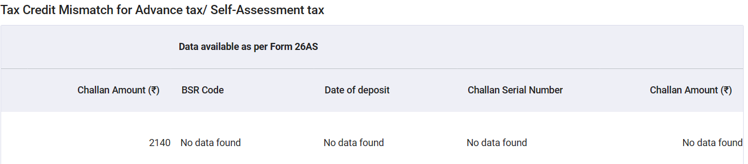

Slide 36
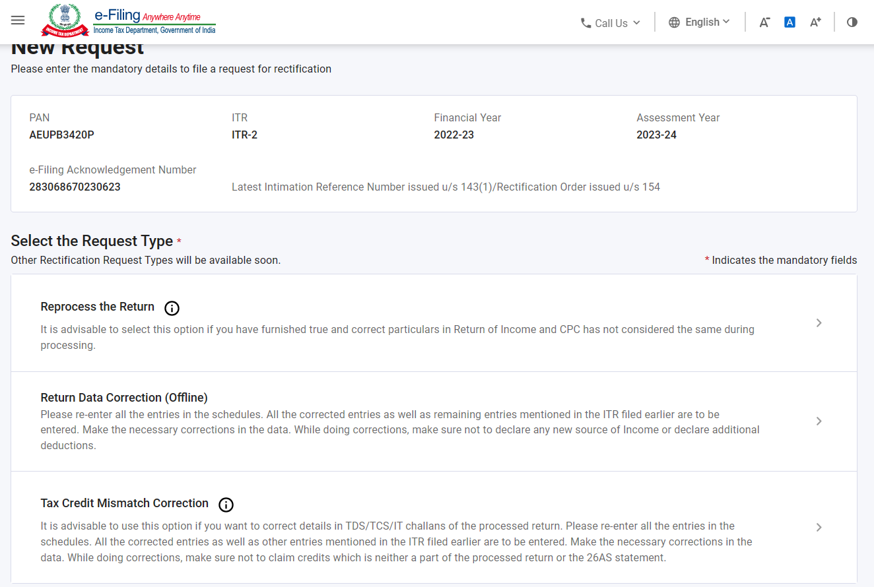

Slide 37
It is advisable to use this option if you want to correct details in TDS/TCS/IT challans of the processed return.
Please re-enter all the entries in the schedules.
All the corrected entries as well as other entries mentioned in the ITR filed earlier are to be entered. Make the necessary corrections in the data.
While doing corrections, make sure not to claim credits which is neither a part of the processed return or the 26AS statement.

Slide 38
Others
TDS deducted under wrong section due to unavailability of information or misinterpretation of transaction details. (Eg. Buying licenced software in hard drive)(TDS for event Management service deducted u/s 194C)

Slide 39
Others
Non-reporting of certain transaction in tds return may cause issuance of notice. (You may enter details of only those employees on whose salary TDS has been deducted. But not report details of person having income more than basic exemption limit and claiming benefit of rebate under 87A.)

Slide 40
TDS on interest to NBFC
Non deducting TDS on payment to NBFC.
Due to direct debit
Form 26A may be obtained

Slide 41
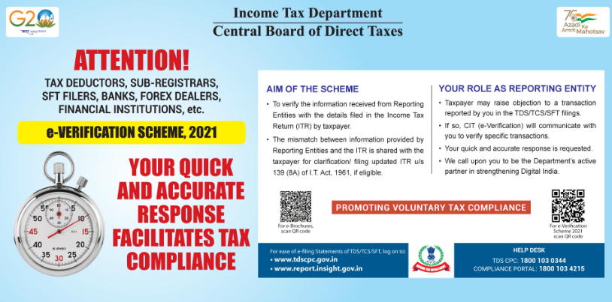

Slide 42
Statement of Financial Transactions

Slide 43
SFT - reporting tool
Tax authorities collect information on certain prescribed high value transactions undertaken
Reporting by prescribed entities
  Section 285BA
  In Form 61A/61B
Information reported by entities is reflected in AID/TIS of Assessee

Slide 44
Reporting entities
An Assessee
Registrar/sub registrar
Motor vehicle registering authority
Post master general
Recognised Stock exchange
Depository
Prescribed financial institutions
others

Slide 45
Financial transactions
S.No. | Nature of transaction | Monetary threshold | Specified person
1. | Cash deposit/withdrawal in Current Account | Agg. to Rs.50 Lakhs | Banking co. or cooperative bank
2. | Cash deposit in other than current account (deposit in saving account) | Agg. to Rs.10 Lakhs | Banking co. or cooperative bank/Post office
3. | Time deposits | Agg.to Rs.10 Lakhs | Banking Co, Post office, Coop., NBFC
4. | Credit card payment | Agg. To Rs.1 Lakh in cash Rs.10L in other mode | ----””----

Slide 46
Financial transactions
S.No. | Nature of transaction | Monetary threshold | Specified person
5. | Receipt of subscription for bonds and debentures | Agg to Rs.10 Lakh | Co. or Institution issuing Bonds
6. | Receipt of Share application money | Agg. to Rs.10 Lakhs | Co. issuing shares
7. | Buyback from any person | Agg.to Rs.10 Lakhs | Listed company
8. | Receipt for acquiring units of MF | Agg.to Rs.10 Lakhs | Trustee or manager of MF
9. | Receipt on sale of foreign currency | Agg.to Rs.10 Lakhs | Authorised dealer

Slide 47
Financial transactions
S.No. | Nature of transaction | Monetary threshold | Specified person
10. | Purchase or sale of immovable property | Stamp Value of Rs.30 Lakh or above | Registrar/ Sub R.
11. | Cash receipt for sale, by any person, of goods or services of any nature (clarification) | Over Rs. 2 Lakh | Person liable for audit u/s44AB
12 and 13. | Demonetisation | Agg.to Rs.12.5 Lakhs in Current A/c and Rs.2.5L in Saving | Banking Co., coop bank, Post office

Slide 48
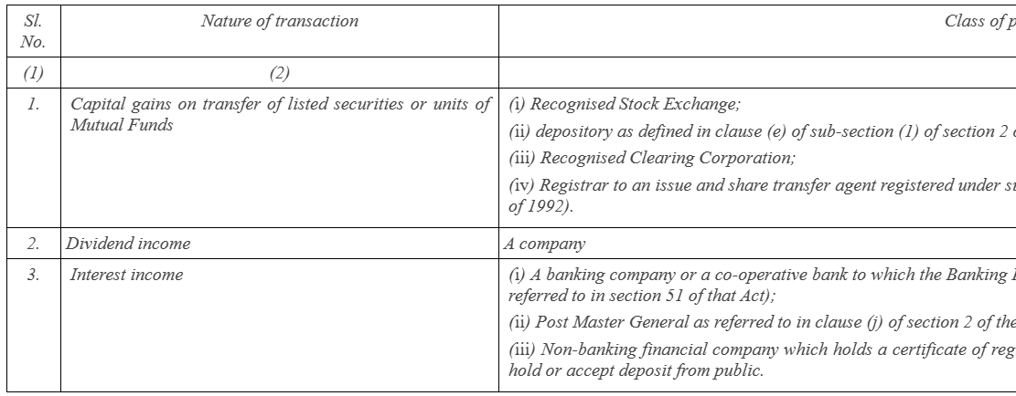
AIS
-Amendment in 2021 (No threshold limit)

Slide 49
Aggregation
If Mr A has two savings account of Rs 5 lakh each, in order to check the monetary threshold of Rs 10 lakh, the amount in both savings account need to be aggregated
If Mr A has purchased shares for a value of Rs 5 lakh in September in an FY and Rs 6 lakh in November of the same FY, the value of both shares needs to be aggregated to check the monetary threshold of Rs 10 lakh.
In case Mr A and Mr B holds two joint savings account of Rs 3 lakh and Rs 7 lakh, an aggregation of Rs 10 lakh is attributed to both Mr A and Mr B separately to check for monetary threshold.

Slide 50
Consequences of non reporting
Non reporting
  Penalty of Rs 500 per day from the expiry of the original due date till the due date mentioned in the notice and
  Rs 1,000 per day beyond the due date specified in the notice.
Inaccurate reporting
  Penalty of Rs 50,000 if it provides inaccurate information in the statement

Slide 51
Annual Information Statement
The AIS information level feedback can be used for providing following inputs:
  Information is correct
  Income is not taxable
  Information is not fully correct: This functionality can be used to modify rent details
  Information relates to other PAN/Year
  Information is duplicate/included in other information
  Information is denied
The feedback provided by taxpayer will be shown separately in AIS and will update the value in Taxpayer Information Summary (TIS).

Slide 52
High Value Transaction Alert
Sms/Email
Compliance portal
E-campaign
  Crypto related
  Credit card huge payments
  Stock market and mutual fund
  Cash related
  Property related
Resolution
Feedback on every transaction
If not considered income – Revise return / updated return

Slide 53
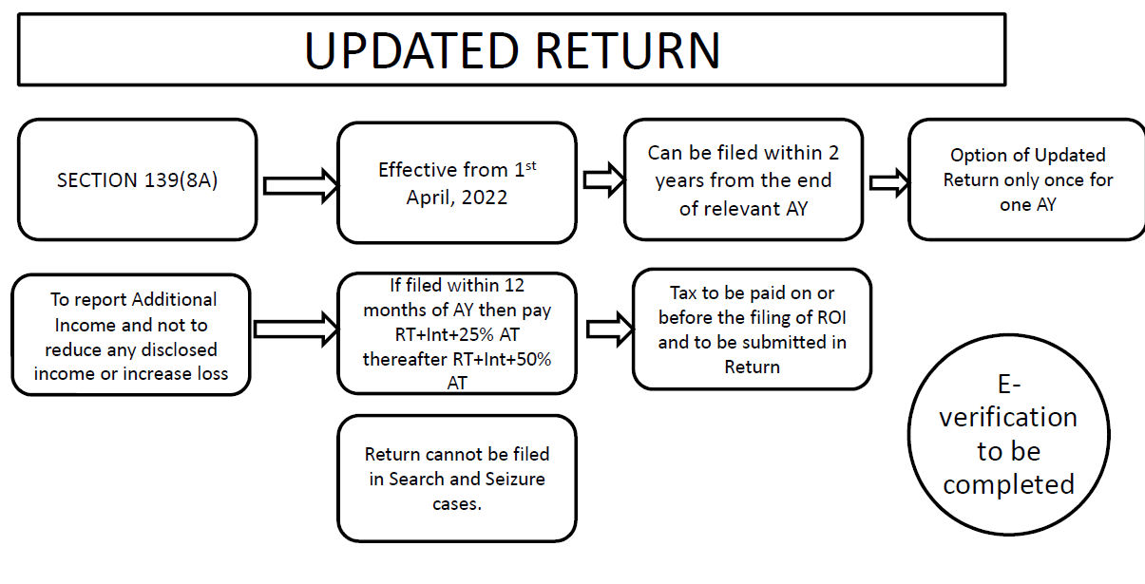

Slide 54
Questions?
Thank You
PANKAJ SHAH
Chartered Accountant
9691893040

