Slide 1
Tax Audit – 360 degree analysis
CA Pankaj Shah
Vice Chairman, TAQRB

Slide 2

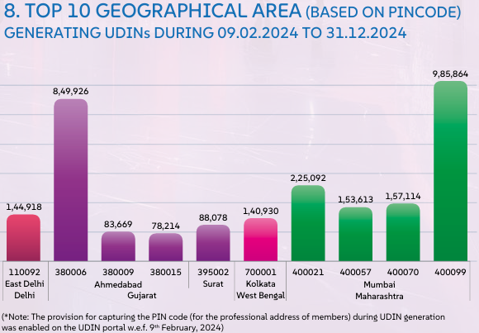
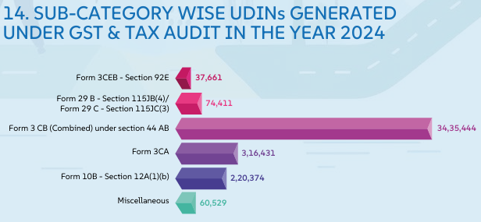
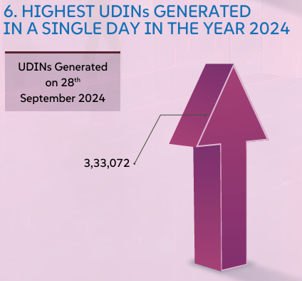

Slide 3
Report of Select Committee

Slide 4
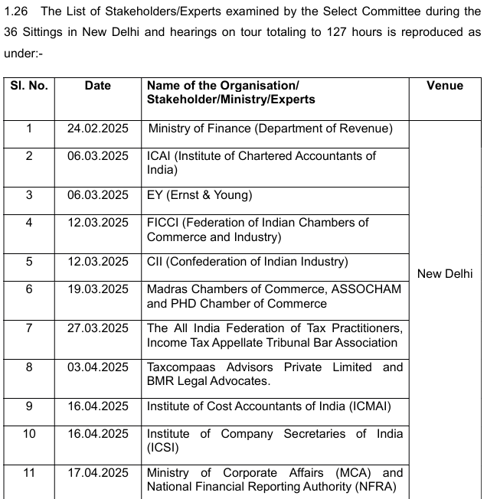

Slide 5
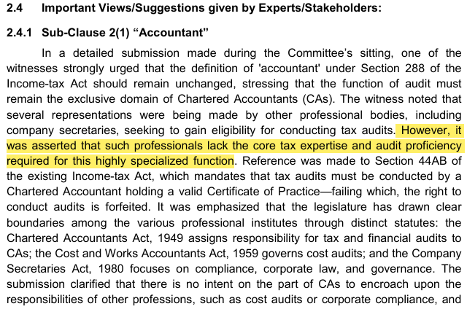

Slide 6
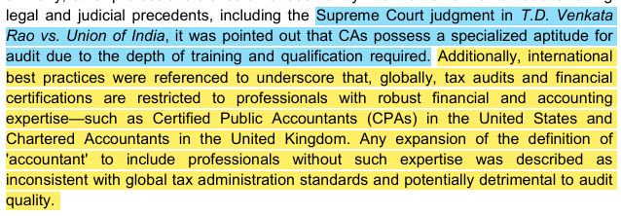

Slide 7
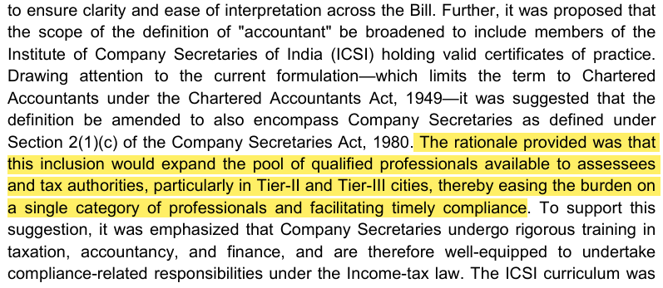
Presence of Chartered Accountants

Slide 8
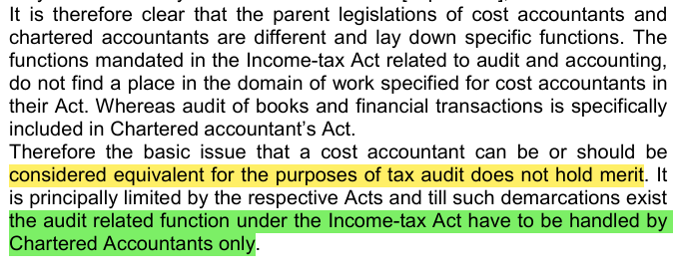
Ministry of Finance supported exclusivity of “Chartered Accountants” for conducting tax audit ☺ ☺
Conclusions

Slide 9
Brand CA - class apart
Supreme Court in case of T.D. Venkat Rao v. UOI (237 ITR 315) has upheld the superiority of CAs by noting that
Chartered Accountants, by reason of their training have special aptitude in the matter of audits and no other person can be held eligible to conduct audit under Section 44AB. Supreme Court further held that CAs are a Class by themselves meaning that CAs are the brand for auditing itself.
| CA. Pankaj G. Shah | + 91 96918 93040 | pankajgshah@gmail.com | Indore |

Slide 10
Tax Audit
Firstly an Audit
General purpose financial statement
Trueness and fairness of Financials
Going concern, historical cost, prudence, Materiality
Psycology – praising, belittling
| CA. Pankaj G. Shah | + 91 96918 93040 | pankajgshah@gmail.com | Indore |

Slide 11
Common mistakes
Non allowable expenses debited to capital account
No need to give list of Debtors and Creditors.
Non Provision of Interest if NPA account
Income tax debited to capital account
Penalties

Slide 12
Audit report - Inventory
Inventory has been accepted as certified by the management
Existence and condition of material asset
Alternative procedures to be applied

Slide 13
NFRA order 11.07.2023
Inventory
  The auditor is required to attend the physical inventory counting as it forms a considerable part of the financial statement.
  Also, no working papers were found in the audit file evidencing that the alternative audit procedures were performed by the EP after he failed to perform physical inventory counting on the reporting date.
  This is a clear violation of SA 501.
Receivables
  The auditor failed to obtain direct confirmation from parties having a significant and material balance of trade receivables and trade payables. Moreover, the auditor failed to perform alternative audit procedures in the absence of confirmations, as required by SA 505.

Slide 14
Common mistakes
Notes to Accounts
  “Debtors and Creditors are subject to confirmation”
Audit Report
  No comments

Slide 15
Compulsory Peer Review and TAQRB
Phase | Firms covered | Peer Review mandatory from
I | Auditing listed companies | 01.04.2022
II | Practice Units rendering attestation services and having 5 or more partners: For these Practice Units, there is a pre-requisite of having Peer Review Certificate before accepting any Statutory audit. | 01.07.2024
III | Practice Units rendering attestation services and having 4 or more partners: For these Practice Units, there is a pre-requisite of having Peer Review Certificate before accepting any Statutory audit. | 01.07.2025
IV | Practice Units rendering attestation services and having 3 or more partners: For these Practice Units, there is a pre-requisite of having Peer Review Certificate before accepting any Statutory audit. or Propose to undertake audits of branches of PSU Banks | 01.01.2026
Tax Audit Quality review Board – Study on common mistakes in Tax Audits

Slide 16
TAQRB
Three tier structure
  Reviewer
  Group
  Board
Purview of Board
  Ensure compliance with reporting requirements of statute
  Compliance with pronouncements, GN and Technical guides
Points to note
  No communication with the Auditor or Auditee
  Review based on information available
Eligibility of Reviewer amended

Slide 17
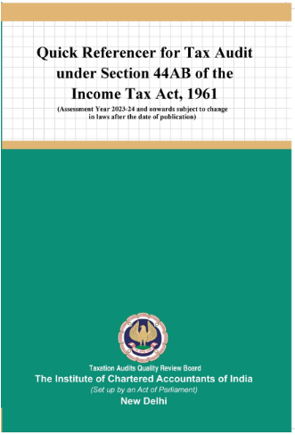
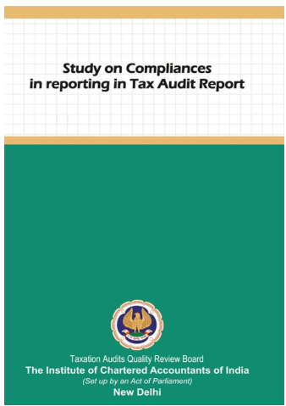
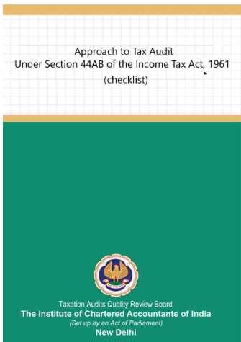
Publications

Slide 18
Tax Audit Quality Review Board
Regular review of tax audit reports
Material mistakes observed
  Disciplinary action – punishment
  Disciplinary reference - Advisory

Slide 19
Reports not signed by client
Common practice -obtain one signed report from client
Auditor signs 3 copies and gives to client
Physical Report signed only by auditor submitted at various forums
Violation of Section 215 of Companies Act
Name removed for 1 year
  CA. Sandhya Vasandani (M.No.128973)’s case

Slide 20
Proxy auditor
Counsel of the Respondent pleaded that his client i.e the Respondent had just signed the financial statements and the actual auditor was CA. Tarang Shah.
His client had merely signed based on reliance on another auditor and had refunded the fee to CA. Tarang Shah.
The Committee on the same, clarified to him, that since the signatures on the financial statement and the Audit Report were of the Respondent and hence the accountability for true and fair view of the documents, signed by her, lies with the Respondent only.
Name removed from the Register of Members for a period of 01(One) year with effect from 24th March, 2023

Slide 21
Undated audit report
All the audit reports were undated.
Audit Report was revised without due Procedure
Misconduct – Gross negligence
  (V. Ayyadurai vs. M. Rajkumar- Page 408 of Vol. II of Part I of the Disciplinary Casesof April, 2015 Judgement delivered on 10th December, 2013)

Slide 22
Revision of audit report
Auditor failed to state not only the reasons for revising the audit report issued by him
Also failed to inform the Charity Commissioner of Trust that his earlier report should not longer be relied upon.
Misconduct – Gross Negligence
  (Shekhar Purushottamrao Kannao vs. Sanjay S. Khandekar Re: [PR-125/13-DD/121/2013/DC /428/2014] Judgement delivered on 7th November, 2017)

Slide 23
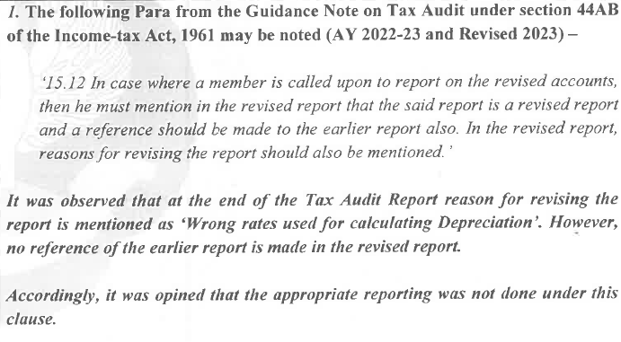
Sample

Slide 24
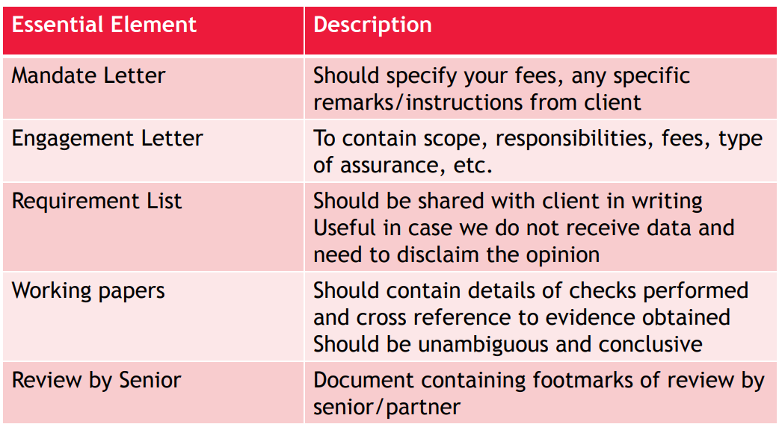
Documentation
CA. Pankaj Shah | 969 189 3040 | pankajgshah@gmail.com |

Slide 25
Applicability

Slide 26
Applicability
Section 44AB
Business Turnover
Rs. 1 crore
Rs. 10 crore
If cash receipts and cash payments do not exceed 5% of total receipts and payments
Profession turnover
Rs. 50 Lakhs

Slide 27
Presumptive Provisions
Turnover up to Rs. 1 Crore and Profit below 6/8%
No audit required, books to be maintained
Section 44AD
Rs. 2 crore
Rs. 3 crore
If total receipts in cash not more than 5%

Slide 28
Issue 1
Assessee engaged in business and profession. Can he claim
S.44AD for business
S.44AD(6)
S.44ADA for profession

Slide 29
CAN S.44AD and 44ADA be opted together
Law does not permit a professional to opt for S.44AD
However in ITR form practically many cases of simultaneous claim of S.44AD and S.44ADA

Slide 30
Specified Profession
Engineering
Legal
Architectural profession
Accountant
Medical
Technical consultant
Interior decoration
Authorized Representative
Company Secretary
Film Artist
Information Technology

Slide 31
Non specified profession
Teacher
Sports coach
Freelancer
Marketing Adviser
HR Consultants
Graphics designer
Translator
Artists (excl. film artist)

Slide 32
Issue 2
Business and Non specified profession
S.44ADA for profession
S.44AD for business

Slide 33
Issue 3:Person engaged in ‘vocation’
Profession includes ‘vocation’
But not specified profession
S.44AD is applicable on ‘business’
So vocation not eligible
Reference
CBDT Circular 641/1992
Ram Kripal Tripathi 125 ITR 408
Does not involve Substantial intellectual inputs
Tailor, hair cutting, electrician, carpenter, driver

Slide 34
Issue 4
Person engaged in business
Has been claiming 44AD in earlier years
This year Turnover less than 1 crore
offering less than 8%
Has commission of Rs.100
Audit requirement?
S.44AD(6)
S.44AD(4) not applicable as excluded and not opted out

Slide 35
Issue 5: F&O transactions
Turnover (for only calculation of limit)
Aggregate positive and negative difference
In options add premium paid
In books
Income on credit and loss on debit side
Salaried persons involved in FNO
S.44AD not automatic
No audit requirement if books maintained
Balance sheet – Broker balance and capital
Profit and loss – income and loss and expenses
Personal balance sheet not required
Savior : S.44AD(6)

Slide 36
Issue 6:Turnover
(inclusive or exclusive of GST)
S.2(112) of CGST defines turnover to exclude CGST, SGST, IGST
Accounting standards provide exclusive system of accounting
Contrary S.145A
Provision in context of excise
Not for bringing goods to location and condition
GST on outward supply
S.145 for method of accounting and not for computation

Slide 37
Issue 7 : Allowances
Carry forward of loss allowable
Not deduction
Current year loss
Adjustment not deduction
Partners remuneration
Deduction u/s 30-38
S.40(a), 40(a)(ia), 40A(3)
Deemed to be allowed
Non obstante 44AD
Unabsorbed depreciation ?

Slide 38
Issue 8:
Section 44AD and 43B(h)
Books are not maintained and
Section 44AD states
  “Notwithstanding anything to the contrary contained in sections 28 to 43C, ……………
  Any deduction allowable under the provisions of sections 30 to 38 shall, for the purposes of sub-section (1), be deemed to have been already given full effect to and no further deduction under those sections shall be allowed.”
  No Disallowance in 44AD cases
| CA Pankaj Shah | 969 189 3040 |

Slide 39
Issue 9 : S.43CA vs. 44AD
44AD : Non obstante 28-43C
Turnover deeming provision
Provisions complementary to each other

Slide 40
TDS Requirement
If in earlier Year
Business turnover exceeds 1 crore
Profession exceeds 50 Lakhs
The condition of getting audited is changed due to increase in tax audit limit
Implications
40(a) N.A.
Other provisions shall apply

Slide 41
Form 3CA/3CB

Slide 42
SA 700 ‘Forming an Opinion and Reporting on Financial Statements
Assessee’s Responsibility for the Financial Statements and the Statement of Particulars in Form 3CD
Tax Auditor’s Responsibility
| CA. Pankaj G. Shah | + 91 96918 93040 | pankajgshah@gmail.com | Indore |

Slide 43
SA 700 – Illustrative- Assessee’s Responsibility for the Financial Statements and the Statement of Particulars in Form No. 3CD
The assessee is responsible for the preparation of the statement of particulars required to be furnished under section 44AB of the Income-tax Act, 1961 annexed herewith in Form No. 3CD read with Rule 6G(1)(b) of Income Tax Rules, 1962 that give true and correct particulars as per the provisions of the Income-tax Act, 1961 read with Rules, Notifications , circulars etc. that are to be included in the Statement.

Slide 44
SA 700 – Illustrative- Tax Auditor’s Responsibility
We are also responsible for verifying the statement of particulars required to be furnished under section 44AB of the Income-tax Act, 1961 annexed herewith in Form No. 3CD read with Rule 6G (1) (b) of Income-tax Rules, 1962. We have conducted my/our verification of the statement in accordance with Guidance Note on Tax Audit under section 44AB of the Income-tax Act, 1961, issued by the Institute of Chartered Accountants of India.

Slide 45
SA 700 – Clause (3) of Form No.3CA or Clause (5) of Form No.3CB
As per Para 11.9 of the Guidance Note-
The ICAI had pursuant to the issuance of the Revised SA 700, Forming an Opinion and Reporting on Financial Statements, prescribed a revised format of the auditor’s report on financial statement. Since Form No. 3CA and Form No. 3CB are required to be filed online in a preset form and the same are not in line with the requirements of SA 700, there is no specifically allocated field for providing information relating to the respective responsibilities of the assessee and the tax auditor as required in terms of the principles laid out in SA 700.
However, having regard to the importance of these respective responsibility paragraphs from the perspective of the readers of the tax audit report, it is suggested that these respective responsibility paragraphs relating can be provided in the space provided for giving observations, etc., under clause (3) of Form No.3CA or Clause (5) of Form No.3CB as the case may be.

Slide 46
SA 700 – Clause (3) of Form No.3CA or Clause (5) of Form No.3CB
The illustrative Assessee’s responsibility paragraph and Tax Auditor’s responsibility paragraphs in respect of Form No.3CB has been given in the Guidance Note. The same are to suitably re-worded to meet the situation envisaged in Form No.3CA.
In most of the cases, these respective responsibilities of the assessee and the tax auditor are not reported under clause (3) of Form No.3CA or Clause (5) of Form No.3CB as the case may be.
In few Tax Audit Reports, is has been reported to read along with manually signed TAR or notes attached with it. These notes also contained paragraphs complying with the requirement of SA 700. However, as per the Guidance note on Tax Audit under section 44AB of the Income tax Act, the same were specifically required to be mentioned / reported under clause (3) of Form No.3CA or Clause (5) of Form No.3CB as the case may be.

Slide 47
To start with
Cross check things – Notes to accounts/CARO
Comparative analysis
Check capital account for major credits/exceptional
Read Guidance note
Documentation must
Tax Audit Review
Engagement letter
| CA. Pankaj G. Shah | + 91 96918 93040 | pankajgshah@gmail.com | Indore |

Slide 48
Obtain
Form 26AS
Balance Confirmations
Bank Reconciliations
Minutes of Board meetings
Stock Statements submitted to bank
Tax assessment orders
Computation of Income and ITR for last 5 yrs
Annual return filed with ROC
| CA. Pankaj G. Shah | + 91 96918 93040 | pankajgshah@gmail.com | Indore |

Slide 49
Disclosures
Form 3CA/3CB
Audit Opinion - Perspective
Disclaimer/Qualification/Adverse
Audit approach – test checks, materiality, etc.
To be signed by Auditor Only
Form 3CD
Reporting of Specific Information
Clause specific assumptions /stands except complete disclaimer/qualification
To be first signed by Assessee
Very important observations/qualification
All partners or Directors
Management Representation
| CA. Pankaj G. Shah | + 91 96918 93040 | pankajgshah@gmail.com | Indore |

Slide 50
Tax Audit
Form 3CB
Para 3 (Audit observation)
Para 5 (3CD observations)
Any clause from (a) to (e)
Form 3CA
(does not require opinion on true and fair)
Para 3(3CD observations)
3rd Proviso

Slide 51
Form 3CB – Clause 5
Category of Qualifications
On Books of Accounts
Inventory related
Insufficiency of audit evidences
Not ascertainable
| CA. Pankaj G. Shah | + 91 96918 93040 | pankajgshah@gmail.com | Indore |

Slide 52
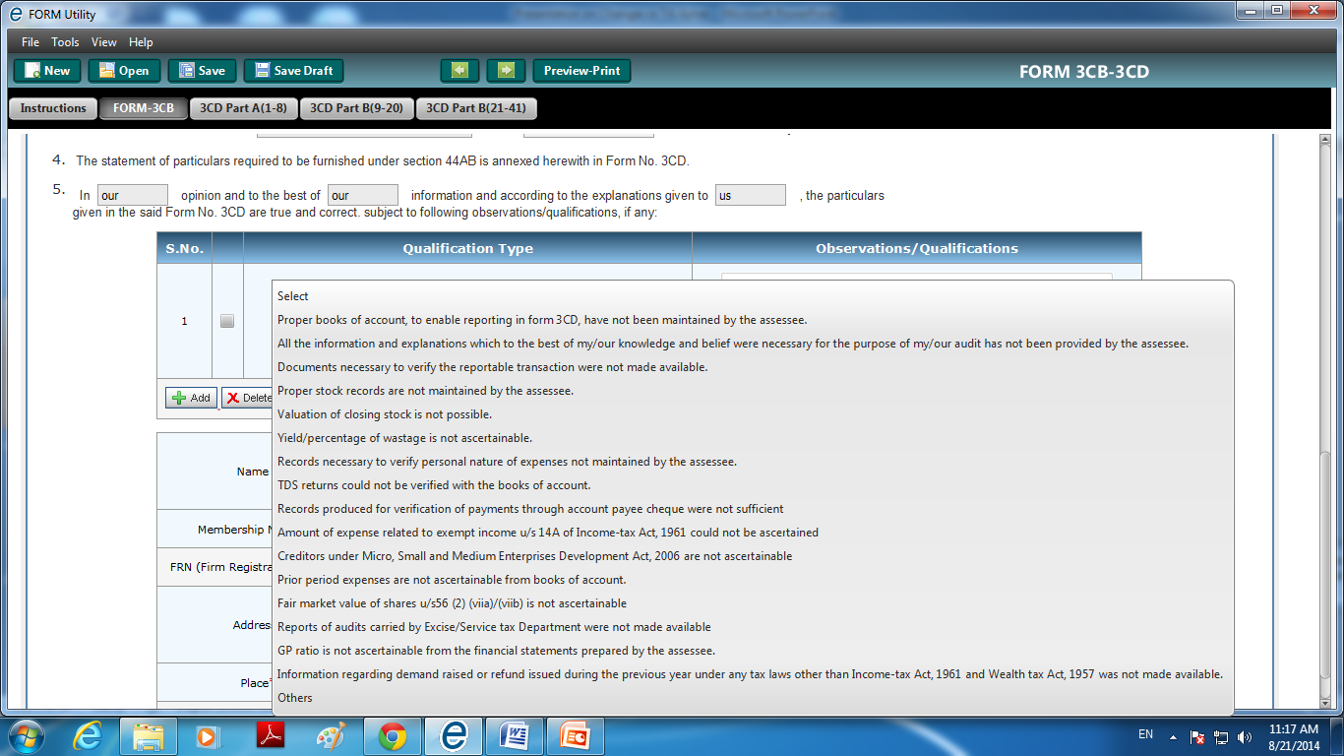

Slide 53
Category | Qualification Type | Observations/ Qualifications
Books of Accounts related | Proper books of account, to enable reporting in form 3CD, have not been maintained by the assessee.
 | All the information and explanations which to the best of my/our knowledge and belief were necessary for the purpose of my/our audit has not been provided by the Assessee.
 | Documents necessary to verify the reportable transaction were not made available.
Inventory related | Proper stock records are not maintained by the assessee.
 | Valuation of closing stock is not possible.
 | Yield/percentage of wastage is not ascertainable.
Extreme
| CA. Pankaj G. Shah | + 91 96918 93040 | pankajgshah@gmail.com | Indore |

Slide 54
Category | Qualification Type | Observations/ Qualifications
Insufficiency of Audit Evidences Disclaimers | Records necessary to verify personal nature of expenses not maintained by the assessee.
 | TDS returns could not be verified with the books of account.
 | Records produced for verification of payments through account payee cheque were not sufficient
Moderate
| CA. Pankaj G. Shah | + 91 96918 93040 | pankajgshah@gmail.com | Indore |

Slide 55
Category | Qualification Type | Observations/ Qualifications
Not Ascertainable disclaimer | Amount of expense related to exempt income u/s 14A of Income-tax Act, 1961 could not be ascertained
 | Creditors under Micro, Small and Medium Enterprises Development Act, 2006 are not ascertainable
 | Prior period expenses are not ascertainable from books of account.
 | Fair market value of shares u/s56 (2) (viia)/(viib) is not ascertainable
 | Reports of audits carried by Excise/Service tax Department were not made available
 | GP ratio is not ascertainable from the financial statements prepared by the assessee.
 | Information regarding demand raised or refund issued during the previous year under any tax laws other than Income-tax Act, 1961 and Wealth tax Act, 1957 was not made available.
Technical
| CA. Pankaj G. Shah | + 91 96918 93040 | pankajgshah@gmail.com | Indore |

Slide 56
Impact of audit qualification in assessment
Delhi High Court in case of PCIT vs. Escorts Limited [2018] 98 taxmann.com 291 (Delhi) has clearly held that Auditor's opinion though relevant and material would not be final and conclusive even when against the assessee.
Auditor's report in a way is a third party and an independent report that can be equated with an expert opinion.
It may be accepted or rejected or partly accepted and partly rejected. It has to be considered with other material.
It cannot be treated as final or binding on the Assessing Officer, or for that matter even on the assessee, except when mandated by a statutory provision, which requires an unqualified auditor's report or certification.
In the absence of statutory provision it would not be right to hold that a reservation or qualifying note in the audit report would be a conclusive and bind finding against the assessee.
| CA. Pankaj G. Shah | + 91 96918 93040 | pankajgshah@gmail.com | Indore |

Slide 57
Impact of Qualification on assessments
Gujarat High Court in Rajkot Engg. Association v. Union of India [1986] 162 ITR 28/26 Taxman 60 (Guj.) had appropriately referred to the affidavit file by the Union of India repelling and quelling misgiving expressed by the assessee on the binding nature of qualifications or reservations expressed in audit reports to clarify and observe:—
  "53. It was, therefore, submitted that if the auditor finds that the financial information furnished to him is not according to the acceptable accounting policy and principles or not according to the relevant regulations and statutory requirements, he may refuse to give an unqualified opinion in which case an assessee would be exposed to grave consequences of not only a best judgment assessment but also to penalty. We can appreciate this apprehension expressed on behalf of the assessee. However, in view of the clarification made by the Union Government in the reply affidavit of Shri Kalyanchand, Under Secretary in the Finance Ministry to the Government of India in paragraph 15 that opinions given by the chartered accountants are not binding either on the assessees or on the assessing officer, we do not think that the assessee will be prejudiced by the qualified opinion given by the tax auditor in any given case.
| CA. Pankaj G. Shah | + 91 96918 93040 | pankajgshah@gmail.com | Indore |

Slide 58
Mistakes in audit reports
Reopening notice merely relying on a technical mistake committed by an auditor was unjustified
Baroque Pharmaceuticals (P.) Ltd. [2022] 137 taxmann.com 94 (Gujarat)
If assessee contends inadvertent error in Form No. 3CD, he should submit revised tax audit report/addendum issued by the tax auditor.
ACIT vs. J.P. Yadav [2022] 138 taxmann.com 320 (Allahabad - Trib.)
Rule 6G(3)
With effect from 1-4-2021, Rule 6G(3) provides that "(3) The report of audit furnished under this rule may be revised by the person by getting revised report of audit from an accountant, duly signed and verified by such accountant, and furnish it before the end of the relevant assessment year for which the report pertains
| CA. Pankaj G. Shah | + 91 96918 93040 | pankajgshah@gmail.com | Indore |

Slide 59
Penalty – S.271J
AO or CIT(A) notices that
incorrect information is given in
Report
Certificate
Rs. 10000 per report/certificate

Slide 60
FORM 3CD

Slide 61
Notes
The information/ details given in Form No. 3CD are as per the books maintained and details and information compiled and furnished by the assessee;
We have broadly reviewed the basis of compiling details and information and we have test checked wherever considered necessary the books and/ or the details/ information compiled by the assessee.
| CA. Pankaj G. Shah | + 91 96918 93040 | pankajgshah@gmail.com | Indore |

Slide 62
Clause 1 - Name of the assessee
As per para 17.1 of the Guidance Note: “Under clause (1) the name of the assessee whose accounts are being audited under section 44AB should be given. However, if the tax audit is in respect of a branch, name of such branch should be mentioned along with the name of the assessee.”

Slide 63
Clause 2 : Address
It has been observed that in certain tax audit reports address mentioned in Form No. 3CA/ 3CB is different from the one mentioned in Annual report or as registered under MCA.
As per the Guidance Note, the tax audit report should contain the address as has been communicated by the assessee to the Income-tax Department for assessment purposes as on the date of signing of the audit report.
| CA. Pankaj G. Shah | + 91 96918 93040 | pankajgshah@gmail.com | Indore |

Slide 64
Clause 4 - Whether the assessee is liable to pay indirect tax like excise duty, service tax, sales tax, goods and services tax, customs duty, etc. if yes, please furnish the registration number or, GST number or any other identification number allotted for the same
This clause requires reporting of registrations under indirect tax law. In certain tax audit reports, registrations under all the other Indirect Tax Laws which have been mentioned in CARO have not been reported under this clause.
In cases, where it is traceable from the Annual Report that the company is registered under the GST Laws, the GST registration no. should have been reported. In certain cases, the same was not done.
Also, in some cases, Registration no. based on PAN did not match with the PAN as reported under clause 3 in some cases.

Slide 65
Clause 4: Indirect tax registration
All the registrations under Indirect tax laws have not been reported
Registration no. is not matching with PAN
  GST no. of Deceased/ Erstwhile partnership

Slide 66
Clause 10a : Nature of business or prof
Information under this clause has to be furnished in respect of each business.
It has been observed that codes for business or profession for all main activities are not being reported.
| CA. Pankaj G. Shah | + 91 96918 93040 | pankajgshah@gmail.com | Indore |

Slide 67
Clause 11a-Whether books of accounts are prescribed under section 44AA, if yes, list of books so prescribed
Under section 44AA NO Books of accounts are prescribed for a company.
Also, the Companies Act, 2013 does not specifically prescribes books of accounts for a Company.
In respect of a business, the tax audit report should report ‘NO” under this sub - clause.

Slide 68
Clause 11 (b)
“(b) List of books of account maintained and the address at which the books of accounts are kept.”
Survey Action can be done at places where books are kept
Management Representation must
All places to be reported
‘Books of account’ defined in S.2(12A)
Ledgers, Day books, Account books,
Cash book and Other books
Cross check with Companies Act, etc
| CA. Pankaj G. Shah | + 91 96918 93040 | pankajgshah@gmail.com | Indore |

Slide 69
Cl 11(b) - List of books of account maintained and the address at which the books of account are kept
(In case books of account are maintained in a computer system, mention the books of account generated by such computer system. If the books of account are not kept at one location, please furnish the addresses of locations along with the details of books of account maintained at each location.
location of maintenance of Books of Account has not been specified.
Books of Accounts are maintained in computer system, is not mentioned (Audit trail)
Discrepancy in respect of reporting of places of Maintenance of records in Tax Audit report visa-vis annual reports
| CA. Pankaj G. Shah | + 91 96918 93040 | pankajgshah@gmail.com | Indore |

Slide 70
Company Rule 11(g)
Audit trail
  Configured
  Operative throughout year
  Tampered or not
  Preserved
Small companies
  Tax audit
  No tax audit – Manual books of accounts
  Implications of qualification – Trail not maintained

Slide 71
Suggestive Note – Audit Trail not maintained
“During the course of our audit, it was observed that the current accounting software being used by the organization does not have the functionality to maintain an audit trail. This limitation is due to the inherent design of the software, and it is not possible to configure this feature within the existing system.
Given the limited number of transactions processed by the organization, it was not deemed feasible by the management to migrate to a more advanced accounting software that offers audit trail functionality. The costs associated with implementing such software would be disproportionately high compared to the organization's transaction volume.
Management has informed that due to this limitation, alternative controls have been implemented to ensure the integrity and accuracy of financial data. These alternative controls include manual reviews, approvals, and documentation.”

Slide 72
11(c) - List of books of account and nature of relevant documents examined.
It has been observed that all the relevant documents examined are not mentioned like Invoices, receipts, vouchers, bills, secretarial, confirmation, certificates, internal & external. In many cases the term “etc.” is used without the mention of detailed documents examined.
As per the Guidance Note reference to all such supporting evidences/ relevant documents is also required to be made under this clause
| CA. Pankaj G. Shah | + 91 96918 93040 | pankajgshah@gmail.com | Indore |

Slide 73
Clause 13
Method of Accounting
Cash
Mercantile
No prior approval to change method
Different source – Different method
J.K. Bankers v. CIT (94 ITR 107)(All)
Vishwanath Acharya v. ACIT 157 ITD 1032 (Mum)
| CA. Pankaj G. Shah | + 91 96918 93040 | pankajgshah@gmail.com | Indore |

Slide 74
ICDS
Mercantile System of Accounting
Computing Income from
Business and Profession
Other Sources

Slide 75
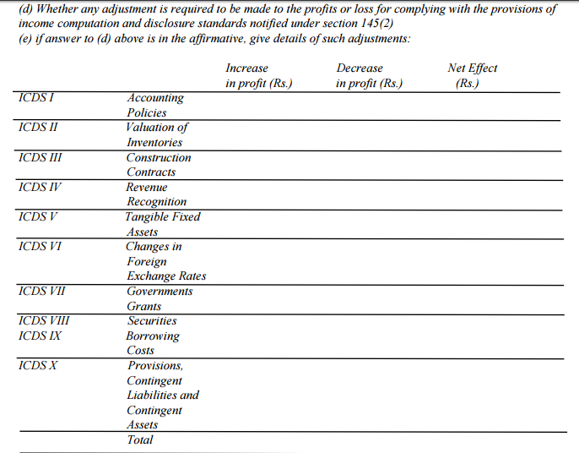
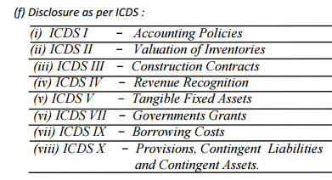
Form 3CD
ITR 3 and 5. Impact is not considered in computing in utility

Slide 76
Notified Standards
ICDS | Dealing with | ICAI AS
I | Accounting Policies | 1
II | Valuation of Inventories | 2
III | Construction Contracts | 7
IV | Revenue Recognition | 9
V | Tangible Fixed Assets | 10
VI | Effects of changes in foreign exchange rates | 11
VII | Government Grants | 12
VIII | Securities | 13
IX | Borrowing Costs | 16
X | Provisions, Contingent Liabilities and Contingent Assets. | 29

Slide 77
ICDS - I
Accounting Policies

Slide 78
ICDS –I ACCOUNTING POLICIES
SCOPE
Deals with Significant Accounting Policies
FUNDAMENTAL ACCOUNTING ASSUMPTIONS
Going concern
Consistency
Accrual
SELECTION OF ACCOUNTING POLICY
Substance over form
Expected M2M loss not to be recognized

Slide 79
Fundamental changes
Accelerate accrual
Double taxation due to MAT
Committee Logic
To avoid differential treatment of loss and income, concept of prudence to be removed
Prudence omitted

Slide 80
Mark to Market
Export Sales 01.03.18
50000USD
Rs.60/$
Year end 31.3.18
50000USD
Rs.65/$
Payment Recd. 10.04.18
50000USD
Rs.62/$
MTM Gain
Rs.2,50,000

Slide 81
Mark to Market Concept
MTM/Expected losses will not be allowed
FAQ MTM profits also not to be taxed

Slide 82
TREATMENT
OF MTM
Allowable/Taxable
Monetary Items
Cash
Receivables
Payables
Not Allowable/Taxable
Non monetary items
Fixed Assets
Forex derivatives
Currency Futures

Slide 83
Mark to Market
Particulars | Enter rate | Year end rate 31.3.18 | MTM Gain/(Loss)
Foreign Currency Creditors | 50000$ @ Rs.60 =30,00,000 | 50000@ 65 =3250000 | (Rs.2,50,000)
USD Future June contract | 1 lot of 10000$ @ Rs.68 | 1 lot of 10000$ @ Rs.62 | (Rs.60000)
Foreign Currency Balance in NRO Account | 10000$ @ Rs.60 =6,00,000 | 10000@ 65 =6,50, 000 | Rs.50,000
UK Pound Future July contract | 2 lot of 5000 UKP @ Rs.80 | 2 lot of 5000 UKP @ Rs.85 | Rs.50,000
Allowable
Not
Allowable
Taxable
Not
Taxable

Slide 84
Change in Accounting Policy
ICAI AS
ICDS
Required by statute
Result in a more appropriate preparation and Presentation
Required by any Accounting Standard
“Reasonable cause” FAQ
Flexibility
Eg. Change in business model, availability of new technology to gather accounting information, etc

Slide 85
Change in an accounting policy
Material Impact
Disclose
Year of change
Year in which such change has first material impact
No Material Impact
No disclosure required

Slide 86
Disclosures in TAR Cl.13(f)(i)
No need to Disclose if Going concern, Consistency and Accrual are followed
Historical Cost convention
Use of Estimates
Accounting Policies
  Revenue Recognition
  Inventory valuation policy
  Provisions
  Tangible Assets
  Forex policy if applicable
  Borrowing Costs, if applicable

Slide 87
ICDS - II
Valuation of Inventories

Slide 88
Clause 14
Method of valuation of closing stock
At Cost
Lower of Cost or and NRV
At NRV
Accounting Standard
Cost – CIT v. Carborandum Universal (149 ITR 759)(Mad)
ICDS: Change from cost to Lower of both
Reasonable cause
No corresponding change in Opening required here
Melmound Corporation (202 ITR 789)(Bom)
Disclosures (not in clause 13)
| CA. Pankaj G. Shah | + 91 96918 93040 | pankajgshah@gmail.com | Indore |

Slide 89
Approach
Inventory list as on year end date
Shortage and Excess list on verification by Client
Obtain Purchase and Sales for April to June
Physical verification (SA)
Existence and condition of Inventory
Inventory is material item of Balance sheet
Retail method
| CA. Pankaj G. Shah | + 91 96918 93040 | pankajgshah@gmail.com | Indore |

Slide 90
Other Issues (Revised)
Standard costing method of inventory valuation permitted if standard cost approximates actual cost
Weighted Average and FIFO accepted
LIFO not acceptable
Notes:
Recoverable taxes not to be reduced from cost. Same as 145A

Slide 91

Cost Formulae – FIFO, WEIGHTED AVG.

Slide 92
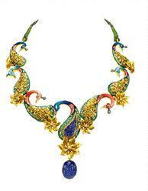



Specific Identification method (LIFO)

Slide 93
First-in First-out and Weighted Average Cost Formula
16. Cost of inventories, other than the inventory dealt with in paragraph 13……………..
PARA 13
“13. The Cost of inventories of items
(i) that are not ordinarily interchangeable; and
(ii) goods or services produced and segregated for specific projects shall be assigned by specific identification of their individual costs.
14. 'Specific identification of cost' means specific costs are attributed to identified items of inventory.”

Slide 94
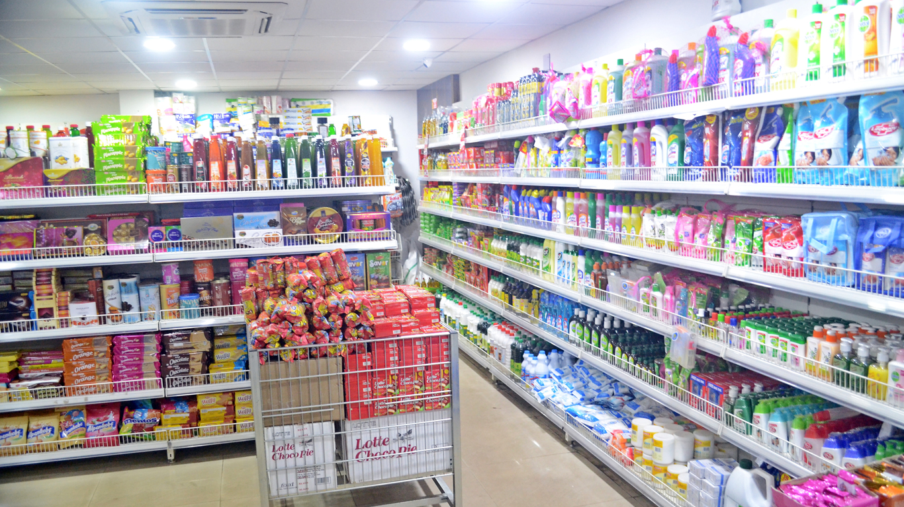
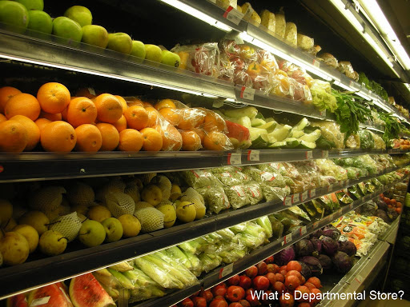
Retail Method

Slide 95
Retail Method
In respect of retail method of measuring inventory, cost is determined by reducing appropriate percentage of gross margin from the sales value.
ICDS now requires that an average percentage for each retail department under retail method is to be mandatorily used

Slide 96
Cost formulae
LIFO, FIFO, Weighted Average
142(2A) w.e.f. 01.04.2023

Slide 97
WIP for Service Providers
AS
Excludes WIP of Service Providers
ICDS 
Definition of Inventory (all tangible)
(i) held for sale in the ordinary course of business;
(ii) in the process of production for such sale;
(iii) in the form of materials or supplies to be consumed in the production process or in the rendering of services.
Revenue Recognition
Percentage Completion method
The cost of services in case of a service provider shall consist of labour and other cost of personnel…………….
Short period Services taking <90 days

Slide 98
Disclosures
General Disclosure
Raw materials, work-in-progress, finished goods, goods for trade and stores, spares, etc. are valued at cost or net realisable value, whichever is lower.
Goods in transit are valued at cost to date.
‘Cost’ comprises all costs of purchase, costs of conversion and other costs incurred in bringing the inventory to the present location and condition.
The cost formulae used is either ‘first in first out’, or ‘specific identification’, or the ‘average cost’, as applicable.

Slide 99
Specific Disclosure
Carrying cost of inventory as on Balance Sheet date is as follows:
  Finished goods………..,
  Traded goods…………….,
  Work in progress………………,
  Raw materials……………

Slide 100
ICDS - VIII
Securities

Slide 101
Securities
Deals with Securities as Stock in trade
Lower of Cost or NRV
Category wise Valuation

Slide 102
Shares | Cost | NRV | Notional Gain / Loss | Accounting Standard
Satyam | 1000 | 100 | (900) | 100
Infosys | 100 | 2000 | 1100 | 100
ICDS |  |  |  | 200

Slide 103
ICDS VII
Government Grants

Slide 104
Amendment
S.2(24)((xviii)
All subsidies and grant are now taxable
Amendment not part of Finance Bill
Exception
Carbon credit
Prepayment of sales tax deferral loan

Slide 105
Government Grants
Grant Received
Depreciable Asset
Specific
Specific Reduction
Non Specific
Reduction from All assets
Non Depreciable
P&L

Slide 106
Government Grants
Recognition cannot be postponed after actual receipt
Receipt is not concluding evidence for accrual of income –Godhra Electricity (SC)
Conditional grant
Accrual Override

Slide 107
Clause 14
Method of valuation of closing stock
At Cost
Lower of Cost or and NRV
At NRV
Accounting Standard
Cost – CIT v. Carborandum Universal (149 ITR 759)(Mad)
ICDS: Change from cost to Lower of both
Reasonable cause
No corresponding change in Opening required here
Melmound Corporation (202 ITR 789)(Bom)
Disclosures (not in clause 13)
| CA. Pankaj G. Shah | + 91 96918 93040 | pankajgshah@gmail.com | Indore |

Slide 108
Approach
Inventory list as on year end date
Shortage and Excess list on verification by Client
Obtain Purchase and Sales for April to June
Physical verification (SA)
Existence and condition of Inventory
Inventory is material item of Balance sheet
| CA. Pankaj G. Shah | + 91 96918 93040 | pankajgshah@gmail.com | Indore |

Slide 109
Clause 13d-Whether any adjustment is required to be made to the profits or loss for complying with the provisions of income computation and disclosure standards notified under section 145(2)
&
Clause 13e -If answer to (d) above is in the affirmative, give details of such adjustments
Details required are not fully disclosed.
While reporting is done in respect of some of ICDS, others are just left blank. In order to ensure clarity, if no adjustments are there to be reported, “0” or “Nil” should be mentioned.

Slide 110
Clause 13f-Disclosure as per ICDS
Reference to the disclosures made in the financial statements is given under these sub-clauses particularly in case of ICDS-I. Disclosure requirement is to report information pertaining to each ICDS notified and not only where any deviation from the notified ICDS is encountered.
As per the disclosure requirement under ICDS, reporting is to be done in respect of all of the notified ICDS except:
  ICDS VI (Changes in Foreign Exchange Rates) and
  ICDS VIII (Securities)
For ICDS V (Tangible Fixed Assets), the prescribed disclosure requirement is similar to the requirements of clause 18 of Form No. 3CD. Accordingly, reference to reporting as done under clause 18 may be given.

Slide 111
Clause 13f-Disclosure as per ICDS
As per disclosure requirements of ICDS – II (Valuation of Inventories), ‘the accounting policies adopted in measuring inventories including the cost formulae used’ are to be reported.
Further, as per Para 3 of the ICDS –II
─ inventories shall be valued at “cost OR net realisable value whichever is lower”.
As per Para 5 of the Revised AS 2
─ inventories shall be valued at “lower of cost AND net realisable value”.
In few cases, the accounting policies reported were as per the language prescribed in Para 5 of the Revised AS-2 (or IND AS-2 wherever applicable) and not as per Para 3 of the ICDS –II. The reporting under clause 13(f) is required to be done as prescribed by the ICDS, which was not done.

Slide 112
Implications of Reporting
Section 143(1)
Disallowance indicated in audit report but not taken in computation of total income
Views taken disclosures
amended by FA 2016 wef AY 2017-18
S.143(1) intimation appealable
| CA. Pankaj G. Shah | + 91 96918 93040 | pankajgshah@gmail.com | Indore |

Slide 113
Cl 16 : Items not credited to P&L
Reporting of following items normally
Interest
Capital gains
Other income
Such items have already been offered in return of income
However such reporting has resulted in automatic additions in S.143(1) intimations
Gifts
| CA. Pankaj G. Shah | + 91 96918 93040 | pankajgshah@gmail.com | Indore |

Slide 114
Cl. 16(d)
Guidance Note
  “Under this clause various amounts falling within the scope of section 28 which are not credited to profit or loss are to be stated”
  The information under these clauses is to be given with reference to the entries in the books of accounts and records made available to the tax auditor

Slide 115
Cl. 21- Contingent liabilities
Reporting required of contingent liabilities debited to P&L
Some tax audits reveal reporting of
Contingent liability disclosed in Notes to accounts
All provisions made in the financials
Such reporting has resulted in automatic disallowances of genuine allowable provisions and those contingent liabilities which have not been claimed in P&L
| CA. Pankaj G. Shah | + 91 96918 93040 | pankajgshah@gmail.com | Indore |

Slide 116
Clause 17: Cases u/s 50C and 43CA
“Where any land or building or both is transferred during the previous year for a consideration less than value adopted or assessed or assessable by any authority of a State Government referred to in section 43CA or 50C, please furnish:”
Details of Property | Consideration Received or Accrued | Value Adopted or Assessed or Assessable
| CA. Pankaj G. Shah | + 91 96918 93040 | pankajgshah@gmail.com | Indore |

Slide 117
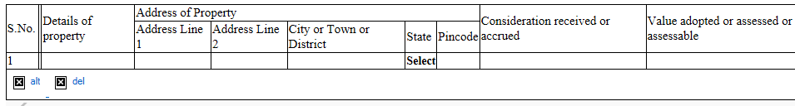
Clause 17: Audit Checklist
Check from 26AS statement on Income tax Portal for TDS u/s 194IA
Check Fixed Assets Account, Investment in Immovable assets account and other Ledgers
Obtain copy of Registered Deed duly certified by Auditee or Sale Agreement
Obtain a Management Representation of land and building sold and values.
| CA. Pankaj G. Shah | + 91 96918 93040 | pankajgshah@gmail.com | Indore |

Slide 118
Clause 17: Issue 4
Proprietor maintains books only for business
Land held in personal capacity sold for below 50C value
Whether Reporting required?
Reporting In case of Firm/Companies, etc.?
No reporting if Transaction value and guideline value are same
| CA. Pankaj G. Shah | + 91 96918 93040 | pankajgshah@gmail.com | Indore |

Slide 119
Clause 18: Fixed asset schedule
It has been observed that the details of additions/ deletions reported in Tax Audit Report are not in line with the figures of additions/ deletions disclosed in Audited financial statements.
Prepare a reconciliation for items like assets purchased in cash on which depreciation is not allowable, etc.
Assets purchased in Cash – item of reconciliation
| CA. Pankaj G. Shah | + 91 96918 93040 | pankajgshah@gmail.com | Indore |

Slide 120
Cl 18: Date of addition
Date of purchase
Date of put to use
  Same in all cases

Slide 121
Clause 18 and 21: Depreciation
Considering significant complexities involved in the computation of profits under the head “Profit and Gains of Business or Profession”, as also, Computation of Total Income under the Income-Tax Act, 1961, including Computation of Depreciation Allowable or deductions and allowances admissible or inadmissible as per and under the provisions of Chapter IV and VIA of the Act, the computation of such allowance/ inadmissible has been reviewed broadly and accordingly, it has been broadly examined whether prima facie, the deductions or allowances claimed are admissible or inadmissible. Otherwise, we have relied on the computation furnished to us based on satisfaction of the conditions and assumptions as determined/ made by the auditee.
| CA. Pankaj G. Shah | + 91 96918 93040 | pankajgshah@gmail.com | Indore |

Slide 122
Clause 18: Depreciation on Intangibles
Item | Citation
Skill and Knowhow of Labour | BOSCH LTD v. CIT (2009-TIOL-736-ITAT-BANG)
Brand Name | Raveendran Pillai 332 ITR 549 (Kerala HC)
Non Compete | Medicorp Tech. 21 DTR 69
Marketing and Commercial Rights | Skyline Caterers (20 SOT 266)
| CA. Pankaj G. Shah | + 91 96918 93040 | pankajgshah@gmail.com | Indore |

Slide 123
Depreciation
Car Registered in Partner’s name – Reflected in Firm’s Balance Sheet – What about Depreciation
  CIT Vs. Aravali Finlease Ltd. 341 ITR 282 (Guj)
  Edwise Consultants P. Ltd. Vs. DCIT 44 ITR 236 /45 CCH 392 (Mum.Trib.)
Depreciation on Individual assets which are not used but forming part of block of asset
  CIT Vs. G. R. Shipping Ltd. – ITA No. 598 of 2009 (Bom HC)
  CIT Vs. Sonic Hiochem Extraction P. Ltd. 94CCH 99 (Bom.)
Depreciation on vehicles for personal use
  Microsoft Corporation India P. Ltd. Vs. Addl CIT 37 ITR 290 (Del. Trib.)
    No Personal use in the case of companies
| CA. Pankaj G. Shah | + 91 96918 93040 | pankajgshah@gmail.com | Indore |

Slide 124
New AS 10- Property, plant and equipment
Machinery spares to be capitalised on consumption as per New AS-10
ICDS V requires it to be charged to P&L as per Old AS-10
Deferred tax liability
| CA. Pankaj G. Shah | + 91 96918 93040 | pankajgshah@gmail.com | Indore |

Slide 125
Clause 20(b) Details of Employee’s Contribution to Funds
Serial number | Nature of fund | Sum received from employees | Due date for payment | The actual amount paid | The actual date of payment to the concerned authorities
Due Date shall not be extended by any grace period
Only Employee’s share to be reported. In many cases the reporting is seen to be combined amount
Incorrect due date should not be maintained.
| CA. Pankaj G. Shah | + 91 96918 93040 | pankajgshah@gmail.com | Indore |

Slide 126
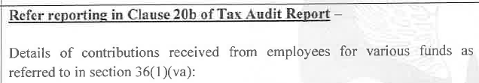
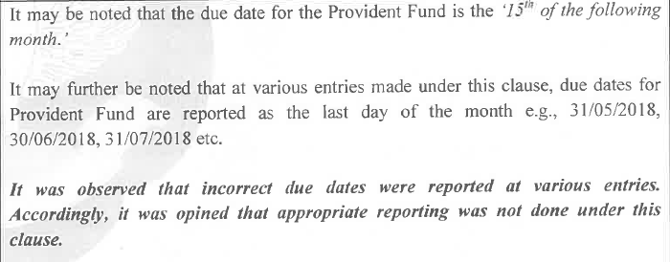

Slide 127
Clause 21(a)
Nature | S.No. | Particulars | Amount in Rs.
Capital, Personal, Advertisement expenditure, etc
Expenditure incurred at clubs being cost for club services and facilities used
Expenditure by way of penalty or fine for violation of any law for the time being force
Expenditure by way of any other penalty or fine not covered above
Expenditure incurred for any purpose which is an offence or which is prohibited by law
| CA. Pankaj G. Shah | + 91 96918 93040 | pankajgshah@gmail.com | Indore |

Slide 128
Capital v. Revenue Expenses
Expenses incurred on leased/rental premises are revenue in nature –
Malabar Mills 288 ITR 815
Modi Spg. & Wvg. Mills v. CIT 200 ITR 544
Amway India v. DCIT 27 SOT 344 (DELHI)
Supreme Court in CIT V. Ramaraju Mills (294 ITR 328) held that
if the production capacity remaining constant even after the replacement of the asset it is allowable as a revenue exp.
Benefit of enduring nature – Empire Jute (SC)
| CA. Pankaj G. Shah | + 91 96918 93040 | pankajgshah@gmail.com | Indore |

Slide 129
Following expenses have been held as revenue
Nature of Expense | Decision
Cost of water proofing of Roof Area | (322 ITR 590)
Renovation expenses including replacement of tiles, painting, false ceiling, portions etc. | (306 ITR 182) (Del.)
Replacement of a part of the machinery | 163 Taxman 201 (SC)
Reconstruction of Road | (100 Taxman 247)(Ahd)
Repairs to Boundary Wall | (2010-TIOL-648-HC-DEL-IT)
Internal furnishings, painting and polishing work, dismantling of old false ceiling, fees for interior designing, lift maintenance, etc. | 121 ITR 165 (Punj. & Har.). (104 ITD 427) (Del)
| CA. Pankaj G. Shah | + 91 96918 93040 | pankajgshah@gmail.com | Indore |

Slide 130
Cl. 21(a): Personal expense debited to P&L
Scrutinise following Expense Accounts :
  Membership and Subscription,
  Staff Welfare Expenses,
  General Expenses,
  Gifts and Presentation,
  Travelling Expenses,,
  Entertainment Expenses, etc
General Note that “payments made as per contractual obligations not considered for this clause”
Refer Auditors Report (CARO) for any comments on personal expenses
If no appeal filed in earlier years for certain disallowances for expenses towards personal motor car expenses, telephone, etc, the same should be mentioned in report.
Scrutinise Credit card payments
| CA. Pankaj G. Shah | + 91 96918 93040 | pankajgshah@gmail.com | Indore |

Slide 131
Clause 21(a) Personal expenses:
The concern has adequate internal control procedures to ensure that no `personal expenses' are debited to the profit and loss account.
On a review of the control system and such expenses, as we considered appropriate, no personal expenses have been found debited to the Profit and Loss Account. The payment as per contractual agreement or normally accepted business practices to the employees are not considered for the purpose of this clause.
| CA. Pankaj G. Shah | + 91 96918 93040 | pankajgshah@gmail.com | Indore |

Slide 132
Clause 21(a): Expenses on fine, penalty, etc
Materiality to be considered while reporting
No view to be expressed on allowability.
Penalty and fine are to be distinguished from contractual obligations -even if such payments are labeled as “penalty” in a contract.
Compensatory vs. penal payments (SC decisions)
Prakash Cotton Mills 201 ITR 684
Ahmedabad Cotton Mfg Co Ltd 205 ITR 163
Malwa Vanaspati & Chemical Co 225 ITR 383
| CA. Pankaj G. Shah | + 91 96918 93040 | pankajgshah@gmail.com | Indore |

Slide 133
Interest on Late Deposit of TDS
  ITO vs. Royal Packaging (ITA No. 1363/Ahd/2010),
  DCIT vs. Narayani Ispat Pvt. Ltd. in ITA No. 2127/Kol/2014 decided on 30.08.2017
  Sai Food Products Pvt. Ltd vs. DCIT in ITA No. 1887/Kol/2016 decided on 06-04-2018
  DCIT vs. Rungta Mines Ltd. in ITA No. 1531/Kol/2017 decided on 05/10/2018
  DCIT vs. Maa Annapurna Transport Agency Ltd. in ITA No. 822/Kol/2018 decided on 15-01-2020
  STUP Consultants Pvt. Ltd. vs. ACIT in ITA No. 5827/Mum/2012 dtd 11.12.2018
    distinguished the interest paid on income-tax/fringe benefits tax with the interest paid on late payment of TDS and held that the amount of tax deduction at source (TDS) represents the amount of income tax of the third parties party on whose behalf the payment was deducted by the assessee & paid to the Government Exchequer.
Against
  MMR Infra vs. DCIT in ITA No. 1609/Ahd/2018 decided on 01-06-2020
| CA. Pankaj G. Shah | + 91 96918 93040 | pankajgshah@gmail.com | Indore |

Slide 134
Clause 21(a) Penalty or fine:
The scope of expenditure in this item, it is submitted, is such that it is not capable of being identified and/ or quantified with reasonable accuracy, having regard to the volume of disbursement as also the plethora of laws, rules and regulations in India.
However we have been informed that no penalties or fines have been levied for violation of any law for the time being in force, nor have any other penalties or fines been paid except for those specified, if any. We have also been informed that no expenditure has been incurred for any purpose which is an offence or which is prohibited by law. On a scrutiny made on a test check basis, we have not come across any expenditure in the nature of penalty or fine debited to the Profit and Loss Account except those specified in the report, if any.
| CA. Pankaj G. Shah | + 91 96918 93040 | pankajgshah@gmail.com | Indore |

Slide 135
Clause 21(b)(i):TDS Disallowances
Reporting Disallowance for
Non deduction of TDS
Non deposit of TDS deducted
Second Proviso to Section 40(a)(ia)
If the Payee has offered the same to tax
Certificate of CA in form 26A
No disallowance
Short deduction – Chadubhai and Jassubhoy (ITAT)
| CA. Pankaj G. Shah | + 91 96918 93040 | pankajgshah@gmail.com | Indore |
Notes:
MP High Court in case of Jawahrlal Agrawal has held that Proviso to Section 40(a)(ia) is retrospective. Similar amendment has been brought in Finance Act 2014. Such amendment also being curative and remedial should also be retrospective as per this jurisdictional High Court decision.

Slide 136
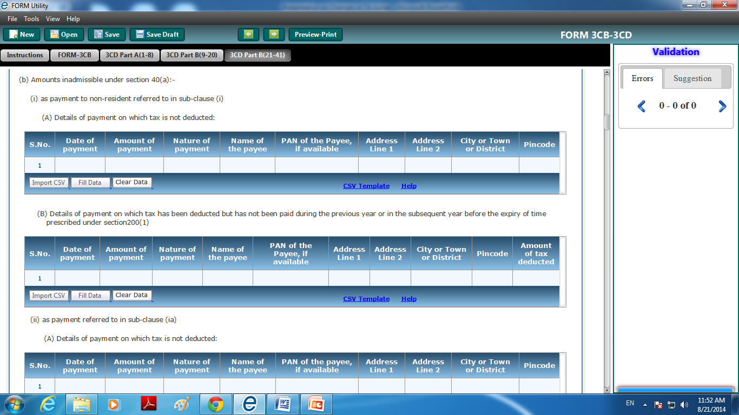
| CA. Pankaj G. Shah | + 91 96918 93040 | pankajgshah@gmail.com | Indore |

Slide 137
Clause 21 (b) :
The assessee has identified, in Attachment ___’, the amount as referred to in Section 40(a)(ia) of the Act on which tax is deductible at source under chapter XVII-B of the Act, and such tax has not been deducted or, after deduction has not been paid during the previous year. However, having regard to the volume of payments as also various payments from which the tax is so deductible, we are unable to determine/verify as to whether any such other amounts have been paid or provided on which the tax was deductible but not deducted or after deduction, has not been credited to the Central Government in accordance with the provisions of Chapter XVII-B.
| CA. Pankaj G. Shah | + 91 96918 93040 | pankajgshah@gmail.com | Indore |

Slide 138
Cl 21(c) – Remuneration to partners
Amount allowable
Amount disallowable
  No reporting is found in case of audit of partnership firms under both allowable and disallowable

Slide 139
Clause 22: MSME related
22.
Amount of interest inadmissible under section 23 of the Micro, Small and Medium Enterprises Development Act, 2006 (MSMED Act); or
Total amount required to be paid to a micro or small enterprise, as referred to in section 15 of the MSMED Act, during the previous year; (total including claimed or unclaimed, paid or unpaid)
Of amount referred to in (ii) above, amount –
  (a) paid up to time given under section 15 of the MSMED Act;
  (b) not paid up to time given under section 15 of the MSMED Act and inadmissible for the previous year.
No requirement to report delayed payment but allowable since paid
during the year

Slide 140
Total amount of MSME
Paid
Within time
After due date
Within the year and allowable
After year and disallowable
Unpaid and Disallowable

Slide 141
Reporting for Clause 22
Para 42.21:
A question may come up as to what the disallowance would be in a case where the auditee is liable to pay interest under MSMED Act, but has not provided for the same in his books.
Where the tax auditor, upon due verification, finds that the auditee has neither provided for nor paid any interest payable under the MSMED Act, then no amount is inadmissible in terms of section 23 of MSMED Act and the amount to be reported under Clause 22 would be NIL.

Slide 142
Reporting for Clause 22
42.22 However, where the auditee has adopted mercantile system of accounting, non-provision of interest liability may affect the true and fair view of financial statements, and the tax auditor should give suitable qualification/observation in Form 3CB.

Slide 143
Suggestive Note:
“Based on the information and records produced before us and the written representation obtained from the management, we report that no delayed payment under section 43B(h) of the Income-tax Act, 1961, or interest payable/paid under section 23 of the Micro, Small and Medium Enterprises Development Act, 2006, has been debited to the profit and loss account, other than the amounts, if any, disclosed in this clause. It has also been informed to us that no claims in respect of interest have been received from vendors and in view of management there is no impact on financial statements. As there is presently no statutory facility to independently verify the MSME registration status of each payee, our reporting is limited to the information and documents made available by the assessee. On a test-check basis, we have verified invoices and documents where MSME/Udyam registration details were stated, in terms of OM No.2(18)/2007-MSME(Pol) dated 26.08.2008 issued by the MSME Department.”

Slide 144
Clause 22: MSME Interest and 43B(h)
Seek list of suppliers with MSME registration under
  Manufacturer
  Service Provider
Verify supplier’s invoices if MSME reg. no. is printed
Take list of outstanding creditors on 31.03.25
  Check Bank reconciliation statement
  MSME reg. as Traders, Manuf. and Service Provider
    Over Due on 31.03.25
    Payment not due as on 31.03.25
      Check due date
  If any objections, take documentation
  Keep sample invoice of all outstanding creditors

Slide 145
Advisory to MSME
OM No.2(28)/2007-MSME(Pol) dated 26.08.2008
  It is advisable that the Micro or small enterprises should mention/ get printed on their letter heads, supply order sheets, invoices, bills, relevant documents, the Entrepreneurs Memorandum number….., so that there always remain an identification of being an MSE supplier”
| CA Pankaj Shah | 969 189 3040 |

Slide 146
Actual payment
Date of tender is relevant
Not date of actual clearing of amount
| CA Pankaj Shah | 969 189 3040 |

Slide 147
Actual payment
CIT v. Ogale Glass Works Ltd. [1954] 25 ITR 529 (SC)
  when a cheque is not dishonoured but encashed, the payment relates back to the date of tendering of cheque. The date of payment would be the date of delivery of the cheque
CIT v. Punalur Paper Mills Ltd.[2019] 111 taxmann.com 50 (Kerala)
| CA Pankaj Shah | 969 189 3040 |

Slide 148
Section 22 of MSME Act (Disclosures)
(i) The principal amount and interest due thereon (to be shown separately) remaining unpaid to any supplier as at the end of each accounting year;
(ii) The amount of interest paid by the buyer in terms of Section 16, along with the amount of payment made to supplier beyond the appointed date during each accounting year;
(iii) The amount of interest due and payable for the delay in making payment (which have been paid but beyond the appointed day during the year) but without adding the interest specified under this Act;
(iv) The amount of interest accrued and remaining unpaid at the end of each accounting year; and
(v) The amount of further interest remaining due and payable even in the succeeding years, until such date when the interest dues as above are actually paid to the small enterprise, for the purpose of disallowance as a deductible expenditure under section 23.

Slide 149
Guidance Note on Section 22 of MSME
Para 42.16: ….. If no disclosure is made by the auditee in the financial statements, he should give an appropriate observation in Form No. 3CB, in addition to verifying compliance with the reporting requirement in clause 22 of Form No. 3CD.

Slide 150
Clause 27a-Amount of Central Value Added Tax Credits/ Input Tax Credit(ITC) availed of or utilised during the previous year and its treatment in profit and loss account and treatment of outstanding Central Value Added Tax Credits/Input Tax Credit (ITC) in accounts
This clause requires reporting of amount of Central Value Added Tax credits availed of or utilised during the previous year and its treatment in the profit and loss account and treatment of outstanding Central Value Added Tax credits in the account.
In few Tax Audit reports GST is reported

Slide 151
Cl 34a : Whether the assessee is required to deduct or collect tax as per the provisions of Chapter XVII-B or Chapter XVII-BB, if yes please furnish
It has been observed that the total of expenses as mentioned under the clause under Tax Audit Report under specific heads like salary, rent etc. were not matching with the relevant figures in financial statements
| CA. Pankaj G. Shah | + 91 96918 93040 | pankajgshah@gmail.com | Indore |

Slide 152
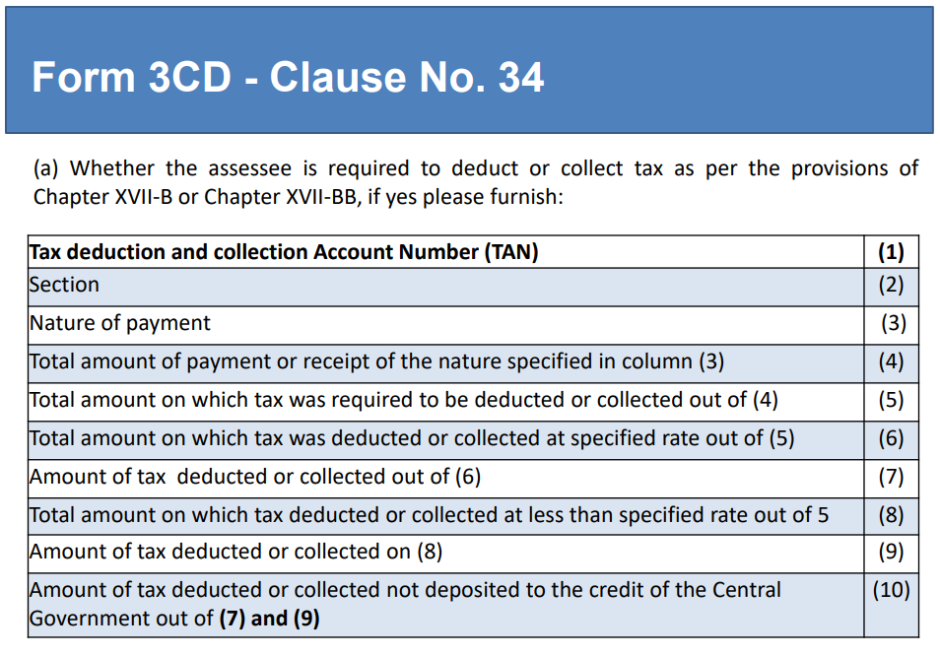
| CA. Pankaj G. Shah | + 91 96918 93040 | pankajgshah@gmail.com | Indore |

Slide 153
Clause 34(a):
Considering significant complexities involved in determining whether a payment / transaction requires deduction of tax under the provisions of Chapter XVII-B of the Act, the compliance with requirements are prima facie examined based on:
i. procedure followed for ensuring the compliance;
ii. broad review of such procedure;
iii. test checks of the transactions and facts thereon; and
iv. legal view, if any, taken by the assessee
Otherwise, we have relied on the representations made by the assessee about the compliance or non-compliance, if any, based on its understanding about applicability or non-applicability of the provisions and assumptions made or view taken on it.

Slide 154
Clause 21(d): 40A(3)
Disallowance/deemed income under section 40A(3)
Electricity Payment to MPEB Companies
Padigela Rajeshwar Ginning Industries ITA 1137/Hyd/2011,
Trivedi Corporation (ITA 2844/Ahd/2006)
M.R. Soap (P.) Ltd. 32 TTJ 505 (DELHI)
New Limit Rs.10000
S.No. | Date of payment | Nature of payment | Amount | Name and Permanent Account Number of the payee, if available

Slide 155
3CD Notes – Cash payments
With regard to Clause 21(d) it is informed to us that the Company follows a policy for making all payments for expenses in excess of Rs. 10,000/- through only account payee cheque or account payee bank drafts or by direct credit to accounts. On a scrutiny made on a test check basis no payment in excess of Rs. 20,000/- made otherwise than by a account payee cheque or account payee bank draft has been noticed except the payment of Rs 2,50,000 made towards Electricity bill paid to Madhya Pradesh Paschim Kshetra Vidyut Vitaran Company Limited (a government company) which has not been considered disallowable under Section 40A(3) by the Company based on following judicial pronouncements:
  Padigela Rajeshwar Ginning Industries (ITA 1137/Hyd/2011)
  Trivedi Corporation (ITA 2844/Ahd/2006)
  M.R. Soap (P.) Ltd. 32 TTJ 505 (Del)

Slide 156
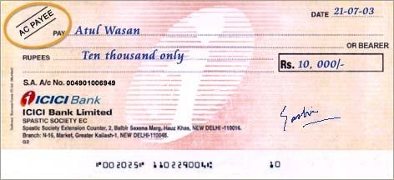
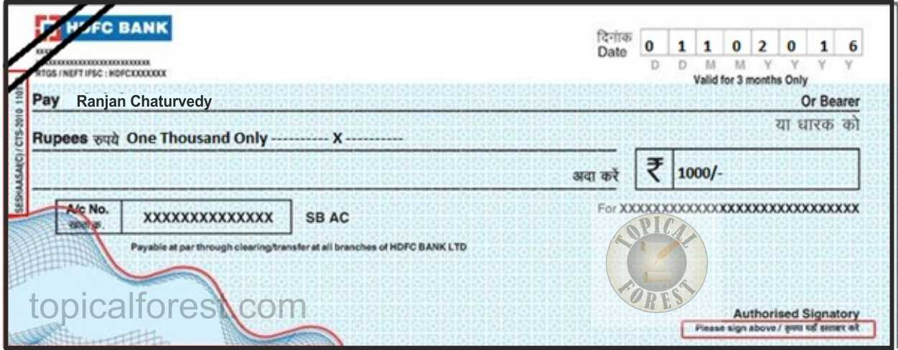

Slide 157
CROSSED CHEQUE vs. A/C PAYEE CHEQUE
There is clear distinction between a crossed cheque and an account payee cheque as in account payee cheque banks are directed to credit amount of an account payee cheque only in account of payee and no other person while crossed cheques are endorsed in favour of a person other than drawee making it difficult to trace constituent of money and thus, crossed cheque is violative of section 40A(3) - Rajmoti Industries v. Asstt. CIT [2014] 45 taxmann.com 72/223 Taxman 428 (Guj.)

Slide 158
Cl. 21(h): Amount inadmissible u/s 14A
S. 14A disallows expenses incurred in relation to earning exempt income. Rule 8D prescribed.
Assessee should itself compute reasonable amount and offer the same instead on Nil disallowance
No exempt income no disallowance

Slide 159
Cl 21(i) – Disallowance u/s 36(1)(iii)
Borrowed as well as Own funds
Interest paid on borrowed funds
Interest free Loan given to sister Concerns
Whether disallowance is warranted u/s 36(1)(iii)
Reliance Utilities (Bom)
S.A. Builders 288 ITR 1 (SC)

Slide 160
Clause 23: 40A(2)(b)
Name and PAN of related persons not reported.
Obtain signed declaration of 40A(2)(b) relatives and their interested entities.
Be vigilant
Interest @ 18%
  Pr CIT v Cama Hotels Ltd - [2016] 68 taxmann.com 153 (Gujarat)
  Balkishan Jagannath Goyal (Indore ITAT

Slide 161
Who is not a relative as per 40A(2)(b)?
Sister
Maternal Grandmother
Married Daughter
Daughter in law

Slide 162
Clause 23 : Related Party
Statutory audit v. TAR
Transfer Pricing
Domestic Transfer Pricing 115BAB

Slide 163
Cl. 25: Amount chargeable u/s 41
Refers to remission or cessation of liability or bad debts for which allowance or deduction has been claimed in an earlier year
Creditors are outstanding for more than 3 years (beyond Limitation period) and no confirmation is available. Whether reporting required?
    Accept representation from Management that they are payable
    Silver Cotton Mills Co Ltd (254 ITR 728)(Guj.)
    Bhogilal Raji Atara (Guj)
Eg. Bad Debts Recovered, Write back of Provisions to be reported here

Slide 164
Clause 26 - S.43B(h)
Opening balance of unpaid MSME dues
Paid during the year
To be reported and claimed

Slide 165
Clause 26: any tax duty cess….. 43B
TDS is not required to be reported

Slide 166
Cl 35b In the case of a manufacturing concern, give quantitative details of the principal items of raw materials, finished products and byproducts :
It has been observed that in certain cases neither percentage of yield has been reported nor any qualification has been given in the Tax Auditor report

Slide 167
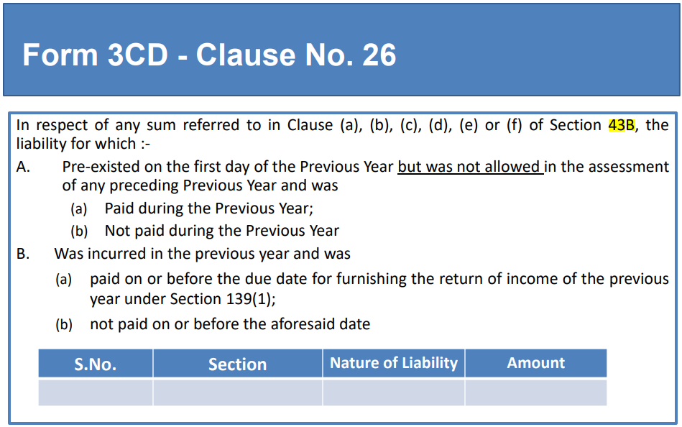

Slide 168
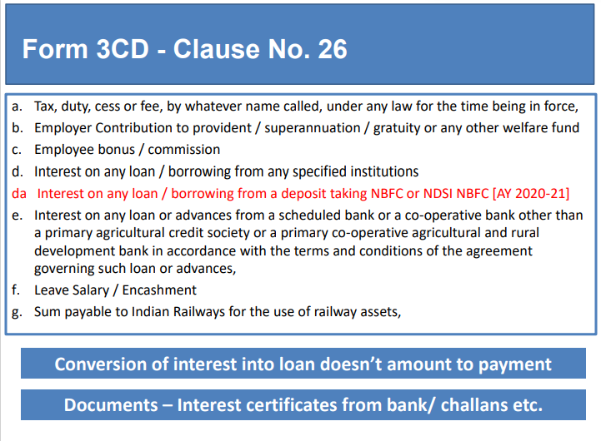

Slide 169
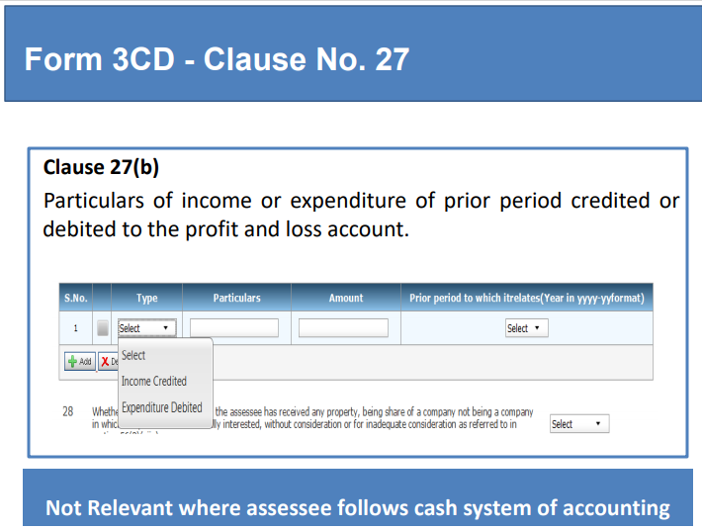

Slide 170
Clause 27(b) - Prior Period Items :
Expenditure/income is treated as being of an earlier year only when the liability to pay / the right to receive has accrued or arisen in an earlier year, in other words though the expenditure/ income relate to an earlier year, if the liability materialized/ crystallized during the year, such cases are not stated under the clause. Short and/or excess provisions on routine matters are not treated as previous year's expenditure or income.

Slide 171
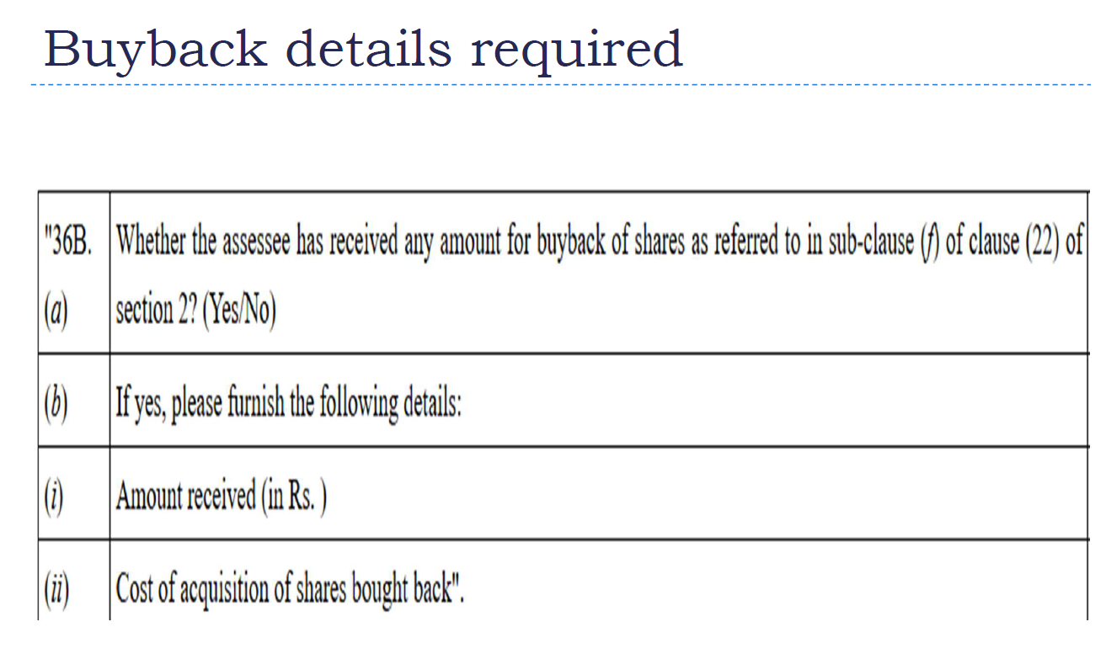

Slide 172
269ST
Ban over Rs.3 Lakhs was recommended by SIT
No person shall receive 2L or more in
aggregate from a person in a day or
respect of a single transaction or
In respect of transactions relating to one event or occasion from a person

Slide 173
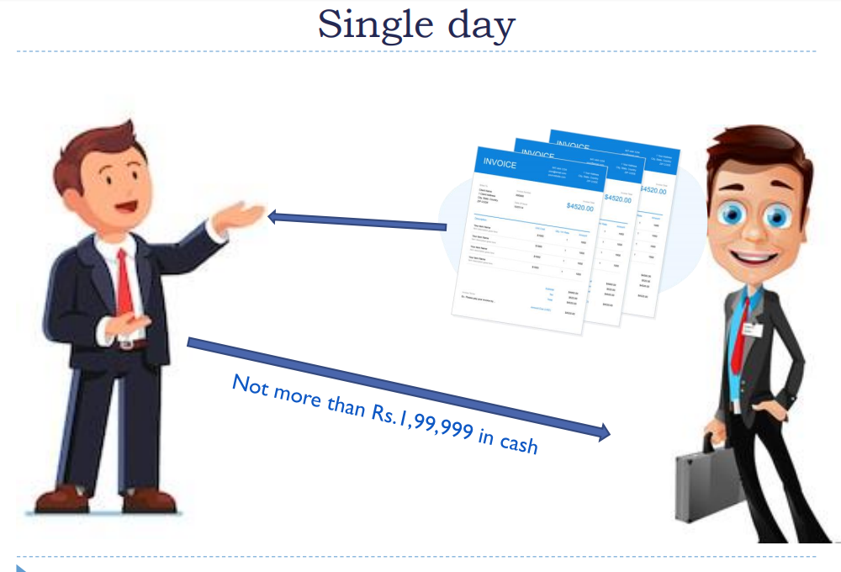

Slide 174
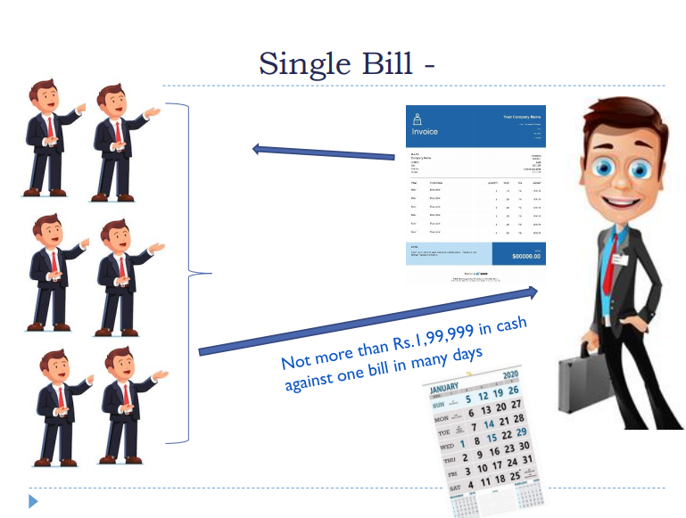

Slide 175
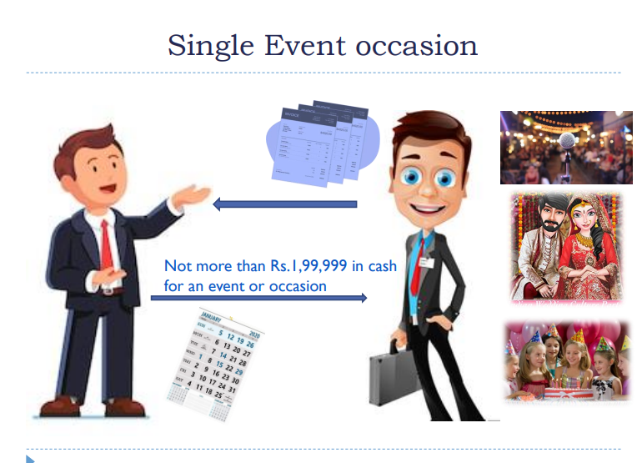

Slide 176
Clause 31 : 269ST
i. Name, address, Permanent Account Number of the payer,
ii. Nature of transaction
iii. Amount of receipt.
iv. Date of receipt.

Slide 177
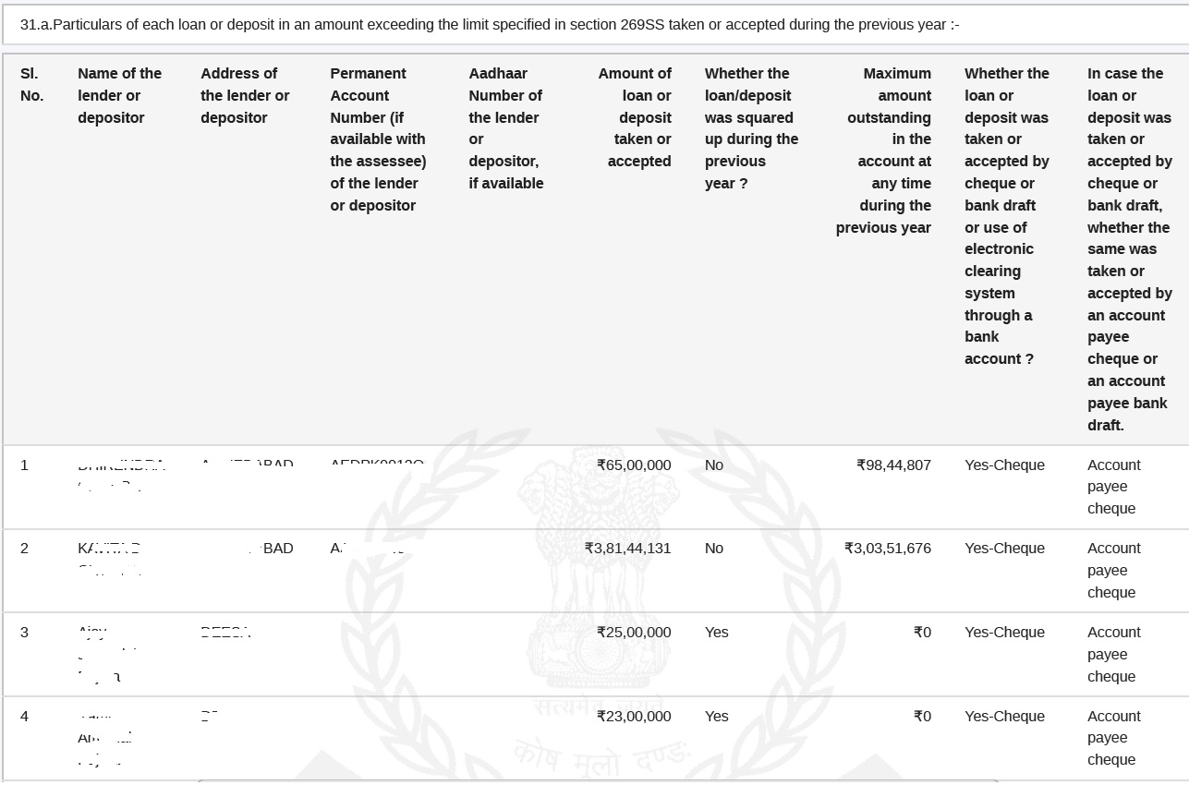

Slide 178
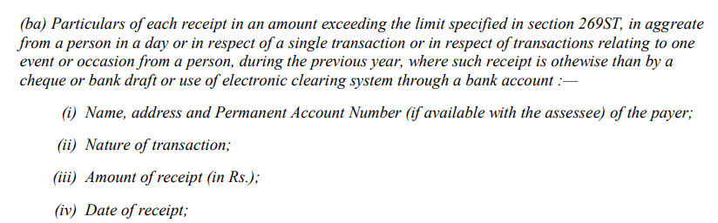
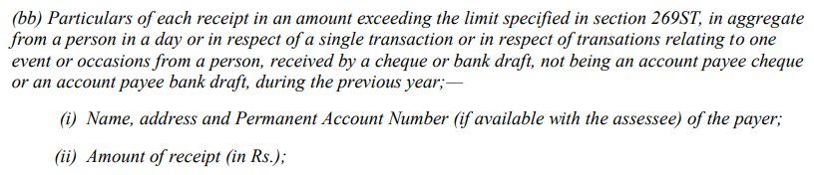
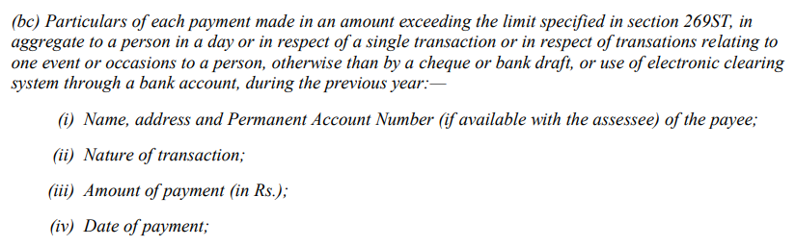

Slide 179
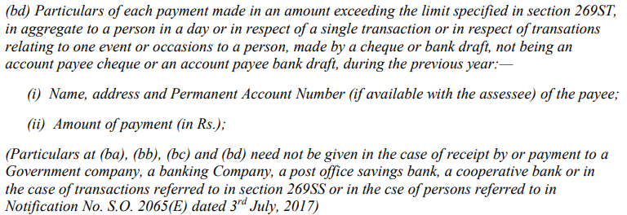

Slide 180
Clause 31
(a) deals with loans or deposit 269SS
(b) deals with specified sum (Builder’s case)
specified sum is money receivable as advance or otherwise in relation to transfer of an immovable property, whether or not transfer has taken place
What in case of real estate business?
(c) repayment of Loan, deposit or specified sum
Whether repayment through cheque, bank draft, ecs
If yes whether the same was even received through account payee cheque or bank draft?

Slide 181
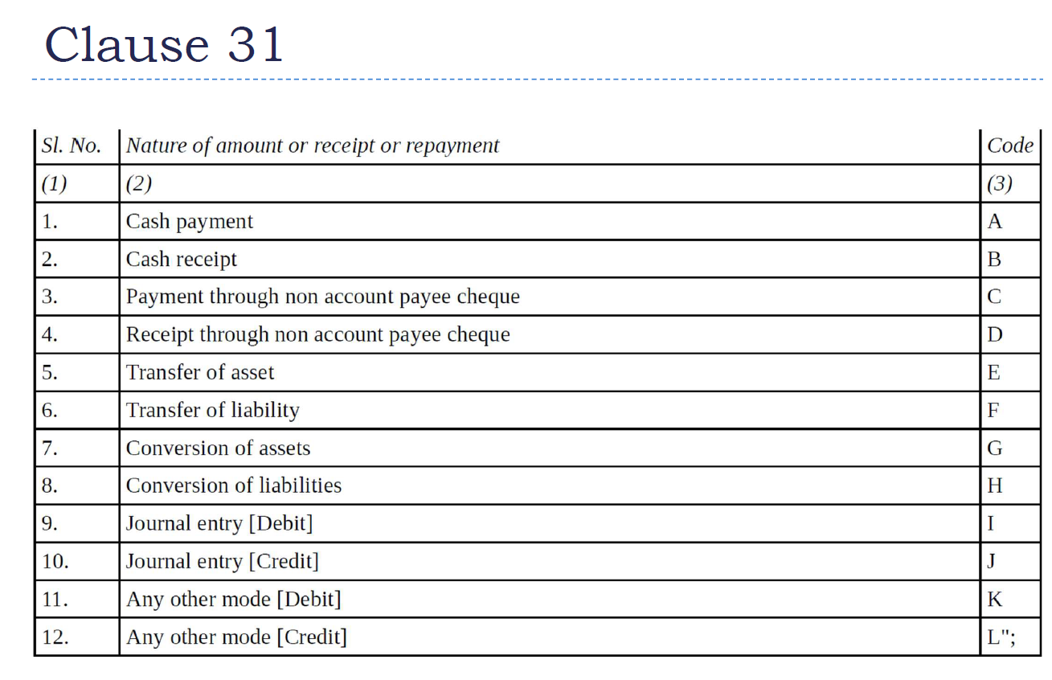

Slide 182
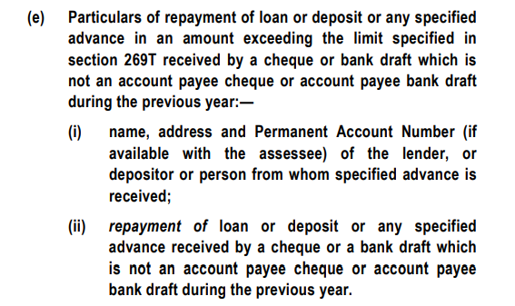
Clause 31(e)

Slide 183
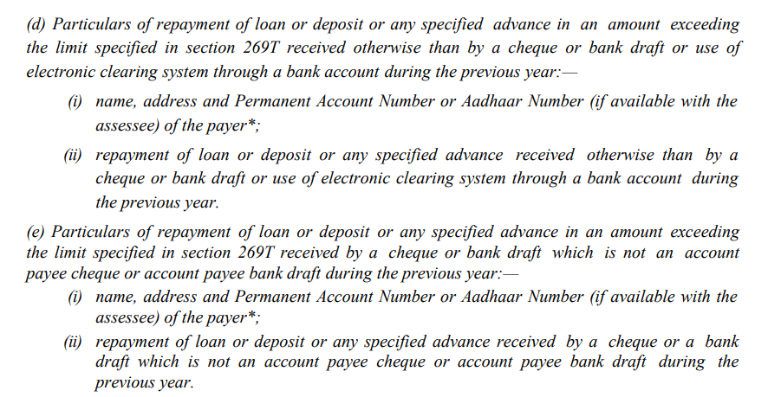
Cl 31
In certain cases, repayment of time deposits such as ‘fixed deposits’ and /or ‘term loans’ reflecting in Annual report were not reported while the same were required to be reported as per the Guidance Note.

Slide 184
Issues on Clause no. 31
Contd….
Accepting/ Repaying Loans/ Advances via Journal Entries:
The provisions of Section 269SS of the Act does not get attracted merely for transfer of amount to a loan account in the form of book entry. CIT Vs. Worldwide Township Projects Ltd., [2014] 367 ITR 433 (Delhi)
Contrary view has been taken by High Court of Bombay in CIT vs Triumph International Finance (I) Ltd. [2012] 345 ITR 270 (Bombay) wherein held that repayment of loan/deposit by merely debiting account through journal entries contravenes provisions of Section 269T.
Further, held by ITAT- Bombay in Lodha Builders Pvt Ltd vs. ACIT, [2014] 34 ITR(T) 157, that penalty cannot be levied u/s 271D and 271E if the transactions are bona fide & genuine even where accepting/ repaying loans/ advances via journal entries contravenes s. 269SS & 269T.

Slide 185
Issues on Clause no. 31
Contd….
  Where the transaction is by an A/c Payee Cheque and no payment was made in Cash. Provisions of Sec 269SS shall not be attracted. CIT Vs Noida Toll Bridge Co. Ltd 262 ITR 260 (Del)
  If the cheque or bank draft through which loan is received is ‘crossed’ but words ‘account payee’ is not written in the crossing but the transaction is otherwise genuine and the bank confirms that these amounts have been deposited in assessee’s account and are as per the banking norms and there was no flaw in the transaction, penalty under Section 271D is not imposable for such a trivial violation. CIT v. Makhija Construction Co. [2002] 123 Taxman 1003 (MP)

Slide 186
Ratios
Turnover ?
GP Ratio
NP Ratio

Slide 187
Ratio
For Net Profit ratio
  Net profit before tax is to be considered
For turnover
  Scrap and by product sale to be included in turnover

Slide 188
Quoting of PAN
Rule 114B of I.T. Rules
Sale or purchase, by any person, of goods or services
More than 2Lakhs per transaction

Slide 189
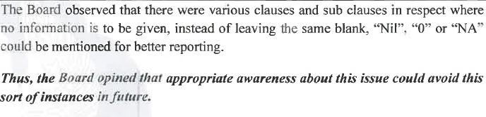
Other clauses

Slide 190
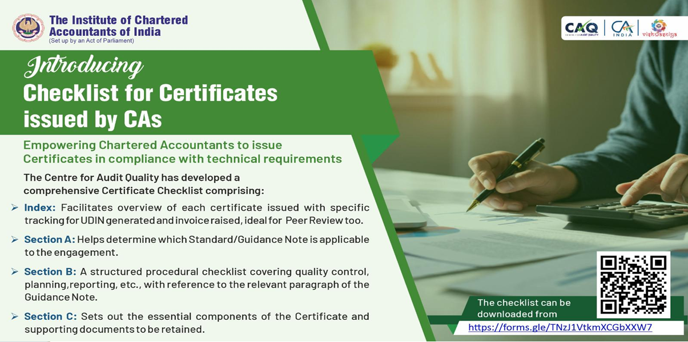

Slide 191


Slide 192
Start Auditing……….
CA Pankaj Shah
Vice Chairman
Tax Audit Quality Review Board
Mobile 9691893040
E-mail: pankajgshah@gmail.com

Slide 193
Clause 44: GST related
Data analytics
Matching the data available with the various tax wings of the Finance Ministry.
tracking and punishing tax evaders
Software / Manual working required

Slide 194
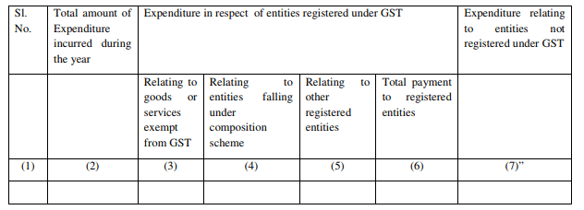

Slide 195
Total Expenditure
Registered supplier GST
Exempt goods and services
Supplier in Composition
Other registered entities (taxable)
Total payment
Unregistered suppliers

Slide 196
Head-wise / nature wise expenditure details not required to be reported
Revenue expenditure
Capital expenditure (Para 82.11 of Exposure Draft)

Slide 197
Total Expenditure incurred during the year
Total expenditure as per P&L
Capital expenditure?
Depreciation?
“Expenditure” “incurred”

Slide 198
Multiple registrations
1. 100 10 10 10 30 70
2. 200 20 20 20 60 140

Slide 199
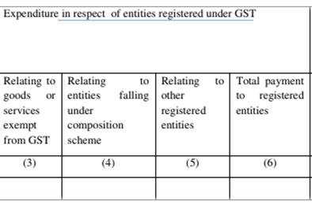
Reporting of Registered supplier
Supply from same person can be exempt and taxable
  Reporting nature wise and not person wise
    Eg Purchases from Ramlal and Sons (Regd entity)
      Petrol 500 non GST
      Lubricant 100 taxable
      Grains 200 Nil rates
      Milk 30 Exempt
2(78) of CGST exempt supply also includes non taxable supply
2(47) – Nil rates included in exempt supply
730
100
830

Slide 200
Paid or payable
Para 82.9 of Exposure Draft on GN

Slide 201
Schedule III supplies
Reporting of transaction referred in Schedule III of CGST
  Neither supply of goods or services
  Salary, sale of land, etc

Slide 202
Important points
Reporting to be given irrespective of Auditee being Registered or unregistered
Expenditure vs. Loss vs. Allowance

Slide 203
Expenditure
Prov for Exp Y Y Y Y Y Y
Imports Y Y
Electricity Y Y Y
RCM exp Y Y Y
Rebate discount Y Y Y Y Y Y
Remuneration and Interest to partner

Slide 204
Difficulty in compilation or reporting
If the assessee is not in a position to give the details as required in clause 44, an appropriate disclosure/disclaimer may be made by the auditor in Form 3CA/3CB.
Suggestive note is given at the end of presentation
Para 82.15 of Exposure draft of GN
| CA. Pankaj G. Shah | + 91 96918 93040 | pankajgshah@gmail.com | Indore |

Slide 205
Manual Systems
IF such information not available, please give note
  Form 3CA
  Form 3CB – Clause 5

Slide 206
Suggestive Note in 3CA/3CB
Clause 44: We have been informed by the assessee that the information required under this clause has not been maintained by it in absence of any disclosure requirement thereof under the Goods and Service tax statute. Further the standard accounting software used by Assessee is not configured to generate any report in respect of such historical data in absence of any prevailing statutory requirement regarding the requisite information in this clause. In view of above we are unable to verify and report the desired information in this clause

Slide 207
Things to do first
Master updation
GST No. of inward supplier
Specify Composition or Regular
Tax Classification of goods
Exempt
Taxable

Slide 208
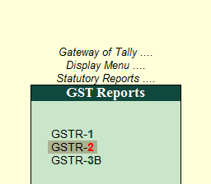

Slide 209
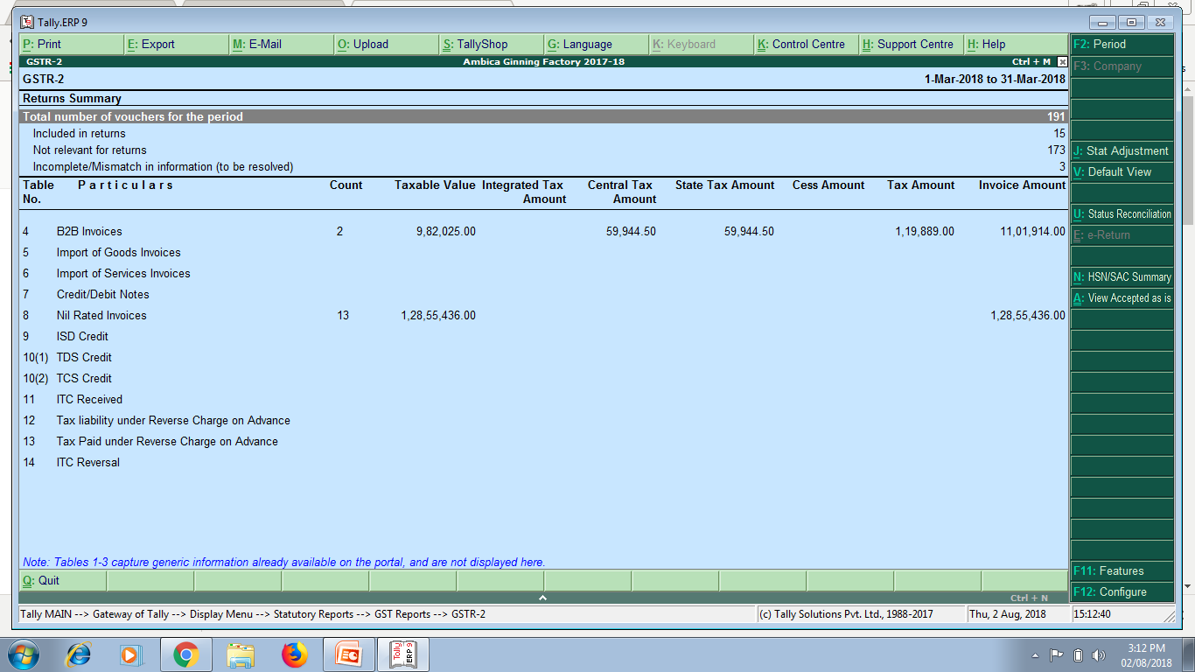
GSTR-2 – Inward supplies
NIL RATED INVOICES

Slide 210
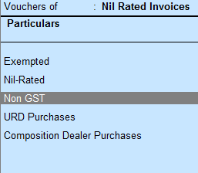

Slide 211
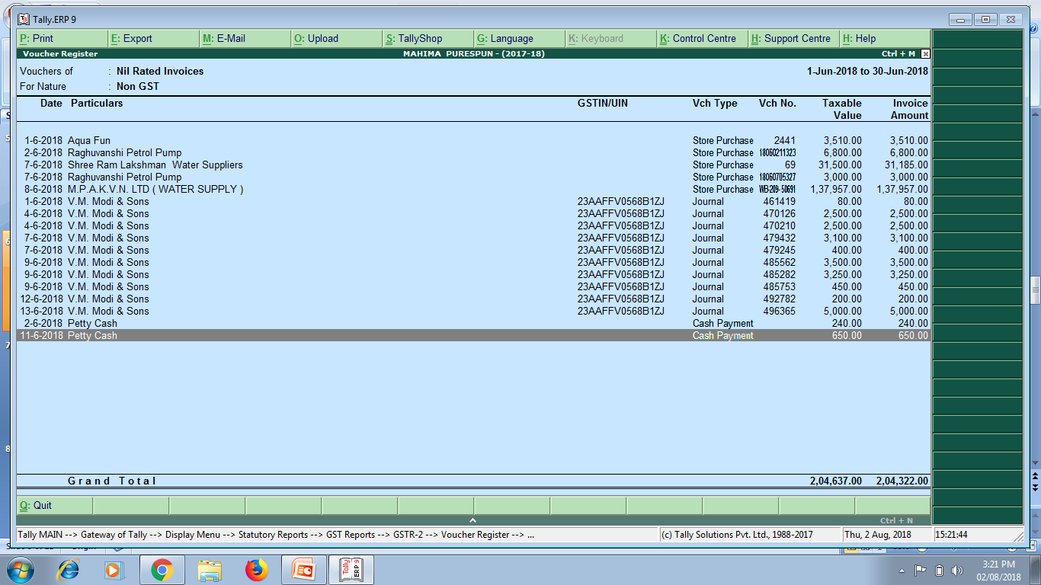
Export these into Excel and add them

Slide 212
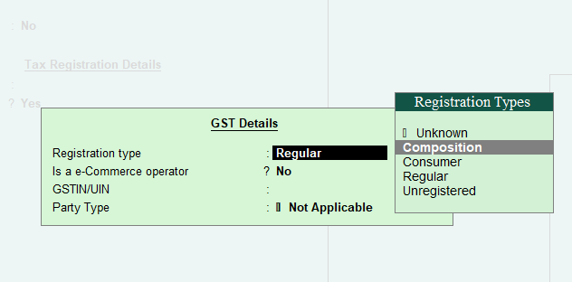
Expenditure relating to Registered entities – Composition Scheme
Relating to entities falling under composition scheme
  Tally feature, While creation of Vendor Master

Slide 213

Composition dealer purchases

Slide 214
General principles to be kept in mind while preparing the statement of particulars for Form 3CD:
Tax Auditor can rely upon the judicial pronouncements while taking any particular view about inclusion or exclusion of any items in the particulars to be furnished under any of the clauses specified in Form No.3CD.
If there is a conflict of judicial opinion on any particular issue, Auditor may refer to the view which has been followed while giving the particulars under any specified clause.
The AS, Guidance Notes, SA issued by the Institute from time to time should be followed.

Slide 215
Important points to be considered by the tax auditor while furnishing the particulars in Form No.3CD….
The information in Form No.3CD should be based on the books of account, records, documents, information and explanations made available to the tax auditor for his examination.
If a particular item of income/ expenditure is covered in more than one of the specified clauses in the statement of particulars, a suitable cross reference to such items at the appropriate places.
If there is any difference in the opinion of the tax auditor and that of the assessee in respect of any information furnished in Form No. 3CD, the tax auditor should state both the view points and also the relevant information in order to enable the tax authority to take a decision in the matter.
If any particular clause in Form No.3CD is not applicable, he should state that the same is not applicable.
In computing the allowance/ disallowance, the law applicable in the relevant year should keep in view, even though the form of audit report may not have been amended to bring it in conformity with the amended law.
In case the auditor relies on a judicial pronouncement, mention the fact as his observations in clause (3) of Form No.3CA or clause (5) provided in Form No.3CB, as the case may be
The tax auditor may qualify his report on matters in respect of which information is not furnished to him and state in his report that the relevant information has not been furnished by the assessee.

