Slide 1

Tax Audit
A national duty by Chartered Accountants
CA. Pankaj G. Shah
BBA, LLB(Hons.), ACS, FCA, DISA(ICA), Insolvency Professional, Registered Valuer

Slide 2
Brand CA - class apart
Supreme Court in case of T.D. Venkat Rao v. UOI (237 ITR 315) has upheld the superiority of CAs by noting that
Chartered Accountants, by reason of their training have special aptitude in the matter of audits and no other person can be held eligible to conduct audit under Section 44AB. Supreme Court further held that CAs are a Class by themselves meaning that CAs are the brand for auditing itself.
| CA. Pankaj G. Shah | + 91 96918 93040 | pankajgshah@gmail.com | Indore |

Slide 3
Tax Audit
Firstly an Audit
General purpose financial statement
Trueness and fairness of Financials
Going concern, historical cost, prudence, Materiality
Psycology – praising, belittling
| CA. Pankaj G. Shah | + 91 96918 93040 | pankajgshah@gmail.com | Indore |

Slide 4
Compulsory Peer Review and TAQRB
Phase | Firms covered | Peer Review mandatory from
I | Auditing listed companies | 01.04.2022
II | Practice Units rendering attestation services and having 5 or more partners: For these Practice Units, there is a pre-requisite of having Peer Review Certificate before accepting any Statutory audit. | 01.04.2023
III | Practice Units rendering attestation services and having 4 or more partners: For these Practice Units, there is a pre-requisite of having Peer Review Certificate before accepting any Statutory audit. | 01.04.2024
IV | Practice Units rendering attestation services and having 3 or more partners: For these Practice Units, there is a pre-requisite of having Peer Review Certificate before accepting any Statutory audit. or Propose to undertake audits of branches of PSU Banks | 01.04.2025
Tax Audit Quality review Board – Study on common mistakes in Tax Audits

Slide 5
Reports not signed by client
Common practice -obtain one signed report from client
Auditor signs 3 copies and gives to client
Physical Report signed only by auditor submitted at various forums
Violation of Section 215 of Companies Act
Name removed for 1 year
  CA. Sandhya Vasandani (M.No.128973)’s case

Slide 6
Proxy auditor
Counsel of the Respondent pleaded that his client i.e the Respondent had just signed the financial statements and the actual auditor was CA. Tarang Shah.
His client had merely signed based on reliance on another auditor and had refunded the fee to CA. Tarang Shah.
The Committee on the same, clarified to him, that since the signatures on the financial statement and the Audit Report were of the Respondent and hence the accountability for true and fair view of the documents, signed by her, lies with the Respondent only.
Name removed from the Register of Members for a period of 01(One) year with effect from 24th March, 2023

Slide 7
Undated audit report
All the audit reports were undated.
Audit Report was revised without due Procedure
Misconduct – Gross negligence
  (V. Ayyadurai vs. M. Rajkumar- Page 408 of Vol. II of Part I of the Disciplinary Casesof April, 2015 Judgement delivered on 10th December, 2013)

Slide 8
Revision of audit report
Auditor failed to state not only the reasons for revising the audit report issued by him
Also failed to inform the Charity Commissioner of Trust that his earlier report should not longer be relied upon.
Misconduct – Gross Negligence
  (Shekhar Purushottamrao Kannao vs. Sanjay S. Khandekar Re: [PR-125/13-DD/121/2013/DC /428/2014] Judgement delivered on 7th November, 2017)

Slide 9
Ensure zero audit fees outstanding
When a significant part of fees due from an ‘audit client’ remains unpaid for a long time, the firm shall determine:
Whether the overdue fees might be equivalent to a loan to the client; and
Whether it is appropriate for the firm to be re-appointed or continue the audit engagement
Legal position
A self-interest threat might be created if a significant part of fees is not paid before the audit report for the following year is issued.
It is generally expected that the firm will require payment of such fees before such audit report is issued.
The requirements and application material set out in Section 511 with respect to “Loans and Guarantees with an Audit Client” might also apply to situations where such unpaid fees exist.

Slide 10
Audit report - Inventory
Inventory has been accepted as certified by the management
Existence and condition of material asset
Alternative procedures to be applied

Slide 11
NFRA order 11.07.2023
Inventory
  The auditor is required to attend the physical inventory counting as it forms a considerable part of the financial statement.
  Also, no working papers were found in the audit file evidencing that the alternative audit procedures were performed by the EP after he failed to perform physical inventory counting on the reporting date.
  This is a clear violation of SA 501.
Receivables
  The auditor failed to obtain direct confirmation from parties having a significant and material balance of trade receivables and trade payables. Moreover, the auditor failed to perform alternative audit procedures in the absence of confirmations, as required by SA 505.

Slide 12
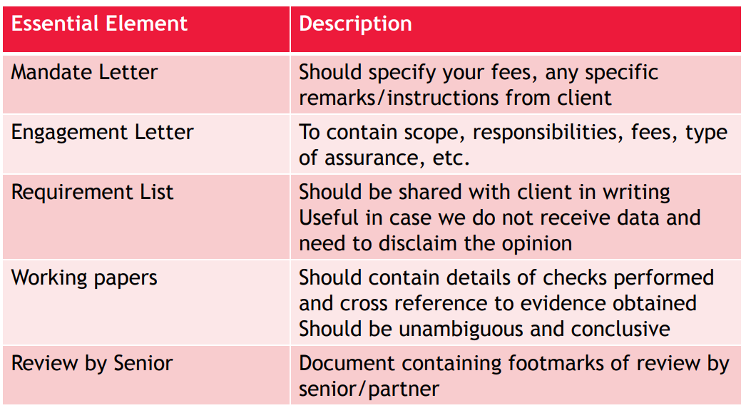
Documentation
CA. Pankaj Shah | 969 189 3040 | pankajgshah@gmail.com |

Slide 13
SA 700 ‘Forming an Opinion and Reporting on Financial Statements
Assessee’s Responsibility for the Financial Statements and the Statement of Particulars in Form 3CD
Tax Auditor’s Responsibility
| CA. Pankaj G. Shah | + 91 96918 93040 | pankajgshah@gmail.com | Indore |

Slide 14
Assessee’s Responsibility
The assessee is responsible for the preparation of the aforesaid financial statements that give a true and fair view of the financial position and financial performance (if applicable) in accordance with the applicable Accounting Standards issued by the Institute of Chartered Accountants of India. This responsibility includes the design, implementation and maintenance of internal control relevant to the preparation and presentation of the financial statements that give a true and fair view and are free from material misstatement, whether due to fraud or error.
The assessee is also responsible for the preparation of the statement of particulars required to be furnished under section 44AB of the Income-tax Act, 1961 annexed herewith in Form No. 3CD read with Rule 6G(1)(b) of Income Tax Rules, 1962 that give true and correct particulars as per the provisions of the Income-tax Act, 1961 read with Rules, Notifications , circulars etc that are to be included in the Statement.
| CA. Pankaj G. Shah | + 91 96918 93040 | pankajgshah@gmail.com | Indore |

Slide 15
Tax Auditor’s Responsibility
My/ Our responsibility is to express an opinion on these financial statements based on my/our audit. I/We have conducted this audit in accordance with the Standards on Auditing issued by the Institute of Chartered Accountants of India. Those Standards require that we comply with ethical requirements and plan and perform the audit to obtain reasonable assurance about whether the financial statements are free from material misstatement.
An audit involves performing procedures to obtain audit evidence about the amounts and disclosures in the financial statements. The procedures selected depend on the auditor’s judgment, including the assessment of the risks of material misstatement of the financial statements, whether due to fraud or error. In making those risk assessments, the auditor considers internal control relevant to the preparation and fair presentation of the financial statements in order to design audit procedures that are appropriate in the circumstances but not for the purposes of expressing an opinion on the effectiveness of the entity’s internal control. An audit also includes evaluating the appropriateness of accounting policies used and the reasonableness of the accounting estimates made by management, as well as evaluating the overall presentation of the financial statements.
I/We believe that the audit evidence I/we have obtained is sufficient and appropriate to provide a basis for my/our audit opinion.
I/We are also responsible for verifying the statement of particulars required to be furnished under section 44AB of the Income-tax Act, 1961 annexed herewith in Form No. 3CD read with Rule 6G (1) (b) of Income-tax Rules, 1962. I/ We have conducted my/our verification of the statement in accordance with Guidance Note on Tax Audit under section 44AB of the Income-tax Act, 1961, issued by the Institute of Chartered Accountants of India.

Slide 16
To start with
Cross check things – Notes to accounts/CARO
Comparative analysis
Check capital account for major credits/exceptional
Read Guidance note
Documentation must
Tax Audit Review
Engagement letter
| CA. Pankaj G. Shah | + 91 96918 93040 | pankajgshah@gmail.com | Indore |

Slide 17
Obtain
Form 26AS
Balance Confirmations
Bank Reconciliations
Minutes of Board meetings
Stock Statements submitted to bank
Tax assessment orders
Computation of Income and ITR for last 5 yrs
Annual return filed with ROC
| CA. Pankaj G. Shah | + 91 96918 93040 | pankajgshah@gmail.com | Indore |

Slide 18
Disclosures
Form 3CA/3CB
Audit Opinion - Perspective
Disclaimer/Qualification/Adverse
Audit approach – test checks, materiality, etc.
To be signed by Auditor Only
Form 3CD
Reporting of Specific Information
Clause specific assumptions /stands except complete disclaimer/qualification
To be first signed by Assessee
Very important observations/qualification
All partners or Directors
Management Representation
| CA. Pankaj G. Shah | + 91 96918 93040 | pankajgshah@gmail.com | Indore |

Slide 19
Tax Audit
Form 3CB
Para 3 (Audit observation)
Para 5 (3CD observations)
Any clause from (a) to (e)
Form 3CA
(does not require opinion on true and fair)
Para 3(3CD observations)
3rd Proviso

Slide 20
Form 3CB – Clause 5
Category of Qualifications
On Books of Accounts
Inventory related
Insufficiency of audit evidences
Not ascertainable
| CA. Pankaj G. Shah | + 91 96918 93040 | pankajgshah@gmail.com | Indore |

Slide 21
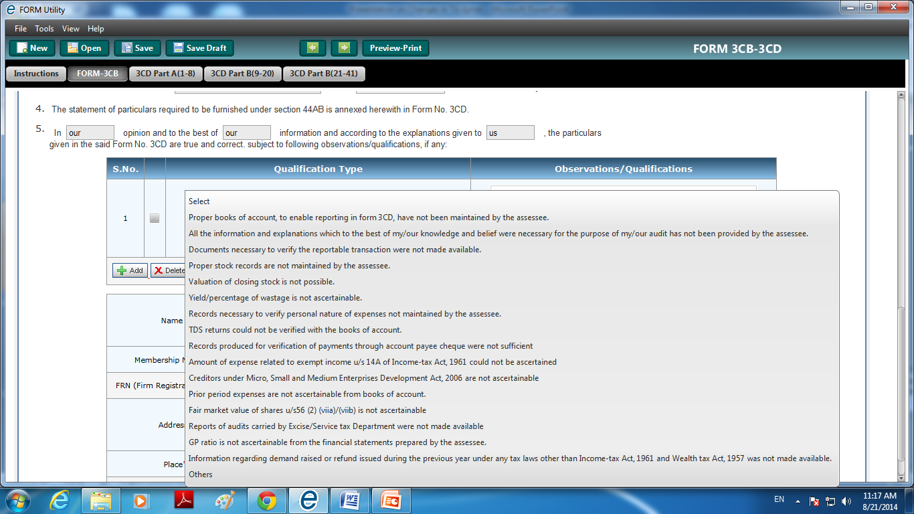

Slide 22
Category | Qualification Type | Observations/ Qualifications
Books of Accounts related | Proper books of account, to enable reporting in form 3CD, have not been maintained by the assessee.
 | All the information and explanations which to the best of my/our knowledge and belief were necessary for the purpose of my/our audit has not been provided by the Assessee.
 | Documents necessary to verify the reportable transaction were not made available.
Inventory related | Proper stock records are not maintained by the assessee.
 | Valuation of closing stock is not possible.
 | Yield/percentage of wastage is not ascertainable.
Extreme
| CA. Pankaj G. Shah | + 91 96918 93040 | pankajgshah@gmail.com | Indore |

Slide 23
Category | Qualification Type | Observations/ Qualifications
Insufficiency of Audit Evidences Disclaimers | Records necessary to verify personal nature of expenses not maintained by the assessee.
 | TDS returns could not be verified with the books of account.
 | Records produced for verification of payments through account payee cheque were not sufficient
Moderate
| CA. Pankaj G. Shah | + 91 96918 93040 | pankajgshah@gmail.com | Indore |

Slide 24
Category | Qualification Type | Observations/ Qualifications
Not Ascertainable disclaimer | Amount of expense related to exempt income u/s 14A of Income-tax Act, 1961 could not be ascertained
 | Creditors under Micro, Small and Medium Enterprises Development Act, 2006 are not ascertainable
 | Prior period expenses are not ascertainable from books of account.
 | Fair market value of shares u/s56 (2) (viia)/(viib) is not ascertainable
 | Reports of audits carried by Excise/Service tax Department were not made available
 | GP ratio is not ascertainable from the financial statements prepared by the assessee.
 | Information regarding demand raised or refund issued during the previous year under any tax laws other than Income-tax Act, 1961 and Wealth tax Act, 1957 was not made available.
Technical
| CA. Pankaj G. Shah | + 91 96918 93040 | pankajgshah@gmail.com | Indore |

Slide 25
Impact of audit qualification in assessment
Delhi High Court in case of PCIT vs. Escorts Limited [2018] 98 taxmann.com 291 (Delhi) has clearly held that Auditor's opinion though relevant and material would not be final and conclusive even when against the assessee.
Auditor's report in a way is a third party and an independent report that can be equated with an expert opinion.
It may be accepted or rejected or partly accepted and partly rejected. It has to be considered with other material.
It cannot be treated as final or binding on the Assessing Officer, or for that matter even on the assessee, except when mandated by a statutory provision, which requires an unqualified auditor's report or certification.
In the absence of statutory provision it would not be right to hold that a reservation or qualifying note in the audit report would be a conclusive and bind finding against the assessee.
| CA. Pankaj G. Shah | + 91 96918 93040 | pankajgshah@gmail.com | Indore |

Slide 26
Impact of Qualification on assessments
Gujarat High Court in Rajkot Engg. Association v. Union of India [1986] 162 ITR 28/26 Taxman 60 (Guj.) had appropriately referred to the affidavit file by the Union of India repelling and quelling misgiving expressed by the assessee on the binding nature of qualifications or reservations expressed in audit reports to clarify and observe:—
  "53. It was, therefore, submitted that if the auditor finds that the financial information furnished to him is not according to the acceptable accounting policy and principles or not according to the relevant regulations and statutory requirements, he may refuse to give an unqualified opinion in which case an assessee would be exposed to grave consequences of not only a best judgment assessment but also to penalty. We can appreciate this apprehension expressed on behalf of the assessee. However, in view of the clarification made by the Union Government in the reply affidavit of Shri Kalyanchand, Under Secretary in the Finance Ministry to the Government of India in paragraph 15 that opinions given by the chartered accountants are not binding either on the assessees or on the assessing officer, we do not think that the assessee will be prejudiced by the qualified opinion given by the tax auditor in any given case.
| CA. Pankaj G. Shah | + 91 96918 93040 | pankajgshah@gmail.com | Indore |

Slide 27
Mistakes in audit reports
Reopening notice merely relying on a technical mistake committed by an auditor was unjustified
Baroque Pharmaceuticals (P.) Ltd. [2022] 137 taxmann.com 94 (Gujarat)
If assessee contends inadvertent error in Form No. 3CD, he should submit revised tax audit report/addendum issued by the tax auditor.
ACIT vs. J.P. Yadav [2022] 138 taxmann.com 320 (Allahabad - Trib.)
Rule 6G(3)
With effect from 1-4-2021, Rule 6G(3) provides that "(3) The report of audit furnished under this rule may be revised by the person by getting revised report of audit from an accountant, duly signed and verified by such accountant, and furnish it before the end of the relevant assessment year for which the report pertains
| CA. Pankaj G. Shah | + 91 96918 93040 | pankajgshah@gmail.com | Indore |

Slide 28
FORM 3CD

Slide 29
Implications of Reporting
Section 143(1)
Disallowance indicated in audit report but not taken in computation of total income
Views taken disclosures
amended by FA 2016 wef AY 2017-18
S.143(1) intimation appealable
| CA. Pankaj G. Shah | + 91 96918 93040 | pankajgshah@gmail.com | Indore |

Slide 30
Cl 16 : Items not credited to P&L
Reporting of following items normally
Interest
Capital gains
Other income
Such items have already been offered in return of income
However such reporting has resulted in automatic additions in S.143(1) intimations
Gifts
| CA. Pankaj G. Shah | + 91 96918 93040 | pankajgshah@gmail.com | Indore |

Slide 31
Cl. 16(d)
Para 28.1 of Exposure draft to GN
  “Under this clause various amounts falling within the scope of section 28 which are not credited to profit or loss are to be stated”
  The information under these clauses is to be given with reference to the entries in the books of accounts and records made available to the tax auditor

Slide 32
Cl. 21- Contingent liabilities
Reporting required of contingent liabilities debited to P&L
Some tax audits reveal reporting of
Contingent liability disclosed in Notes to accounts
All provisions made in the financials
Such reporting has resulted in automatic disallowances of genuine allowable provisions and those contingent liabilities which have not been claimed in P&L
| CA. Pankaj G. Shah | + 91 96918 93040 | pankajgshah@gmail.com | Indore |

Slide 33
Notes
The information/ details given in Form No. 3CD are as per the books maintained and details and information compiled and furnished by the assessee;
We have broadly reviewed the basis of compiling details and information and we have test checked wherever considered necessary the books and/ or the details/ information compiled by the assessee.
| CA. Pankaj G. Shah | + 91 96918 93040 | pankajgshah@gmail.com | Indore |

Slide 34
Penalty – S.271J
AO or CIT(A) notices that
incorrect information is given in
Report
Certificate
Rs. 10000 per report/certificate

Slide 35
Clause 2 : Address
It has been observed that in certain tax audit reports address mentioned in Form No. 3CA/ 3CB is different from the one mentioned in Annual report or as registered under MCA.
As per the Guidance Note, the tax audit report should contain the address as has been communicated by the assessee to the Income-tax Department for assessment purposes as on the date of signing of the audit report.
| CA. Pankaj G. Shah | + 91 96918 93040 | pankajgshah@gmail.com | Indore |

Slide 36
Clause 10a : Nature of business or prof
Information under this clause has to be furnished in respect of each business.
It has been observed that codes for business or profession for all main activities are not being reported.
| CA. Pankaj G. Shah | + 91 96918 93040 | pankajgshah@gmail.com | Indore |

Slide 37
Clause 11 (b)
“(b) List of books of account maintained and the address at which the books of accounts are kept.”
Survey Action can be done at places where books are kept
Management Representation must
All places to be reported
‘Books of account’ defined in S.2(12A)
Ledgers, Day books, Account books,
Cash book and Other books
Cross check with Companies Act, etc
| CA. Pankaj G. Shah | + 91 96918 93040 | pankajgshah@gmail.com | Indore |

Slide 38
Cl 11(b) - List of books of account maintained and the address at which the books of account are kept
(In case books of account are maintained in a computer system, mention the books of account generated by such computer system. If the books of account are not kept at one location, please furnish the addresses of locations along with the details of books of account maintained at each location.
location of maintenance of Books of Account has not been specified.
Books of Accounts are maintained in computer system, is not mentioned (Audit trail)
Discrepancy in respect of reporting of places of Maintenance of records in Tax Audit report visa-vis annual reports
| CA. Pankaj G. Shah | + 91 96918 93040 | pankajgshah@gmail.com | Indore |

Slide 39
11(c) - List of books of account and nature of relevant documents examined.
It has been observed that all the relevant documents examined are not mentioned like Invoices, receipts, vouchers, bills, secretarial, confirmation, certificates, internal & external. In many cases the term “etc.” is used without the mention of detailed documents examined.
As per the Guidance Note reference to all such supporting evidences/ relevant documents is also required to be made under this clause
| CA. Pankaj G. Shah | + 91 96918 93040 | pankajgshah@gmail.com | Indore |

Slide 40
Clause 13
Method of Accounting
Cash
Mercantile
No prior approval to change method
Different source – Different method
J.K. Bankers v. CIT (94 ITR 107)(All)
Vishwanath Acharya v. ACIT 157 ITD 1032 (Mum)
| CA. Pankaj G. Shah | + 91 96918 93040 | pankajgshah@gmail.com | Indore |

Slide 41
Clause 14
Method of valuation of closing stock
At Cost
Lower of Cost or and NRV
At NRV
Accounting Standard
Cost – CIT v. Carborandum Universal (149 ITR 759)(Mad)
ICDS: Change from cost to Lower of both
Reasonable cause
No corresponding change in Opening required here
Melmound Corporation (202 ITR 789)(Bom)
Disclosures (not in clause 13)
| CA. Pankaj G. Shah | + 91 96918 93040 | pankajgshah@gmail.com | Indore |

Slide 42
Approach
Inventory list as on year end date
Shortage and Excess list on verification by Client
Obtain Purchase and Sales for April to June
Physical verification (SA)
Existence and condition of Inventory
Inventory is material item of Balance sheet
| CA. Pankaj G. Shah | + 91 96918 93040 | pankajgshah@gmail.com | Indore |

Slide 43
Clause 17: Cases u/s 50C and 43CA
“Where any land or building or both is transferred during the previous year for a consideration less than value adopted or assessed or assessable by any authority of a State Government referred to in section 43CA or 50C, please furnish:”
Details of Property | Consideration Received or Accrued | Value Adopted or Assessed or Assessable
| CA. Pankaj G. Shah | + 91 96918 93040 | pankajgshah@gmail.com | Indore |

Slide 44
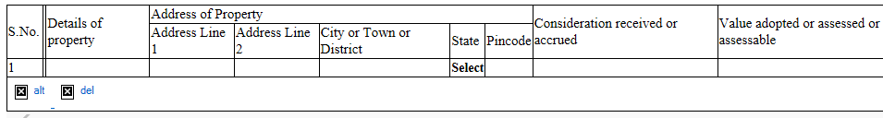
Clause 17: Audit Checklist
Check from 26AS statement on Income tax Portal for TDS u/s 194IA
Check Fixed Assets Account, Investment in Immovable assets account and other Ledgers
Obtain copy of Registered Deed duly certified by Auditee or Sale Agreement
Obtain a Management Representation of land and building sold and values.
| CA. Pankaj G. Shah | + 91 96918 93040 | pankajgshah@gmail.com | Indore |

Slide 45
Clause 17: Issue 4
Proprietor maintains books only for business
Land held in personal capacity sold for below 50C value
Whether Reporting required?
Reporting In case of Firm/Companies, etc.?
No reporting if Transaction value and guideline value are same
| CA. Pankaj G. Shah | + 91 96918 93040 | pankajgshah@gmail.com | Indore |

Slide 46
Clause 18: Fixed asset schedule
It has been observed that the details of additions/ deletions reported in Tax Audit Report are not in line with the figures of additions/ deletions disclosed in Audited financial statements.
Prepare a reconciliation for items like assets purchased in cash on which depreciation is not allowable, etc.
Assets purchased in Cash – item of reconciliation
| CA. Pankaj G. Shah | + 91 96918 93040 | pankajgshah@gmail.com | Indore |

Slide 47
Clause 18 and 21: Depreciation
Considering significant complexities involved in the computation of profits under the head “Profit and Gains of Business or Profession”, as also, Computation of Total Income under the Income-Tax Act, 1961, including Computation of Depreciation Allowable or deductions and allowances admissible or inadmissible as per and under the provisions of Chapter IV and VIA of the Act, the computation of such allowance/ inadmissible has been reviewed broadly and accordingly, it has been broadly examined whether prima facie, the deductions or allowances claimed are admissible or inadmissible. Otherwise, we have relied on the computation furnished to us based on satisfaction of the conditions and assumptions as determined/ made by the auditee.
| CA. Pankaj G. Shah | + 91 96918 93040 | pankajgshah@gmail.com | Indore |

Slide 48
Clause 18: Depreciation on Intangibles
Item | Citation
Skill and Knowhow of Labour | BOSCH LTD v. CIT (2009-TIOL-736-ITAT-BANG)
Brand Name | Raveendran Pillai 332 ITR 549 (Kerala HC)
Non Compete | Medicorp Tech. 21 DTR 69
Marketing and Commercial Rights | Skyline Caterers (20 SOT 266)
| CA. Pankaj G. Shah | + 91 96918 93040 | pankajgshah@gmail.com | Indore |

Slide 49
Depreciation
Car Registered in Partner’s name – Reflected in Firm’s Balance Sheet – What about Depreciation
  CIT Vs. Aravali Finlease Ltd. 341 ITR 282 (Guj)
  Edwise Consultants P. Ltd. Vs. DCIT 44 ITR 236 /45 CCH 392 (Mum.Trib.)
Depreciation on Individual assets which are not used but forming part of block of asset
  CIT Vs. G. R. Shipping Ltd. – ITA No. 598 of 2009 (Bom HC)
  CIT Vs. Sonic Hiochem Extraction P. Ltd. 94CCH 99 (Bom.)
Depreciation on vehicles for personal use
  Microsoft Corporation India P. Ltd. Vs. Addl CIT 37 ITR 290 (Del. Trib.)
    No Personal use in the case of companies
| CA. Pankaj G. Shah | + 91 96918 93040 | pankajgshah@gmail.com | Indore |

Slide 50
New AS 10- Property, plant and equipment
Machinery spares to be capitalised on consumption as per New AS-10
ICDS V requires it to be charged to P&L as per Old AS-10
Deferred tax liability
| CA. Pankaj G. Shah | + 91 96918 93040 | pankajgshah@gmail.com | Indore |

Slide 51
Clause 20(b) Details of Employee’s Contribution to Funds
Serial number | Nature of fund | Sum received from employees | Due date for payment | The actual amount paid | The actual date of payment to the concerned authorities
Due Date shall not be extended by any grace period
| CA. Pankaj G. Shah | + 91 96918 93040 | pankajgshah@gmail.com | Indore |

Slide 52
Clause 21(a)
Nature | S.No. | Particulars | Amount in Rs.
Capital, Personal, Advertisement expenditure, etc
Expenditure incurred at clubs being cost for club services and facilities used
Expenditure by way of penalty or fine for violation of any law for the time being force
Expenditure by way of any other penalty or fine not covered above
Expenditure incurred for any purpose which is an offence or which is prohibited by law
| CA. Pankaj G. Shah | + 91 96918 93040 | pankajgshah@gmail.com | Indore |

Slide 53
Capital v. Revenue Expenses
Expenses incurred on leased/rental premises are revenue in nature –
Malabar Mills 288 ITR 815
Modi Spg. & Wvg. Mills v. CIT 200 ITR 544
Amway India v. DCIT 27 SOT 344 (DELHI)
Supreme Court in CIT V. Ramaraju Mills (294 ITR 328) held that
if the production capacity remaining constant even after the replacement of the asset it is allowable as a revenue exp.
Benefit of enduring nature – Empire Jute (SC)
| CA. Pankaj G. Shah | + 91 96918 93040 | pankajgshah@gmail.com | Indore |

Slide 54
Following expenses have been held as revenue
Nature of Expense | Decision
Cost of water proofing of Roof Area | (322 ITR 590)
Renovation expenses including replacement of tiles, painting, false ceiling, portions etc. | (306 ITR 182) (Del.)
Replacement of a part of the machinery | 163 Taxman 201 (SC)
Reconstruction of Road | (100 Taxman 247)(Ahd)
Repairs to Boundary Wall | (2010-TIOL-648-HC-DEL-IT)
Internal furnishings, painting and polishing work, dismantling of old false ceiling, fees for interior designing, lift maintenance, etc. | 121 ITR 165 (Punj. & Har.). (104 ITD 427) (Del)
| CA. Pankaj G. Shah | + 91 96918 93040 | pankajgshah@gmail.com | Indore |

Slide 55
Cl. 21(a): Personal expense debited to P&L
Scrutinise following Expense Accounts :
  Membership and Subscription,
  Staff Welfare Expenses,
  General Expenses,
  Gifts and Presentation,
  Travelling Expenses,,
  Entertainment Expenses, etc
General Note that “payments made as per contractual obligations not considered for this clause”
Refer Auditors Report (CARO) for any comments on personal expenses
If no appeal filed in earlier years for certain disallowances for expenses towards personal motor car expenses, telephone, etc, the same should be mentioned in report.
Scrutinise Credit card payments
| CA. Pankaj G. Shah | + 91 96918 93040 | pankajgshah@gmail.com | Indore |

Slide 56
Clause 21(a) Personal expenses:
The concern has adequate internal control procedures to ensure that no `personal expenses' are debited to the profit and loss account.
On a review of the control system and such expenses, as we considered appropriate, no personal expenses have been found debited to the Profit and Loss Account. The payment as per contractual agreement or normally accepted business practices to the employees are not considered for the purpose of this clause.
| CA. Pankaj G. Shah | + 91 96918 93040 | pankajgshah@gmail.com | Indore |

Slide 57
Clause 21(a): Expenses on fine, penalty, etc
Materiality to be considered while reporting
No view to be expressed on allowability.
Penalty and fine are to be distinguished from contractual obligations -even if such payments are labeled as “penalty” in a contract.
Compensatory vs. penal payments (SC decisions)
Prakash Cotton Mills 201 ITR 684
Ahmedabad Cotton Mfg Co Ltd 205 ITR 163
Malwa Vanaspati & Chemical Co 225 ITR 383
| CA. Pankaj G. Shah | + 91 96918 93040 | pankajgshah@gmail.com | Indore |

Slide 58
Interest on Late Deposit of TDS
  ITO vs. Royal Packaging (ITA No. 1363/Ahd/2010),
  DCIT vs. Narayani Ispat Pvt. Ltd. in ITA No. 2127/Kol/2014 decided on 30.08.2017
  Sai Food Products Pvt. Ltd vs. DCIT in ITA No. 1887/Kol/2016 decided on 06-04-2018
  DCIT vs. Rungta Mines Ltd. in ITA No. 1531/Kol/2017 decided on 05/10/2018
  DCIT vs. Maa Annapurna Transport Agency Ltd. in ITA No. 822/Kol/2018 decided on 15-01-2020
  STUP Consultants Pvt. Ltd. vs. ACIT in ITA No. 5827/Mum/2012 dtd 11.12.2018
    distinguished the interest paid on income-tax/fringe benefits tax with the interest paid on late payment of TDS and held that the amount of tax deduction at source (TDS) represents the amount of income tax of the third parties party on whose behalf the payment was deducted by the assessee & paid to the Government Exchequer.
Against
  MMR Infra vs. DCIT in ITA No. 1609/Ahd/2018 decided on 01-06-2020
| CA. Pankaj G. Shah | + 91 96918 93040 | pankajgshah@gmail.com | Indore |

Slide 59
Clause 21(a) Penalty or fine:
The scope of expenditure in this item, it is submitted, is such that it is not capable of being identified and/ or quantified with reasonable accuracy, having regard to the volume of disbursement as also the plethora of laws, rules and regulations in India.
However we have been informed that no penalties or fines have been levied for violation of any law for the time being in force, nor have any other penalties or fines been paid except for those specified, if any. We have also been informed that no expenditure has been incurred for any purpose which is an offence or which is prohibited by law. On a scrutiny made on a test check basis, we have not come across any expenditure in the nature of penalty or fine debited to the Profit and Loss Account except those specified in the report, if any.
| CA. Pankaj G. Shah | + 91 96918 93040 | pankajgshah@gmail.com | Indore |

Slide 60
Clause 21(b)(i):TDS Disallowances
Reporting Disallowance for
Non deduction of TDS
Non deposit of TDS deducted
Second Proviso to Section 40(a)(ia)
If the Payee has offered the same to tax
Certificate of CA in form 26A
No disallowance
Short deduction – Chadubhai and Jassubhoy (ITAT)
| CA. Pankaj G. Shah | + 91 96918 93040 | pankajgshah@gmail.com | Indore |
Notes:
MP High Court in case of Jawahrlal Agrawal has held that Proviso to Section 40(a)(ia) is retrospective. Similar amendment has been brought in Finance Act 2014. Such amendment also being curative and remedial should also be retrospective as per this jurisdictional High Court decision.

Slide 61
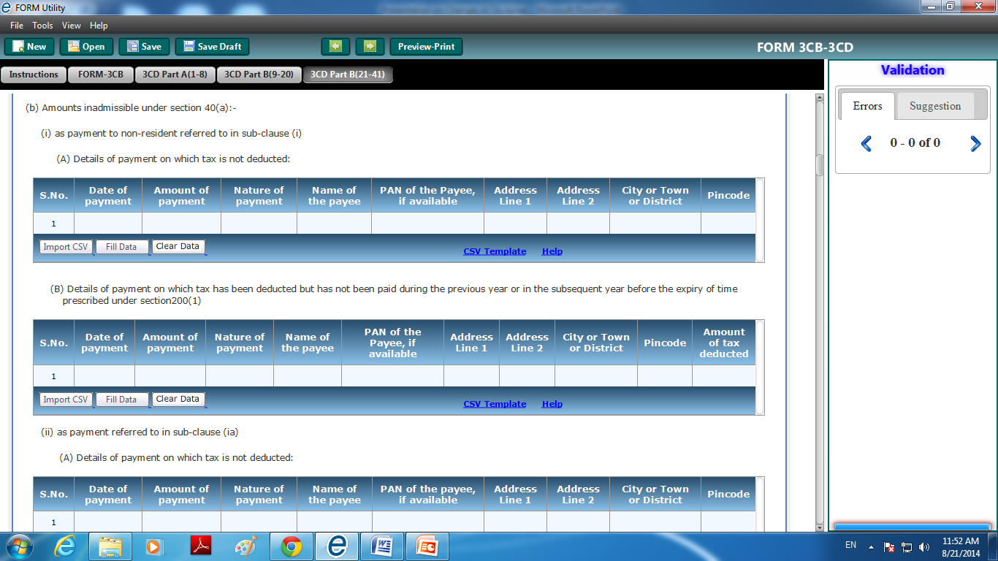
| CA. Pankaj G. Shah | + 91 96918 93040 | pankajgshah@gmail.com | Indore |

Slide 62
Clause 21 (b) :
The assessee has identified, in Attachment ___’, the amount as referred to in Section 40(a)(ia) of the Act on which tax is deductible at source under chapter XVII-B of the Act, and such tax has not been deducted or, after deduction has not been paid during the previous year. However, having regard to the volume of payments as also various payments from which the tax is so deductible, we are unable to determine/verify as to whether any such other amounts have been paid or provided on which the tax was deductible but not deducted or after deduction, has not been credited to the Central Government in accordance with the provisions of Chapter XVII-B.
| CA. Pankaj G. Shah | + 91 96918 93040 | pankajgshah@gmail.com | Indore |

Slide 63
Cl 34a : Whether the assessee is required to deduct or collect tax as per the provisions of Chapter XVII-B or Chapter XVII-BB, if yes please furnish
It has been observed that the total of expenses as mentioned under the clause under Tax Audit Report under specific heads like salary, rent etc. were not matching with the relevant figures in financial statements
| CA. Pankaj G. Shah | + 91 96918 93040 | pankajgshah@gmail.com | Indore |

Slide 64
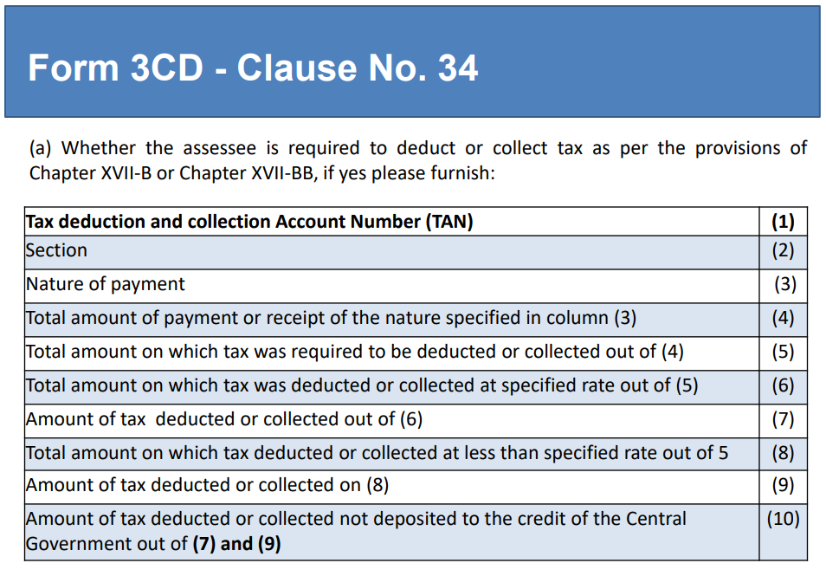
| CA. Pankaj G. Shah | + 91 96918 93040 | pankajgshah@gmail.com | Indore |

Slide 65
Foreign Remittances
Insist on Form 15CB certificate for all foreign remittances during Audit from Client.
Penalty u/s 271-I of Rs.1,00,000
Non obtaining of such certificate may result in wrong determination of tax and violation of Sec.195.
Treating as “Assessee in Default” and Penalty u/s 271C and Interest

Slide 66
Clause 34(a):
Considering significant complexities involved in determining whether a payment / transaction requires deduction of tax under the provisions of Chapter XVII-B of the Act, the compliance with requirements are prima facie examined based on:
i. procedure followed for ensuring the compliance;
ii. broad review of such procedure;
iii. test checks of the transactions and facts thereon; and
iv. legal view, if any, taken by the assessee
Otherwise, we have relied on the representations made by the assessee about the compliance or non-compliance, if any, based on its understanding about applicability or non-applicability of the provisions and assumptions made or view taken on it.

Slide 67
Clause 21(d): 40A(3)
Disallowance/deemed income under section 40A(3)
Electricity Payment to MPEB Companies
Padigela Rajeshwar Ginning Industries ITA 1137/Hyd/2011,
Trivedi Corporation (ITA 2844/Ahd/2006)
M.R. Soap (P.) Ltd. 32 TTJ 505 (DELHI)
New Limit Rs.10000
S.No. | Date of payment | Nature of payment | Amount | Name and Permanent Account Number of the payee, if available

Slide 68
3CD Notes – Cash payments
With regard to Clause 21(d) it is informed to us that the Company follows a policy for making all payments for expenses in excess of Rs. 10,000/- through only account payee cheque or account payee bank drafts or by direct credit to accounts. On a scrutiny made on a test check basis no payment in excess of Rs. 20,000/- made otherwise than by a account payee cheque or account payee bank draft has been noticed except the payment of Rs 2,50,000 made towards Electricity bill paid to Madhya Pradesh Paschim Kshetra Vidyut Vitaran Company Limited (a government company) which has not been considered disallowable under Section 40A(3) by the Company based on following judicial pronouncements:
  Padigela Rajeshwar Ginning Industries (ITA 1137/Hyd/2011)
  Trivedi Corporation (ITA 2844/Ahd/2006)
  M.R. Soap (P.) Ltd. 32 TTJ 505 (Del)

Slide 69
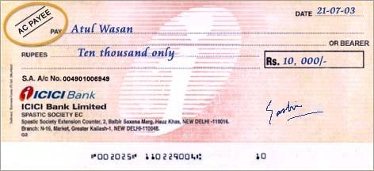
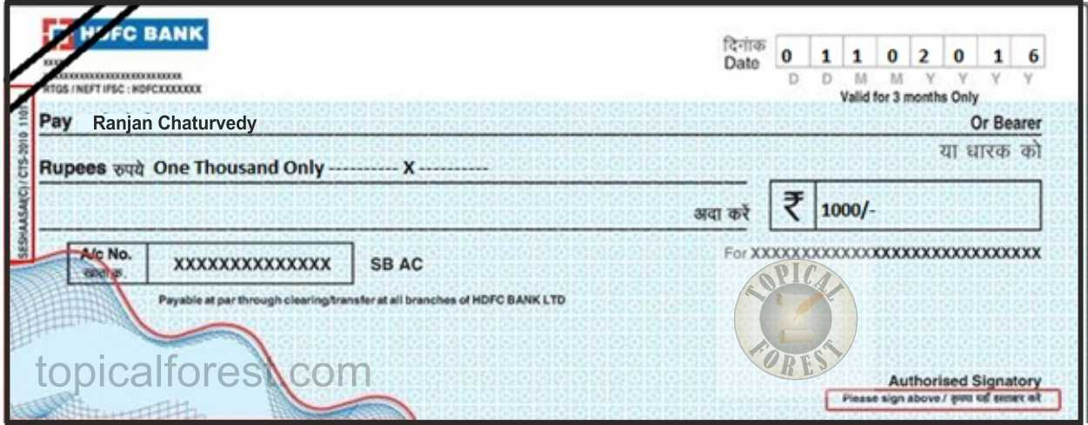

Slide 70
CROSSED CHEQUE vs. A/C PAYEE CHEQUE
There is clear distinction between a crossed cheque and an account payee cheque as in account payee cheque banks are directed to credit amount of an account payee cheque only in account of payee and no other person while crossed cheques are endorsed in favour of a person other than drawee making it difficult to trace constituent of money and thus, crossed cheque is violative of section 40A(3) - Rajmoti Industries v. Asstt. CIT [2014] 45 taxmann.com 72/223 Taxman 428 (Guj.)

Slide 71
Cl. 21(h): Amount inadmissible u/s 14A
S. 14A disallows expenses incurred in relation to earning exempt income. Rule 8D prescribed.
Assessee should itself compute reasonable amount and offer the same instead on Nil disallowance
No exempt income no disallowance

Slide 72
Cl 21(i) – Disallowance u/s 36(1)(iii)
Borrowed as well as Own funds
Interest paid on borrowed funds
Interest free Loan given to sister Concerns
Whether disallowance is warranted u/s 36(1)(iii)
Reliance Utilities (Bom)
S.A. Builders 288 ITR 1 (SC)

Slide 73
Clause 23: 40A(2)(b)
Name and PAN of related persons not reported.
Obtain signed declaration of 40A(2)(b) relatives and their interested entities.
Be vigilant
Interest @ 18%
  Pr CIT v Cama Hotels Ltd - [2016] 68 taxmann.com 153 (Gujarat)
  Balkishan Jagannath Goyal (Indore ITAT

Slide 74
Clause 23 : Related Party
Statutory audit v. TAR
Transfer Pricing
Domestic Transfer Pricing 115BAB

Slide 75
Cl. 25: Amount chargeable u/s 41
Refers to remission or cessation of liability or bad debts for which allowance or deduction has been claimed in an earlier year
Creditors are outstanding for more than 3 years (beyond Limitation period) and no confirmation is available. Whether reporting required?
    Accept representation from Management that they are payable
    Silver Cotton Mills Co Ltd (254 ITR 728)(Guj.)
    Bhogilal Raji Atara (Guj)
Eg. Bad Debts Recovered, Write back of Provisions to be reported here

Slide 76
Cl 35b In the case of a manufacturing concern, give quantitative details of the principal items of raw materials, finished products and byproducts :
It has been observed that in certain cases neither percentage of yield has been reported nor any qualification has been given in the Tax Auditor report

Slide 77
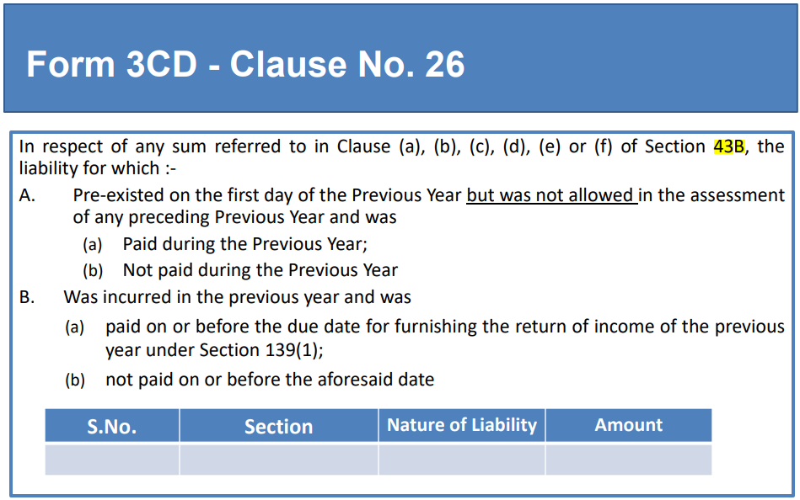

Slide 78
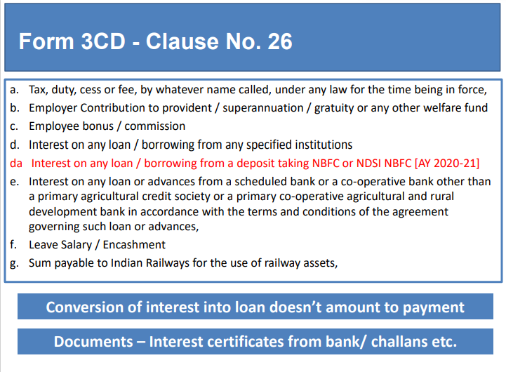

Slide 79
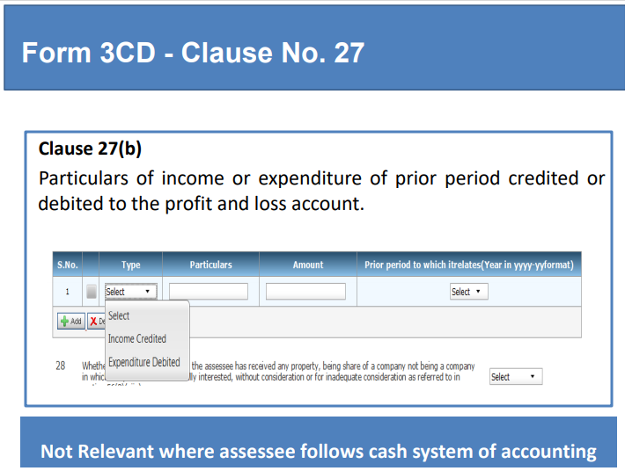

Slide 80
Clause 27(b) - Prior Period Items :
Expenditure/income is treated as being of an earlier year only when the liability to pay / the right to receive has accrued or arisen in an earlier year, in other words though the expenditure/ income relate to an earlier year, if the liability materialized/ crystallized during the year, such cases are not stated under the clause. Short and/or excess provisions on routine matters are not treated as previous year's expenditure or income.

Slide 81
Clause 29: Section 56(2)(viib)
Assessee Company has issued shares to Resident
Public are not substantially interested in such Company
Issue price is higher than FMV
Report Excess from FMV received after following checks:
Obtain Management Representation
Insist for DCF Valuation Report from a CA
S.No. | Name of the person from whom consideration received for issue of shares | PAN of the person, if available | No. of Shares issued | Amount of consideration received | Fair Market value of the shares

Slide 82
269ST
Ban over Rs.3 Lakhs was recommended by SIT
No person shall receive 2L or more in
aggregate from a person in a day or
respect of a single transaction or
In respect of transactions relating to one event or occasion from a person

Slide 83
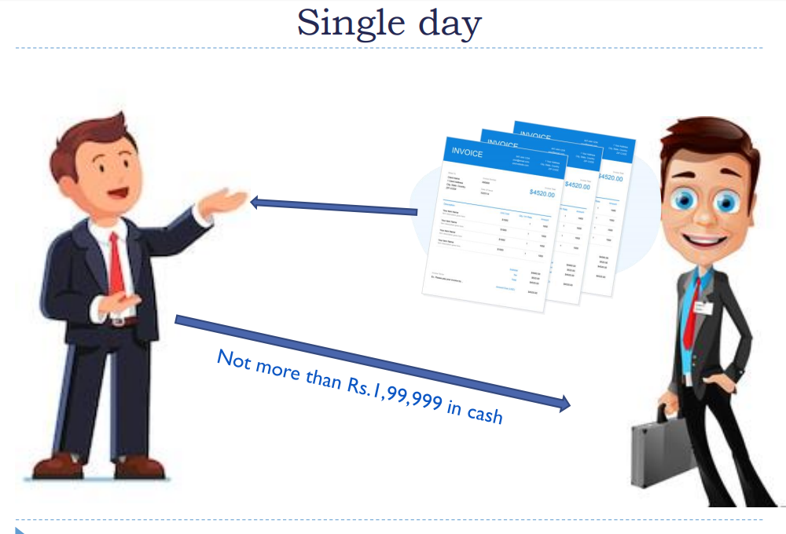

Slide 84
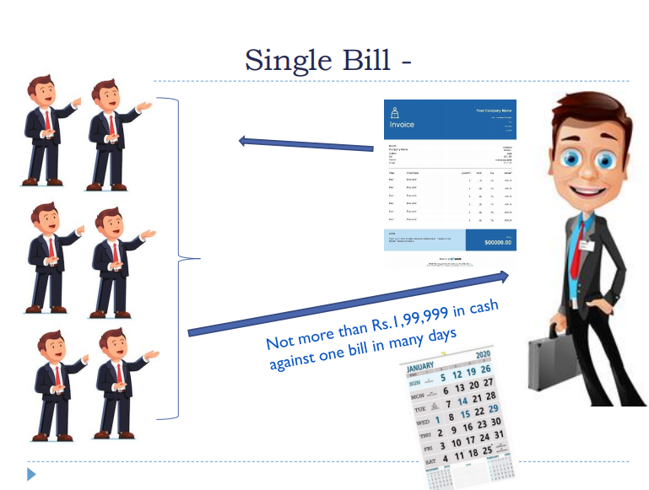

Slide 85
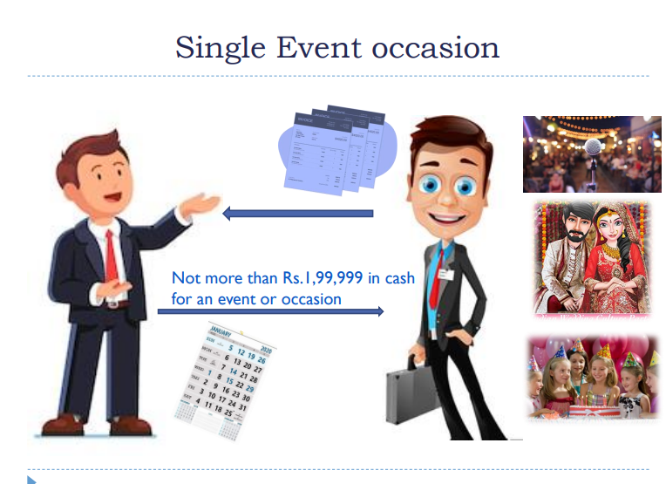

Slide 86
Clause 31 : 269ST
i. Name, address, Permanent Account Number of the payer,
ii. Nature of transaction
iii. Amount of receipt.
iv. Date of receipt.

Slide 87
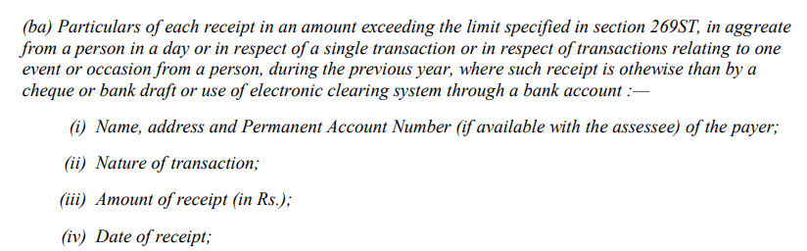
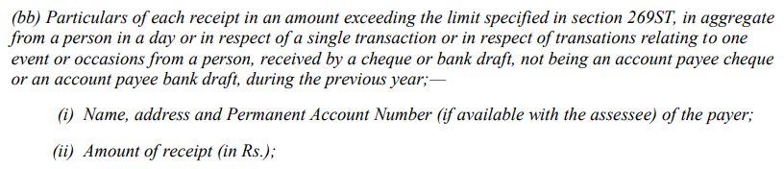
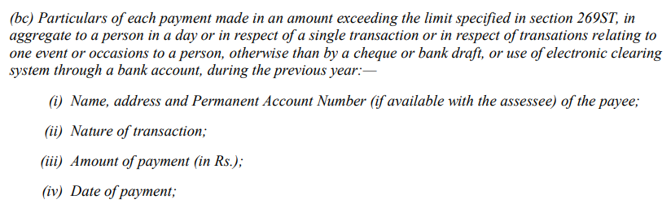

Slide 88
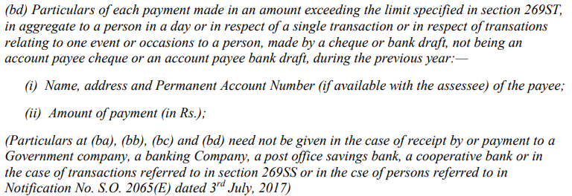

Slide 89
Clause 31
(a) deals with loans or deposit 269SS
(b) deals with specified sum (Builder’s case)
specified sum is money receivable as advance or otherwise in relation to transfer of an immovable property, whether or not transfer has taken place
What in case of real estate business?
(c) repayment of Loan, deposit or specified sum
Whether repayment through cheque, bank draft, ecs
If yes whether the same was even received through account payee cheque or bank draft?

Slide 90
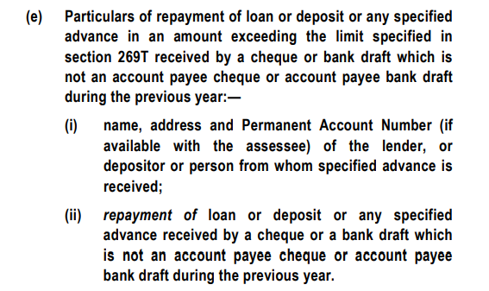
Clause 31(e)

Slide 91
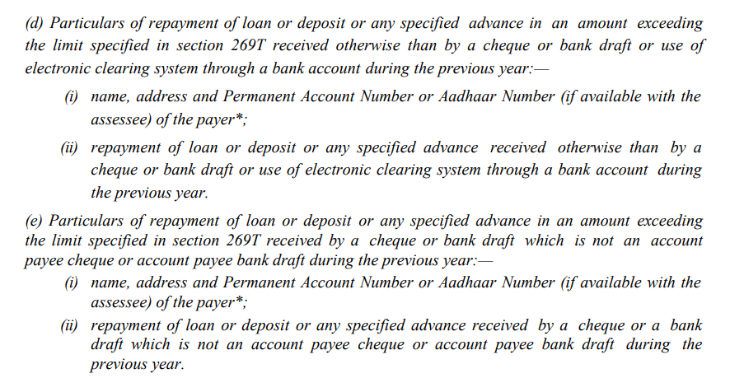
Cl 31
In certain cases, repayment of time deposits such as ‘fixed deposits’ and /or ‘term loans’ reflecting in Annual report were not reported while the same were required to be reported as per the Guidance Note.

Slide 92
Issues on Clause no. 31
Contd….
Accepting/ Repaying Loans/ Advances via Journal Entries:
The provisions of Section 269SS of the Act does not get attracted merely for transfer of amount to a loan account in the form of book entry. CIT Vs. Worldwide Township Projects Ltd., [2014] 367 ITR 433 (Delhi)
Contrary view has been taken by High Court of Bombay in CIT vs Triumph International Finance (I) Ltd. [2012] 345 ITR 270 (Bombay) wherein held that repayment of loan/deposit by merely debiting account through journal entries contravenes provisions of Section 269T.
Further, held by ITAT- Bombay in Lodha Builders Pvt Ltd vs. ACIT, [2014] 34 ITR(T) 157, that penalty cannot be levied u/s 271D and 271E if the transactions are bona fide & genuine even where accepting/ repaying loans/ advances via journal entries contravenes s. 269SS & 269T.

Slide 93
Issues on Clause no. 31
Contd….
  Where the transaction is by an A/c Payee Cheque and no payment was made in Cash. Provisions of Sec 269SS shall not be attracted. CIT Vs Noida Toll Bridge Co. Ltd 262 ITR 260 (Del)
  If the cheque or bank draft through which loan is received is ‘crossed’ but words ‘account payee’ is not written in the crossing but the transaction is otherwise genuine and the bank confirms that these amounts have been deposited in assessee’s account and are as per the banking norms and there was no flaw in the transaction, penalty under Section 271D is not imposable for such a trivial violation. CIT v. Makhija Construction Co. [2002] 123 Taxman 1003 (MP)

Slide 94
Quoting of PAN
Rule 114B of I.T. Rules
Sale or purchase, by any person, of goods or services
More than 2Lakhs per transaction

Slide 95
Clause 44: GST related
Data analytics
Matching the data available with the various tax wings of the Finance Ministry.
tracking and punishing tax evaders
Software / Manual working required

Slide 96
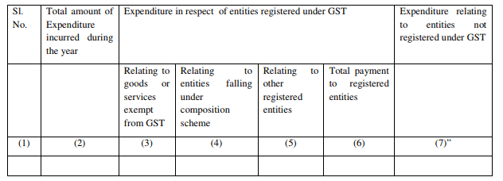

Slide 97
Total Expenditure
Registered supplier GST
Exempt goods and services
Supplier in Composition
Other registered entities (taxable)
Total payment
Unregistered suppliers

Slide 98
Head-wise / nature wise expenditure details not required to be reported
Revenue expenditure
Capital expenditure (Para 82.11 of Exposure Draft)

Slide 99
Total Expenditure incurred during the year
Total expenditure as per P&L
Capital expenditure?
Depreciation?
“Expenditure” “incurred”

Slide 100
Multiple registrations
1. 100 10 10 10 30 70
2. 200 20 20 20 60 140

Slide 101
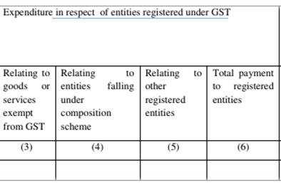
Reporting of Registered supplier
Supply from same person can be exempt and taxable
  Reporting nature wise and not person wise
    Eg Purchases from Ramlal and Sons (Regd entity)
      Petrol 500 non GST
      Lubricant 100 taxable
      Grains 200 Nil rates
      Milk 30 Exempt
2(78) of CGST exempt supply also includes non taxable supply
2(47) – Nil rates included in exempt supply
730
100
830

Slide 102
Paid or payable
Para 82.9 of Exposure Draft on GN

Slide 103
Schedule III supplies
Reporting of transaction referred in Schedule III of CGST
  Neither supply of goods or services
  Salary, sale of land, etc

Slide 104
Important points
Reporting to be given irrespective of Auditee being Registered or unregistered
Expenditure vs. Loss vs. Allowance

Slide 105
Expenditure
Prov for Exp Y Y Y Y Y Y
Imports Y Y
Electricity Y Y Y
RCM exp Y Y Y
Rebate discount Y Y Y Y Y Y
Remuneration and Interest to partner

Slide 106
Difficulty in compilation or reporting
If the assessee is not in a position to give the details as required in clause 44, an appropriate disclosure/disclaimer may be made by the auditor in Form 3CA/3CB.
Suggestive note is given at the end of presentation
Para 82.15 of Exposure draft of GN
| CA. Pankaj G. Shah | + 91 96918 93040 | pankajgshah@gmail.com | Indore |

Slide 107
Manual Systems
IF such information not available, please give note
  Form 3CA
  Form 3CB – Clause 5

Slide 108
Suggestive Note in 3CA/3CB
Clause 44: We have been informed by the assessee that the information required under this clause has not been maintained by it in absence of any disclosure requirement thereof under the Goods and Service tax statute. Further the standard accounting software used by Assessee is not configured to generate any report in respect of such historical data in absence of any prevailing statutory requirement regarding the requisite information in this clause. In view of above we are unable to verify and report the desired information in this clause

Slide 109
Things to do first
Master updation
GST No. of inward supplier
Specify Composition or Regular
Tax Classification of goods
Exempt
Taxable

Slide 110
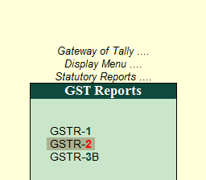

Slide 111
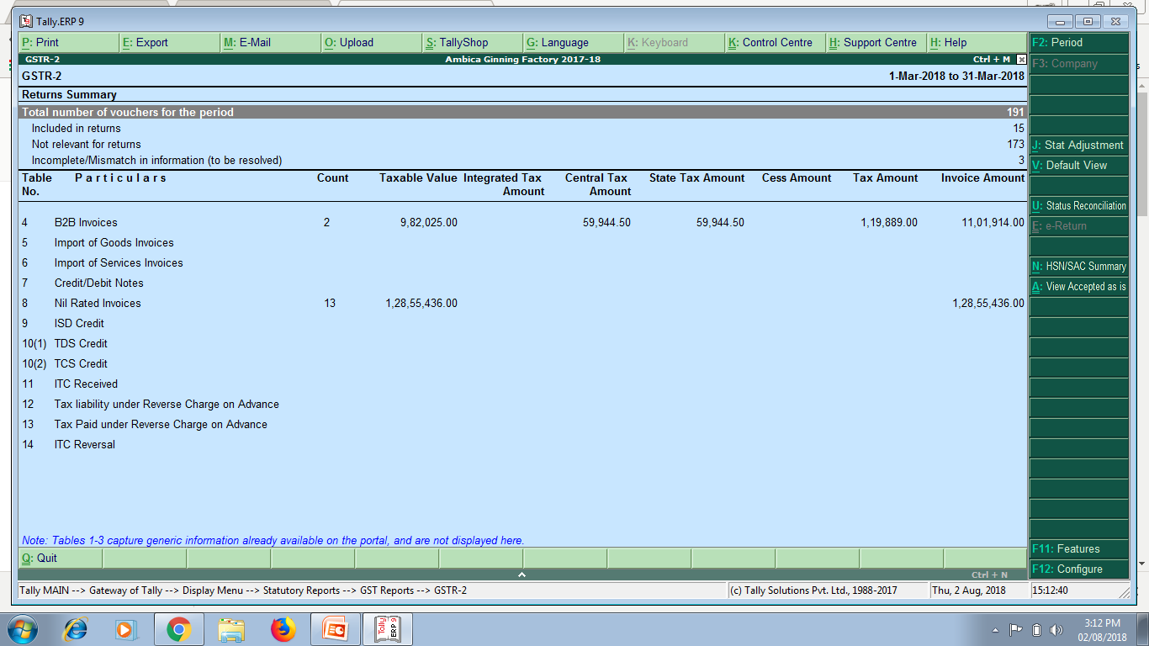
GSTR-2 – Inward supplies
NIL RATED INVOICES

Slide 112
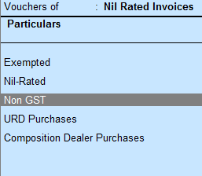

Slide 113
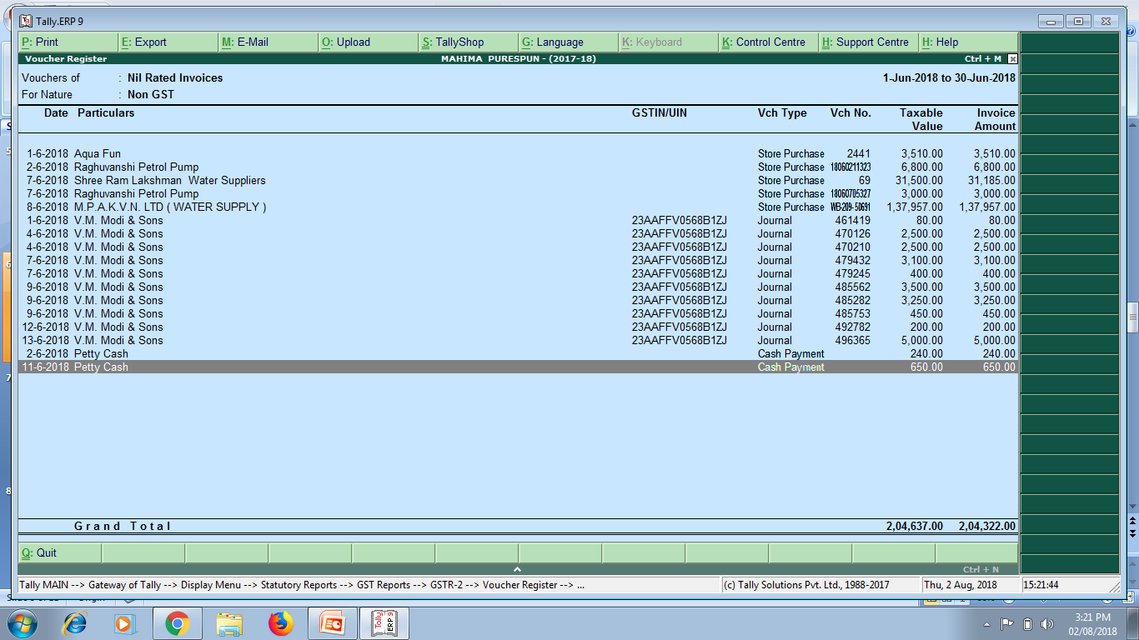
Export these into Excel and add them

Slide 114
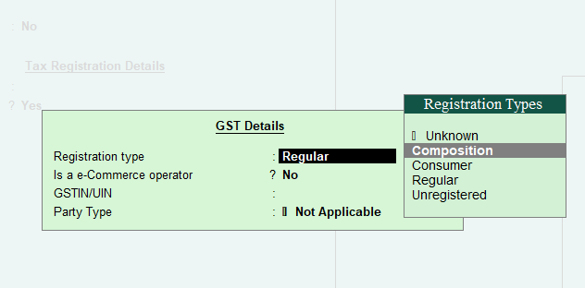
Expenditure relating to Registered entities – Composition Scheme
Relating to entities falling under composition scheme
  Tally feature, While creation of Vendor Master

Slide 115
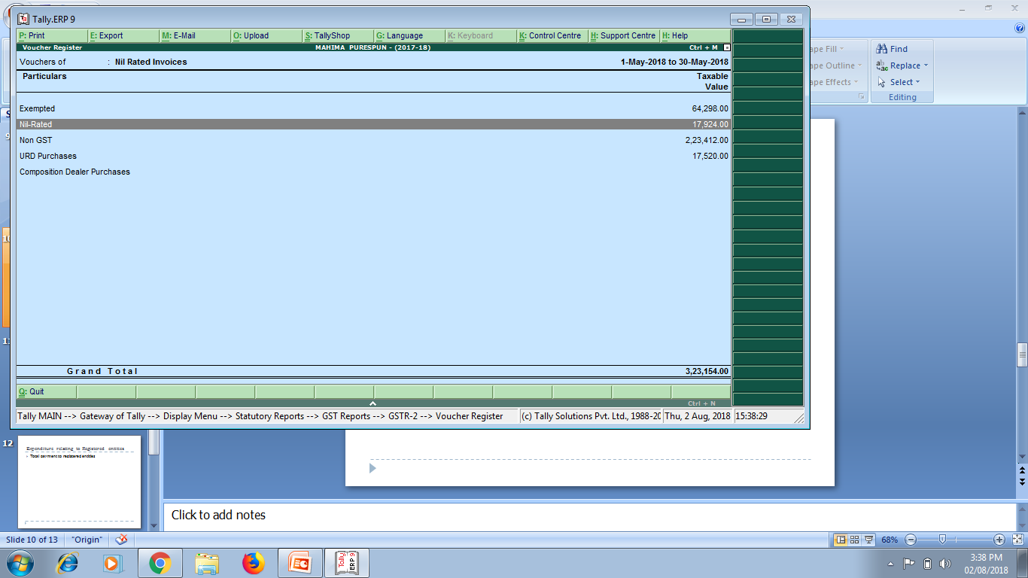
Composition dealer purchases

Slide 116
General principles to be kept in mind while preparing the statement of particulars for Form 3CD:
Tax Auditor can rely upon the judicial pronouncements while taking any particular view about inclusion or exclusion of any items in the particulars to be furnished under any of the clauses specified in Form No.3CD.
If there is a conflict of judicial opinion on any particular issue, Auditor may refer to the view which has been followed while giving the particulars under any specified clause.
The AS, Guidance Notes, SA issued by the Institute from time to time should be followed.

Slide 117
Important points to be considered by the tax auditor while furnishing the particulars in Form No.3CD….
The information in Form No.3CD should be based on the books of account, records, documents, information and explanations made available to the tax auditor for his examination.
If a particular item of income/ expenditure is covered in more than one of the specified clauses in the statement of particulars, a suitable cross reference to such items at the appropriate places.
If there is any difference in the opinion of the tax auditor and that of the assessee in respect of any information furnished in Form No. 3CD, the tax auditor should state both the view points and also the relevant information in order to enable the tax authority to take a decision in the matter.
If any particular clause in Form No.3CD is not applicable, he should state that the same is not applicable.
In computing the allowance/ disallowance, the law applicable in the relevant year should keep in view, even though the form of audit report may not have been amended to bring it in conformity with the amended law.
In case the auditor relies on a judicial pronouncement, mention the fact as his observations in clause (3) of Form No.3CA or clause (5) provided in Form No.3CB, as the case may be
The tax auditor may qualify his report on matters in respect of which information is not furnished to him and state in his report that the relevant information has not been furnished by the assessee.

Slide 118
Thank You
Start Auditing……
CA Pankaj G. Shah
Mobile 9691893040
E-mail: pankajgshah@gmail.com

