Slide 1
Taxation of Shares and Securities
CA. Pankaj Shah

Slide 2
Changes over the period
Dividend is now fully taxable in the hands of shareholders
LTCG is taxable u/s. 112A
CBDT accepted the proposition that AO would not recategorize LTCG as business income.

Slide 3
Tax Treatment of Share Transactions
Share Transactions
Business
Trading
Day Trading /Speculative
Investment
Stock Market Sale
Short Term
15% (Sec. 111A)
Long Term
10% in excess of Rs. 1,00,000 per year (Sec. 112A)
Buy Back By Companies
Fully Exempt
Taxable at Normal Rates
Loss not allowed as set off from other income

Slide 4
Capital Loss (Sec. 70,71,74)
A long term capital loss can be adjusted only against long term capital gains
A short term capital loss can be adjusted against both long term as well as short term capital gains but from no other income.
Inter se Adjustment of Capital Gains and Loss , arising from two different asset categories, is permissible.

Slide 5
Capital Loss – Case 1
Short Term Capital Loss from Shares (STT Paid) | -5,00,000
Short Term Capital Gains from Land | +10,00,000
Set Off ?

Slide 6
Capital Loss – Case 2
Short Term Capital Loss from Shares (STT Paid) | -5,00,000
Long Term Capital Gains from Land | +10,00,000
Set Off ?

Slide 7
Capital Loss – Case 3
Short Term Capital Loss from Shares Of Reliance (STT Paid) | -10,00,000
Short Term Capital Gains from Shares Of Infosys (STT Paid) | +5,00,000 | -5,00,000
Short Term Capital Gains from Land |  | +10,00,000
Montgomery Emerging Markets Fund [ 100 ITD 217 (MUM)(SB) “gains or loss is computed on the basis of individual asset and transaction and not on the basis of class of assets.”
Set Off ?

Slide 8
Share Dealing By Company- Sec. 73
Even if transactions in shares are delivery based still they are to be treated as speculative transactions.
Explanation to Sec. 73 provides that If any part of the business of a company consists in the purchase and sale of shares of other companies -
such company shall, for the purposes of Sec. 73 (losses in speculation business), be treated as carrying on a speculation business to the extent to which the business consists of the purchase and sale of such shares.
However this special provision is not applicable in case of following companies :
G.T.I. consists mainly of income under “Income from H.P. “, "Capital Gains" and "Income from other sources“ OR
the principal business is banking/granting of loans and advances

Slide 9
Section 112A
Chargeable as income from capital gains
Transfer of
  Equity share in a company
  Unit of equity oriented fund
STT is paid on
  Acquisition and transfer of LTCA (exceptions)
Tax computation = LTCG over 1 Lakh taxable @ 10%
  No indexation benefit
  Grandfathering available S 55(2)(ac)

Slide 10
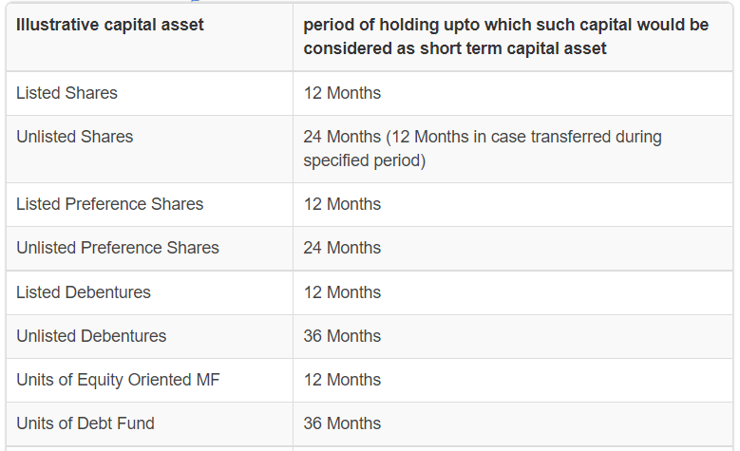
Holding period

Slide 11
Dividend
Taxable as normal income
Only 20% expenses allowable as deduction
Surcharge for individuals capped at 15%

Slide 12
Valuation rules
Transferor
  S.50CA
Transferee
  S.56(2)(x)
Issuer Company
  S/56(2)(viib)

Slide 13
Rule 11UA(1)(c)(b) - Valuation of unquoted equity shares: (w.e.f. 01/04/2018)
FMV= (A+B+C+D - L)× (PV)/(PE)
A= book value of all the assets (other than jewellery, artistic work, shares, securities and immovable property) in the balance-sheet.
B= the price which the jewellery and artistic work would fetch if sold in the open market on the basis of the valuation report obtained from a registered valuer.
C= fair market value of shares and securities as determined in the manner provided in this rule
D= the value adopted or assessed or assessable by any authority of the Government for the purpose of payment of stamp duty in respect of the immovable property.

Slide 14
Contd..
L= book value of liabilities shown in the balance sheet LESS
  (a) paid-up capital in respect of equity shares
  (b) the amount set apart for payment of dividends on preference shares and equity shares…
  (c) reserves and surplus…
  (d) any amount representing provision for taxation…
  (e) any amount representing provisions made for meeting liabilities, other than ascertained liabilities
  (f) any amount representing contingent liabilities other than arrears of dividends payable in respect of cumulative preference shares
PV= the paid up value of such equity shares
PE = total amount of paid up equity share capital as shown in the balance-sheet

Slide 15
Rule 11UA(1)(c)(c) - Valuation of unquoted shares other than equity shares which are not listed in any recognized stock exchange
Preference Shares
FMV= price it would fetch if sold in the open market on the valuation date and
the assessee may obtain a report from a merchant banker or an accountant in respect of which such valuation.
Note: Recent notification of Central Govt. which omitted Word “an accountant” was only in respect of Rule 11UA(2)(b) which specify the valuation rule for Section 56(2)(viib) and not for Section 56(2)(x)

Slide 16
"valuation date" means the date on which the property or consideration, as the case may be, is received by the assessee.
"balance-sheet“ means the balance-sheet of such company (including the notes annexed thereto and forming part of the accounts) as drawn up on the valuation date which has been audited by the auditor appointed under of the Companies Act.

Slide 17
Section 50CA

Slide 18
Section 50CA- Overview
New provision in case of transfer of unquoted shares
Analogous to s. 50C
Where the consideration received or accruing
On transfer of share of a company other than a quoted share
If such consideration < FMV (as per Rule 11UAA)
Then, Such FMV will be considered as Full value of consideration for the purpose of Section 48.
The section applies only if the shares are held as capital asset and not as stock-in-trade.
The section applies to all shares whether equity or preference. However, the section does not cover convertible debentures.
Effective from AY 2018-19

Slide 19
S.50CA
Transfer of shares of company
  Public is not substantially interested
Similar to S.50C
Fair Value will be deemed sale consideration
Double taxation
  50CA on seller
  56(2)(x) on purchaser

Slide 20
Challenges in Valuation
Going concern incorrectly being valued at asset base
Valuation date - as on date of transaction
  practically an act impossible to perform as based on audited financials
Valuing investments of the entity
  This requires even the financials of those entities to be drawn and audited !!.
Date of valuation
  Date of issue, allotment, credit of security
Reinstatement of CA for Valuation!!!
  Merchant bankers – high compliance cost
DLOM, Tax impact, etc not considered in Rule11UA

Slide 21
Bonus Issue
DCIT vs. Dr. Rajan Pai [2017] 48 ITR(T) 170 - Bang. ITAT,
  held that an assessee who received bonus shares could never be considered as receiving something without consideration or for a consideration less than the fair market value of the property. When bonus shares are received, it is not something which has been received free or for a lesser fair market value. A consideration has flown out from the holder of the shares, may be unknown to him, which is reflected in the depression in the intrinsic value of the original shares held by him.

Slide 22
Right Issue
Sudhir Menon HUF vs. ACIT [2014] 148 ITD 260
  In a pro-rata allotment of shares in proportion to existing shareholding of the shareholders, there is only an apportionment of the value of their existing holding over a larger number of shares.
  A higher than proportionate or a non-uniform allotment would attract the rigour of the provision. This is only understandable in as much as the same would only be to the extent of the disproportionate allotment and, further, by suitably factoring in the decline in the value of the existing holding.
  In case of right shares, to the extent it is allotted to a person not against his existing shareholding or, even so, albeit disproportionately, there is scope for value or property being passed on to him, depending on the terms of the allotment, which cannot be said to be in lieu of or as recompense of his existing property.

Slide 23
Sudhir Menon - Is it a settled law?
Khoday Distilleries vs. CIT 307 ITR 312
  ‘Allotment of shares’ does not involve ‘transfer’
Circular No.10/2018 dtd 31.12.18
Genuine right issue vs. bogus capital building to be seen
Mere disproportionate right issue should not trigger provision of Section 56(2)(x)
Subhodh MenonTS-718- ITAT-2018(Mum)
  Sec. 56(2)(vii) being anti-abuse provision would not apply to bona fide business transaction, notes that in case of assessee, rights issue and share allotment was done to comply with loan agreement covenant as a matter of business exigency,

Slide 24
S.56(2)(viib)
Company other than public substantially interested
More than face value
Receives amount > fair value of shares
  To curb accommodation entry buy backs
Rule 11UA
  Book Value
  Discounted free cash flow method

Slide 25
Section 56(2)(viib)
Valuation by Merchant Banker
Discounted Free cash flow method
Profit based always higher value
Appropriate for going concern

Slide 26
Less than F.V.
Fair Value
More than F.V.
S.56(2)(x) on reveiver
S.56(2)(viib) on issuer
Book Value
Transaction price
Issue price
(Intrinsic value)
Discounted cash flow method

Slide 27
Share
Issue
Issuer
S.56(2)(viib)
Asset based
RV
CA
Merchant Banker
Rule 11UA(2)
Merchant Banker if DFCF
Book Value
Receiver
No specific Section
Transfer
Seller
S.50CA
Rule 11UAA
Specified
No valuer
Buyer
S.56(2)(x)
Rule 11UA(1)
Specified
No valuer

Slide 28
buyback
S. 115QA – tax @ 23.30% (20% plus 12% surcharge plus 4% cess) in the hands of domestic companies on distributed income on buy-back
S. 10(34A) – exempts income in the hands of shareholders
  S. 50CA? - no implication
  If no buyback tax is payable by the Company, is exemption still available to shareholder u/s 10(34A)?
  Covers dividend, capital gains, business income?
    “any income arising to an assessee, being a shareholder, on account of buy back of shares by the company as referred to in section 115QA”

Slide 29
Use of buyback in lieu of dividend?
23.30% v. 35.88%
Companies returned Rs. 39,000 cr to shareholders through buyback in FY 20-21 – almost double of the previous year (Source: ET)
  Infosys, Sun Pharma, Welspun India, TCS etc.

Slide 30
Transfer of unlisted shares
Completion of transfer - when?
Vasudev Ramchandra Shelat v Pranlal Jayanand Thakar [1975] 45 Comp Case 43 (SC) – transferee gets title to the shares once he has the share certificates and blank transfers signed by the registered holder
CBDT Circular No. 704 dated April 28, 1995
Demat shares - Sufficient to submit depository receipt / transfer slip to complete transfer

Slide 31
Litigation penny stocks
Documentation
Holding period in De-materialisation
Natural justice rules like confrontation, cross examination
Mere increase in price not sufficient to disallow

Slide 32
Structuring shareholding patterns

Slide 33
Class of companies
Company
Private
Public
Listed
Unlisted

Slide 34
Flexibility to private companies
S. 43 and S. 47
Equity shares, preference shares, Hybrid shares
optional
Notification No. GSR 464(E) dated June 5, 2015

Slide 35
Speculation

Slide 36
SPECULATION BUSINESS
A transaction which is not periodically or ultimately settled by delivery or transfer of the contracted goods is a ‘speculative transaction’ as defined by S. 43(5) of the Income-tax Act.
No exception is made in that section for shares and stocks – in fact, s. 43(5) specifically includes stocks and shares, and hence the provisions of S. 43(5) equally apply to dealing in shares and stocks. Under the normal understanding, a speculative transaction is one where there is no intention to take or give delivery.
However, under the income-tax law, the intention of the purchaser or seller to take or give delivery of the shares is immaterial for determining a speculative transaction. What is material is whether delivery or transfer has actually taken place or not.

Slide 37
Section 36(1)(iii)
Reliance Utilities Limited (Bom)
Section 14A virtually Not Applicable now

Slide 38
ICDS - VIII
Securities

Slide 39
Securities
Deals with Securities as Stock in trade
Lower of Cost or NRV
Category wise Valuation

Slide 40
Shares | Cost | NRV | Notional Gain / Loss | Accounting Standard
Satyam | 1000 | 100 | (900) | 100
Infosys | 100 | 2000 | 1100 | 100
ICDS |  |  |  | 200

Slide 41
S.56 – receipt of Property
“Property” means the following capital asset of the assessee
  (i) immovable property being land or building or both;
  (ii) share and securities;
  (iii) jewellery;
  (iv) archaeological collections;
  (v) drawings;
  (vi) paintings;
  (vii) sculptures; or
  (viii) any work of art.
  (ix) Bullion
“Fair market value” of a property other than immovable property, means the value determined in accordance with Rule 11U and 11UA

Slide 42
S.56 and Deposit Receipts
Looking into the entire scheme of s. 56(2)(x) where, in addition to money, certain properties are also brought in tax net, the answers seems to be no.
In Asstt. CIT vs. Anuj Agarwal [2010]3Taxmann.com 46 (Mum.-ITAT), it was held that gift of Indian Millennium Deposit Certificate issued by SBI along with gift deed is not receipt of sum of money.
  Not sum of money
  No securities as per SCRA

Slide 43
BUSINESS INCOME Vs. CAPITAL GAINS
CBDT Clarifications
Judiciary
CBDT Instruction No.1827 dated 31.8.1989
A host of decisions
Circular No.4 dated 15.6.2007
Circular No.6 dated 29.02.2016

Slide 44
CBDT Clarification-2016
Where assessee itself opts to treat share and securities as Stock in trade
- income would be treated as business income.
For listed shares where holding period > 12 months and assessee desires to treat the income as L.T.C.G.,
-It shall not be disputed by the A.O.
-However, assessee shall not be allowed to opt for a different stand in subsequent years.

Slide 45
Judiciary- Some Important Factors
Need to consider totality of facts
Possible to have two portfolios
% of C.G. from + 1 month holding and upto 1 month
Source of funds- Owned OR borrowed
Entries in books
Treatment in earlier years.
Stock turnover ratio.
Dividend Income
No. of scrip
Purchase in Primary market or secondary market
Main source of income.
Delivery Based and Non Delivery Based

Slide 46

Business Income Vs. Capital Gains
No single factor is important. Need to consider totality of facts.
G. Venkataswami Naidu & Co. v. CIT 35 ITR 594 (SC)
  the total effect of all relevant factors and circumstances that determines the character of the transaction
Notes:
AO normally takes only 1 factor into consideration i.e. volume/ frequency of transactions

Slide 47
Business Income Vs. Capital Gains
Whether number of transactions is the only important criteria ?
Assistant Commissioner of Income-tax vs. Smt. Gargi Shitalkumar Patel [2012] 13 ITR(T) 386 (Ahmedabad - Trib.)
Number of transactions is stated to be 1000 in 255 scrips … However, except the parameter of frequency in purchase/ sale of shares, all other parameters indicate that the transactions were in the nature of investment and not the trade transactions.
Even for frequency, it was explained that the assessee was mostly making the investment in B-Group scrips and to avoid risk, he made investment in several scrips instead of investing in one scrip.
It is well settled that, to determine whether the assessee is a trader or investor in shares, no single test is conclusive but cumulative effect of all the facts are to be seen. In the case of the assessee, one fact, i. e. , frequent purchase/sale of shares cannot be said to be against the assessee.
Notes:
AO normally takes only 1 factor into consideration i.e. volume/ frequency of transactions

Slide 48
Business Income Vs. Capital Gains
Treated as STCG even if volume is high
Janak S. Rangwalla [2007] 11 SOT 627 (MUM)
Nagindas P. Sheth (HUF) v. ACIT (Mum.)(Trib.) ITA. No. 961/Mum/2010.

Slide 49
Business Income Vs. Capital Gains
Possible to have two portfolios
CBDT circular no. 4 dated 15.6.2007
Sarnath Infrastructure (P.) Ltd. v. Asstt. CIT (2009) 120 TTJ 216 (Luck.)
Requires a great deal of precaution on the part of the assessee like separate entries in books of accounts, transactions through separate contract notes etc.
A separate DP account, a separate bank account or a separate broker altogether shall make the case of assessee further stronger.

Slide 50
Business Income Vs. Capital Gains
Entries in Books of Accounts
Management Structure & Systems (P) Ltd. v. ITO (2010) 37 DTR (Ahd.) (Trib) 345
Hitesh Satishchandra Doshi vs. Joint Commissioner of Income-tax 21(3), Mumbai [2011] 140 TTJ 32 (MUM)
  The assessee valued the shares under investment portfolio at cost and never valued the balance at the beginning as well as at the end of the year of market price or realization value
Notes:
AO normally takes only 1 factor into consideration i.e. volume/ frequency of transactions

Slide 51
Business Income Vs. Capital Gains
With delivery and Without delivery Transactions
Gopal Purohit vs. Joint Commissioner of Income-tax, 25(3)
  Mumbai Tribunal [2009] 29 SOT 117 (MUM)
  confirmed by Hon. Mumbai High Court (188 Taxmann 140)
  SLP against High Court’s order dismissed by Apex Court.
Notes:
AO normally takes only 1 factor into consideration i.e. volume/ frequency of transactions

Slide 52
Business Income Vs. Capital Gains
% of C.G. from more then 1 month holding and upto 1 month
Sugamchand C. Shah [2011] 16 taxmann.com 204 (Ahd.)
  It was to be directed that shares held for more than a month would be treated as investment and on their sale short-term capital gain would be charged whereas in case of shares held for less than a month, gain on sale of them would be treated as profit from business
  Hitesh Satishchandra Doshi, ITAT Mumbai
  S.T.C.G. from the shares sold after 30 days but before one year was Rs. 37,76,143(i.e. approx. 71.31% of total S.T.C.G.). Total profit treated as STCG.
Notes:
AO normally takes only 1 factor into consideration i.e. volume/ frequency of transactions

Slide 53
Business Income Vs. Capital Gains
Source of funds- Owned OR Borrowed
Management Structure & Systems (P) Ltd. , ITAT Ahd.
  The assessee used his own surplus funds for investing in shares and not borrowed any money
  Hitesh Satishchandra Doshi, ITAT Mumbai
    The assessee was having its own funds to the extent of 95 per cent of the investment.
  Smt. Divyaben C. Shah v. Dy. CIT 117 Taxman 188 (Rajkot)(Mag)
Notes:
AO normally takes only 1 factor into consideration i.e. volume/ frequency of transactions

Slide 54
Business Income Vs. Capital Gains
Treatment in earlier years.
Management Structure & Systems (P) Ltd. v. ITO (2010) 37 DTR (Ahd.) (Trib) 345
  In the preceding years, the assessee consistently declared the gain/profit on the sale of the shares as ‘Capital Gains’ and the same has been accepted by the A.O.
  Though the rule of res judicata is not applicable to income-tax proceedings, in the absence of change in facts, there should be consistency in the approach of the Revenue.
Notes:
AO normally takes only 1 factor into consideration i.e. volume/ frequency of transactions

Slide 55
Business Income Vs. Capital Gains
Purchase from Primary Market OR Secondary Market .
Smt. Divyaben C. Shah v. Dy. CIT 117 Taxman 188 (Rajkot)(Mag)
  Purchased almost all scrips from the primary market
  Out of her own funds, and not out of borrowed funds
  Once shares sold, were never repurchased
  Not maintaining books of accounts nor valuing shares at lower of cost or market price
Notes:
AO normally takes only 1 factor into consideration i.e. volume/ frequency of transactions

Slide 56
Factors which go against the assessee …
Stock Turnover Ratio
In Mukeshbhai Babulal Shah’ case -32 taxmann.com 6, Rajkot - Trib. has held a stock turnover ratio of 1:16 to be against the assessee.
Transaction in the same scrip
In Tarun Amarchand Jain’s case, 21 taxmann.com 319 , repetitive transactions in same scrip have been considered as one of the reason of treatment as Business Income .
Also in PVS Raju vs Addl CIT, 340 ITR 75 (AP)

Slide 57
TAXATION OF DERIVATIVES

Slide 58
Taxation Of Derivatives
Commodity
Whether Speculative?
Taxation Of Derivatives
Equity
Currency
What is the turnover?
Whether Sec. 44AD Applies?

Slide 59
Whether Speculative?
Sec. 43(5) defines “speculative transaction” to mean a transaction…
in which a contract for the purchase or sale of any commodity, including stocks and shares, is periodically or ultimately settled otherwise than by the actual delivery or transfer of the commodity or scrips.

Slide 60
Equity Derivatives- Whether Speculative?
Clause (d) to the proviso to section 43(5) -
“An eligible transaction in respect of trading in derivatives referred to in clause (ac) of section 2 of the Securities Contracts (Regulation) Act, 1956 ..carried out in a recognised stock exchange”
shall not be deemed to be a speculative transaction

Slide 61
Commodity Derivatives- Whether Speculative?
Clause (e) to the proviso to section 43(5) -
“an eligible transaction in respect of trading in commodity derivatives carried out in a recognised stock exchange, which is chargeable to commodities transaction tax” (the requirement of chargeability of commodity transaction tax is not applicable for agricultural commodity derivatives)
shall not be deemed to be a speculative transaction

Slide 62
Currency Derivatives- Whether Speculative?
Currency derivatives are covered by clause (ac) of section 2 of the Securities Contracts (Regulation) Act, 1956 and accordingly shall be covered by Clause (d) to the proviso to section 43(5)
Inventures Knowledge Services (P) Ltd. vs. ITO, (2016) 156 ITD 727 (Mumbai -Trib)
Nand Nandan Agrawal Vs Dy. CIT (ITAT Agra)-IT Appeal Nos. 349 & 350 (Agra) of 2016

Slide 63
Whether Speculative..
Classification of derivatives transactions as non-speculative is NOT always beneficial…

Slide 64
Derivatives - What is the turnover?
The total of favourable and unfavourable differences
Premium received on sale of options
In respect of any reverse trades entered, the difference thereon

Slide 65
Derivative P & L
With notional turnover figures, how to present the P & L ?
Use of some notional / balancing account is required.

Slide 66
Whether explanation to S.73 is attracted to Derivatives?
The explanation to S. 73 deems the business of a company (subject to certain exclusions) consisting of purchases /sale of shares as speculation business.
Whether transactions in derivatives get hit by Expl. To Sec. 73?

Slide 67
Whether explanation to S.73 is attracted to Derivatives?
Delhi High Court in the case of DLF Commercial Developers Ltd. [2013] 35 taxmann.com 280
……… By all accounts the derivatives are based on stocks and shares, which fall squarely within the explanation to Section 73 (4). Therefore, it is idle to contend that derivatives do not fall within that provision
Contrary View by
High Court of Calcutta
Asian Financial Services Ltd. Vs. Commissioner of Income Tax

Slide 68
Derivatives – Whether Sec. 44AD Applies?
Why Not???

Slide 69
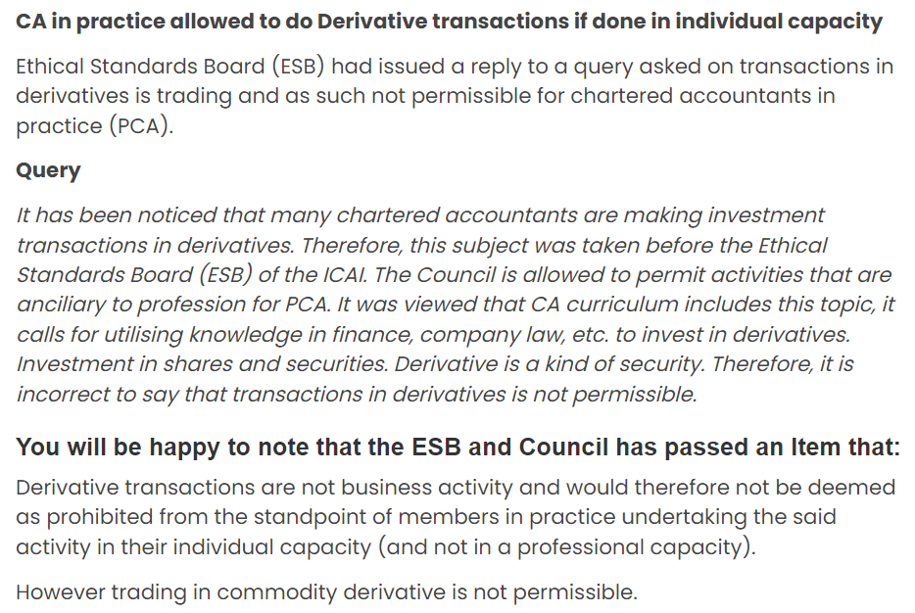

Slide 70
Thank you
CA. Pankaj Shah
969 189 3040
pankajgshah@gmail.com

